Slide 1
Today’s Material
Stack ADT
Definition
Array based implementation
Linked List based implementation
Implementing Stack ADT using List ADT
Applications
Visualization
https://www.cs.usfca.edu/~galles/visualization/StackArray.html
https://www.cs.usfca.edu/~galles/visualization/StackLL.html

Slide 2
Stack ADT
Stack is a container in which all insertions and deletions of elements are made at one end, called the top of the stack.
Alternatively, in a stack the element to be deleted is the most recently inserted.
This is also called last-in-first-out (LIFO)
Classical example for stacks is a stack of trays in a cafeteria

Slide 3
Stack: push
top of the stack
top of the stack
top of the stack
Initial Stack of trays
After green plate
is inserted
After black plate
is inserted
A stack has a top where insertions and deletions are made
Insert operation in a stack is often called push
Notice that the element pushed to a stack is always placed at the top of the stack

Slide 4
Stack: pop
pop the top element
off the stack
pop the top element
off the stack
top of the stack
top of the stack
top of the stack
Initial Stack of trays
After green plate
is popped off
After gray plate
is popped off
Delete operation in a stack is often called pop
Notice that the element popped off the stack is always the one residing on top of the stack (LIFO)

Slide 5
Stack ADT
Stack is a container in which all insertions and deletions of elements are made at one end, called the top of the stack
Common stack operations:
push(E e) – push element to the top of the stack
E pop() – Remove & return the top element
E top() – Return the top element w/o removing it
isEmpty() – Return true if the stack is empty
size() – Returns the number of elements in the stack

Slide 6
Stack Usage Example
main(){
Stack<Integer> S = new Stack<>();
if (S.isEmpty()) System.out.println(“Stack is empty”); // Empty stack
S.push(49);
S.push(23); // 49, 23
System.out.printf(“Top of the stack is: %d\n”, S.top()); // prints 23
S.push(44); // 49, 23, 44
S.push(22); // 49, 23, 44, 22
System.out.printf(“Removing the top element: %d\n”, S.pop()); // prints 22
System.out.printf(“Removing the top element: %d\n”, S.pop()); // prints 44
System.out.printf(“Removing the top element: %d\n”, S.pop()); // prints 23
System.out.printf(“Top of the stack is: %d\n”, S.top()); // prints 49
System.out.printf(“Removing the top element : %d\n”, S.pop()); // prints 49
if (S.isEmpty()) System.out.printf(“Stack is empty\n”); // Empty stack
} //end-main

Slide 7
Java Stack Hierarchy
implements
<<interface>>
Iterable
extends
<<interface>>
Collection
<<interface>>
List
AbstractList
Vector
Stack

Slide 8
How do we implement Stack ADT?
2 ways to implement a stack
Using an array
Using a linked list

Slide 9
Implementing Stack ADT using an Array
We can implement a Stack with an array “arr” as follows
0
1
2
3
4
5
6
arr
15
6
2
9
top = 3
top = 4
3
top = 3
9
9
top = 3
9
top = 2
2
2
2
2
6
6
6
6
15
15
15
15
After 3 is
popped
off
After 9 is
popped
off
Initial Stack
After 3 is pushed

Slide 10
Stack ADT & ArrayStack Declarations
interface Stack<E> {
public void push(E e);
public E top();
public E pop();
public boolean isEmpty();
public int size();
};
class ArrayStack<E> implements Stack<E>{
private E[] arr; // array to store stack elements
private int top; // current top of the stack
public void push(E e);
public E top();
public E pop();
public boolean isEmpty();
public int size();
};

Slide 11
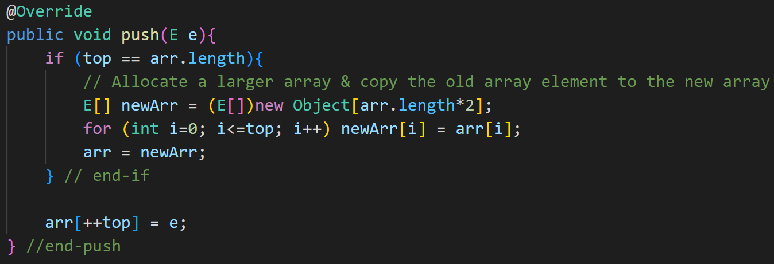
ArrayStack: push

Slide 12
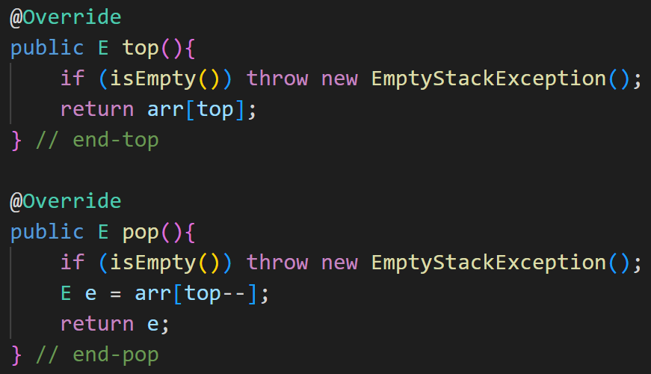
ArrayStack: top & pop

Slide 13
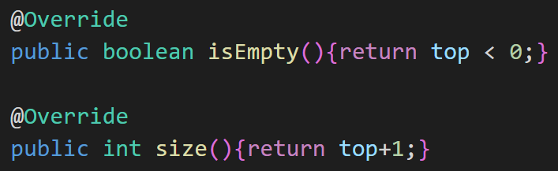
ArrayStack: isEmpty & size

Slide 14
Implementing Stack ADT using a Singly Linked List
top
9
2
6
15
Initial Stack
push(3)
top
3
9
2
6
15
After 3 is pushed
pop()
top
9
2
6
15
After 3 is popped
pop()
top
2
6
15
After 9 is popped

Slide 15
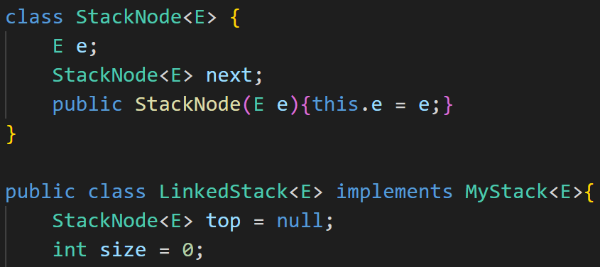
LinkedStack: Declarations

Slide 16
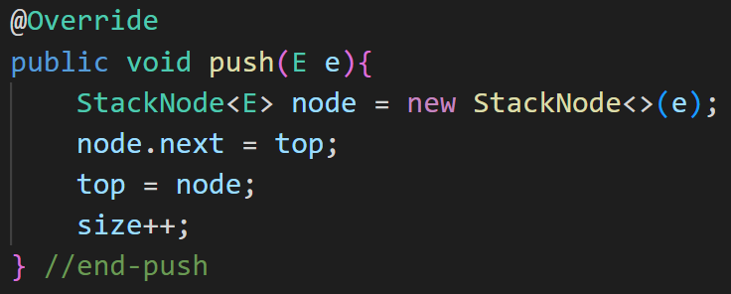
LinkedStack: push

Slide 17
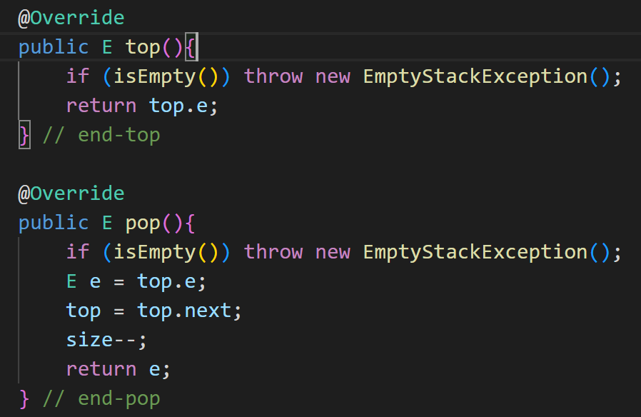
LinkedStack: top & pop

Slide 18
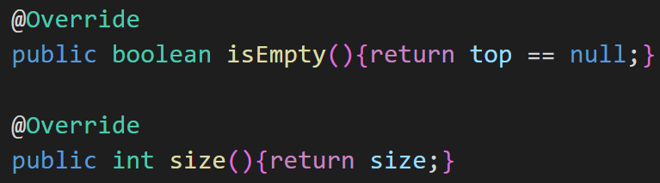
LinkedStack: isEmpty & size

Slide 19
Implementing Stack ADT using the List ADT
We have already covered and implemented the List ADT
We had two implementations of the List ADT
ArrayList
LinkedList
Can we make use of the List ADT to implement the Stack ADT?
Yes! Simply append/remove the last element from the List ADT

Slide 20
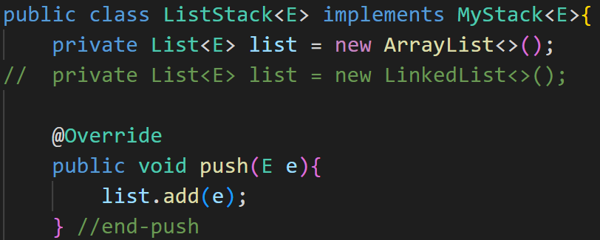
Implementing Stack ADT using the List ADT

Slide 21
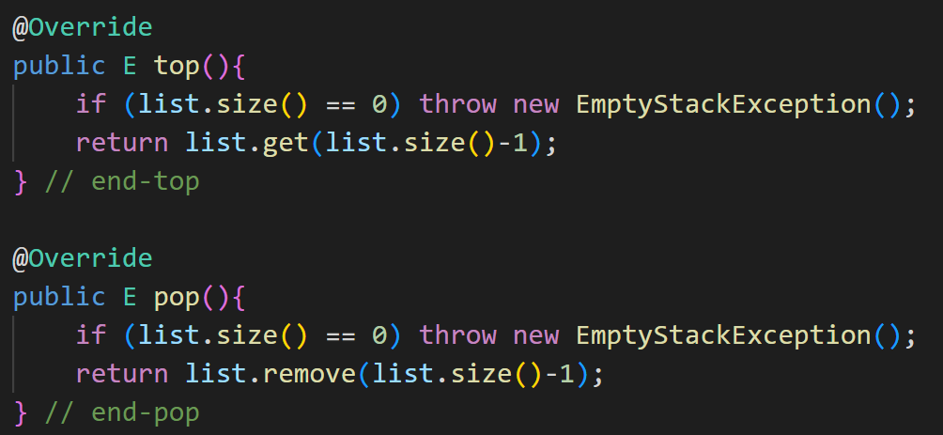
Implementing Stack ADT using the List ADT

Slide 22
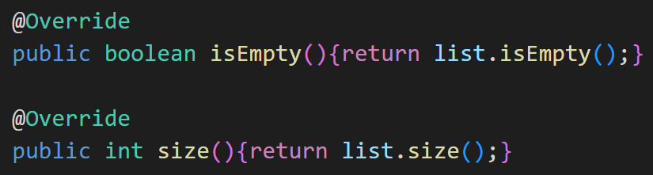
Implementing Stack ADT using the List ADT

Slide 23
Running Times of Stack ADT ops
Operation | Running Time
push | O(1)
top/pop | O(1)
isEmpty | O(1)
size | O(1)

Slide 24
Stack ADT in different Programming Languages
PL | Class
C++ | stack
Java | Stack
C# | Stack
JS | -
Python | -

Slide 25
Application of Stacks: Expression Evaluation
How do we evaluate an expression?
20+2*3+(2*8+5)*4
Specify the sequence of operations (called a postfix or reverse polish notation)
Store 20 in accumulator A1
Compute 2*3 and store the result 6 in accumulator A2
Compute A1+A2 and store the result 26 in A1
Compute 2*8 and store the result in A2
Compute 5+A2 and store the result 21 in A2
Compute 4*A2 and store the result 84 in A2
Compute A1+A2 and store the result 110 in A1
Return the result, 110, stored in A1
20 2 3 * + 2 8 * 5 + 4 * + (postfix/reverse-polish notation)

Slide 26
Application of Stacks: Expression Evaluation
The advantage of the postfix notation is that the postfix notation clearly specifies the sequence of operations without the need for parenthesis
Therefore it is much easier to evaluate a postfix expression than an infix expression

Slide 27
Application of Stacks: Expression Evaluation
It turns out we can easily convert an infix expression to postfix notation using a stack
When an operand is encountered, output it
(2) When ‘(‘ is encountered, push it
(3) When ‘)’ is encountered, pop all symbols off the stack until ‘(‘ is encountered
(4) When an operator is encountered (+, -, *, /), pop symbols off the stack until you encounter a symbol that has lower priority
(5) Push the encountered operator to the stack

Slide 28
Steps in converting the infix expression 20 + 2*3 + (2*8+5) *4 to postfix notation
(1)
(2)
(3)
20 2
*
20 2 3
20 2 3 * +
+
+
+
Output
Output
Output
Stack
Stack
Stack
(4)
(5)
(6)
*
+
(
20 2 3 * +
(
20 2 3 * + 2 8
(
20 2 3 * + 2 8 * 5
+
Output
+
Output
+
Output
Stack
Stack
Stack
(7)
(8)
(9)
20 2 3 * + 2 8 * 5 +
*
20 2 3 * + 2 8 * 5 + 4
20 2 3 * + 2 8 * 5 + 4 * +
+
+
Output
Output
Output
Stack
Stack
Stack

Slide 29
Evaluating a postfix expression
We can also use a stack to evaluate an expression specified in postfix notation
When an operand is encountered, push it to the stack
(2) When an operator is encountered, pop 2 operands off the stack, compute the result and push the result back to the stack
(3) When all symbols are exhausted, the result will be the last symbol in the stack

Slide 30
Steps in evaluating the postfix expression: 20 2 3 * + 2 8 * 5 + 4 * +
(1)
(2)
(3)
(4)
(5)
top
3
top
8
2
top
6
2
top
16
20
20
top
26
26
26
Stack
Stack
Stack
Stack
Stack
Push: 20, 2, 3
Pop 3, 2
Compute 3 * 2
Push 6
Pop 6, 20
Compute 6 + 20
Push 26
Push 8, 2
Pop 8, 2
Compute 8 * 2
Push 16
(6)
(7)
(8)
(9)
(10)
top
5
top
4
16
top
21
21
top
84
20
20
26
26
top
110
Stack
Stack
Stack
Stack
Stack
Push: 5
Pop 5, 16
Compute 5 + 16
Push 21
Push 4
Pop 4, 21
Compute 4 * 21
Push 84
Pop 84, 26
Compute 84 * 26
Push 110

Slide 31
Stack ADT in different OOPLs
OOPL | Class name
C++ | stack
Java | Stack
C# | Stack
Python | deque
JavaScript | -

Slide 32
LeetCode 20: Valid Parenthesis
You are given a math expression that consists of the following parenthesis: ()[]{}.
Write a function that tests whether the given expression is well-formed.
For example:
{(a+b)-[c+d]} is well-formed
(a+b)-[c+d*(e-f]) is not well-formed

Slide 33
Valid Parenthesis – An idea
An idea that almost works but does not:
Simply count the number of times each parenthesis occurs
When you see an opening parenthesis, increment its count
When you see a closing parenthesis, decrement its count
At no point in time, the value of a count can be less than 0. That is, a parenthesis must be opened before it is closed
When the expression is done, all counts must be 0
E.g. {(a+b)-[c+d]}
‘(‘ = 0
‘[’ = 0
‘{’ = 0
E.g. (a+b)-[c+d*(e-f])

Slide 34
Valid Parenthesis - Solution
Use a stack
When you see an opening parenthesis, push it to stack
i.e., {, (, [ ➔ Push to stack
When you see a closing parenthesis, pop the item at the top of the stack. This item must be the opening parenthesis for this closing parenthesis.
i.e.., }, ), ] ➔ Pop the stack: Must match the closing parenthesis
When the expression is done, the stack must be empty

Slide 35
Valid Parenthesis – Ex. Run
{(a+b)-[c+d]}
→
→
(
→
→
[
→
→
{
{
{
{
{
Expr:
{
(
)
[
]
}
(a+b)-[c+d*(e-f])
→
→
→
→
(
→
(
(
[
[
[
Expr:
(
)
[
(
]
Mismatch!

Slide 36
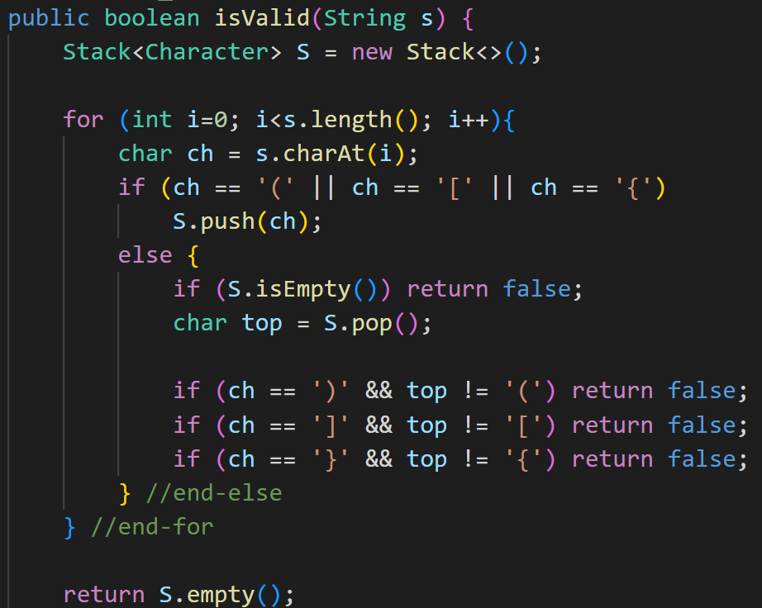
Valid Parenthesis – Java Code

Slide 37
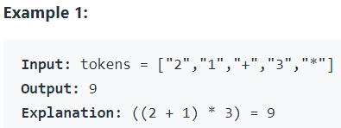
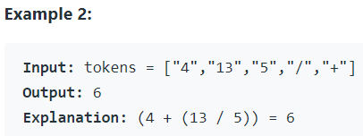
LeetCode 150. Evaluate Reverse Polish Notation
Evaluate the value of an arithmetic expression in Reverse Polish Notation
Valid operators are +, -, *, and /. Each operand may be an integer or another expression
Note that division between two integers should truncate toward zero
It is guaranteed that the given RPN expression is always valid. That means the expression would always evaluate to a result, and there will not be any division by zero operation.

Slide 38
LeetCode 155: Min Stack
Design a stack with the operations:
Has the usual push & pop operations
Has an additional method min that returns the minimum element in the stack
All operations must run in 0(1) time
3
2
2
2
→
→
5
→
5
→
5
→
5
→
5
4
4
4
4
4
4
4
5
2
3
min:
4
4
2
2
2
4

Slide 39
Stack with minimum - Solution
The idea is to have two stacks
The first stack (S1) holds the pushed elements
The second stack (S2) holds the min elements (called a monotonic stack)
3
2
2
2
S1
→
→
5
→
5
→
5
→
5
→
→
→
5
4
4
4
4
4
4
4
Pushed Items:
4
5
2
3
S2
→
→
→
2
2
→
2
→
→
→
4
4
4
4
4
4
4

Slide 40
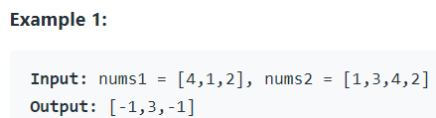
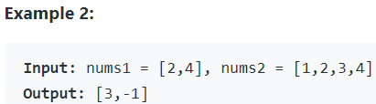
496. Next Greater Element I (Monotonic Stack)
The next greater element of some element x in an array is the first greater element that is to the right of x in the same array.
You are given two distinct 0-indexed integer arrays nums1 and nums2, where nums1 is a subset of nums2
For each 0 <= i < nums1.length, find the index j such that nums1[i] == nums2[j] and determine the next greater element of nums2[j] in nums2. If there is no next greater element, then the answer for this query is -1.
Return an array ans of length nums1.length such that ans[i] is the next greater element as described above.

