Slide 1
Today’s Material
Queue ADT
Definition
Array based implementation
Linked List based implementation
Applications
Deque ADT
Double-ended Queue
Applications
Visualization
https://www.cs.usfca.edu/~galles/visualization/QueueArray.html

Slide 2
Queue ADT
Queue is a container in which all additions are made at one end called the rear of the queue and all deletions are made from the other end called the front of the queue
Alternatively, in a queue the element deleted is the one that stayed in the queue the longest. This is also called first-in-first-out (FIFO)
Classical example of queues is a queue of people waiting to pay bills.

Slide 3
Queue ADT Concept and Example
Queue of people waiting to pay bills
Rear of the queue
Next person will join the queue
from the rear
Front of the queue
Next person to be served
A queue has a front and a rear
The add operation is often called enqueue
The remove operation is often called dequeue

Slide 4
Queue ADT
Queue is a container in which all additions are made at one end called the rear of the queue and all deletions are made from the other end called the front of the queue
Common Queue operations:
E front() – Return the element at the front w/o removing
void enqueue(E e) – Add the element to the end of the Q
E dequeue() – Remove & return the element at the front
boolean isEmpty() – Return true if the Q is empty
boolean isFull() – Return true if the Q is full
int size() – Return the number of elements in the Q

Slide 5
Queue ADT Usage Example
main(){
Queue<Integer> Q = new Queue<>();
if (Q.isEmpty()) println(“Queue is empty”); // Q empty now
Q.enqueue(49); // 49
Q.enqueue(23); // 49, 23
println(“Front of the Q is: ” + Q.dequeue()); // prints 49
Q.enqueue(44); // 23, 44
Q.enqueue(22); // 23, 44, 22
println(“Front of the Q is: ” + Q.dequeue()); // prints 23
println(“Front of the Q is: ” + Q.dequeue()); // prints 44
println(“Front of the Q is: ” + Q.dequeue()); // prints 22.
println(“Front of the Q is: ” + Q.dequeue()); // Error!
if (Q.isEmpty()) println(“Queue is empty”); // Q empty now
} //end-main

Slide 6
Java Stack, Queue, Deque Hierarchy
<<interface>>
Iterable
implements
extends
<<interface>>
Collection
<<interface>>
List
<<interface>>
Queue
AbstractList
<<interface>>
Deque
Vector
AbstractSequentialList
Stack
LinkedList

Slide 7
How do we implement the Queue ADT?
2 ways to implement a queue
Using an array
Using a singly linked list

Slide 8
Implementing Queue ADT using an Array
Use an array E arr[N]
front points to the front element of the queue, i.e., holds the index of the array Q that contains the front of the queue
rear points to next slot after the last element in the queue
size contains the current number of elements in the queue
An empty queue is one where size == 0
A full queue is one where size == N

Slide 9
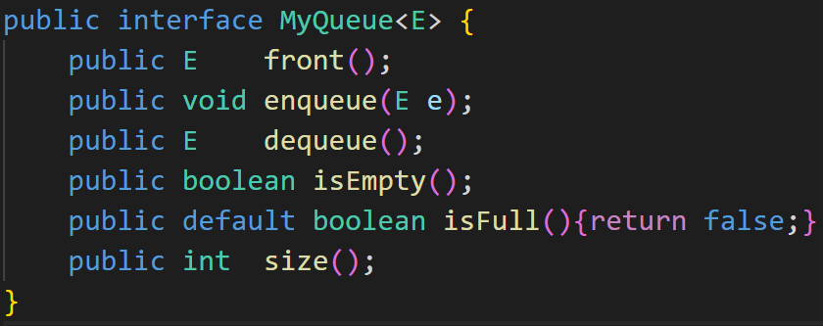
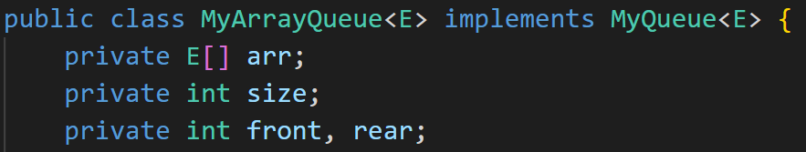
Queue ADT & ArrayQueue Declarations

Slide 10
Implementing Queue ADT using an Array
We can implement a queue of at most “N” elements with an array int Q[N] and 3 variables: int front, int rear, int size as follows
0
1
2
3
4
5
6
front and rear are equal to each other and size == 0 in an empty Queue
arr
An Empty Queue
size = 0
front = 3
rear = 3
0
1
2
3
4
5
6
front points to the first element in the Queue
rear points to the next slot after the last element in the Queue
A partially-full Queue
4
7
9
15
6
8
2
size = 3
front = 3
rear = 6
0
1
2
3
4
5
6
front and rear are equal to each other and size == N=7 in a full Queue
A Full Queue
4
7
9
15
6
8
2
size = 7
rear = 3
front = 3

Slide 11
Implementing Queue ADT using an Array
0
1
2
3
4
5
6
size = 3
Initial
Queue
Q
15
6
8
front = 3
rear = 6
size = 4
0
1
2
3
4
5
6
After 4 is inserted
Q
15
6
8
4
rear = 0
front = 3
Conceptual view
of the final queue:
circular array
size = 5
0
1
2
3
4
5
6
After 20 is inserted
Q
20
15
6
8
4
6
Front = 4
rear = 1
front = 3
5
Rear = 1
0
4
8
20
size = 4
After 15 is removed
0
1
2
3
4
5
6
1
6
4
Q
20
6
8
4
rear = 1
2
3
front = 4

Slide 12
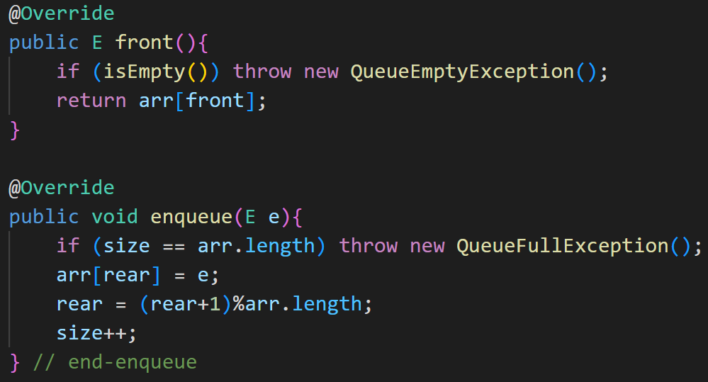
ArrayQueue: front, enqueue

Slide 13
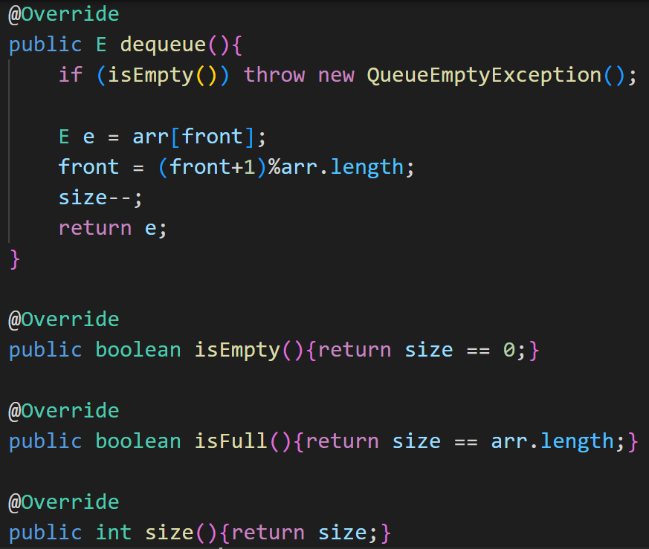
ArrayQueue: dequeue, isEmpty, isFull, size

Slide 14
ArrayQueue: Last Word
We can implement a queue of at most “N-1” elements with an array int arr[N] and 2 variables: int front, int rear (no size)
Think about how you would define
An empty queue
A full queue
Front and rear are equal to each other in an empty queue
An Empty Queue
arr
front = 3
rear = 3
There is one empty space between rear and front in a full queue
A Full Queue
arr
4
7
15
6
8
2
rear = 2
front = 3

Slide 15
Implementing Queue ADT using a Singly Linked List
front
rear
9
2
6
15
Initial
Queue
enqueue(3)
front
rear
9
2
6
15
3
After 3 is enqueued
dequeue()
front
rear
2
6
15
3
After 9 is dequeued
dequeue()
front
rear
6
15
3
After 2 is dequeued

Slide 16
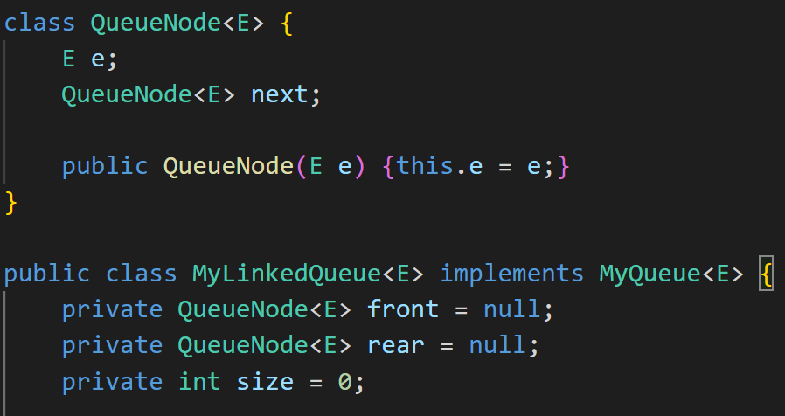
LinkedQueue Declarations

Slide 17
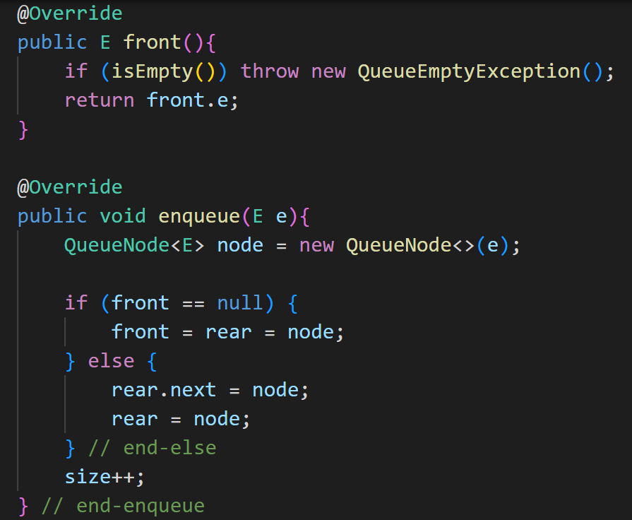
LinkedQueue: front, enqueue

Slide 18
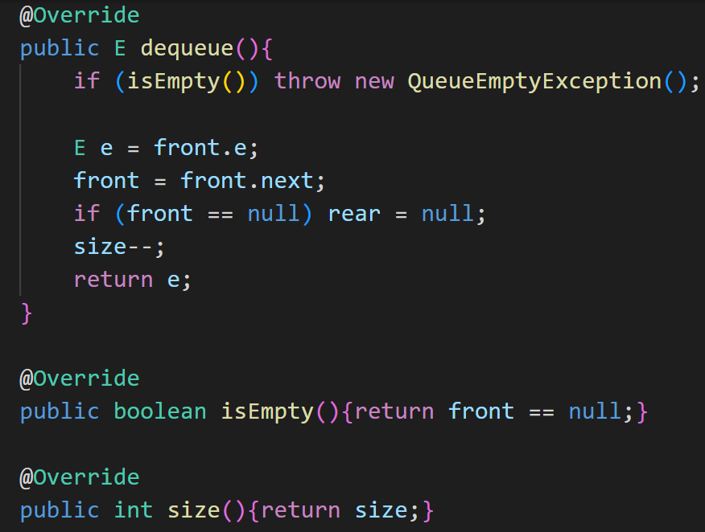
LinkedQueue: dequeue, isEmpty, size

Slide 19
Running Times of Queue ADT operations
Operation | Running Time
enqueue | O(1)
front | O(1)
dequeue | O(1)
isEmpty | O(1)
size | O(1)

Slide 20
Queue ADT in different OOPLs
OOPL | class
C++ | queue
Java | Queue
C# | Queue
Python | deque from collections
JavaScript | -

Slide 21
Double-Ended Queue (Deque) ADT
A Deque is a special queue, where you can add and remove elements from both ends of the collection
Common deque operations:
E first() – Get the element at the front
E last() – Get the element at the end
void addFirst(E e) – Add an element at the front
void addLast(E e) – Add an element at the end
E removeFirst() – Remove the element at the front
E removeLast() – Remove the element at the end
boolean isEmpty() – Return true if the deque is empty
int size() – Return the number of elements in the deque

Slide 22
How do we implement the Deque ADT?
2 ways to implement a deque
Using an array
Using a doubly linked list

Slide 23
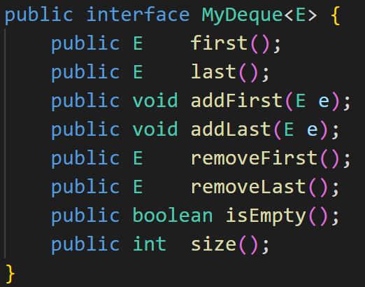
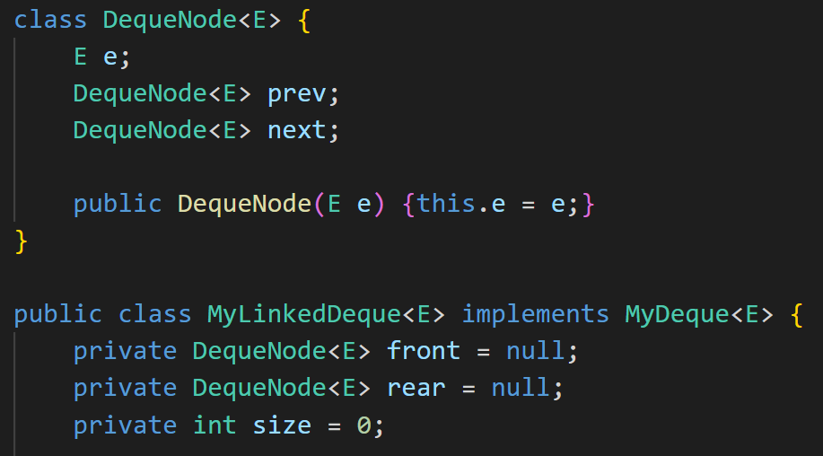
Deque ADT & LinkedDeque Declarations

Slide 24
Deque ADT in different OOPLs
OOPL | class
C++ | deque
Java | Deque
C# | -
Python | deque from collections
JavaScript

Slide 25
Applications of Queues
File servers: Users needing access to their files on a shared file server machine are given access on a FIFO basis
Printer Queue: Jobs submitted to a printer are printed in order of arrival
Phone calls made to customer service hotlines are usually placed in a queue

Slide 26
LeetCode 225: Implement Stack using Queues
class MyStack {
public:
/** Initialize your data structure here. */
MyStack() {
}
/** Push element x onto stack. */
void push(int x) {
}
/** Removes the element on top of the stack and returns that element. */
int pop() {
}
/** Get the top element. */
int top() {
}
/** Returns whether the stack is empty. */
bool empty() {
}
};

Slide 27
LeetCode 225: Implement Stack using Queues
If we use a Deque, then things are very simple
Ex: Insert the elements: 1, 2, 3, 4, 5 in this order
dq = <1, 2, 3, 4, 5>
empty(): dq.empty()
push(6): dq.addLast(6)-><1, 2, 3, 4, 5, 6>
top(): dq.last()
pop(): dq.removeLast()-><1, 2, 3, 4>

Slide 28
LeetCode 225: Implement Stack using Queues
If we use a Queue, then things get a little complicated:
We will make sure that the top of the stack is stored at the front of the Queue
Ex: Insert the elements: 1, 2, 3, 4, 5 in this order
push(1): Q = <1>
push(2): Q = <2, 1>
push(3): Q = <3, 2, 1>
push(4): Q = <4, 3, 2, 1>
push(5): Q = <5, 4, 3, 2, 1>

Slide 29
LeetCode 225: Implement Stack using Queues
If we use a Queue, then things get a little complicated
Ex: Insert the elements: 1, 2, 3, 4, 5 in this order
Q = <5, 4, 3, 2, 1>
empty(): Q.empty()
push(6): Q.add(6)-> <5, 4, 3, 2, 1, 6> -> <6, 5, 4, 3, 2, 1>
top(): Q.peek()
pop(): Q.remove()-> <4, 3, 2, 1>

Slide 30
LeetCode 232: Implement Queue using Stacks
Implement a first in first out (FIFO) queue using only two stacks. The implemented queue should support all the functions of a normal queue (push, peek, pop, and empty)
class MyQueue {
public MyQueue() {}
public void push(int x) {}
public int pop() {}
public int peek() {}
public boolean empty() {}
}

Slide 31
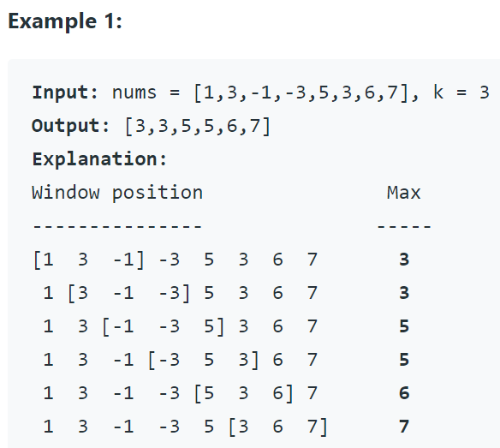
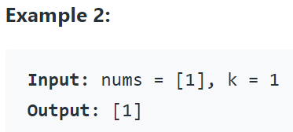
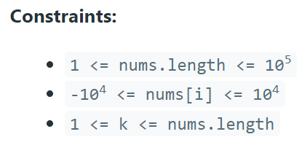
LeetCode 239: Sliding Window Maximum (Deqeue)
You are given an array of integers nums, there is a sliding window of size k which is moving from the very left of the array to the very right. You can only see the k numbers in the window. Each time the sliding window moves right by one position.
Return the max sliding window.

