Slide 1
Today’s Material
Red-Black Trees
Motivation
Conversion from 2-3 Trees
Definition
AA-Tree
Visualization:
https://www.cs.usfca.edu/~galles/visualization/RedBlack.html

Slide 2
Red-Black Trees: Motivation
2-3 Trees are great
They are perfectly-balanced, and give guaranteed O(logN) insertion/deletion/search performance
BUT: They are hard to implement
There are some 2-nodes and some 3-nodes
You also have to distinguish between the internal and leaf nodes, which makes life difficult!

Slide 3
Red-Black Trees: Motivation
Question: Can we get all the good sides of 2-3 trees, and avoid its peculiarities?
That is, can we implement a 2-3 tree as a binary search tree?
Red-Black BST or simply Red-Black Tree (RB Tree)
The RB-Tree we will look at here is a variant of general RB Trees called the Right-leaning RB Tree/Left-leaning RB Tree
Right-leaning/Left-leaning RB Trees are easier to implement, but possess all the good properties of general RB Trees

Slide 4
Represent this 2-3 Tree as a Binary Search Tree
A 2-3 Tree
4, 11
2-node
3-node
2
8
15, 20
1
3
5, 7
9
14
18
23
2-nodes→Nothing to do. Already binary tree nodes
How can we represent 3 nodes as binary tree nodes?

Slide 5
Converting a 3-node to a Right-Leaning RB Tree
To represent a 3-node as a BST node, we create a two-node combination as follows (Right-leaning RB Tree node):
Corresponding
Right-leaning RB Tree node
A 3-node in a 2-3 Tree
b
b
d
d
A
C
E
A
C
E
A < b < C < d < E
A < b < C < d < E

Slide 6
Converting a 2-3 Tree to a Right-Leaning RB Tree
A 2-3 Tree
Corresponding RLRB Tree
4, 11
4
11
2
8
15, 20
2
8
15
1
3
5, 7
9
14
18
23
20
1
3
5
9
14
18
23
7
All nodes are marked BLACK. Only the second child of a 3-node is marked RED

Slide 7
RLRB Tree: DIY Exercise
Corresponding RLRB Tree
A 2-3 Tree
60, 80
60
80
55
66
85, 90
55
66
85
90
Insert 87 into this 2-3 tree and show the corresponding RLRB Tree

Slide 8
Converting a 2-3 Tree to a Left-Leaning RB Tree
Notice that it is also possible to encode a 3-node as a Left Leaning RB Tree node as follows
Corresponding
Left-leaning RB Tree node
A 3-node in a 2-3 Tree
d
b
d
b
A
C
E
A
C
E
A < b < C < d < E
A < b < C < d < E

Slide 9
Converting a 2-3 Tree to a Left-Leaning RB Tree
Corresponding LLRB Tree
A 2-3 Tree
4, 11
11
4
2
8
15, 20
20
15
2
8
1
3
5, 7
9
14
18
23
1
3
7
9
14
18
23
5
All nodes are marked BLACK. Only the first child of a 3-node is marked RED

Slide 10
LLRB Tree: DIY Exercise
Corresponding LLRB Tree
A 2-3 Tree
80
60, 80
60
55
66
85, 90
90
55
66
85
Insert 87 into this 2-3 tree and show the corresponding LLRB Tree

Slide 11
RB Tree Path Length
What’s the shortest path from the root to a leaf look like?
All BLACK nodes
What’s the longest path from the root to a leaf look like?
Alternating from one BLACK to one RED node
Therefore, the length of the longest path is at most twice the length of the shortest path

Slide 12
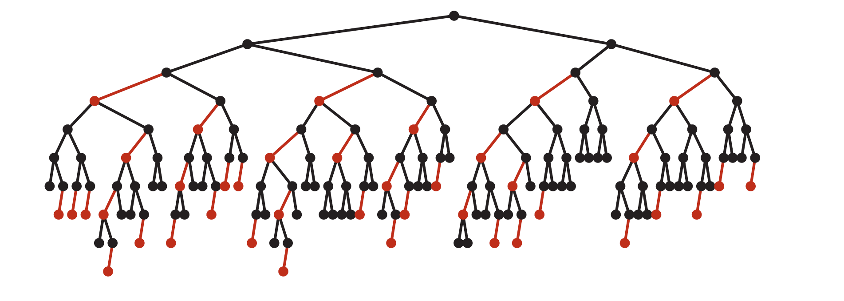
Average Height of a LLRB/RLRB Tree
Turns out that a LLRB tree looks more like this in practice
The height of a LLRB with “n” nodes is never greater than 2log2(N+1)
This means that all operations are guaranteed O(logN)
Recall that for AVL trees, max. height is at most 1.44log2(N)

Slide 13
Red-Black Tree: Format Definition
(1) Each node is either red or black
(2) The root is black
→ Since it either arises as a 2-node or the top node of a 3-node
(3) All null pointers are treated as if they point to black nodes
→ A conceptual convenience
(4) If a node is red, then both its children are black
→ Since the children of a 3-node are either 2-nodes or the top of another 3-node pair
(5) Every path from a given node to any of its null descendants contains the same number of black nodes
→ Since all leaf nodes in a 2-3 tree are at the same depth

Slide 14
General RB Tree
This definition of general RB Tree allows RB trees of the following sort, which is NOT a 2-3 tree!
Root
12
5
15
In fact, the general RB Tree is equivalent to a 2-3-4 tree, which is a variant of 2-3 tree, where an internal node can have 2, 3 or 4 children

Slide 15
An example 2-3-4 Tree
2-node
9
3-node
4-node
3, 6
12, 15, 18
1, 2
4, 5
7, 8
10, 11
13, 14
16, 17
19, 20
We know how to convert 3 nodes to RB tree nodes
Either create a LLRB tree node or a RLRB tree node
How do we convert 4 nodes to general RB tree nodes?

Slide 16
Converting a 4-node to a general RB Tree node
Corresponding
General RB Tree node
A 4-node in a 2-3-4 Tree
b
d
f
d
b
f
A
C
E
G
A
C
E
G
A < b < C < d < E < f < G
A < b < C < d < E < f < G

Slide 17
An example 2-3-4 Tree & the corresponding RB Tree
2-node
9
3-node
4-node
3, 6
12, 15, 18
1, 2
4, 5
7, 8
10, 11
13, 14
16, 17
19, 20
9
3-node
3
4-node
15
6
12
18
1
4
7
19
10
13
16
2
5
8
11
14
17
20

Slide 18
AA Tree
Implementing general RB trees is quite messy due to many special cases that arise
That’s why people usually implement a variant named AA-Tree
Named after its inventor Arne Anderson (1993)
AA tree is a RLRB implementation
AA tree enforces RLRB by the following condition
(6) Each red node can arise only as the right child of a black node
This condition is enforced through restructuring rotations

Slide 19
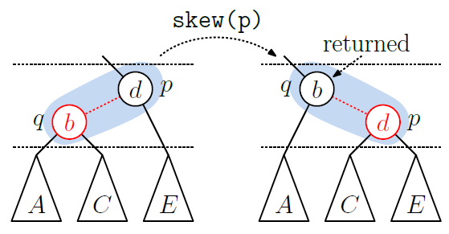
AA Tree structuring: skew operation
If p is black and has a red left child, rotate so that the red child is now on the right

Slide 20
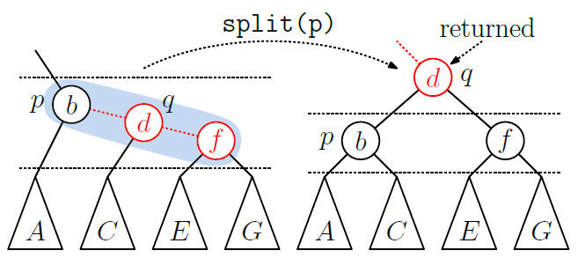
AA Tree structuring: split operation
If p is black and has a chain of two consecutive red nodes to its right, split this triple by performing a left rotation at p and promoting p’s right child, call it q, to the next higher level

Slide 21
AVL Tree vs RB Tree
AVL trees provide faster lookups than RB Trees because they are more strictly balanced
RB Trees provide faster insertion and deletion than AVL trees as fewer rotations are needed due to relatively relaxed balancing
Due to their better overall performance, RB Trees are usually preferred in practice compared to AVL trees
C++ set, multiset, map, multimap, Java TreeSet and TreeMap, C# Dictionary use RB Trees as the underlying data structure

