Slide 1
Today’s Material
Set ADT
Map ADT

Slide 2
Ordered Set ADT
Recall that an ordered set is an ADT that stores keys in sorted order
In a set there are no duplicate keys
Ordered Set ADT Operations
add(key)
remove(key)
contains(key)
min()
max()
previous(key)
next(key)
isEmpty()
size()
clear()
iterator
1
3
4
7
9
The benefits of ordering are:
The container can support min, max, previous, next operations
When we iterate over the keys stored in the container, we get the keys in sorted order in O(n) time

Slide 3
Ordered Set ADT vs Set ADT
What if we relax the ordering constraint
The container still stores keys with no duplicates
But the keys can be stored in any order
When we iterate over the keys in the container, we get them in arbitrary order
This is called the Set ADT
OrderedSet
1
3
4
7
9
Set
3
1
7
4
9

Slide 4
Ordered Set ADT vs Set ADT
Ordered Set ADT Operations
Set ADT Operations
add(key)
remove(key)
contains(key)
min()
max()
previous(key)
next(key)
isEmpty()
size()
clear()
iterator
add(key)
remove(key)
contains(key)
isEmpty()
size()
clear()
iterator
In Set ADT, we only have add, remove, find (contains) operations

Slide 5
Java Set Hierarchy
implements
<<interface>>
Iterable
interface Iterable<E>
extends
Iterator<E> iterator()
<<interface>>
Collection
interface Set<E>
boolean add(E e)
boolean remove(E e)
boolean contains(E e)
boolean isEmpty()
int size()
void clear()
<<interface>>
Set
AbstractSet
HashSet

Slide 6
Ordered Map ADT vs Map ADT
Ordered Map ADT Operations
Map ADT Operations
value get(key)
put(key, value)
remove(key)
containsKey(key)
minKey()
maxKey()
previous(key)
next(key)
isEmpty()
size()
clear()
iterator()
value get(key)
put(key, value)
remove(key)
containsKey(key)
isEmpty()
size()
clear()
iterator()

Slide 7
Java Map Hierarchy
implements
extends
<<interface>>
Map
interface Map<K,V>
V get(K key)
V put(K key, V value)
V remove(K key);
boolean containsKey(K key)
boolean isEmpty();
int size();
void clear();
AbstractMap
HashMap

Slide 8
How to implement Set/Map ADTs?
Use an array to store the keys in any order: 3, 1, 4, 9, 7
0
1
2
3
4
5
N-1
A
3
1
4
9
7
Operation
add
remove
find
Array
O(N) to find/O(1) to add
O(N) to find/O(1) to remove
O(N)

Slide 9
How to implement Set/Map ADTs?
Use a linked-list to store the keys in any order: 3, 1, 4, 9, 7
head
3
1
4
9
7
tail
Operation
add
remove
find
Linked List
O(N) to find/O(1) to add
O(N) to find/O(1) to remove
O(N)

Slide 10
How to implement Set/Map ADTs?
Use a search tree to store the keys in sorted order: 3, 1, 4, 9, 7
root
Operation
add
remove
find
Search Tree
O(logN)
O(logN)
O(logN)
7
3
9
1
4

Slide 11
How to implement Set/Map ADTs?
Operation
add
remove
find
Array
O(N) to find/O(1) to add
O(N) to find/O(1) to remove
O(N)
Linked List
O(N) to find/O(1) to add
O(N) to find/O(1) to remove
O(N)
Search Tree
O(logN)
O(logN)
O(logN)
Can we design a data structure that can support all these operations in expected O(1) time?
Hash Tables

Slide 12
LeetCode 217: Contains Duplicate
Given an array of integers, find if the array contains any duplicates
Your function should return true if any value appears at least twice in the array, and it should return false if every element is distinct
Example:
Input: [1,2,3,1]
Output: true
Example:
Input: [1,2,3,4]
Output: false

Slide 13
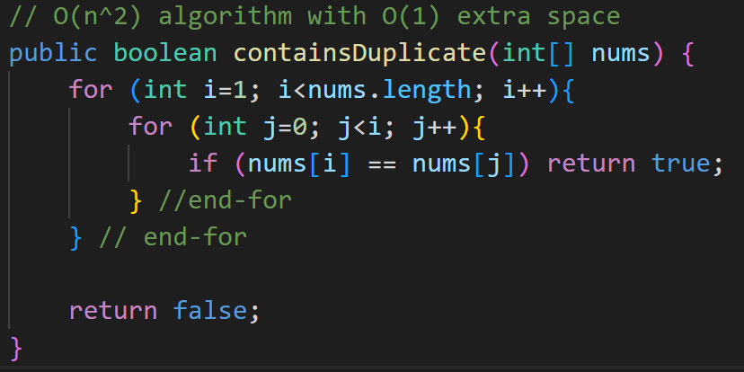
LeetCode 217: Solution 1
This is the O(n^2) brute-force solution. Gets TLE

Slide 14
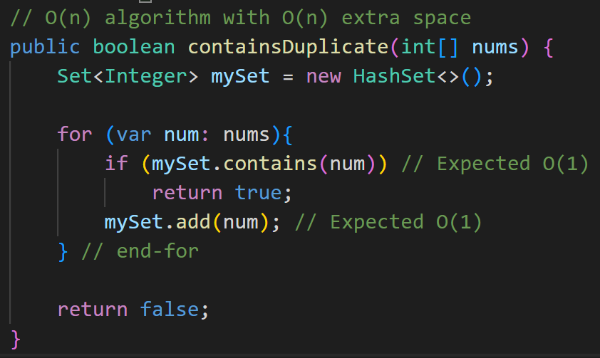
LeetCode 217: Solution 2
This is the most efficient O(n) solution, but uses O(n) extra space (time vs space tradeoff)

Slide 15
LeetCode 1: Two Sum
Given an array of integers nums and an integer target, return indices of the two numbers such that they add up to target.
You may assume that each input would have exactly one solution, and you may not use the same element twice.
You can return the answer in any order.
Example:
Input: nums = [2,7,11,15], target = 9
Output: nums[0] + nums[1] == 9, so we return [0, 1].
Example
Input: nums = [3,2,4], target = 6
Output: [1,2]

Slide 16
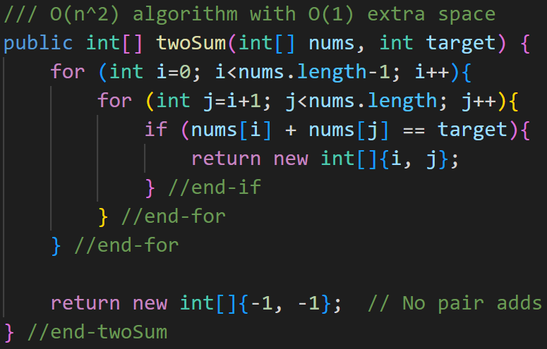
LeetCode 1: Solution 1
This is the O(n^2) brute-force solution

Slide 17
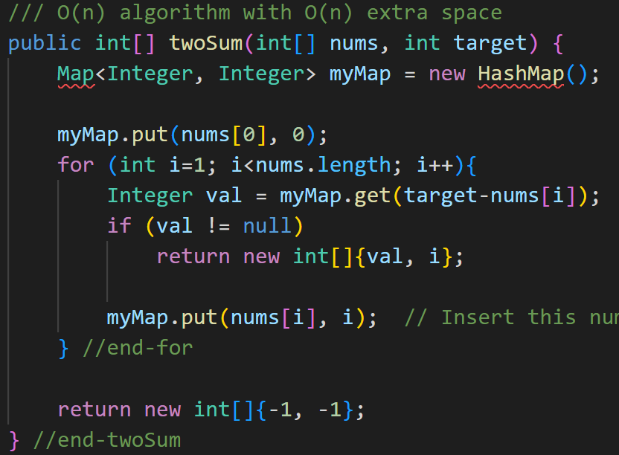
LeetCode 1: Solution 2
This is the most efficient O(n) solution, but uses O(n) extra space (time vs space tradeoff)

