Slide 1
Today’s Material
Hash Table
Definition
Hash Functions
Handling Collisions
Separate Chaining
Open Addressing
Visualization
https://www.cs.usfca.edu/~galles/visualization/OpenHash.html
https://www.cs.usfca.edu/~galles/visualization/ClosedHash.html

Slide 2
Hash Tables - Motivation
Set ADT Operations
add(key)
remove(key)
find(key)
Use a search tree such as a BST, AVL, Splay, Red-Black, B-Tree etc. as the underlying DS
all ops O(logN)
Can we design a DS where add/remove/find are all expected O(1)?
Yes: Hash Tables

Slide 3
Hash Tables – Main Idea
Main idea: Use the key (string or number) to index directly into an array – O(1) time to access records
Hash Table. N = 11
0
45
1
// Returns the index of
// the key in the table
int HashFunction(int key){
return key%N;
} //end-HashFunction
2
45
3
3
3
16
4
20
5
42
16
6
Keys 20 & 42 both map to the same cell– 9
Called a collision!
Need to handle collisions
7
8
20
42?
9
10

Slide 4
Hash Tables – String Keys
If the keys are strings, then convert them to an integer index
Hash Table. N = 11
john
0
1
// Returns the index of
// the key in the table
int HashFunc(char key[]){
?????????
} //end-HashFunc
2
john
3
alice
bob
bob
4
sarit
5
6
alice
7
8
sarit
9
10

Slide 5
Hash Functions for String Keys
If keys are strings, can get an integer by adding up ASCII values of characters in key
Problems?
// Returns the index of
// the key in the table
int HashFunction(String key){
int hashCode = 0;
int len = key.length();
for (int i=0; i<len; i++){
hashCode += key.charAt(i);
} //end-for
return hashCode % N;
} //end-HashFunction
Will map “abc” and “bac” to the same slot!
2. If all keys are 8 or less characters long, then will map only to positions 0 through 8*127 = 1016
Need to evenly distribute keys

Slide 6
Hash Functions for String Keys
Problems with adding up char values for string keys
If string keys are short, will not hash to all of the hash table
Different character combinations hash to the same value
“abc”, “bca”, and “cab” all add up to 6
Suppose keys can use any of 26 characters plus blank
A good hash function for strings: treat characters as digits in base 27 (using “a” = 1, “b” = 2, “c” = 3, ……… “z” = 26, “ “ (space) = 27)
“abc” = 1*27^2 + 2*27^1 + 3 = 729+54+3=786
“bca” = 2*27^2 + 3*27^1 + 1 = 1458+81+1=1540
“cab” = 3*27^2 + 1*27^1 + 2 = 2187+27+2=2216
Can use 32 instead of 27 and shift left by 5 bits for faster multiplication

Slide 7
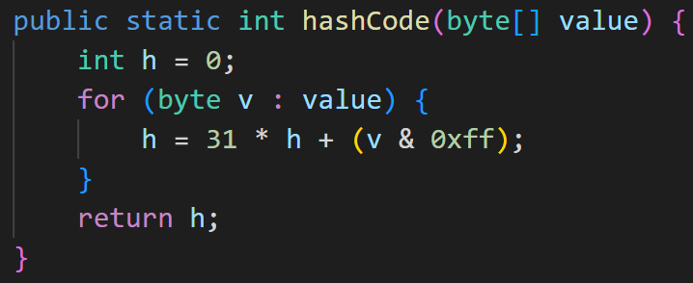
Hash Functions for String Keys
A good hash function for strings: treat characters as digits in base 27
Can use 32 instead of 27 and shift left by 5 bits for faster multiplication
// Map the key into a Hash Table bucket
int HashFunction(String key){
int hashCode = 0;
int len = key.length();
for (i=0; i<len; i++){
hashCode = (hashCode << 5) +
key.charAt(i)-’a’;
} //end-for
return hashCode % N;
} //end-HashFunction
Java String hashCode method

Slide 8
Properties of Good Hash Functions
Should be efficiently computable – O(1) time
Should hash evenly throughout hash table
Should utilize all slots in the table
Should minimize collisions

Slide 9
Java hashCode() method
Each object in Java inherits a hashCode() method from the Object class
By default, the hashCode of an object is equal to its memory address
If you want to store your objects in a HashSet or HashMap, you have to override both the hashCode() and equals() methods
hashCode() method should use all of the member variables of the class to compute a random hash value
equals() must return true if the objects are equal to each other

Slide 10
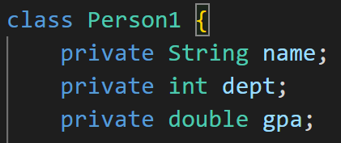
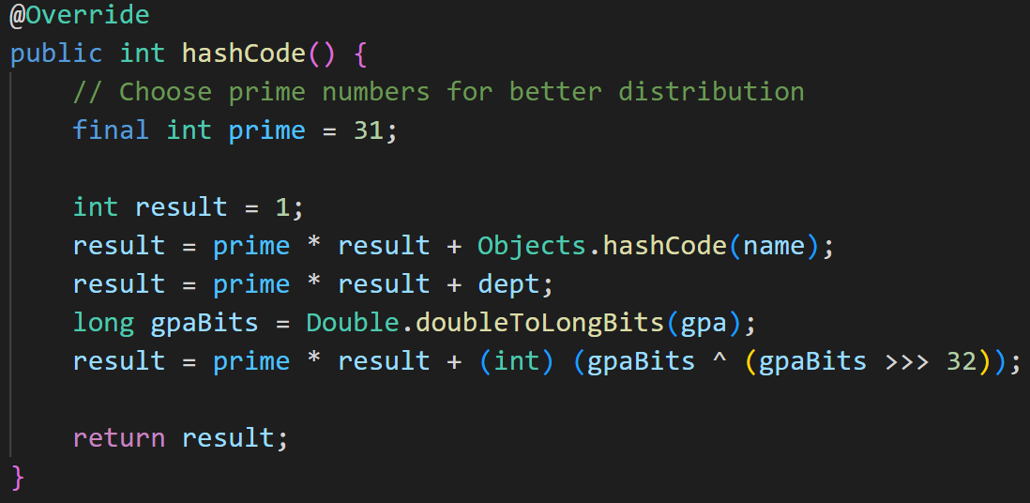
hashCode() for a Person class (1)
Custom hashCode() implementation

Slide 11
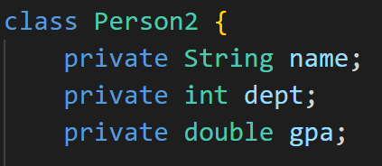
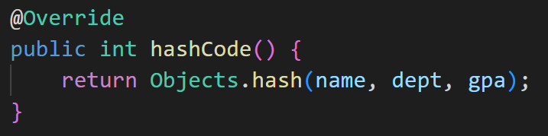
hashCode() for a Person class (2)
Simply call Objects.hash(), which does the same thing

Slide 12
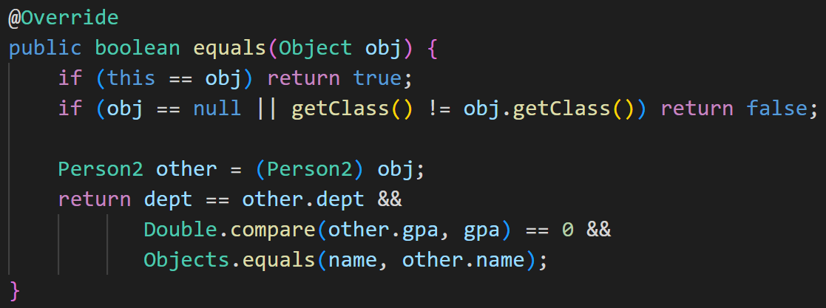
equals() method for the Person class
Must also implement the equals method

Slide 13
More on hashCode() & equals() methods in Java
Two “equal” objects MUST have the same hashCode
equal objects → same hashCode
Two objects having the same hashCode are NOT necessarily equal
It just means that they will map into the same bucket in the hash table
same hashCode does NOT mean equal objects
Rule of thumb:
Whenever you override equals() method, make sure that you also override hashCode() method and use the same attributes that you use to check for equality to compute the hash code of the object using Objects.hash() method

Slide 14
Hash Table Size
We need to make sure that Hash Table is big enough for all keys and that it facilitates the Hash Function’s job to evenly distribute the keys
What if TableSize is 10 and all keys end in 0?
All keys would map to the same slot!
Need to pick TableSize carefully
typically, a prime number is chosen

Slide 15
Collisions and their Resolution
A collision occurs when two different keys hash to the same value
E.g. For TableSize = 17, the keys 18 and 35 hash to the same value
18 mod 17 = 1 and 35 mod 17 = 1
Cannot store both data records in the same slot in array!
Two different methods for collision resolution:
Separate Chaining: Use data structure (such as a linked list) to store multiple items that hash to the same slot
Open addressing (or probing): search for empty slots using a second function and store item in first empty slot that is found

Slide 16
Separate Chaining
Each hash table cell holds a pointer to a linked list of records with same hash value (i, j, k in figure)
Collision: Insert item into linked list
To Find an item: compute hash value, then do Find on linked list
Can use a linked-list for Find/Insert/Delete in linked list
Can also use BSTs: O(log N) time instead of O(N). But lists are usually small – not worth the overhead of BSTs
# of keys occupying
the slot
null
i
k1
null
null
j
k2
k3
k4
null
null
k
k5
k6
null
null
* Hash(k1) = i
* Hash(k2)=Hash(k3)=Hash(k4) = j
* Hash(k5)=Hash(k6)=k

Slide 17
Separate Chaining Example
Insert {18, 19, 20, 29, 30, 31} into empty hash table with TableSize = 10 using separate chaining
0
20
30
1
31
18
18 % 10 = 8
19 % 10 = 9
20 % 10 = 0
29 % 10 = 9
30 % 10 = 0
31 % 10 = 1
2
19
3
20
4
5
29
6
30
7
31
8
18
9
19
29

Slide 18
Pros/Cons of Separate Chaining
+ Simple to implement: Separate chaining is straightforward to implement and understand
+ No limit on load factor: It can handle a higher load factor (number of elements divided by the number of buckets) without significant performance degradation
- Memory overhead: Each bucket requires additional memory to store the chain, which can lead to increased memory usage
- Indirection: Accessing elements requires traversing the chain, introducing an extra indirection step
Question: Can we handle collisions w/o extra space?
Yes: Open addressing

Slide 19
Collision Resolution by Open Addressing
Open addressing (or probing): When collision occurs, try alternative cells in the array until an empty cell is found
Given an item X, try cells h0(X), h1(X), h2(X), …, hi(X)
hi(X) = (Hash(X) + F(i)) mod TableSize (i = 0, 1, 2, …)
Define F(0) = 0
F is the collision resolution function. Three possibilities:
Linear: F(i) = i
Quadratic: F(i) = i^2
Double Hashing: F(i) = i*Hash2(X)

Slide 20
Open Addressing I: Linear Probing
Main Idea: When collision occurs, scan down the array one cell at a time looking for an empty cell
hi(X) = (Hash(X) + i) mod TableSize (i = 0, 1, 2, …)
Compute hash value and increment until free cell is found

Slide 21
Linear Probing Example
Insert {18, 19, 20, 29, 30, 31, 28} into empty hash table with TableSize = 10 using linear chaining
0
20
hi(X) = (Hash(X) + i) mod TableSize (i = 0, 1, 2, …)
1
29
2
30
3
31
4
28
5
6
7
8
18
9
19

Slide 22
Drawbacks of Linear Probing
Works until array is full, but as number of items N approaches TableSize, access time approaches O(N)
Very prone to cluster formation (as in our example)
If key hashes into a cluster, finding free cell involves going through the entire cluster
Inserting this key at the end of cluster causes the cluster to grow: future Inserts will be even more time consuming!
This type of clustering is called Primary Clustering
Can have cases where table is empty except for a few clusters
Does not satisfy good hash function criterion of distributing keys uniformly

Slide 23
Open Addressing II: Quadratic Probing
Main Idea: Spread out the search for an empty slot Increment by i^2 instead of i
hi(X) = (Hash(X) + i²) mod TableSize (i = 0, 1, 2, …)
No primary clustering but secondary clustering possible

Slide 24
Quadratic Probing Example I
Insert {18, 19, 20, 29, 30, 31, 28} into empty hash table with TableSize = 10 using double probing
0
20
hi(X) = (Hash(X) + i²) mod TableSize (i = 0, 1, 2, …)
(28+9) % 10 = 7
1
30
2
31
3
29
4
5
6
7
28
8
18
9
19

Slide 25
Quadratic Probing Example II
Insert {1, 2, 5, 10, 17} into empty hash table with TableSize = 16 using double probing
hi(X) = (Hash(X) + i²) mod TableSize (i = 0, 1, 2, …)
(17+25)%16=10
0
1
2
2
5
5
7
10
Theorem: If TableSize is prime and the table is at most half-full, quadratic probing will always find an empty slot
10
12
15

Slide 26
Open Addressing III: Double Hashing
Idea: Spread out the search for an empty slot by using a second hash function
No primary or secondary clustering
hi(X) = (Hash(X) + i*Hash2(X)) mod TableSize for i = 0, 1, 2, …
E.g. Hash2(X) = R – (X mod R)
R is a prime smaller than TableSize
No clustering but slower than quadratic probing due to Hash2

Slide 27
Double Hashing Example
Insert {18, 19, 20, 29, 31, 28} into empty hash table with TableSize = 10 using double hashing
hi(X) = (Hash(X) + i*Hash2(X)) mod TableSize for i = 0, 1, 2, …
E.g. Hash2(X) = R – (X mod R), R = 7
(28+2*7)%10 = 2
Hash(28) = 7-(28%7) = 7
0
20
1
31
2
28
3
4
5
29
6
7
8
18
9
19

Slide 28
Pros/Cons of Open Addressing
+ Less memory overhead: There is no need to store additional data structures for collision resolution, leading to lower memory usage compared to separate chaining
+ Cache-friendliness: Elements are stored directly in the hash table, which can improve cache locality and performance
- Limited load factor: Open addressing performs best with a low load factor. As the table becomes more filled, the likelihood of clustering and increased probing steps rises, leading to performance degradation
- Difficulty with deletions: Deleting elements requires special handling to mark slots as "deleted" while maintaining probing integrity

Slide 29
Deletion with Separate Chaining
0
30
1
31
2
3
4
5
55
6
7
8
18
9
19
29

Slide 30
Lazy Deletion with Linear Probing
Need to use lazy deletion if we use probing (why?)
Think about how Find(X) would work…
Delete(30), then Find(31)
Mark array slots as “Empty/Deleted”
0
20
1
29
2
D
3
31
4
28
5
E
6
E
7
E
8
18
9
19

Slide 31
Separate Chaining vs Open Addressing
Performance: Separate chaining usually performs better at higher load factors, while open addressing is more efficient at lower load factors
Memory Usage: Open addressing generally requires less memory because there are no additional data structures to store collision chains
Clustering: Open addressing can suffer from clustering, which is when elements "clump" together in the hash table, causing longer probing sequences. Separate chaining does not suffer from this issue
Deletions: Handling deletions can be more challenging with open addressing, as special markers are needed to maintain the integrity of the probing sequence. Separate chaining handles deletions very easily

Slide 32
Rehashing
If table gets too full or if many deletions have occurred:
Running time for Find etc. gets too long, and
Inserts may fail!
What do we do?
Rehashing – Allocate a larger hash table (of size ~2*TableSize) whenever the table gets too full!

Slide 33
Rehashing
New Table
How does it work?
Cannot just copy data from old table: Bigger table has a new hash function
Go through old hash table, ignoring items marked deleted
Recompute hash value for each non-deleted key and put the item in new position in new table
Running time = O(N)
but happens very infrequently
New Table
0
20
1
29
2
D
3
31
4
28
5
E
6
E
7
E
8
18
9
19

Slide 34
Hash Tables vs Search Trees
Hash Tables are good if you would like to perform ONLY insert/delete/find
Hash Tables are not good if you would also like to get a sorted ordering of the keys
Keys are stored arbitrarily in the Hash Table
Hash Tables use more space than search trees
Our rule of thumb: Time versus space tradeoff ☺
Search Trees efficiently support previous/next/min/max operations, which cannot efficiently be supported by a Hash Table. Furthermore, Search Trees give the keys in sorted order.

Slide 35
LeetCode 705: Design Hash Set
Design a HashSet without using any built-in hash table libraries. To be specific, your design should include these functions:
add(value): Insert a value into the HashSet.
contains(value): Return whether the value exists in the HashSet or not.
remove(value): Remove a value in the HashSet. If the value does not exist in the HashSet, do nothing.

Slide 36
LeetCode 706: Design Hash Map
Design a HashMap without using any built-in hash table libraries. To be specific, your design should include these functions:
put(key, value): inserts a (key, value) pair into the HashMap. If the key already exists in the map, update the corresponding value
get(key): Returns the value to which the specified key is mapped, or -1 if this map contains no mapping for the key
remove(value): removes the key and its corresponding value if the map contains the mapping for the key

