Slide 1
Today’s Material
Priority Queue ADT
Definition & Operations
https://docs.oracle.com/javase/8/docs/api/java/util/PriorityQueue.html
Using an Array to implement the PQ ADT
Using a TreeMap to implement the PQ ADT
Binary Heap Data Structure
Definition
Using a Binary Heap to implement the PQ ADT
Visualization
https://www.cs.usfca.edu/~galles/visualization/Heap.html

Slide 2
FIFO Queue
We know about FIFO queues
It is a container that has two ends front and rear, where a new-coming item is inserted at the rear, and the next item to be removed is the one at the front
Lines at the supermarket, at the bank etc.
front
rear
2
4
1
8
12
enqueue(6)
front
rear
2
4
1
8
12
6
dequeue()
front
rear
4
1
8
12
6

Slide 3
Priority Queue ADT
In some applications, elements have priorities. The next element to be served is the one that has the highest priority
Some operating system schedule jobs (tasks or processes) according to their priority
Doctors in ER take patients according to the severity of their injuries
Discrete event simulation (Events are ordered according to their time of execution)

Slide 4
Priority Queue ADT
A priority queue is an ADT (container) that organizes its elements according to their priorities, and always returns the element with the highest priority, i.e., the element having the smallest value or the largest value
pop()
pop()
pop()
5
5
5
3
3
5
3
3
9
9
9
1
9
5
7
5
7
5
7
7
2
2
5
2
2
2

Slide 5
PQ ADT Operations
interface MyPQ<E> {
E top(); // Return the element with the highest priority (w/o removing
void push(E e); // Add a new element to the PQ
E pop(); // Remove and return the element with the highest priority
boolean isEmpty(); // Is the PQ empty?
int size(); // # of elements in the PQ
void clear(); // Remove all elements
}

Slide 6
Java PriorityQueue Hierarchy
implements
interface Iterable<E>
<<interface>>
Iterable
Iterator<E> iterator()
extends
interface Collection<E>
<<interface>>
Collection
boolean isEmpty()
int size()
void clear()
<<interface>>
Queue
class AbstractQueue<E>
E element()
boolean add(E e)
E remove(E e)
AbstractQueue
PriorityQueue
class PriorityQueue<E>
E peek()
boolean offer(E e)
E poll(E e)

Slide 7
Using an array to implement the PQ ADT
Use an array to store the keys in arbitrary order: 3, 1, 7, 4, 9
0
1
2
3
4
5
N-1
A
3
1
7
4
9
Operation
top
push
pop
Array
O(1)
O(1)
O(N)
Sorted Array
O(1)
O(N)
O(N)
Notice that storing the keys in sorted order does NOT help!

Slide 8
Using a TreeMap to implement the PQ ADT
Use an TreeMap to store the keys in sorted order: 1, 3, 3, 4, 7, 7, 9
(4, 1)
Operation
top
push
pop
TreeMap
O(logN)
O(logN)
O(logN)
(1, 1)
(7, 2)
(3, 2)
(9, 1)

Slide 9
Comparison of PQ Implementations
Operation
top
push
pop
Array
O(1)
O(1)
O(N)
TreeMap
O(logN)
O(logN)
O(logN)
Array is good but pop is O(n), which is very slow!
TreeMap is good but:
unnecessarily maintains full lexicographical/sorted ordering
uses a search tree as the underlying DS, which is a linked DS
Question: Can we design an array-based DS that supports all these operations in O(logn) or lower time?
Yes! Binary Heap

Slide 10
Binary Heap
A binary heap is a binary tree that is:
1. Complete: the tree is completely filled except possibly the bottom level, which is filled from left to right
2. Satisfies the heap property: The key stored in every node is smaller than (or equal to) the keys stored in its children
Therefore, the root node always contains the smallest key in a heap (assuming this is a min-heap)
2
-2
1
Which of these is not a heap?
6
4
0
1
2
6
8
7
0
3
4
5

Slide 11
Array Implementation of Binary Heaps
Since binary heaps are complete binary trees, we can avoid pointers and use an array as follows:
0
H:
2
4
6
7
6
2
1
2
0
1
2
3
4
5
6
7
4
6
3
4
N = 5
7
6
Root node = H[0]
Children of H[i] -> H[2i+1], H[2i+2]
Parent of H[i] -> H[(i-1)/2]
Keep track of current size N (number of elements)

Slide 12
Using a Binary Heap to implement the PQ ADT
We can use a binary heap to implement the PQ ADT operations
Simply store the PQ elements in a binary heap as shown below
Min-Heap
Min-PQ
2
8
11
4
3
6
10
9
7
5
8
9
2
4
5
11
9
Min-Heap
7
3
6
10
2
9
5
3
8
6
4
10
11
9
7
9

Slide 13
PQ operations: top()
top():
Easy! Return root value H[0]
Running time = O(1)
2
4
3
7
5
8
9
11
9
6
10

Slide 14
PQ operations: pop() – First Try
pop():
Delete (and return) value at root node
We now have a “Hole” at the root
Need to fill the hole with another value
Replace with smallest child?
Try replacing 2 with smallest child and that node with its smallest child, and so on…what happens?
The heap property is still satisfied in the final tree, i.e., the key stored in every node is smaller than the keys stored in its children
BUT, the resulting tree is NOT a complete binary tree!
2
4
3
7
5
8
9
11
9
6
10
After pop()
3
4
8
7
5
9
11
9
6
10

Slide 15
PQ operations: pop() – Second Try
pop:
Delete (and return) value at root node
We now have a “Hole” at the root
Need to fill the hole with another value
Since heap is smaller by one node, we need to empty the last slot
Steps:
Move last item to top; decrease size by 1
Push down the top item to its correct position in the heap
2
4
3
7
5
8
9
11
9
6
10
N = 11
2
4
3
7
5
8
9
11
9
6
10

Slide 16
pushdown()
10
3
3
4
3
4
10
4
8
7
5
8
9
7
5
8
9
7
5
10
9
11
9
6
11
9
6
11
9
6
Keep comparing with children H[2i+1] and H[2i+2]
Replace with smaller child and go down one level
Done if
both children are >= item or
reached a leaf node
What is the running time?

Slide 17
Running time analysis of pop/pushDown
Running time is O(height of tree)
What is the height of a complete binary tree of N nodes?
O(log2(N))

Slide 18
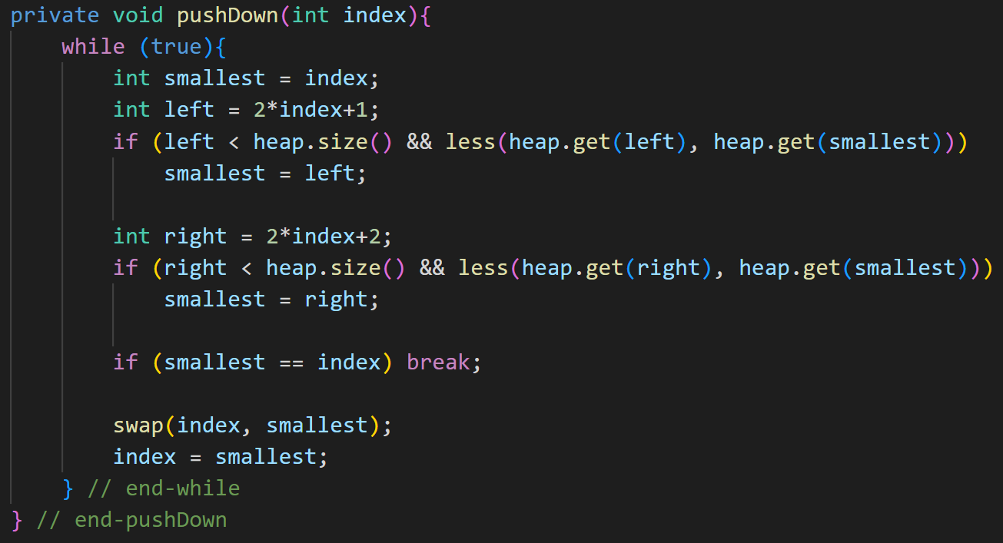
pushDown()

Slide 19
PQ operations: push(E e)
2
4
3
7
5
8
9
11
9
6
N = 11
2
4
3
7
5
8
9
11
9
6
How would we insert a key, say 1, to this min-heap?

Slide 20
PQ operations: push(E e)
2
4
3
7
5
8
9
11
9
6
1
N = 12
2
4
3
7
5
8
9
11
9
6
1
Insert the new element in the last location
Increase the size of the heap by 1
This preserves the complete tree property
Now, push the key up to restore the heap property

Slide 21
PQ operations: push(E e)
After 2 steps
2
2
1
4
3
4
3
2
3
7
5
8
9
7
1
8
9
7
4
8
9
11
9
6
1
11
9
6
5
11
9
6
5
Insert at last node and keep comparing with parent H[(i-1)/2]
If parent is larger, replace with parent and go up one level
Done if
Key of the parent <= item or
Reached top node H[0]
Running time?
O(height of tree) = O(log2(N))

Slide 22
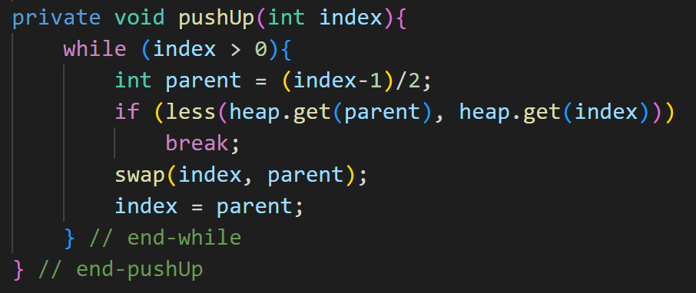
pushUp()

Slide 23
Comparison of PQ Implementations
Operation
top
push
pop
Array
O(1)
O(1)
O(N)
TreeMap
O(logN)
O(logN)
O(logN)
Binary Heap
O(1)
O(logN)
O(logN)

Slide 24
Another Operation: makeHeap()
Say you are given a list of N elements
E.g., 20, 6, 3, 10, 16, 2, 10, 14, 8, 7
What’s the best way to convert this list into a min-heap?
This operation is called makeHeap() or buildHeap()
Here is one solution (top-down heap build):
Start with an empty heap
Insert each element one-by-one
Running time?
N push operations = O(NlogN)
Can we do better?

Slide 25
Building a Heap Bottom Up
Treat input array as a heap and fix it using pushDown
for i = N/2 to 1 do
pushDown(i) // Push the parent key down if necessary
Why N/2?
Nodes after N/2 are leaves!
The above algorithm builds a heap in O(N) time!

Slide 26
Building a Heap Bottom Up: Example
0
20
20
20
1
2
6
3
6
3
6
3
3
4
5
6
10
16
2
10
10
7
2
10
8
7
2
10
14
8
7
14
8
16
14
10
16
7
8
9
2
2
20
20
6
3
6
20
6
2
6
2
8
7
20
10
8
7
3
10
8
7
3
10
8
7
3
10
14
10
16
14
10
16
14
10
16
14
10
16

Slide 27
Comparison of PQ Implementations
Operation
top
push
pop
makePQ
Array
O(1)
O(1)
O(N)
O(N)
TreeMap
O(logN)
O(logN)
O(logN)
O(NlogN)
Binary Heap
O(1)
O(logN)
O(logN)
O(N)

Slide 28
Two more PQ Operations: contains & remove
Most PQ implementations (C++, Python) only support the given operations. That is:
top()
push()
pop()
Although not very common, it is possible to implement two more operations as exemplified by Java PriorityQueue class
contains(E e): Returns true if PQ contains the element
remove(E e): Remove the element “e” from the PQ (if it exists)

Slide 29
PQ operation: contains
2
contains(6)
4
3
true
5
6
8
9
11
9
7
10
2
contains(1)
4
3
false
5
6
8
9
11
9
7
10

Slide 30
PQ Operation: remove
2
2
2
remove(4)
pushDown
4
3
10
3
5
3
5
6
3
9
5
6
3
9
9
6
3
9
11
9
7
10
11
9
7
11
10
7
2
2
2
remove(7)
pushUp
4
3
4
3
3
3
5
6
3
9
5
6
3
9
5
4
9
3
11
9
7
10
3
11
9
3
10
11
9
6
10

Slide 31
Naïve implementation of contains & remove
The easiest way to implement “contains” is to walk over the binary heap to find the index of the element (assuming it exists) and then returning true
“remove” first finds the index and then removes the element at that index by copying the last element of the heap to this index and then performs pushUp or pushDown
This would restore the heap property
Problem: Need to do a linear scan of the heap each time contains or remove is called, which takes O(n)
This is how Java PriorityQueue class implements these two operations

Slide 32
Fast implementation of contains & remove (1)
In order to implement these operations efficiently:
contains: O(1)
remove: O(logn)
we would need a mechanism to find the index of the element in the heap in O(1) time
This requires that we maintain a HashMap mapping the element to the element’s index in the heap
Recall that a PQ can have duplicate elements
Need to keep track of ALL indices where an element occurs
We can store these indices in a HashSet

Slide 33
Fast implementation of contains & remove (2)
heap
0
map
set
1
1
0
1
2
2
1
2
2
2
3
3
4
5
6
3
5
8
3
4
3
4
4
4
6
8
7
7
7
7
3
During push, pop & remove, we need to update the map properly

Slide 34
Indexed PQ
In our PQ implementations so far we only stored values, which may contain duplicates
In some algorithms (Dijkstra’s short paths, Prim’s MST, etc.), we would like to store (key, value) pairs in the PQ, where keys are unique
The PQ is still organized using the values, but now “contains” and “remove” operations are based on keys, not on values

Slide 35
Indexed PQ Example
map
index
heap
Janet
0
0
(Janet, 1)
Steve
1
1
2
Alice
2
(Steve, 2)
(Alice, 2)
Adam
3
3
5
4
6
Sarit
4
(Adam , 3)
(Sarit, 3)
(Bob, 3)
(Jenny, 4)
Bob
5
7
8
Jenny
6
(John , 7)
(Jill, 3)
John
7
Jill
8

Slide 36
Indexed PQ ADT Operations
interface MyIndexedPQ<K,V> {
Entry<K,V> top();
void push(K key, V value);
Entry<K,V> pop();
V get(K key);
boolean contains(K key);
V remove(K key);
V update(K key, V value);
boolean isEmpty();
int size();
void clear();
}

Slide 37
Indexed PQ Operation: update
heap
0
(Janet, 1)
1
2
(Steve, 2)
(Alice, 2)
3
4
5
6
(Adam , 3)
(Sarit, 3)
(Bob, 3)
(Jenny, 4)
heap
7
0
8
(Janet, 1)
(John , 7)
(Jill, 3)
1
2
update(John, 1)
(John, 1)
(Alice, 2)
3
4
5
6
(Steve , 2)
(Sarit, 3)
(Bob, 3)
(Jenny, 4)
7
8
(Adam , 3)
(Jill, 3)

Slide 38
Indexed PQ Operation: update
heap
0
(Janet, 1)
1
2
(Steve, 2)
(Alice, 2)
3
4
5
6
(Adam , 3)
(Sarit, 3)
(Bob, 3)
(Jenny, 4)
heap
7
8
0
(John , 7)
(Jill, 3)
(Janet, 1)
1
2
update(Steve, 6)
(Adam, 3)
(Alice, 2)
3
4
5
6
(Jill , 3)
(Sarit, 3)
(Bob, 3)
(Jenny, 4)
7
8
(John , 7)
(Steve, 6)

Slide 39
Example Usage of Indexed PQ: Dijkstra’s Shortest Path Algorithm
A
6
5
3
B
2
1
D
C
2
5
4
1
E
1
F
4
8
G
Compute the shortest paths from A to all other vertices

Slide 40
Example Usage of Indexed PQ: Dijkstra’s Shortest Path Algorithm
A
Key
Key index
0
6
5
A
0
6
5
3
B
3
B
D
1
2
1
1
2
1
3
C
C
2
2
2
5
4
1
D
3
5
4
1
2
E
1
F
E
4
4
1
5
F
5
4
8
G
4
8
6
G
6
Compute the shortest paths from 0 to all other vertices

Slide 41
Last Operation: Merge
Merge(H1, H2): Merge two heaps H1 and H2 of size O(N). H1 and H2 are stored in two different arrays. E.g. Combine queues from two different sources to run on one CPU.
Can do O(N) Insert operations:
Running Time: O(N log N)
Better: Copy H2 at the end of H1 and use MakeHeap
Running Time: O(N)
Can we do better (i.e. Merge in O(log N) time?)
Yes. Binomial Heaps, Fibonacci Heaps
Will not be covered in this class

