Slide 1
Today’s Material
Recap of the course
Data Structures
Array
Linked List
Tree & Search Tree
Trie
Hash Table
Binary Heap
Abstract Data Types
List
Stack, Queue, Deque, PriorityQueue
Set
Map

Slide 2
Course Recap
Data Structures
Ways of organizing data in memory
Contiguous Allocation
Array
Non-contiguous (Linked) Allocation
Linked List
Trees & Search Tree
Trie
Hash Table
Binary Heap
Graph (to be covered in CS323 Algorithms course)
Abstract Data Types (ADT)
A container with a set of operations
Can be implemented in many different ways using different DSs
List (A container for an ordered sequence of elements)
Stack (LIFO container)
Queue (FIFO container)
Deque (Double ended Queue)
Set (A container for keys)
Map (A cont. for <key, value> pairs)
Priority Queue (Organize elements based on their priority)

Slide 3
Arrays
Memory
All elements of the array are stored contiguously in memory
Can access kth element in O(1) time
But are fixed size: Arrays cannot be made bigger!
You have to know the size of the data you will store in the array beforehand
Memory
0
0
1
2
1
Address
2
100
D[0][0]
101
D[0][1]
Row 0
102
D[0][2]
Address
103
D[0][3]
100
A[0]
1 byte
104
D[1][0]
101
A[1]
105
D[1][1]
Row 1
102
A[2]
106
D[1][2]
103
A[3]
107
D[1][3]
104
A[4]
D[2][0]
108
109
D[2][1]
Row 3
110
D[2][2]
111
D[2][3]
byte A[5]
byte D[3][4]

Slide 4
Singly Linked Lists
node
class LinkedListNode<E> {
E e;
LinkedListNode<E> next;
};
value
next
Pictorial view of a list node
LinkedListNode<E> head;
LinkedListNode<E> tail;
head = T
tail = W
e1
Y
e2
X
e3
Z
e4
W
e5
null
Pictorial view of the list shown on the previous page
Notice that T, W, X, Y and Z are arbitrary locations in memory

Slide 5
Doubly Linked Lists
List
Head
List
Tail
e1
prev
next
e2
prev
next
e3
prev
next
null
null
class DoublyLinkedListNode<E> {
E e;
DoublyLinkedListNode<E> prev;
DoublyLinkedListNode<E> next;
};
DoublyLinkedListNode<E> head;
DoublyLinkedListNode<E> tail;

Slide 6
Trees
root
A tree is a set of nodes that is either:
a. an empty set of nodes, or
b. has one node called the root from which zero or more trees (“subtrees”) descend.
A tree with N nodes always has N-1 edges
Two nodes in a tree have at most one path between them
Can a non-zero path from node N reach node N again?
No! Trees can never have cycles.
+
+
*
20
*
+
4
2
3
*
5
2
8
An expression tree representing the infix expression:
20 + 2*3 + (2*8+5) *4

Slide 7
Search Trees
Root
A Binary Search Tree (BST) is a binary tree in which the value in every node is:
> all values in the node’s left subtree
< all values in the node’s right subtree
15
6
18
3
7
30
2
4
13
9
14
x
BST Node
class BSTNode<E> {
BSTNode<E> left;
E e;
BSTNode<E> right;
};
left
key
right

Slide 8
Height Balanced Search Trees
Adelson-Velskii and Landis (AVL) trees (1962)
Splay trees and other self-adjusting trees (1978)
B-trees and other multiway search trees (1972)
Red-Black trees (1972)
Also known as Symmetric Binary B-Trees
6
0
1
5
7
0
0
4
8
0
9
0
An AVL Tree

Slide 9
Tries
Use the chars/digits of a key as indices during search
0 1 2 3 4 5 6 7 8 9
0
2
10
11
21
100
101
110
2195

Slide 10
Hash Tables with Separate Chaining
null
i
k1
null
// Returns the index of
// the key in the table
int HashFunction(key){
…
} //end-HashFunction
null
k1
j
k2
k3
k4
null
k2
null
k5
k
k5
k6
null
null
* Hash(k1) = i
* Hash(k2) =Hash(k3)=Hash(k4) = j
* Hash(k5) =Hash(k6)=k

Slide 11
Binary Heap
A binary heap is a binary tree that is:
1. Complete: the tree is completely filled except possibly the bottom level, which is filled from left to right
2. Satisfies the heap property: The key stored in every node is smaller than (or equal to) the keys stored in its children
Therefore, the root node always contains the smallest key in a heap (assuming this is a min-heap)
2
-2
1
6
4
0
1
2
5
8
7
0
3
4
6

Slide 12
Graphs (to be covered in CS323)
City F
70
City E
City J
City C
30
60
50
60
City I
City B
City D
40
90
City A
50
90
130
80
City H
Nodes: Cities
Edges: Roads
100
City G

Slide 13
Abstract Data Type (ADT)
An Abstract Data Type (ADT) is a container (a.k.a. collection) with a set of operations
From the programmer’s perspective, an ADT is a black box
Operations specify how the ADT behaves, but do not reveal how they are implemented internally
In many cases, there are more than one way to implement the same ADT
An ADT is a very good example of OOP encapsulation & information (data) hiding (and usually inheritance & polymorphism)
interface ADTName
Operations (ADT Methods)
Operation1(…)
Operation2(…)
Operation3(…)
…
…
…

Slide 14
List ADT
A List is container for an ordered sequence of elements with duplicates
Unlike arrays, which are of fixed size, a List is dynamically expandable
All OOPLs have the concept of a list
2, 4, 1, 8, 12
add(13)
2, 4, 1, 8, 12, 13
add(2, 9)
2, 4, 9, 1, 8, 12, 13
remove(4)
2, 4, 9, 1, 12, 13

Slide 15
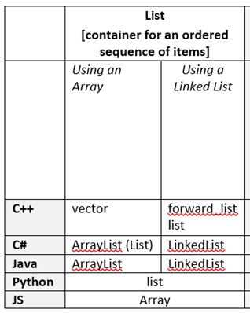
List ADT Implementations in OOPLs
Three lists for the sequence: 2, 4, 1, 8, 12
vector
2
4
1
8
12
forward_list
2
4
1
8
12
list
2
4
1
8
12
https://en.cppreference.com/w/cpp/container/vector
https://en.cppreference.com/w/cpp/container/list

Slide 16

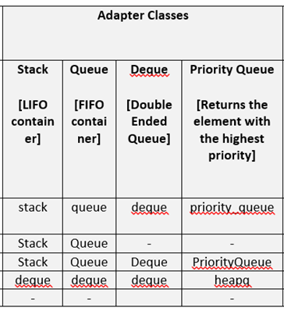
Adapter Classes
There are four adapter classes:
Stack (LIFO)
Queue (FIFO)
Deque (Double-ended Queue)
Priority Queue (Binary Heap)
C++ Operations
push(element)
pop()
top()/front()/back()
empty()

Slide 17


Stack ADT
A container with one end called the Top of the Stack (ToS), where elements are added and removed from in LIFO order
ToS
ToS
8
ToS
12
1
pop()
1
push(12)
1
4
4
4
2
2
2

Slide 18

Queue ADT
A container with two ends called front and rear respectively, where elements are added from the rear, and removed from the front in FIFO order
front
rear
2
4
1
8
12
push(6)
front
rear
2
4
1
8
12
6
pop()
front
rear
4
1
8
12
6

Slide 19
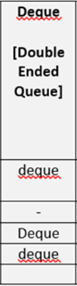
Deque ADT
A container with two ends called front and rear respectively, where elements are can be added and removed both from the front and from the rear
front
rear
2
4
1
8
12
push_back(6)
front
rear
2
4
1
8
12
6
push_front(7)
front
rear
7
2
4
1
8
12
6

Slide 20
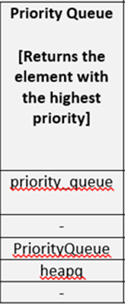
Priority Queue (Binary Heap) ADT
A container that orders its elements with respect to their priorities, and returns the element with the highest priority, i.e., the element having the smallest or the largest value)
pop()
pop()
5
5
5
3
3
3
9
1
1
1
5
7
5
7
5
2
2
2
2
2
2

Slide 21
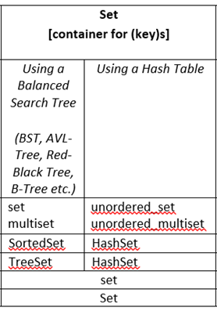
Set ADT
A container to store unique keys
5
Operations
insert(key)
erase(key)
find(key)
3
9
1
4
7
2
6
All operations
take O(logn) if a search tree is used
take O(1) if a hash table is used

Slide 22
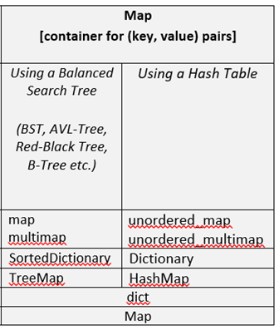
Map ADT
A container that stores unique (key, value) pairs
(5, A)
Operations
insert(key, value)
find(key)
erase(key)
(3, B)
(1, M)
(2, K)
(6, E)
(8, Z)
(9, F)
(7, T)
All operations
take O(logn) if a search tree is used
take O(1) if a hash table is used

Slide 23
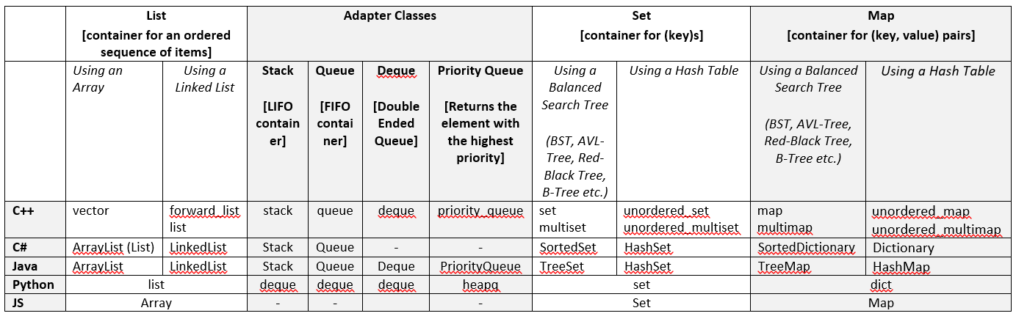
Taxonomy of ADTs in Different OOPLs
https://en.cppreference.com/w/cpp/container
https://docs.oracle.com/javase/8/docs/api/index.html
https://docs.microsoft.com/en-us/dotnet/standard/collections/

Slide 24
Future Directions & Recommendations
Look at the DS & Algorithms problems in HackerRank.com, LeetCode.com etc. and solve them in your spare time
Solving just one problem a week may be good enough
Make sure that you do this regularly
You can only understand how things work by getting your hands dirty and implementing them
Practice makes perfect (Übung macht Meister ☺)

