Slide 1
Abstract Data Type (ADT)
An Abstract Data Type (ADT) is a container (a.k.a. collection) with a set of operations
From the programmer’s perspective, an ADT is a black box
Operations specify how the ADT behaves, but do not reveal how they are implemented internally
In many cases, there are more than one way to implement the same ADT
An ADT is a very good example of OOP encapsulation & information (data) hiding (And usually inheritance & polymorphism)
Attributes (ADT State)
…
…
Operations (ADT Methods)
Operation1(…)
Operation2(…)
Operation3(…)
…
…
…

Slide 2
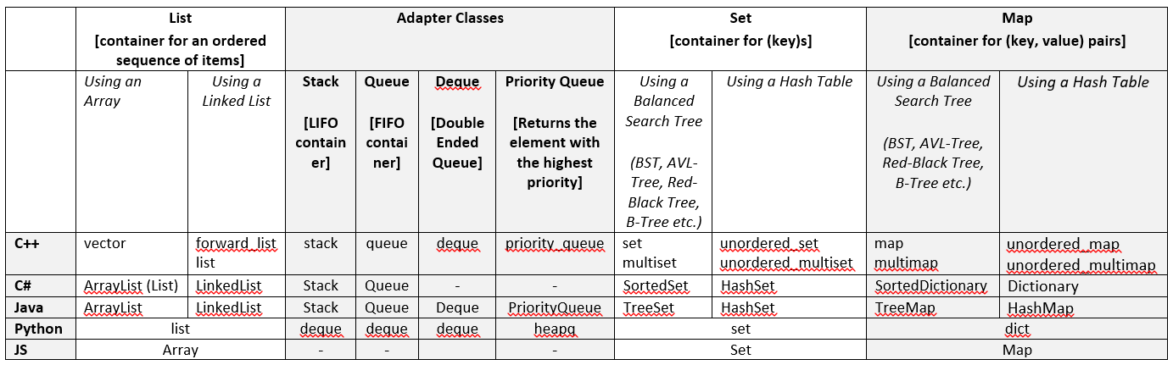
Taxonomy of ADTs in Different OOPLs
https://en.cppreference.com/w/cpp/container
https://docs.oracle.com/javase/8/docs/api/index.html
https://docs.microsoft.com/en-us/dotnet/standard/collections/

Slide 3
List ADT
A List is container for an ordered sequence of elements with duplicates
Unlike arrays, which are of fixed size, a List is dynamically expandable
All OOPLs have the concept of a list
2, 4, 1, 8, 12
add(13)
2, 4, 1, 8, 12, 13
add(2, 9)
2, 4, 9, 1, 8, 12, 13
remove(4)
2, 4, 9, 1, 12, 13

Slide 4
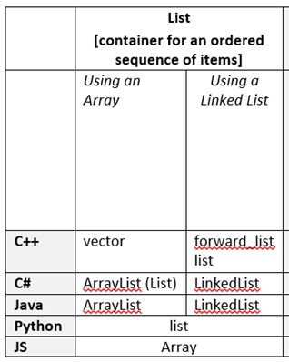
List ADT Implementations in OOPLs
Three lists for the sequence: 2, 4, 1, 8, 12
vector
2
4
1
8
12
forward_list
2
4
1
8
12
list
2
4
1
8
12
https://en.cppreference.com/w/cpp/container/vector
https://en.cppreference.com/w/cpp/container/list

Slide 5
Using the List ADT (C++)
void main(){
// Create an empty list object
vector<int> list;
list.push_back(10); // 10
list.push_back(5); // 10, 5
list.insert(list.begin()+1, 7); // 10, 7, 5
list.insert(list.begin()+2, 9); // 10, 7, 9, 5
list.at(3); // Returns 5
list.erase(list.begin()+1); // 10, 9, 5
list.size(); // Returns 3
list.empty(); // Returns false
list.erase(list.begin()); // 9, 5
list.clear(); // empty list
list.empty(); // Returns true
}/* end-main */

Slide 6

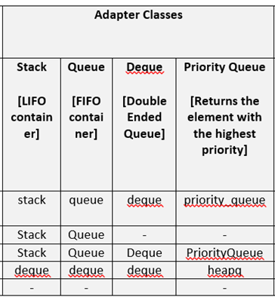
Adapter Classes
There are four adapter classes:
Stack (LIFO)
Queue (FIFO)
Deque (Double-ended Queue)
Priority Queue (Binary Heap)
C++ Operations
push(element)
pop()
top()/front()/back()
empty()

Slide 7


Stack ADT
A container with one end called the Top of the Stack (ToS), where elements are added and removed from in LIFO order
ToS
ToS
8
ToS
12
1
pop()
1
push(12)
1
4
4
4
2
2
2

Slide 8
Using the Stack ADT (C++)
void main(){
// Create an empty stack object
stack<int> S;
S.push(10); // 10
S.push(5); // 10, 5
S.push(7); // 10, 5, 7
S.top(); // Returns 7 (does not remove)
S.pop(); // 10, 5
S.top(); // Returns 5 (does not remove)
S.size(); // Returns 2
S.empty(); // Returns false
S.pop(); // 10
S.pop(); //
S.empty(); // Returns true
}/* end-main */

Slide 9

Queue ADT
A container with two ends called front and rear respectively, where elements are added from the rear, and removed from the front in FIFO order
front
rear
2
4
1
8
12
push(6)
front
rear
2
4
1
8
12
6
pop()
front
rear
4
1
8
12
6

Slide 10
Using the Queue ADT (C++)
void main(){
// Create an empty queue object
queue<int> Q;
Q.push(10); // 10
Q.push(5); // 10, 5
Q.push(7); // 10, 5, 7
Q.front(); // Returns 10 (does not remove)
Q.pop(); // 5, 7
Q.front(); // Returns 5 (does not remove)
Q.size(); // Returns 2
Q.empty(); // Returns false
Q.pop(); // 7
Q.pop(); //
Q.empty(); // Returns true
}/* end-main */

Slide 11
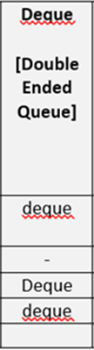
Deque ADT
A container with two ends called front and rear respectively, where elements are can be added and removed both from the front and from the rear
front
rear
2
4
1
8
12
push_back(6)
front
rear
2
4
1
8
12
6
push_front(7)
front
rear
7
2
4
1
8
12
6

Slide 12
Using the Deque ADT (C++)
void main(){
// Create an empty deque object
deque<int> dq;
dq.push_back(10); // 10
dq.push_back(5); // 10, 5
dq.push_front(7); // 7, 10, 5
dq.front(); // Returns 7 (does not remove)
dq.back(); // Returns 5 (does not remove)
dq.pop_front(); // 10, 5
dq.front(); // Returns 10 (does not remove)
dq.size(); // Returns 2
dq.empty(); // Returns false
dq.pop_back(); // 10
dq.pop_back(); //
dq.empty(); // Returns true
}/* end-main */

Slide 13

Priority Queue (Binary Heap) ADT
A container that orders its elements with respect to their priorities, and returns the element with the highest priority, i.e., the element having the smallest or the largest value)
Max-PQ
pop()
pop()
5
5
5
3
3
3
9
1
1
1
5
7
5
7
5
2
2
2
2
2
2

Slide 14
Using the Priority Queue ADT (C++)
void main(){
// Create an empty max-heap
priority_queue<int> Q;
Q.push(1); // 1
Q.push(5); // 5, 1
Q.push(3); // 5, 1, 3
Q.top(); // Returns 5 (does not remove)
Q.pop(); // 3, 1
Q.top(); // Returns 3 (does not remove)
Q.size(); // Returns 2
Q.empty(); // Returns false
Q.pop(); // 1
Q.pop(); //
Q.empty(); // Returns true
}/* end-main */

Slide 15
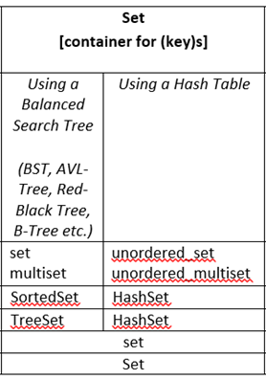
Set ADT
A container to store unique keys
5
Operations
insert(key)
erase(key)
find(key)
3
9
1
4
7
2
6
All operations
take O(logn) if a search tree is used
take O(1) if a hash table is used

Slide 16
Using the set ADT (C++)
void main(){
// Create an empty ordered (tree) set
set<int> mySet;
mySet.insert(1); // 1
mySet.insert(5); // 1, 5
mySet.insert(3); // 1, 3, 5 mySet.size(); // Returns 3
auto iter = mySet.find(3); // returns an iterator to 3
auto pIter = std::prev(iter, 1); // returns an iterator to 1
auto pNext = std::next(iter, 1); // returns an iterator to 5
for (auto val: mySet) // Iterate over the set elements
cout << val << endl; // Get them in sorted order 1, 3, 5
}/* end-main */

Slide 17
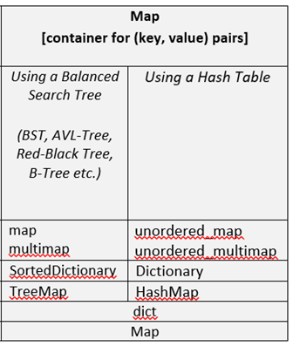
Map ADT
A container that stores unique (key, value) pairs
(5, A)
Operations
insert(key, value)
find(key)
erase(key)
(3, B)
(1, M)
(2, K)
(6, E)
(8, Z)
(9, F)
(7, T)
All operations
take O(logn) if a search tree is used
take O(1) if a hash table is used

Slide 18
Using the map ADT (C++)
void main(){
// Create an empty ordered (tree) map
map<int, char> mySet;
mySet.insert({1, ‘e’}); // (1, ‘e’)
mySet.insert({5, ‘z’}); // (1, ‘e’), (5, ‘z’)
mySet.insert({3, ‘b’}); // (1, ‘e’), (3, ‘b’), (5, ‘z’)
mySet.size(); // Returns 3
auto iter = mySet.find(3); // returns an iterator to (3, ‘b’)
auto pIter = std::prev(iter, 1); // returns an iterator to (1, ‘e’)
auto pNext = std::next(iter, 1); // returns an iterator to (5, ‘z’)
for (auto val: mySet) // Iterate over the set elements
// Get them in sorted order (1, ‘e’), (3, ‘b’), (5, ‘z’)
cout << val.first << “, “, << val.second << endl; }/* end-main */

