Slide 1
Today’s Material
Iterative Algorithms and their analysis
Asymptotic Notations
Big O, Ω , Θ Notations
Review of Discrete Math
Summations
Logarithms

Slide 2
Finding the sum of an array of numbers
[3, 9, 6, 5, 2]
Sum
25

Slide 3
Finding the sum of an array of numbers
int Sum(int A[], int N) {
int sum = 0;
int i=0;
while (i<N){
sum += A[i];
i++;
} //end-for
return sum;
} //end-Sum
Time Complexity T(n):
How many steps does this algorithm take to finish?
We define a step to be a unit of work that can be executed in constant amount of time in a machine.
Space Complexity S(n):
How much space does the algorithm require during execution?

Slide 4
Finding the sum of an array of numbers
Times Executed
1
1
N
N
N
1
---------
int Sum(int A[], int N) {
int sum = 0;
int i=0;
while (i<N){
sum += A[i];
i++;
} //end-while
return sum;
} //end-Sum
Total: 2 + N + N + N + 1 = 3N + 3
Running Time: T(N) = 3N+3
Space Complexity: S(N) = N+3

Slide 5
Power(a, n): Compute a^{n}
(a, n)
(3, 10)
Power
Power
a^{n}
3¹⁰ = 59049

Slide 6
Power(a, n)
Times Executed
1
N
N
N
1
---------
int Power(int a, int n) {
int pow = 1;
while (n > 0){
pow *= a;
n--;
} // end-while
return pow;
} //end-Power
T(N): 1 + N + N + N + 1 = 3N+2
S(N): 3
There is in fact a T(N) = logN algorithm. Think about it!

Slide 7
Primality Test (I)
Given a positive number “n”, return true if it is a prime number, false otherwise
bool isPrime(int n) {
if (n == 1) return false;
if (n == 2) return true;
int x = 2;
while (x < n){
if (n % x == 0) return false;
x++;
} // end-while
return true;
} //end-isPrime
T(N): 1 + 1 + 1 + 3*(N-2) + 1 = 3N-2

Slide 8

Primality Test (II)
Given a positive number “n”, return true if it is a prime number, false otherwise
bool isPrime(int n) {
if (n == 1) return false;
if (n == 2) return true;
int x = 2;
while (x*x <= n){
if (n % x == 0) return false;
x++;
} // end-while
return true;
} //end-isPrime

Slide 9
Nested for loops
for (i=1; i<=N; i++){
for (j=1; j<=N; j++){
printf(“Foo\n”);
} //end-for-inner
} //end-for-outer
How many times is the printf statement executed?
Or how many Foo will you see on the screen?

Slide 10
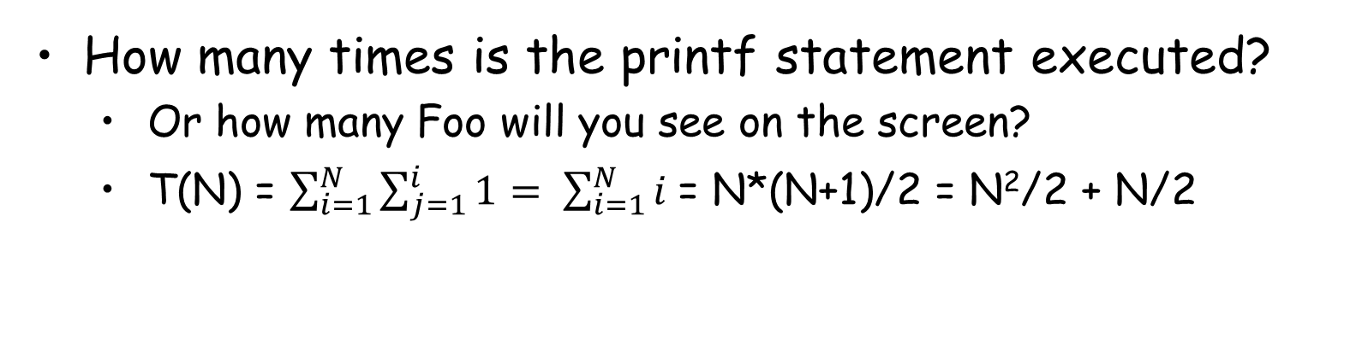
Nested for loops
for (i=1; i<=N; i++){
for (j=1; j<=i; j++){
printf(“Foo\n”);
} //end-for-inner
} //end-for-outer
How many times is the printf statement executed?
Or how many Foo will you see on the screen?
T(N) = $\sum_{i=1}^{N}{\sum_{j=1}^{i}{1= \sum_{i=1}^{N}{i} }}$= N*(N+1)/2 = N²/2 + N/2

Slide 11
Nested for loops
for (i=1; i<=N; i++){
for (j=1; j<=i; j++){
println(“Foo\n”);
} //end-for-inner
} //end-for-outer
i # of times the inner loop iterates
------ ---------------------------------------
1 1
2 2
…. …
N N
--------------------------------------
T(N) = 1+2+3+…+N = (N*(N+1))/2

Slide 12
Matrix Multiplication
You are given two NxN matrices A & B
Compute C = A x B
5
1
2
1
2
2
12
13
1
2
4
x
3
1
3
=
6
2
7
2
1
4
A
B
C
C[0][0] = A[0][0]*B[0][0] + A[0][1]*B[1][0] + A[0][2]*B[2][0]
C[0][0] = 5*1 + 1*3 + 2*2 = 5+3+4 = 12

Slide 13
Matrix Multiplication
/* Two dimensional arrays A, B, C. Compute C = A*B */
for (i=0; i<N; i++) {
for (j=0; j<N; j++) {
C[i][j] = 0;
for (int k=0; k<N; k++){
C[i][j] += A[i][k]*B[k][j];
} //end-for-innermost
} //end-for-inner
} //end-for-outer

Slide 14
Linear Search
You are given an unordered array of numbers and a key
Implement an algorithm that returns the index of the array where the key is stored
If the key does not exist in the array, return -1
0
1
2
3
4
5
6
7
8
9
10
11
12
13
14
15
9
4
10
1
20
12
3
99
65
52
25
11
91
34
62
55
Key = 12 ➔ Return 5, which is the index of the array where 12 is stored
Key = 77 ➔ Return -1 because 77 is NOT in the array

Slide 15
Linear Search
Times Executed
1
1<=L<=N
1<=L<=N
0<=L<=N
1
1
---------
int LinearSearch(int A[], int N, int key){
int i = 0;
while (i < N){
if (A[i] == key) break;
i++;
} //end-while
if (i < N) return i;
else return -1;
} //end-LinearSearch
Total: 1+3*L+1 = 3L+2

Slide 16
Linear Search
What’s the best case?
Loop iterates just once =>T(n) = 5
What’s the average (expected) case?
Loop iterates N/2 times =>T(n)=3*n/2+2 = 1.5n+2
What’s the worst case?
Loop iterates N times =>T(n) = 3n+2

Slide 17
Worst Case Analysis of Algorithms
We will only look at WORST CASE running time of an algorithm. Why?
Worst case is an upper bound on the running time. It gives us a guarantee that the algorithm will never take any longer
For some algorithms, the worst case happens fairly often. As in this search example, the searched item is typically not in the array, so the loop will iterate N times
The “average case” is often roughly as bad as the “worst case”. In our search algorithm, both the average case and the worst case are linear functions of the input size “n”

Slide 18
Motivation for Asymptotic Notations
Summation: T(N) = 3N + 3
Power: T(N) = 3N + 2
Matrix Multiplication: T(N) = N³ + N²
Linear Search: T(N) = 3N + 2
Motivation: We want to express the running time of an algorithm more succinctly
In general, what really matters is the “asymptotic” performance as N → ∞, regardless of what happens for small input sizes N

Slide 19
3 Asymptotic Notations
Big-O: Asymptotic Upper Bound
Ω : Asymptotic Lower Bound
Θ : Asymptotic Tight Bound

Slide 20
Big-O Notation: Asymptotic Upper Bound
T(n) = O(f(n)) [T(n) is big-Oh of f(n) or order of f(n)]
If there are positive constants c & n0 such that
T(n) <= c*f(n) for all n >= n0
c*f(n)
Running Time
T(n)
n0
Input size N
Example: T(n) = 50n is O(n). Why?
50n <= c*n for all n>=1
Choose c=50, n0=1. Many other choices work too!

Slide 21
Big-O Notation: Asymptotic Upper Bound
T(n) = O(f(n))
If there are positive constants c & n0 such that
T(n) <= c*f(n) for all n >= n0
Example: T(n) = 2n+5 is O(n) why?
We want T(n) = 2n+5 <= c*n for all n>=n0
2n+5 <= 7n for all n>=1
c = 7, no = 1
2n+5 <= 3n for all n>=5
c = 3, no=5
Many other c & n0 values would work too

Slide 22
Big-O Notation: Asymptotic Upper Bound
T(n) = O(f(n))
If there are positive constants c & n0 such that
T(n) <= c*f(n) for all n >= n0
Example: T(n) = 2n+5 is O(n²) why?
We want T(n) = 2n+5 <= c*n² for all n>=n0
2n+5 <= 1*n² for all n>=4
c = 1, no = 4
2n+5 <= 2*n² for all n>=3
c = 2, no = 3
Many other c & no values would work too

Slide 23
Big-O Notation: Asymptotic Upper Bound
T(n) = O(f(n))
If there are positive constants c & n0 such that
T(n) <= c*f(n) for all n >= n0
Example: T(n) = n(n+1)/2 is O(?)
T(n) = n²/2 + n/2 is O(N²). Why?
n²/2 + n/2 <= 1*n² for all n >=1
So, T(n)=n*(n+1)/2 <= 1*n² for all n >=1
c=1, no=1
Note: T(n) is also O(n³). Why?

Slide 24
Big-O Notation: Asymptotic Upper Bound
T(n) = O(f(n))
If there are positive constants c & n0 such that
T(n) <= c*f(n) for all n >= n0
Example: T(n) = 3n³-4n²+3n-4
T(n) = 3n³-4n²+3n-4 <= cn³ for all n >= n0
T(n) = 3n³-4n²+3n-4 <= 3n³+3n³ <= 6n³ for all n >= 1
c=6, n0=1

Slide 25
Ω Notation: Asymptotic Lower Bound
T(n) = Ω(f(n))
If there are positive constants c & n0 such that
T(n) >= c*f(n) for all n >= n0
T(n)
c*f(n)
Running Time
n0
Input size N
Example: T(n) = 2n + 5 is Ω(n). Why?
2n+5 >= 2n, for all n >= 1
T(n) = 5*n² - 3*n is Ω(n²). Why?
5*n² - 3*n >= 4*n², for all n >= 4

Slide 26
Ω Notation: Asymptotic Lower Bound
T(n) = Ω(f(n))
If there are positive constants c & n0 such that
T(n) >= c*f(n) for all n >= n0
Example: T(n) = 3n³-4n²+3n-4 is Ω(n³). Why?
3n³-4n²+3n-4 >= cn³, for all n >= n0
Let’s pick c = 1
3n³-4n²+3n-4 >= n³
n0=1 → 3-4+3-4 >= 1 Not OK
n0=2 → 3x8 – 4x4 + 3x2 – 4 >= 1
→ 24 – 16 + 6 – 4 >= 1 OK
So, c=1, n0=2 holds

Slide 27
Ω Notation: Asymptotic Lower Bound
Is usually used to express the lower bound for a problem. For example:
ALL comparison-based SEARCHING algorithms have a lower-bound of Ω(logN)
ALL comparison-based SORTING algorithms have a lower-bound of Ω(NlogN)
Convex hull has a lower bound of Ω(NlogN)

Slide 28
Θ Notation: Asymptotic Tight Bound
T(n) = Θ(f(n))
If there are positive constants c1, c2 & n0 such that
c1*f(n) <= T(n) <= c2*f(n) for all n >= n0
c2*f(n)
T(n)
Running Time
c1*f(n)
n0
Input size N
Example: T(n) = 2n + 5 is Θ(n). Why?
2n <= 2n+5 <= 3n, for all n >= 5
T(n) = 5*n² - 3*n is Θ(n²). Why?
4*n² <= 5*n² - 3*n <= 5*n², for all n >= 4

Slide 29
Common running times we will encounter
Name | Big-Oh | Comment
Constant | O(1) | Can’t beat it!
Log log | O(loglogN) | Extrapolation search
Logarithmic | O(logN) | Typical time for good searching algorithms
Linear | O(N) | This is about the fastest that an algorithm can run given that we need O(N) just to read the input
NLogN | O(NlogN) | Most sorting algorithms
Quadratic | O(N²) | Acceptable when the data size is small (N<1000)
Cubic | O(N³) | Acceptable when the data size is small (N<1000)
Exponential | O(2^{N}) | Only good for really small input sizes (n<=20)
Factorial | O(N!) | Only good for really small input sizes (n<=15)
Increasing cost
Polynomial time

Slide 30
Some Math
S(N) = 1 + 2 + 3 + 4 + … N =
Sum of Squares:
Geometric Series: A > 1
A < 1

Slide 31
Some More Math
Linear Geometric Series:
Harmonic Series:
Logs:

Slide 32
More on Summations
Summations with general bounds:
Linearity of Summations:

Slide 33
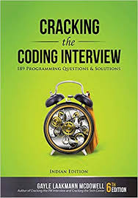
Example
void foo(int[] array, int N) {
int sum = 0;
int product = 1;
for (int i= 0; i < N; i++) {
sum += array[i];
} // end-for
for (int i= 0; i < N; i++) {
product*= array[i];
} // end-for
printf(“sum: %d, product: %d\n”, sum, product);
} // end-foo

Slide 34
Example
void foo(int[] array, int N) {
for (int i= 0; i < N; i++) {
for (int j = i + 1; j < N; j++) {
printf(“%d \n”, array[i] + array[j]);
} // end-for
} // end-for
} // end-foo
i Inner loop iterates
---- --------------------
0 n-1
1 n-2
n-2 1
----------------------
T(N) = 1 + 2 + … + N-1 = (N-1)*N/2 = O(N²)

Slide 35
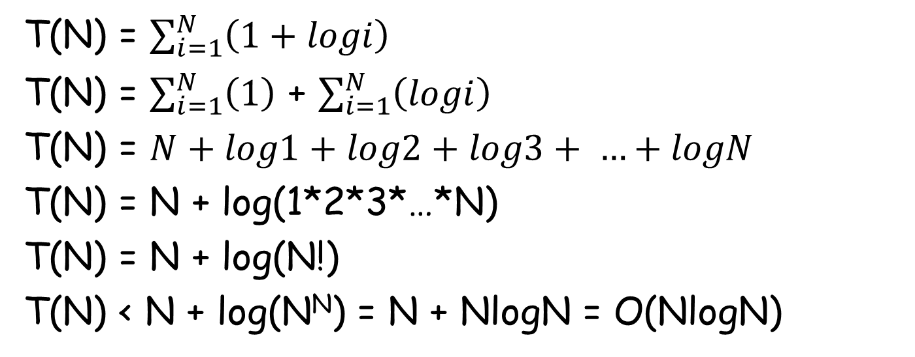
Example
for (i=1; i<=N; i++){
for (j=i; j>0; j/=2){
println(“Foo\n”);
} //end-for-inner
} //end-for-outer

Slide 36
Time-Space Tradeoff
It is usually the case that if you use more memory, it might be possible to solve a problem faster
Called the time-space tradeoff
Meaning that as you lose from memory, you gain from speed
Not always applicable, but sometimes it is

Slide 37
LeetCode 217. Contains Duplicate
A very important problem in computer science
Given an array of numbers, determine if there are two numbers with the same value
A = [4, 2, 7, 10, 6, 9] → No
A = [4, 2, 7, 10, 6, 9, 7] → Yes. We have two 7s

Slide 38
LeetCode 217. Contains Duplicate I
bool checkDuplicate(int A[], int N){
for (i=0; i<N-1; i++){
for (j=i+1; j<N; j++){
if (A[i] == A[j]) return true;
} //end-for-inner
} // end-for-outer
return false;
} //end-checkDuplicate
A = [4, 2, 7, 10, 6, 9, 7]
T(N) = 1 + 2 + … + N-1 = O(N²)
S(N) = O(N)

Slide 39
LeetCode 217. Contains Duplicate II
bool checkDuplicate(int A[], int N){
QuickSort(A, N); // O(NlogN)
for (i=1; i<N; i++){
if (A[i] == A[i-1]) return true;
} // end-for
return false;
} //end-checkDuplicate
Input A = [4, 2, 7, 10, 6, 9, 7]
After Sorting: A = [2, 4, 6, 7, 7, 9, 10]
T(N) = NlogN + N = O(NlogN)
S(N) = O(N)

Slide 40
LeetCode 217. Contains Duplicate III
bool checkDuplicate(int A[], int N){
unordered_set<int> S; // HashSet
for (i=0; i<N; i++){
if (S.find(A[i]) != S.end()) return true;
S.insert(A[i]);
} // end-for
return false;
} //end-checkDuplicate
Input A = [4, 2, 7, 10, 6, 9, 7]
Set S = {4, 2, 7, 10, 6, 9}
T(N) = O(N)
S(N) = O(N) [But requires O(N) extra space]

Slide 41
LeetCode 349. Intersection of Two Arrays
Given two arrays A & B, each representing a set of numbers, compute their intersection set C
A = [4, 2, 5, 1, 9, 7, 15, 11]
B = [1, 20, 7, 18, 5, 6]
C = [1, 7, 5]
Brute force: O(NxM)
Using sorting: O(NlogN + MlogM)
Using extra space (HashSet): O(N+M)

Slide 42
LeetCode 2784. Check if Array is Good
You are given an integer array nums. We consider an array good if it is a permutation of an array base[n]
base[n] = [1, 2, ..., n - 1, n, n] (in other words, it is an array of length n + 1 which contains 1 to n - 1 exactly once, plus two occurrences of n). For example, base[1] = [1, 1] and base[3] = [1, 2, 3, 3]
Return true if the given array is good, otherwise return false
Note: A permutation of integers represents an arrangement of these numbers

Slide 43
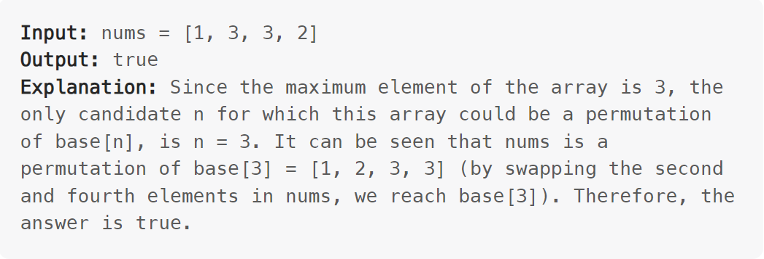
LeetCode 2784. Check if Array is Good
Brute-force solution: O(n^2)
Sort + Process: O(nlogn)
Use a Look up Table: O(n)

