Slide 1
Today’s Material
Searching
Linear Search
Binary Search
Search Trees
Interpolation Search
Using Hash Tables
Using a Look Up Table

Slide 2
Searching
One of the most important problems in computer science
Problem: Given an array of “N” elements, search to find if a given “key” exists or not
Sometimes you are asked to return the index of the array cell where the key is stored
If the collection is a map, you may be asked to return the value given the key

Slide 3
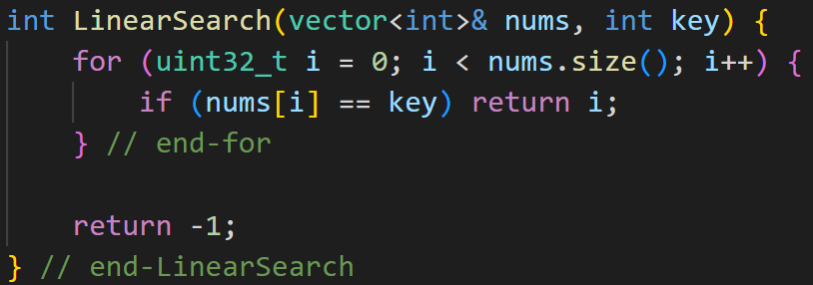
Linear Search
If the array is unsorted, then you have to do linear search
0
1
2
3
4
5
6
7
8
9
10
11
12
13
14
15
9
4
10
1
20
12
3
99
65
52
25
11
91
34
62
55
Key = 12 ➔ Return 5, which is the index of the array where 12 is stored
Key = 77 ➔ Return -1 because 77 is NOT in the array

Slide 4
Binary Search
If the input array is sorted, we can do Binary Search
Idea: Reduce the search space in half by comparing the target key with the key stored in the middle of the array
Example: Let’s search for 55
0
1
2
3
4
5
6
7
8
9
10
11
12
13
14
15
3
8
10
11
20
50
55
60
65
70
72
90
91
94
96
99
left
right

Slide 5
Binary Search Example: find(55)
0
1
2
3
4
7
8
11
15
3
8
10
11
20
50
55
60
91
94
96
99
60
65
70
72
90
left
right
0
1
2
3
4
6
7
8
11
15
3
8
10
11
91
94
96
99
11
20
50
55
60
65
70
72
90
left
middle
right
Eliminated

Slide 6
Binary Search: : find(55) (continued)
0
1
2
3
4
5
6
7
8
11
15
3
8
10
11
20
50
91
94
96
99
50
55
60
65
70
72
90
Eliminated
left
middle
right
0
1
2
3
4
5
6
7
8
11
15
3
8
10
11
20
50
55
60
91
94
96
99
55
65
70
72
90
left
right
Eliminated
middle
Now we found 55→ Successful search
Had we searched for 57, we would have terminated at the next step unsuccessfully

Slide 7
Binary Search - Algorithm
// Return the index of the array containing the key or –1 if key not found
int BinarySearch(int A[], int N, int key){
left = 0;
right = N-1;
while (left <= right){
int middle = left+(right-left)/2; // Index of the key to test against
if (key == A[middle]) return middle; // Key found. Return the index
else if (key < A[middle]) right = middle – 1; // Eliminate the right side
else left = middle+1; // Eliminate the left side
} //end-while
return –1; // Key not found
} //end-BinarySearch
Worst case running time: T(N) = O(log2N). Why?

Slide 8
Binary Search Running Time Analysis
N →N/2 ->N/4 ->N/8 ->N/16 ->…… ->N/2^{k}
N →N/2¹ ->N/2² ->N/2³ ->N/2⁴ ->……->N/2^{k}
N/2^{k} = 1
2^{k} = N
k = log2(N)
T(N) = O(logN)

Slide 9
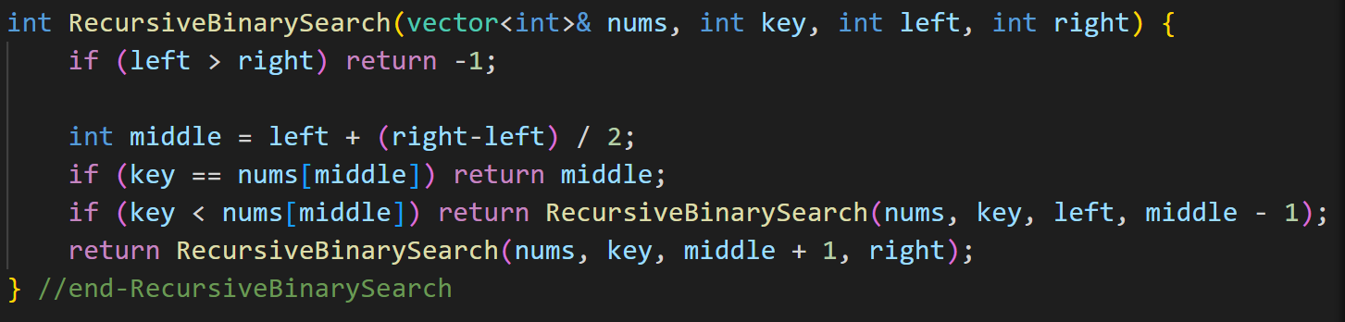
Recursive Binary Search
Binary Search can also be recursively implemented as follows
This is NOT preferred though because this algorithm has O(logN) space complexity, whereas the space complexity of the iterative algorithm is O(1)

Slide 10
lower_bound/bisect_left
What if you want to return the index of the first element for which the predicate element < key is FALSE, i.e., key >= element
Called the lower_bound or bisect_left operation
find(20)→4
Consider the predicate: element < key
When key = 20, here is what we have:
We are looking for the first cell for which the predicate is FALSE
T
T
T
T
F
F
F
F
F
F
F
F
F
F
F
F
3
8
10
11
20
20
20
50
65
70
72
90
91
94
96
99

Slide 11
lower_bound/bisect_left (another example)
find(60) -> 8
T
T
T
T
T
T
T
T
F
F
F
F
F
F
F
F
3
8
10
11
20
20
20
50
65
70
72
90
91
94
96
99
find(100) -> 16
T
T
T
T
T
T
T
T
T
T
T
T
T
T
T
T
3
8
10
11
20
20
20
50
65
70
72
90
91
94
96
99

Slide 12
upper_bound/bisect_right
What if you want to return the index of the first element for which the predicate element <= key is FALSE, i.e., key > element
Called the upper_bound or bisect_right operation
find(20)→7
Consider the predicate: element <= key
When key = 20, here is what we have:
We are looking for the first cell for which the predicate is FALSE
T
T
T
T
T
T
T
F
F
F
F
F
F
F
F
F
3
8
10
11
20
20
20
50
65
70
72
90
91
94
96
99

Slide 13
upper_bound/bisect_right (another example)
find(60) -> 8
T
T
T
T
T
T
T
T
F
F
F
F
F
F
F
F
3
8
10
11
20
20
20
50
65
70
72
90
91
94
96
99
find(100) -> 16
T
T
T
T
T
T
T
T
T
T
T
T
T
T
T
T
3
8
10
11
20
20
20
50
65
70
72
90
91
94
96
99

Slide 14
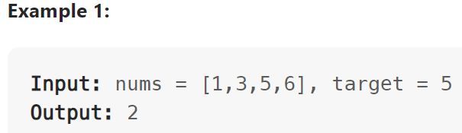
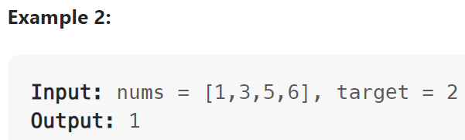
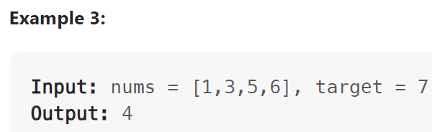
LeetCode 35. Search Insert Position
Given a sorted array of distinct integers and a target value, return the index if the target is found. If not, return the index where it would be if it were inserted in order.
You must write an algorithm with O(log n) runtime complexity.

Slide 15
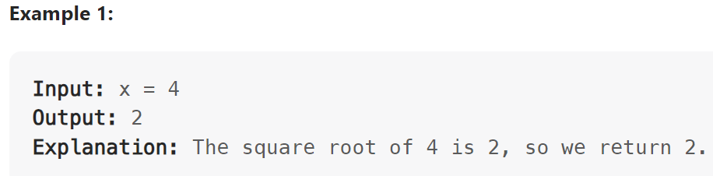
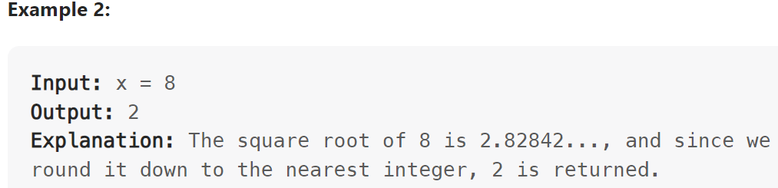
LeetCode 69. Sqrt(x)
Given a non-negative integer x, return the square root of x rounded down to the nearest integer. The returned integer should be non-negative as well.
You must not use any built-in exponent function or operator.
For example, do not use pow(x, 0.5) in c++ or x ** 0.5 in python.

Slide 16
LeetCode Problems (Binary Search)
704. Binary Search
374. Guess Number Higher or Lower
278. First Bad Version
744. Find Smallest Letter Greater Than Target
2089. Find Target Indices After Sorting Array
275. H-Index II
540. Single Element in a Sorted Array
1237. Find Positive Integer Solution for a Given Equation

Slide 17
LeetCode Problems (Binary Search)
367. Valid Perfect Square – similar to 69
74. Search a 2D Matrix
875. Koko Eating Bananas
1283. Find the Smallest Divisor Given a Threshold (similar to 875)
2064. Minimized Maximum of Products Distributed to Any Store (sim. to 875)
1011. Capacity To Ship Packages Within D Days (similar to 875)
1760. Minimum Limit of Balls in a Bag (same as 1011)
2187. Minimum Time to Complete Trips (similar to 875)
1870. Minimum Speed to Arrive on Time (similar to 875)

Slide 18
LeetCode Problems (Binary Search)
2226. Maximum Candies Allocated to K Children
1482. Minimum Number of Days to Make m Bouquets
1802. Maximum Value at a Given Index in a Bounded Array
1552. Magnetic Force Between Two Balls
1898. Maximum Number of Removable Characters
852. Peak Index in a Mountain Array
162. Find Peak Element
1095. Find in Mountain Array

Slide 19
LeetCode Problems (Binary Search)
153. Find Minimum in Rotated Sorted Array - Similar to 33
154. Find Minimum in Rotated Sorted Array II - Similar to 33
34. Find First and Last Position of Element in Sorted Array
240. Search a 2D Matrix II

Slide 20
Search Trees
If your data is dynamic and you also need to support insert & delete in addition to search while maintaining the sorted ordering of your data, you can use a search tree
Binary Search Tree (emulates binary search)
AVL Tree
2-3 Tree
Red-Black Tree
B/B+ Tree
Recall that all operations in search trees take O(logN)

Slide 21
Lower Bound of Comparison-based Search
All comparison-based search algorithms have a theoretical lower bound of Ω(logN)
This means that it is theoretically impossible to design a comparison-based search algorithm that runs faster than Ω(logN)
How to break the Ω(logN) barrier? Turn the key into an index
Interpolation search
Hash tables
Look up tables

Slide 22
Interpolation Search
What if we know that we have integer keys, and the keys in the array are uniformly distributed?
Can we make use this information to make Binary Search converge faster?
Interpolation Search (https://en.wikipedia.org/wiki/Interpolation_search)
0
1
2
3
4
5
6
7
8
9
10
11
12
13
14
15
5
10
15
20
25
30
35
40
45
50
55
60
65
70
75
80
If you are searching for 10, would you first look at the middle?
No. You know that 10 will be somewhere at the beginning
This is similar to how we would look up a word in a dictionary
Where do you expect the word “book” to be located in a dictionary?
At the beginning of course

Slide 23
Binary Search Probes
0
1
2
3
4
5
6
7
8
9
10
11
12
13
14
15
5
10
15
20
25
30
35
40
45
50
55
60
65
70
75
80
Find(10). Binary Search will probe the following cells:
Iteration 1: left=0, right=15, middle=7
Iteration 2: left=0, right=6, middle=3
Iteration 3: left=0, right=2, middle=1 → Found

Slide 24
Interpolation Search Probes
0
1
2
3
4
5
6
7
8
9
10
11
12
13
14
15
5
10
15
20
25
30
35
40
45
50
55
60
65
70
75
80
Here is how Interpolation Search computes the middle index:
left=0, right=15, key=10
middle = left+(right-left)*(key-nums[left])/(nums[right]-nums[left])
Iteration 1: middle = 0 + (15-0)*(10-5)/(80-5) = 0 + 1 = 1 → Found
You can see that we found the key in just ONE probe!
left=0, right=15, key=40
middle = 0 + (15-0)*(40-5)/(80-5) = 0 + 7 = 7 → Found
We again find the key in just ONE probe!

Slide 25
Interpolation Search: Intuition
We have right-left+1 buckets
The range of numbers is nums[right]-nums[left]
If the numbers are uniformly distributed, then each bucket should contain the range
(nums[right]-nums[left])/(right-left)
Our key should then take us to the bucket:
left + (right-left)*(key-nums[left])/(nums[right]-nums[left])
Ex: key=nums[left] → left + 0
Ex: key=nums[right] → left + (right-left)
Ex: key=(nums[right]-nums[left])/2 → left + (right-left)/2

Slide 26
Interpolation Search: Worst Case
0
1
2
3
4
5
6
7
8
9
10
11
12
13
14
15
5
10
15
20
25
30
35
40
45
50
55
60
65
70
75
5000
Worst case occurs when all numbers increase monotonically, but there is a very large number at the end as shown above
left=0, right=15, key=75
middle = left+(right-left)*(key-array[left])/(array[right]-array[left])
Iteration 1: middle = 0 + (15-0)*(75-5)/(5000-5) = 0 + 0 = 0
Iteration 2: left=1, right=15, middle=1
Iteration 3: left=2, right=15, middle=2
Iteration 4: left=3, right=15, middle=3
….
Iteration 15: left=14, right=15, middle=14 → Found

Slide 27
Interpolation Search Summary
Can quickly converge to the bucket where the key should be located if the keys are uniformly distributed
Use only if you know that the keys are somewhat uniformly distributed
Turns into linear search if the keys are skewed
Running time:
Best case: O(1)
Average case: O(loglogN)
Worst case: O(N)

Slide 28
Hash Tables
In many applications we have a dynamic data set
We would like to be able to add, remove and search an element
We don’t care if the elements are stored in sorted order inside the collection (No sorted ordering)
In such applications, it is best to use a hash table
Recall HashSet/HashMap from your DS class
All operations (insert, delete, search) take expected O(1) time

Slide 29
Look Up Table (LUT)
In some applications you have integer keys and the range of keys are limited
Keys in the range [100-5000]
In such apps, we can create a Look Up Table (LUT) and directly index the key into the LUT
Thus all operations (insert, delete, search) become perfect O(1)

Slide 30
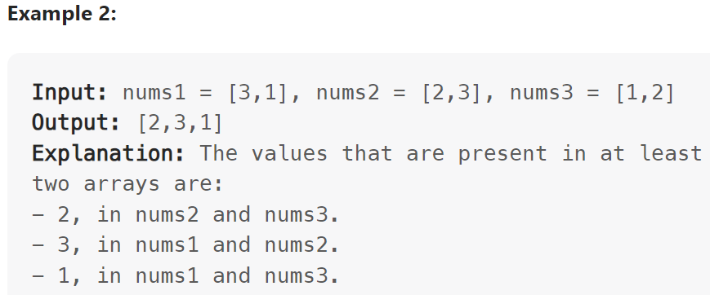
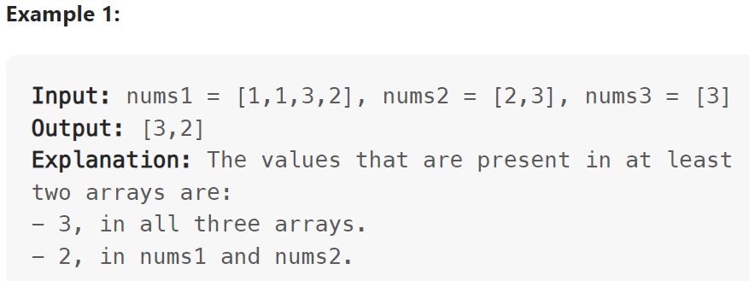
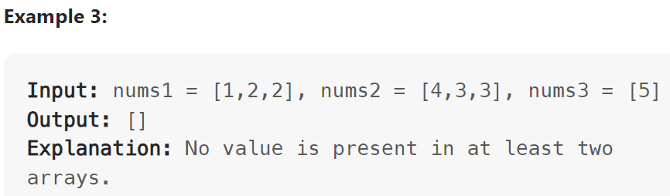
LeetCode 2032. Two Out of Three
Given three integer arrays nums1, nums2, and nums3, return a distinct array containing all the values that are present in at least two out of the three arrays. You may return the values in any order.

Slide 31
LeetCode 2032. Two Out of Three
This is essentially a search question
We take a number from nums1 and see if it exists in nums2 or nums3
Then we intersect nums2 & nums3 in a similar way
Three solutions
Brute-force linear search
Using HashSet + HashMap
Using a Look Up Table (1 <= nums1[i], nums2[j], nums3[k] <= 100)

Slide 32
Summary of Searching
Unsorted Array
Linear Search: O(N)
Sorted Array
Binary Search: O(logN)
Dynamic dataset with insert, delete & search (Sorted ordering)
Search Trees: All operations are O(logN)
Sorted array with uniformly distributed integer keys
Interpolation Search: O(loglogN)
Dynamic dataset with insert, delete & search (NO ordering)
Hash Table: All operations are expected O(1)
Integer keys with limited range (Sorted ordering)
Look Up Table (LUT): All operations are perfect O(1)

