Slide 1
Today’s Material
Divide & Conquer (Recursive) Sorting Algorithms
QuickSort
Partitioning
External Sorting

Slide 2
MergeSort Review
int MS(int A[], int left, int right){
if (left>=right) return 0;
int middle = left + (right-left)/2;
MS(A, left, middle);
MS(A, middle+1, right);
B = Merge LHS & RHS;
Copy B to A;
} //end-MS
Worst case running time: Θ(NlogN)
Stable, but NOT in-place!
Question: Can we design an in-place sorting algorithm that runs in expected O(NlogN) time?
Yes: QuickSort

Slide 3
Quicksort
Quicksort Algorithm:
Partition array into left and right sub-arrays such that: Elements in left sub-array < elements in right sub-array
Recursively sort left and right sub-arrays
Concatenate left and right sub-arrays with pivot in middle
void QS(int A[], int left, int right){
if (left >= right) return;
int index = Partition(A, left, right);
QS(A, left, index-1);
QS(A, index+1, right);
} // end-QS

Slide 4
Partition
How to Partition the Array
Choose an element from the array as the pivot
Move all elements < pivot into left sub-array and all elements >= pivot into right sub-array
Pivot?
One choice: use first element in array
A = [9, 16, 4, 15, 2, 5, 17, 1]
Suppose pivot = 9
Left subarray = 4, 2, 5, 1 (All elements < 9)
Right sub-array = 16, 15, 17 (All elements >= 9)

Slide 5
Quicksort Example
Sort the array containing:
9
16
4
15
2
5
17
1
Pivot
Partition
4 2 5 1 <
9
< 16 15 17
Partition
2 1
4
5
15
16
17
Concatenate
1
2
5
15
17
1 2
4
5
15 16 17
Concatenate
Concatenate
1 2 4 5 9 15 16 17

Slide 6
Another Quicksort Example
Sort the array containing:
81
56
71
10
63
27
81
42
14
95
38
27
10, 14, 38, 27 < 42 < 71, 95, 63, 81, 56
< 10 < 14, 38, 27
63, 56 < 71 < 81, 95
< 14 < 38, 27
56 < 63
81 < 95
27 < 38
10, 14, 27, 38, 42, 56, 63, 71, 81, 95

Slide 7
Partition 1: Partitioning with Extra Space
We can easily implement the partition function with O(N) extra space as follows
Allocate B[N]
Go over A, and copy all elements < pivot to B
Go over A, and copy all elements >= pivot to B
Copy all elements in B to A
Deallocate B

Slide 8
Partition 2: Partitioning in Place
Seems like we need an extra array for partitioning and concatenating left/right sub-arrays!
No!
We can implement the same algorithm in-place as follows
pivot=A[0]
Set pointers i and j to the beginning and the end of the array
Increment i until you hit an element A[i] > pivot
Decrement j until you hit an element A[j] < pivot
Swap A[i] and A[j]
Repeat until i and j cross (i exceeds or equals j)
Restore the pivot by swapping A[0] with A[j]

Slide 9
Partition 2: Partitioning in Place
Swap
1
9 16 4 15 2 5 17 1
Swap A[i] and A[j]
16
i
j
Swap
5
15
Swap A[i] and A[j]
9 1 4 15 2 5 17 16
i
i
j
j
Swap
9 1 4 5 2 15 17 16
Swap A[j] and pivot]
2
9
j
i
i
Partitioning Complete
2 1 4 5 9 15 17 16
<=9
>=9

Slide 10
Partition 2: Another example
9
16
3
4
15
1
10
2
5
9
12
i
j
9
9
3
4
15
1
10
2
5
16
12
i
j
9
9
3
4
5
1
10
2
15
16
12
i
j
9
9
3
4
5
1
2
10
15
16
12
j
i
2
9
3
4
5
1
9
10
15
16
12

Slide 11
Partition 2: Yet another example
9
16
2
3
4
5
6
7
8
i
j
9
8
2
3
4
5
6
7
16
j
i
7
8
2
3
4
5
6
9
16
j
i

Slide 12
Partition2
int Partition2(int A[], int left, int right){
if (left >= right) return left;
int pivot = A[left]; // Pivot is the first element
int i=left+1, j=right;
while (true){
while (A[i]<pivot && i<j) i++; // Move i
while (A[j]>pivot) j--; // Move j
// j stops over a number for which A[j] <= pivot
if (i>=j) break;
Swap(&A[i], &A[j]);
i++; j--;
} //end-while
Swap(&A[j], &A[left]); // Restore the pivot
return j; // return the index of the pivot
} //end-Partition2

Slide 13
Pivotal Role of Pivots
How do we pick the pivot for each partition?
Pivot choice can make a big difference in run time
1st Idea: Pick the first element in (sub)array as pivot
What if it is the smallest or largest?
What if the array is sorted? How many recursive calls does quicksort make?
2 4 6 8 9
2 4 6 8 9
2 4 6 8 9
2 4 6 8 9
2 4 6 8 9
Total: O(N) recursive calls!

Slide 14
Choosing the Right Pivot
2nd idea: Pick a random element
Gets rid of asymmetry in left/right sizes
But…requires calls to pseudo-random number generator – expensive
3rd idea: Pick median (N/2 largest element)
Ideal but hard to compute without sorting!
Compromise: Pick median of three elements

Slide 15
Median-of-Three Pivots
Find the median of the first, middle and last element
2 4 9 15 16
5 4 2 15 16
9
5
Takes only O(1) time
Less chance of poor performance as compared to looking at only 1 element
For sorted inputs, splits array nicely in half each recursion
Good performance

Slide 16
Partition with MedianOf3 Heuristic
42
71
10
14
95
63
38
27
81
56
Before Partition
Pivot = MedianOf3(42, 95, 56) = 56
42
71
10
14
81
63
38
27
56
95
After MedianOf3
i
j
42
27
71
10
14
81
63
38
71
27
56
95
Need to swap 71 & 27
i
j
42
27
10
14
38
81
81
63
38
71
56
95
Need to swap 81 & 38
i
j
42
27
10
14
38
56
63
63
81
71
56
95
Swap A[i]=63 & pivot=56
j
i
42
27
10
14
38
56
81
71
63
95
After Partition
<= 56
>= 56

Slide 17
MedianOf3 Algorithm
// Assumes right-left >= 2 (at least 3 elements)
int MedianOf3(int A[], int left, int right){
int center = left + (right-left)/2;
// Sort A[left], A[right], A[center]
if (A[left] > A[center]) Swap(&A[left], &A[center]);
if (A[left] > A[right]) Swap(&A[left], &A[right]);
if (A[center] > A[right]) Swap(&A[center], &A[right]);
Swap(&A[center], &A[right-1]); // Hide the pivot
return A[right-1]; // Return the pivot
} //end-MedianOf3

Slide 18
Partition 3: Partition with MedianOf3
// Assumes right-left >= 2 (at least 3 elements)
int Partition3(int A[], int left, int right){
int pivot = MedianOf3(A, left, right);
int i = left; int j = right-1;
while (true){
while (A[++i] < pivot);
while (A[--j] > pivot);
if (i >= j) break;
Swap(&A[i], &A[j]);
} //end-while
Swap(&A[i], &A[right-1]); // Restore the pivot
return i;
} //end-Partition3

Slide 19
QuickSort Performance Analysis
Best Case Performance: Algorithm always chooses best pivot and keeps splitting sub-arrays in half at each recursion
T(0) = T(1) = O(1) (constant time if 0 or 1 element)
For N > 1, 2 recursive calls + linear time for partitioning
Recurrence Relation for T(N) = 2T(N/2) + O(N)
Big-Oh function for T(N) = O(N logN)

Slide 20
QuickSort Performance Analysis
Worst Case Performance: Algorithm keeps picking the worst pivot – one sub-array empty at each recursion
T(0) = T(1) = O(1)
T(N) = T(N-1) + O(N)
T(N-2) + O(N-1) + O(N) = …
T(0) + O(1) + … + O(N)
T(N) = O(N²)
Fortunately, average case performance is O(N log N)

Slide 21
Partition 4: Predicate-based Partitioning
Sometimes we want to partition the array based on a predicate as follows:
Move all elements satisfying the predicate to the beginning of the array
Preserve the order of the elements satisfying the predicate
Move all the remaining elements that do NOT satisfy the predicate to the end of the array in any order
Return the number of elements that satisfy the predicate

Slide 22
Partition 4: Predicate-based Partitioning
Here is how we can implement this partitioning algorithm
Find the index of the first cell for which the predicate fails
Save this index
Then walk over the rest of the array to find elements for which the predicate holds, and swap this element with arr[index] & increment the index
Return the index

Slide 23
Partition 4: predicate: num < 10
9
16
3
4
15
1
10
2
5
9
12
index=First index for which predicate fails
index
9
3
16
4
15
1
10
2
5
9
12
9
3
4
16
15
1
10
2
5
9
12
9
3
4
1
15
16
10
2
5
9
12
9
3
4
1
2
16
10
15
5
9
12
9
3
4
1
2
5
10
15
16
9
12
9
3
4
1
2
5
9
15
16
10
12
Notice: order of the elements that satisfy
the predicate are preserved.
num < 10
index

Slide 24
Partition 4: predicate: num % 2 == 1
9
16
3
4
15
1
10
2
5
9
12
index=First index for which predicate fails
index
9
3
16
4
15
1
10
2
5
9
12
9
3
15
4
16
1
10
2
5
9
12
9
3
15
1
16
4
10
2
5
9
12
9
3
15
1
5
4
10
2
16
9
12
9
3
4
1
2
5
9
15
16
10
12
Notice: order of the elements that satisfy
the predicate are preserved.
num % 2 == 1
index

Slide 25
Partition 4: Partitioning in Place
This partitioning algorithm may cause up to O(n) swaps!
nums=[10, 1, 2, 3, 4, 5, 6, 7, 8, 9]
Predicate: num < 10
→ 10 has to be swapped n-1 times
If we were to employ Partion2, we could partition this array with just one swap, by swapping 10 with 9:
nums = [9, 1, 2, 3, 4, 5, 6, 7, 8, 10]
Warning: Use partition4 only if preserving the order of the elements that satisfy the predicate is important
Otherwise, use Partition2/Partition3
num < 10

Slide 26
C++ Partition function
C++ has two built-on predicate-based partition functions
stable_partition
https://en.cppreference.com/w/cpp/algorithm/stable_partition
Preserves the ordering of all elements
Uses Partition1 (extra space)
Returns an iterator that points to the first element of the vector for which the predicate fails
partition:
https://en.cppreference.com/w/cpp/algorithm/partition
Does NOT preserve the ordering of elements
Uses Partition2 to minimize the number of swaps
Returns an iterator that points to the first element of the vector for which the predicate fails

Slide 27
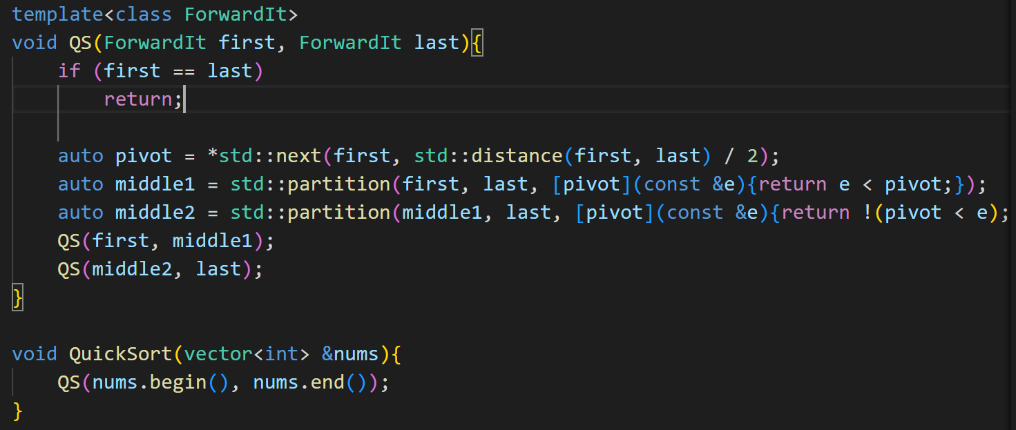
QS using C++ Partition function

Slide 28
External Sorting
What if the data to be sorted does not fit into memory?
You have a machine with 1GB memory, but have 8GB of data to be sorted stored on a disk?
We need to divide the data to several pieces, sort each piece and then merge the results
8GB unsorted data:
1GB
1GB
1GB
1GB
1GB
1GB
1GB
1GB
Sort each 1GB piece separately & store on disk
1GB sorted data:
total 8 pieces
1GB
1GB
1GB
1GB
1GB
1GB
1GB
1GB
8-Way Merging
8GB sorted data

Slide 29
Example
2, 8, 1, 20
30, 5, 7, 15
12, 4, 8, 25
18, 7, 9, 15
QSort
QSort
QSort
QSort
1, 2, 8, 20
5, 7, 15, 30
4, 8, 12, 25
7, 9, 15, 18
i
j
k
m
1, 2, 4, 5, 7, 7, 8, 8, 9, 12, 15, 15, 18, 20, 25, 30

Slide 30
External Sorting Running Time
Assume you have N bytes to sort
Further assume that your memory is M bytes
There are K = N/M pieces
Sorting 1 piece takes: MlogM
Sorting K pieces: K*MlogM
Merging K pieces: K*N
Total: O(K*MlogM + K*N) = O(NlogM + N²/M)
It is possible to perform K-way merging in N*logK time using a Priority Queue (binary heap)

Slide 31
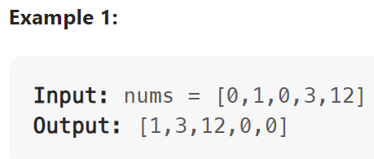
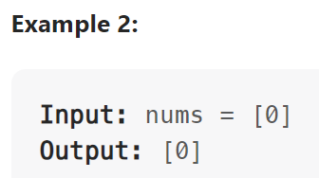
LeetCode 283. Move Zeroes (Partition)
Given an integer array nums, move all 0's to the end of it while maintaining the relative order of the non-zero elements.
Note that you must do this in-place without making a copy of the array.

Slide 32
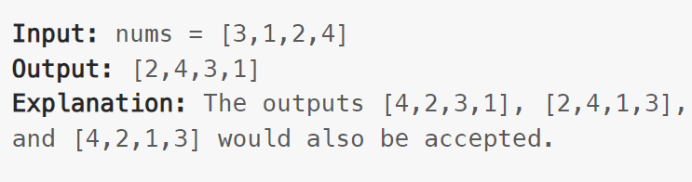
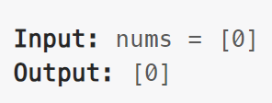
LeetCode 905. Sort Array By Parity (Partition)
Given an integer array nums, move all the even integers at the beginning of the array followed by all the odd integers.
Return any array that satisfies this condition.

Slide 33
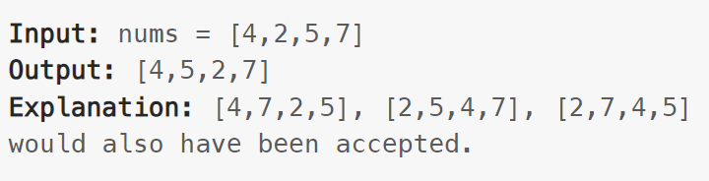
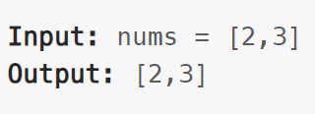
LeetCode 922. Sort Array By Parity II (Partition)
Given an array of integers nums, half of the integers in nums are odd, and the other half are even.
Sort the array so that whenever nums[i] is odd, i is odd, and whenever nums[i] is even, i is even.
Return any answer array that satisfies this condition.

