Slide 1
Today’s Material
Medians & Order Statistics

Slide 2
Selection: Problem Definition
Given a sequence of numbers a1, a2, a3, a4,…, aN and integer “k”, 0 <= k <= N-1, compute the k^{th} smallest element
A=[4, 6, 3, 1, 10, 8, 15, 9, 11]. 3rd smallest?
Sorted A=[1, 3, 4, 6, 8, 9, 10, 11, 15]
Minimum is when k = 0, Maximum is when k = N-1
Median is a special case where k = N/2
A=[1, 3, 4, 6, 8, 9, 10, 11, 15] ➔ Median: 8
B=[1, 2, 3, 4, 5, 6, 7, 8] ➔ Median: (4+5)/2=4.5

Slide 3
Brute Force Solution
There is an obvious brute-force solution
Just sort the numbers in ascending order and return the k^{th} element of the array
Takes O(nlogn)—Time to sort the numbers
Can we do better?
There is a deterministic O(n) algorithm, but it is very complicated and not very practical
However, there is a simple randomized algorithm, whose expected running time is O(n)
We will only look at this randomized algorithm--next

Slide 4
Randomized Algorithms – An Intro
A randomized algorithm is one that incorporates a random number generator
Studies in recent years because many of the practical algorithms make use of randomization
There are 2 classes of randomized algorithms
Monte Carlo Algorithms
May make an error in its output, but presumably the probability of this happening is very small
Las Vegas Algorithms
Always produces the correct answer, but there is a small probability that the algorithm takes longer than it should
With Monte Carlo algorithms randomization affects the result, with Las Vegas it affects the running time

Slide 5
A Simple Monte-Carlo Algorithm for Primality Test
Problem: Given a number N, is N prime?
Important for cryptography
Randomized Monte-Carlo Algorithm based on a result by Fermat:
Guess a random number A, 0 < A < N
If (A^{N-1} mod N) ≠ 1, then Output “N is not prime”
Otherwise, Output “N is (probably) prime”
N is prime with high probability but not 100%
Can repeat steps 1-3 to make error probability close to 0

Slide 6
A Las Vegas Randomized Selection
As we mentioned, there is an O(n) expected-case randomized Las-Vegas algorithm for Selection
Always produces the correct answer, but with low probability it might take longer than O(n)
Idea is based on a modification of QuickSort:
Consider the Partition() procedure in QuickSort with a randomly chosen pivot “x”
q = Partition(A) with pivot “x”
The array is partitioned into two halves A[0..q-1] [x] [q+1..N-1] :
All elements in A[0..q-1] <= x
A[q] = x
All elements in A[q+1..N-1] >= x
You can see that Partition performs a weak form of sorting with “x” in the middle
num<=x
num>=x

Slide 7
Randomized Partition Algorithm
int Partition(int A[], int left, int right){
if (left >= right) return left;
int randomIndex = randomNumber(left, right); // random in [left, right]
Swap(nums[left], nums[randomIndex]); // Bring the pivot to the beginning
int pivot = A[left];
int i=left+1, j=right;
while (true){
while (A[i] < pivot && i<j) i++; // Move i
while (A[j] > pivot) j--; // Move j
// j stops over a number for which A[j] <= pivot
if (i>=j) break;
Swap(&A[i], &A[j]);
i++; j--;
} //end-while
Swap(&A[j], &A[left]); // Restore the pivot
return j; // return the index of the pivot
} //end-Partition

Slide 8
A Las Vegas Randomized Selection
Assume Partition(A, left, right) returns “q”
If k==q then return A[q];
If k < q then we recurse on the left sublist, A[left..q-1], and find select the k^{th} smallest element there
If k > q then we recurse on the right sublist [q+1..right], and look for the k^{th} element there

Slide 9
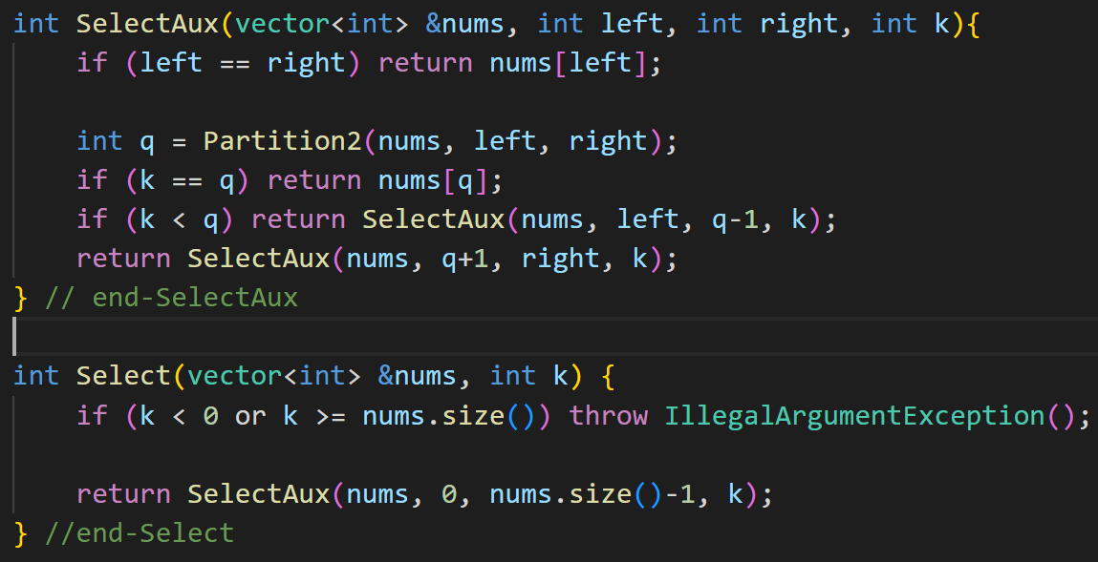
Randomized Selection

Slide 10
Running Time - 1
Because the algorithm is randomized, we analyze its “expected” time complexity
Where the expectation is taken over all possible choices of the random pivot element
Let T(n) denote the expected case running time of the algorithm on a list of size “n”
Our analysis is with respect to the worst-case in “i”
That is, since we do not know what “i” is, we make the worst case assumption that whenever we partition the list, the i^{th} smallest element occurs on the side having greater number of elements
Partitioning procedure takes O(n)

Slide 11
Running Time - 2
There are “n” possible choices for the pivot
Each is equally likely with probability 1/n
If “x” is the k^{th} smallest element of the list, then we create two sublists of size “k” and “n-k”
If we assume that we recurse on the larger side of the two sublists, then we get
T(n) <=
Basically, the recurrence can be simplified to:
T(n) <=

Slide 12
Running Time - 3
Then an induction argument is used to show that T(n) <= c*n for some appropriately chosen constant c
After working through the induction proof, we arrive at the condition
c*(3n/4 – ½) + n < c*n
This is satisfied for any c >= 4
This technique of setting up an induction with an unknown parameter, and then determining the conditions on the parameter is known as “constructive proof”

Slide 13
C++ nth_element
void nth_element(first, nth, last); // 0 <= nth < N
https://en.cppreference.com/w/cpp/algorithm/nth_element
Is a partial sorting algorithm that rearranges elements in [first, last) such that:
The element pointed at by nth is changed to whatever element would occur in that position if [first, last) were sorted
All of the elements before this new nth element are less than or equal to the elements after the new nth element

Slide 14
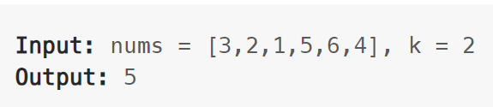
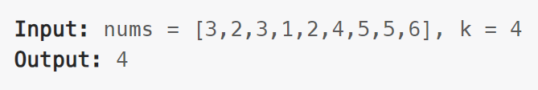
LeetCode 215. Kth Largest Element in an Array
Given an integer array nums and an integer k, return the kth largest element in the array.
Note that it is the kth largest element in the sorted order, not the kth distinct element.
Can you solve it without sorting?

Slide 15
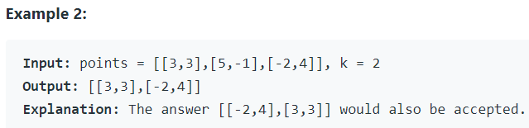
LeetCode 973. K Closest Points to Origin
Given an array of points where points[i] = [xi, yi] represents a point on the X-Y plane and an integer k, return the k closest points to the origin (0, 0).
The distance between two points on the X-Y plane is the Euclidean distance (i.e., √(x1 - x2)2 + (y1 - y2)2).
You may return the answer in any order. The answer is guaranteed to be unique (except for the order that it is in).
2 Solutions:
O(nlogn) using sorting, Efficient: O(n) using QuickSelect

Slide 16
LeetCode Problems
215. Kth Largest Element in an Array
973. K Closest Points to Origin
347. Top K Frequent Elements
347. Top K Frequent Elements
1985. Find the Kth Largest Integer in the Array
2611. Mice and Cheese
2583. Kth Largest Sum in a Binary Tree

