Slide 1
Today’s Material
Binary Heap
Definition
Operations: top(), pop(), push(), makeHeap()
HeapSort
Priority Queue ADT
Definition
Heap-based implementation
C++ priority_queue class

Slide 2
Binary Heap
A binary heap is a binary tree that is:
1. Complete: the tree is completely filled except possibly the bottom level, which is filled from left to right
2. Satisfies the heap property: The key stored in every node is smaller than (or equal to) the keys stored in its children
Therefore, the root node always contains the smallest key in a heap (assuming this is a min-heap)
2
-2
1
Which of these is not a heap?
6
4
0
1
2
6
8
7
0
3
4
5

Slide 3
Array Implementation of Binary Heaps
Since binary heaps are complete binary trees, we can avoid pointers and use an array as follows:
0
H:
2
4
6
7
6
2
1
2
0
1
2
3
4
5
6
7
4
6
3
4
N = 5
7
6
Root node = H[0]
Children of H[i] -> H[2i+1], H[2i+2]
Parent of H[i] -> H[(i-1)/2]
Keep track of current size N (number of elements)

Slide 4
Heap operations: top()
top():
Easy! Return root value H[0]
Running time = O(1)
2
4
3
7
5
8
9
11
9
6
10

Slide 5
Heap operations: pop() – First Try
pop():
Delete (and return) value at root node
We now have a “Hole” at the root
Need to fill the hole with another value
Replace with smallest child?
Try replacing 2 with smallest child and that node with its smallest child, and so on…what happens?
The heap property is still satisfied in the final tree, i.e., the key stored in every node is smaller than the keys stored in its children
BUT, the resulting tree is NOT a complete binary tree!
2
4
3
7
5
8
9
11
9
6
10
After pop()
3
4
8
7
5
9
11
9
6
10

Slide 6
Heap operations: pop() – Second Try
pop:
Delete (and return) value at root node
We now have a “Hole” at the root
Need to fill the hole with another value
Since heap is smaller by one node, we need to empty the last slot
Steps:
Move last item to top; decrease size by 1
Push down the top item to its correct position in the heap
2
4
3
7
5
8
9
11
9
6
10
N = 11
2
4
3
7
5
8
9
11
9
6
10

Slide 7
pushdown()
10
3
3
4
3
4
10
4
8
7
5
8
9
7
5
8
9
7
5
10
9
11
9
6
11
9
6
11
9
6
Keep comparing with children H[2i+1] and H[2i+2]
Replace with smaller child and go down one level
Done if
both children are >= item or
reached a leaf node
What is the running time?

Slide 8
Running time analysis of pop/pushDown
Running time is O(height of tree)
What is the height of a complete binary tree of N nodes?
O(log2(N))

Slide 9
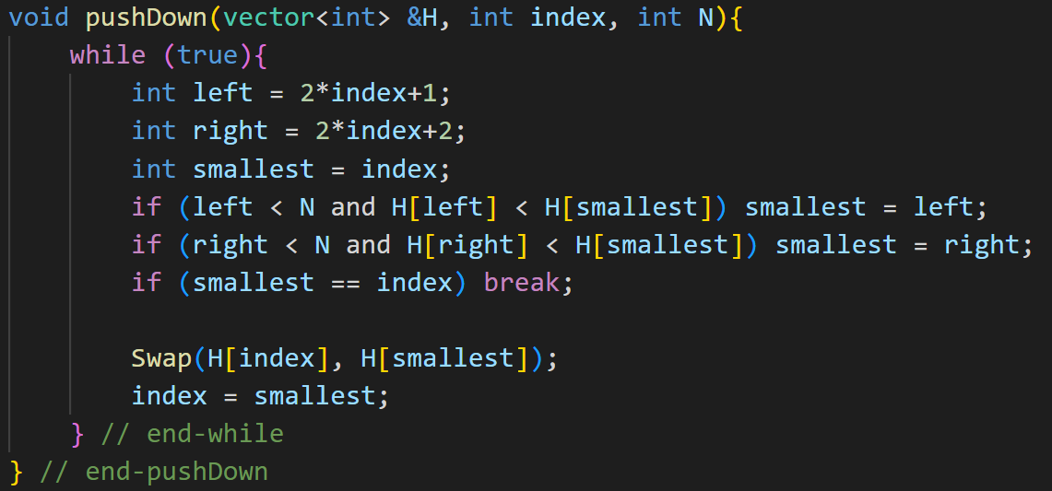
pushDown()

Slide 10
Heap operations: push(int num)
2
4
3
7
5
8
9
11
9
6
N = 11
2
4
3
7
5
8
9
11
9
6
How would we insert a key, say 1, to this min-heap?

Slide 11
Heap operations: push(int num)
2
4
3
7
5
8
9
11
9
6
1
N = 12
2
4
3
7
5
8
9
11
9
6
1
Insert the new element in the last location
Increase the size of the heap by 1
This preserves the complete tree property
Now, push the key up to restore the heap property

Slide 12
Heap operations: push(int num)
After 2 steps
2
2
1
4
3
4
3
2
3
7
5
8
9
7
1
8
9
7
4
8
9
11
9
6
1
11
9
6
5
11
9
6
5
Insert at last node and keep comparing with parent H[(i-1)/2]
If parent is larger, replace with parent and go up one level
Done if
Key of the parent <= item or
Reached top node H[0]
Running time?
O(height of tree) = O(log2(N))

Slide 13
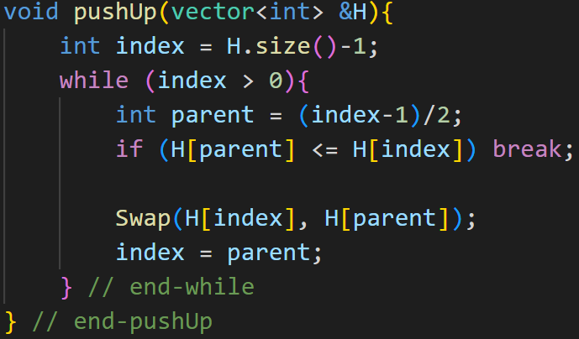
pushUp()

Slide 14
Running Times of Heap Operations
Operation
top
push
pop
Running Time
O(1)
O(logN)
O(logN)

Slide 15
Another Operation: makeHeap()
Say you are given a list of N elements
E.g., 20, 6, 3, 10, 16, 2, 10, 14, 8, 7
What’s the best way to convert this list into a min-heap?
This operation is called makeHeap() or buildHeap()
Here is one solution (top-down heap build):
Start with an empty heap
Insert each element one-by-one
Running time?
N push operations = O(NlogN)
Can we do better?

Slide 16
Building a Heap Bottom Up
Treat input array as a heap and fix it using pushDown
for i = N/2 to 1 do
pushDown(i) // Push the parent key down if necessary
Why N/2?
Nodes after N/2 are leaves!
The above algorithm builds a heap in O(N) time!

Slide 17
Building a Heap Bottom Up: Example
0
20
20
20
1
2
6
3
6
3
6
3
3
4
5
6
10
16
2
10
10
7
2
10
8
7
2
10
14
8
7
14
8
16
14
10
16
7
8
9
2
2
20
20
6
3
6
20
6
2
6
2
8
7
20
10
8
7
3
10
8
7
3
10
8
7
3
10
14
10
16
14
10
16
14
10
16
14
10
16

Slide 18
Running Times of Heap Operations
Operation
top
push
pop
makeHeap
Running Time
O(1)
O(logN)
O(logN)
O(N)

Slide 19
Using a Heap for Sorting
Main Idea:
Build a max-heap
Do N pop() operation and store each max element in the unused end of array
8
9
Build Max-Heap
2
9
5
8
4
5
4
2
DeleteMax
Initial Array
DeleteMax
5
8
8
2
9
4
5
4
2
5
2
Build Heap
8
9
4
9
9
5
8
4
2
DeleteMax
8
5
2
4
9
Largest element in correct place after 1st pop()

Slide 20
Heapsort Analysis
Heapsort is in-place…is it also stable?
Not stable!
Running time?
Time needed for building max-heap + time for N pop() operations =
= O(N) + O(N LogN) = O(N LogN)
Can also show that running time is (N log N) for some inputs, so worst case is (N log N)

Slide 21
Priority Queue ADT
A priority queue is an ADT (container) that organizes its elements according to their priorities, and always returns the element with the highest priority, i.e., the element having the smallest value or the largest value
pop()
pop()
pop()
5
5
5
3
3
5
3
3
9
9
9
1
9
5
7
5
7
5
7
7
2
2
5
2
2
2

Slide 22
Using a Binary Heap to implement the PQ ADT
We can use a binary heap to implement the PQ ADT operations
Simply store the PQ elements in a binary heap as shown below
Min-Heap
Min-PQ
2
8
11
4
3
6
10
9
7
5
8
9
2
4
5
11
9
Min-Heap
7
3
6
10
2
9
5
3
8
6
4
10
11
9
7
9

Slide 23
C++ priority_queue class
void main(){
// Create an empty max-heap
priority_queue<int> Q;
Q.push(1); // 1
Q.push(5); // 5, 1
Q.push(3); // 5, 1, 3
Q.top(); // Returns 5 (does not remove)
Q.pop(); // 3, 1
Q.top(); // Returns 3 (does not remove)
Q.size(); // Returns 2
Q.empty(); // Returns false
Q.pop(); // 1
Q.pop(); //
Q.empty(); // Returns true
}/* end-main */

Slide 24
LeetCode Problems
2530. Maximal Score After Applying K Operations
2558. Take Gifts From the Richest Pile
1962. Remove Stones to Minimize the Total
347. Top K Frequent Elements
23. Merge k Sorted Lists
973. K Closest Points to Origin
347. Top K Frequent Elements
1792. Maximum Average Pass Ratio

Slide 25
LeetCode Problems
1648. Sell Diminishing-Valued Colored Balls
767. Reorganize String
2208. Minimum Operations to Halve Array Sum
1405. Longest Happy String
1046. Last Stone Weight
1054. Distant Barcodes
1801. Number of Orders in the Backlog
1642. Furthest Building You Can Reach
373. Find K Pairs with Smallest Sums

Slide 26
LeetCode Problems
2233. Maximum Product After K Increments
1882. Process Tasks Using Servers
2462. Total Cost to Hire K Workers
1942. The Number of the Smallest Unoccupied Chair
264. Ugly Number II
313. Super Ugly Number
1781. Sum of Beauty of All Substrings

Slide 27
LeetCode Problems
1094. Car Pooling
1834. Single-Threaded CPU
2251. Number of Flowers in Full Bloom
407. Trapping Rain Water II
2034. Stock Price Fluctuation
2163. Minimum Difference in Sums After Removal of Elements

