Slide 1
Today’s Material
Introduction 2 Dynamic Programming
What is it?
How is it done?
Top down DP (Memoization)
Bottom up DP
Example Problems
Fibonacci Numbers
Least Cost Path Problem

Slide 2
Dynamic Programming (Motivation)
Recall the divide & conquer strategy
P
P1
P2
Pn
.........................
P11
P12
...
P1n
P21
P22
P2n
Pn1
Pn2
Pnn
...
...
................................................................................................................................................
Base
Cases
P
P
P
P
P
P
P
P
P
...................
P
P
P
It occurs that in many divide & conquer formulations, there is often an overlap between sub-problems
E.g., P1n, P22 and Pn1 are all the same sub-problem

Slide 3
Dynamic Programming (Motivation)
There is an overlap between sub-problems, BUT
the simple recursive implementation solves the same problem over and over again, resulting in an extremely large running time
In such problems, it is usually the case that you indeed have a polynomial number of distinct sub-problems
But since the recursion solves the same sub-problem over and over again, the total number of recursions becomes exponential

Slide 4
What is Dynamic Programming
The idea with dynamic programming is simple:
Instead of solving the same sub-problem repeatedly, solve it once, and store the result to this problem in a table
The next time we encounter the same sub-problem, we do not solve it again, but take the result to this problem from the table
Thus we solve each distinct sub-problem once
Since the total number of distinct sub-problems is polynomial, we get a polynomial time algorithm
Notice that this is another example where we use more memory to reduce the running time (time-vs-space tradeoff)

Slide 5
Ex: Fibonacci Numbers
Fibonacci numbers are formulated recursively as follows
F(0) = 0
F(1) = 1
F(n) = F(n-1) + F(n-2)
Here is a simple recursive implementation:
int F(int n){
if (n == 0) return 0;
if (n == 1) return 1;
return F(n-1) + F(n-2);
} // end-F

Slide 6
Recursion Tree for F(6)
F(6)
F(5)
F(4)
F(4)
F(3)
F(3)
F(2)
F(3)
F(2)
F(2)
F(1)
F(2)
F(1)
F(1)
F(0)
F(2)
F(1)
F(1)
F(0)
F(1)
F(0)
F(1)
F(0)
F(1)
F(0)
Running time T(n) = ~O(2^{n})

Slide 7
Fibonacci Numbers
Although we have an exponential running time, notice that there are only “n” distinct sub-problems that need to be solved
To get the solution for F(n), we need the solutions for
F(n-1), F(n-2), F(n-3), …, F(1), F(0)
But the naïve recursive implementation solves the same sub-problems over and over again, which results in an exponential running time
In fact, we should be able to solve this problem in O(n) time by solving each sub-problem once

Slide 8
Dynamic Programming Implementation
How can we apply dynamic programming to this problem?
As we said before, the first time we encounter a sub-problem, we solve it and store the result to this sub-problem in a TABLE
The next time we encounter the same sub-problem, we do not re-solve it again
Since we already have the solution stored in the TABLE, we simply retrieve the solution from the table, and be done with this sub-problem

Slide 9
Top Down DP (Memoization)
We can implement this logic in two different ways
Top-down DP (a.k.a. memoization): The idea is to take the naïve recursive implementation, and change it
Before making a recursive call for a sub-problem, we check if we already have the solution for this sub-problem in the solution TABLE
If we do, we simply take the solution from the table, thus short-circuiting the recursion
If we not have the solution to this sub-problem yet, we make the recursive-call, which returns the solution, and then store the returned solution in the TABLE

Slide 10
Fibonacci: Top Down DP for F(6)
F(6)
F(5)
F(4)
F(4)
F(3)
int F(int n){
if (T[n] >= 0) return T[n];
return T[n] = F(n-1) + F(n-2);
} // end-F
F(3)
F(2)
F(2)
F(1)
T
0
1
-1
-1
-1
-1
-1
F(1)
F(0)
0
1
2
3
4
5
6

Slide 11
Bottom Up DP
The idea is to start with the solutions to the base-problems and store them in the table
Then we start filling up the solution table from ground-up, until we reach the root of the recursion tree
We then return the solution to the given problem from the solution table
Bottom up DP formulations lend themselves to an iterative implementation

Slide 12
Fibonacci: Bottom Up DP1
T
0
1
-
-
-
-
-
0
1
2
3
4
5
6
BottomUpDP(int n){
T[0] = 0;
T[1] = 1;
for (int i = 2; i <= n; i++) {
T[i] = T[i - 1] + T[i - 2];
} //end-for
int result = T[n];
} //end-BottomUpDP

Slide 13
Fibonacci: Bottom Up DP - Saving Space
Notice one thing in the previous implementation
At the time we want to compute F(n), we only need the solutions to
F(n-1) and F(n-2)
We don’t really care if we still have the solutions to
F(0), F(1), .., F(n-3)
This means that we do not have to store the solutions to these sub-problems anymore. We only need to store the solutions to the last two sub-problems
Therefore, instead of using O(n) amount of extra space to store the solutions to ALL sub-problems, we can just use two local variables to store the solutions to the last two sub-problems. This would be enough to solve this problem.

Slide 14
Fibonacci: Bottom Up DP2
BottomUpDP2(int n){
a = 0; // Represents the solution to F(n-2)
b = 1; // Represents the solution to F(n-1)
int result; // Represents the solution to F(n)
for (int i = 2; i <= n; i++) {
result = b + a; // F(n) = F(n-1) + F(n-2)
// Change a & b for the next iteration
a = b; // a = F(n-1)
b = result; // b = F(n)
} //end-for
return result;
} //end-BottomUpDP2
a
0
b
1
result
-
2
i

Slide 15
Designing DP Algorithms
Dynamic Programming is NOT always applicable
There are two elements that a problem must have in order for DP to be applicable
Polynomial Number of distinct Sub-problems
The total number of sub-problems to be solved must be at most a polynomial number
Optimal Substructure (Principle of Optimality)
This states that for the global problem to be solved optimally, each sub-problem must also be solved optimally
Not all optimization problems satisfy this property

Slide 16
Principle of Optimality (1)
Consider the problem of computing the shortest simple path from a--> b
a
c
b
must be the
shortest path
must be the
shortest path
So the shortest-path problem satisfies the principle of optimality

Slide 17
Principle of Optimality (2)
Consider the computing the longest simple path from a--> b
a
c
b
does not have to be
the longest path
does not have to be
the longest path
a
b
The longest path from a->b: a->c->d->b
BUT
The longest path from a->c: a->b->d->c
c
d
The longest path problem does NOT satisfy the
principle of optimality

Slide 18
Designing DP Algorithms
Here is how you design a DP algorithm:
Recursive Formulation (Substructure)
Decompose your problem into smaller sub-problems
Express the solution to the original problem in terms of solutions to the sub-problems
Table Structure
Store solutions to sub-problems in a table
This is done because solutions to sub-problems are re-used many times
Bottom-Up Computation
Combine solutions to smaller sub-problems to get the solution to the larger problems

Slide 19
Least Cost Path Problem
S | 1 | 5
2 | 4 | 2
1 | 3 | G
You are given a NxN matrix with each slot containing a number indicating the cost of going through that slot
Initially you are at (0, 0)
You are only allowed to go Down or Right
You want to go to (N-1, N-1)
Find the path that has the minimum total cost

Slide 20
The Entire Recursion Tree
S | 1 | 5
2 | 4 | 2
1 | 3 | G
(0, 0)
Down
Right
(1, 0)
(0, 1)
(2, 0)
(1, 1)
(1, 1)
(0, 2)
(2, 1)
(2, 1)
(1, 2)
(2, 1)
(1, 2)
(1, 2)
(2, 2)
(2, 2)
(2, 2)
(2, 2)
(2, 2)
(2, 2)
The greedy algorithm takes the red path
The optimal solution is the blue path

Slide 21
LCP: Recursive Formulation
0 if i=N-1 && j=N-1
T[i][j] =
min(T[i+1][j], T[i][j+1]) + grid[i][j] otherwise
Path through
the down slot
Path through
the right slot
(i, j)
(i, j+1)
(i+1, j)

Slide 22
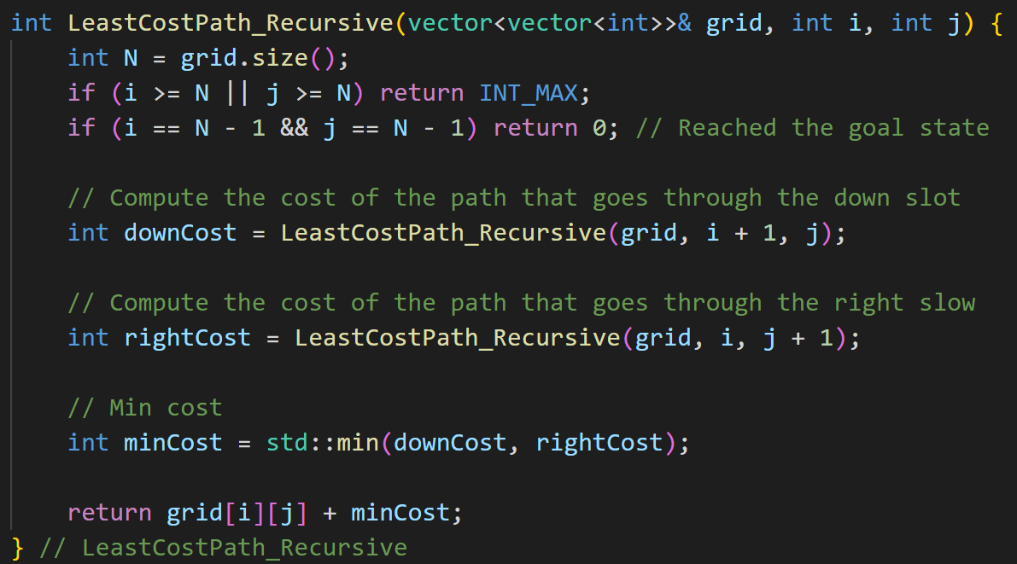
LCP: Recursive Algorithm

Slide 23
LCP: A DP Solution?
Down
(0, 0)
Right
(1, 0)
(0, 1)
(2, 0)
(1, 1)
(1, 1)
(0, 2)
(2, 1)
(2, 1)
(1, 2)
(2, 1)
(1, 2)
(1, 2)
(2, 2)
(2, 2)
(2, 2)
(2, 2)
(2, 2)
(2, 2)
Notice that we only have NxN=N² distinct sub-problems

Slide 24
LCP: A Top Down DP Solution
Down
(0, 0)
Right
(1, 0)
(0, 1)
(2, 0)
(1, 1)
(1, 1)
(0, 2)
(2, 1)
(2, 1)
(1, 2)
(1, 2)
(2, 2)
(2, 2)
Notice that we only have NxN=N² distinct sub-problems

Slide 25
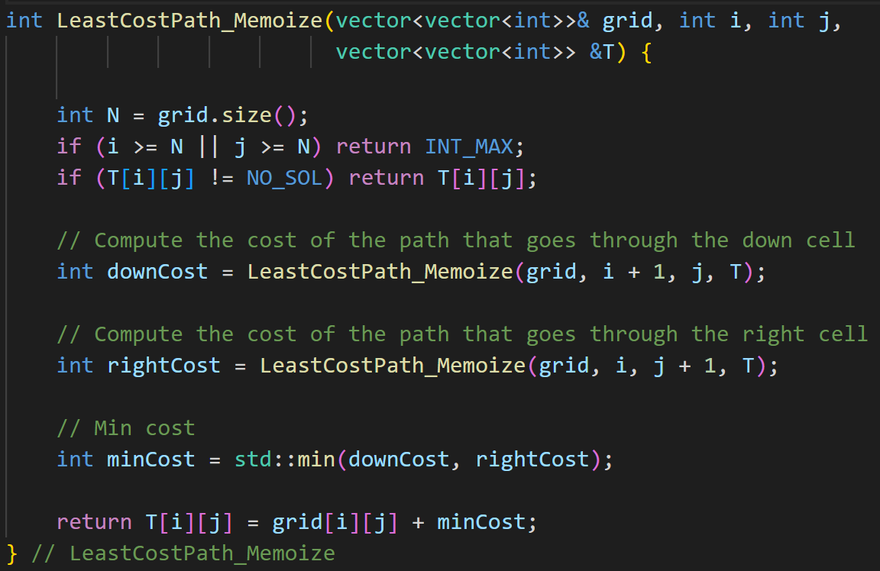
LCP: A Top Down DP Solution

Slide 26
LCP: Bottom Up DP Formulation
It is possible to fill-up the solution table iteratively in a bottom-up manner as follows
We need to fill up the table bottom-up, starting from T[N-1][N-1] working up towards T[0][0]
The final result will be in T[0][0]
{0 if i=N-1 and j=N-1
T[i][j] ={grid[i][j] + T[i][j+1] if i == N-1 (last row)
{grid[i][j] + T[i+1][j] if j == N-1 (last column)
{grid[i][j] + min{T[i+1][j], T[i][j+1]} if i<N-1 and j<N-1

Slide 27
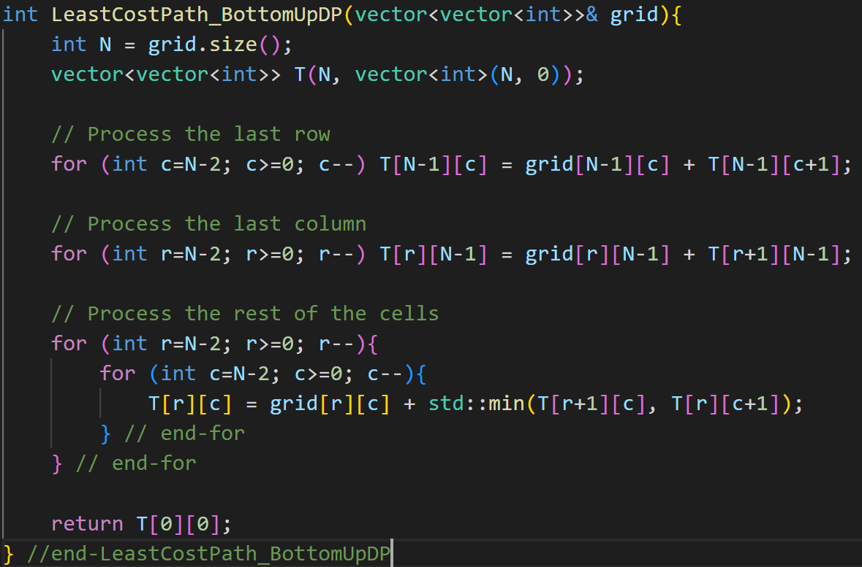
LCP: Bottom Up DP Algorithm

Slide 28
LCP: Computing the actual path
In our DP implementation so far, we only computed the cost of the path
How can we change this to also compute the actual matrix locations on the minimum cost path?
The idea is to maintain another table dir[i][j] that tells us where to go from (i, j). We can either go
DOWN to (i+1, j)
RIGHT to (i, j+1)

Slide 29
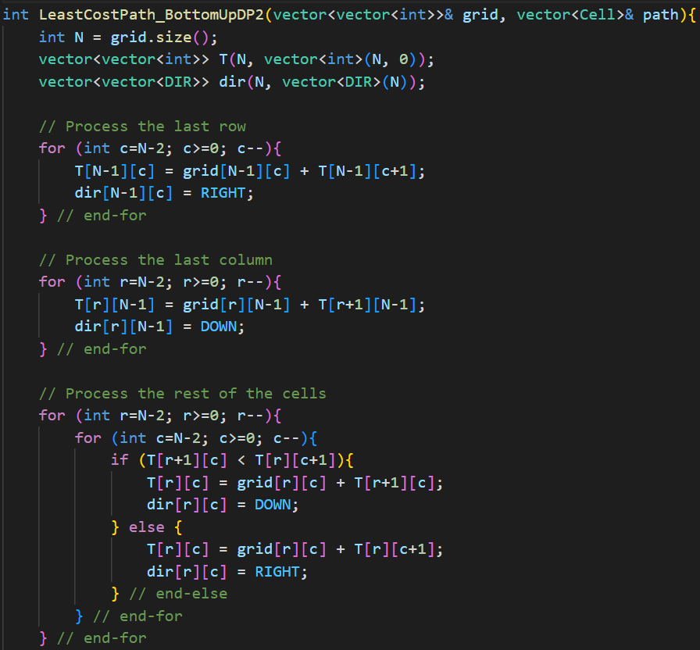
LCP: Computing the actual path

Slide 30
LeetCode Problems
509. Fibonacci Number
1137. N-th Tribonacci Number
70. Climbing Stairs
397. Integer Replacement
1025. Divisor Game
375. Guess Number Higher or Lower II

