Slide 1
Today’s Material
0-1 Knapsack Problem
Problem Definition
Fractional Knapsack Problem & Greedy solution
Brute-force Recursive Solution
Top-Down DP solution
Bottom-Up DP solution
Finding the selected items

Slide 2
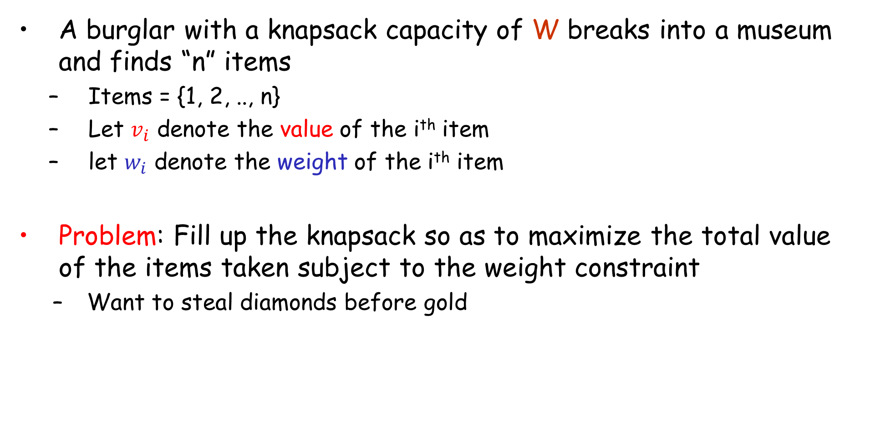
0-1 Knapsack Problem
A burglar with a knapsack capacity of W breaks into a museum and finds “n” items
Items = {1, 2, .., n}
Let $v_{i}$ denote the value of the i^{th} item
let $w_{i}$ denote the weight of the i^{th} item
Problem: Fill up the knapsack so as to maximize the total value of the items taken subject to the weight constraint
Want to steal diamonds before gold

Slide 3

0-1 Knapsack: Formal Definition
Given
v = <$v_{1}$, $v_{2}$, …, $v_{n}$>
w = <$w_{1}$, $w_{2}$, …, $w_{n}$>
Knapsack capacity W > 0
Determine the subset S (of objects to “take”) that maximizes the value
$$\sum_{i}^{S}{v_{i}}$$
subject to the constraint
$$\sum_{i}^{S}{w_{i}≤W}$$

Slide 4
0-1 Knapsack vs. Fractional Knapsack
The knapsack problem has two versions:
0-1 Knapsack: The burglar cannot take a fraction of an object
S/he can either take the entire object (1) or leave it behind (0)
Fractional Knapsack: The burglar can take a fraction of an object for a fraction of its value and weight
This version of the problem has a simple greedy solution

Slide 5
0-1 Knapsack: Examples
I = {i1, i2, i3, i4, i5} // Items
v = {30, 20, 100, 90, 160} // value
w = {5, 10, 20, 30, 40} // weight
W = 60 // Knapsack capacity
S1 = {i2, i3, i4}.
Total Weight: 10+20+30 = 60 <= W
Total Value: 20+100+90 = 210
S2 = {i1, i3, i4}.
Total Weight: 5+20+30 = 55 <= W
Total Value: 30+100+90 = 220

Slide 6
0-1 Knapsack: Examples (cont.)
n = 5 items
I = {i1, i2, i3, i4, i5} // Items
v = {30, 20, 100, 90, 160} // Value
w = {5, 10, 20, 30, 40} // Weight
W = 60 // Knapsack capacity
S3 = {i3, i5}.
Total Weight: 20+40 = 60 <= W
Total Value: 100 + 160= 260
This is in fact the optimal solution

Slide 7
Knapsack: Greedy Algorithm
Let’s design a greedy algorithm for the Knapsack prob.
The greedy thing to do will be:
compute the gain per unit of weight (vi/wi) for each item “i”
fill in the knapsack starting with the item having the highest gain
continue this way until the knapsack is filled

Slide 8
Fractional Knapsack: Greedy Algorithm
60
60
35
--
40
40
$140
30
20
20
$100
10
5
5
$30
$20
$100
$90
$160
-----
Knapsack
$30
$270
Gain
6.0 2.0 5.0 3.0 4.0
Greedy solution to
Fractional problem

Slide 9
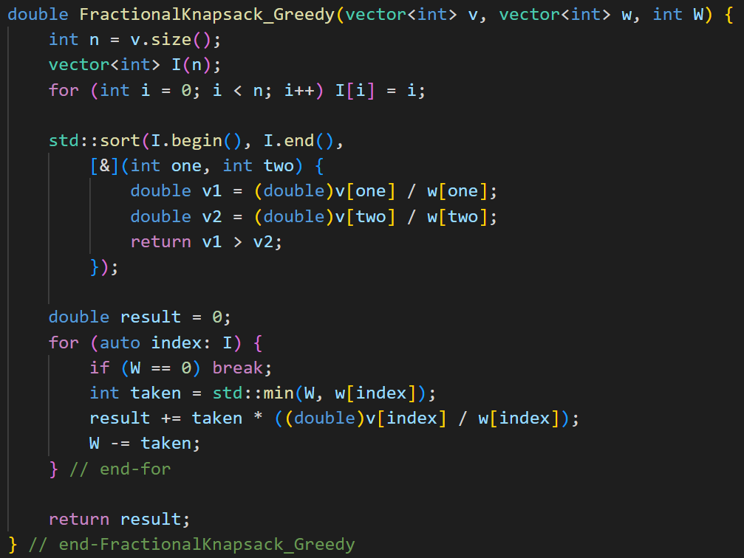
Fractional Knapsack: Greedy Algorithm

Slide 10
0-1 Knapsack: Greedy Algorithm
60
60
60
60
35
--
40
40
30
40
$140
$90
$160
30
20
20
20
20
$100
$100
$100
10
5
5
$30
5
$30
$20
$100
$90
$160
-----
-----
-----
Knapsack
$30
$270
$220
$260
Gain
6.0 2.0 5.0 3.0 4.0
Greedy solution to
Fractional problem
Greedy solution to
0-1 problem
Optimal solution to
0-1 problem

Slide 11
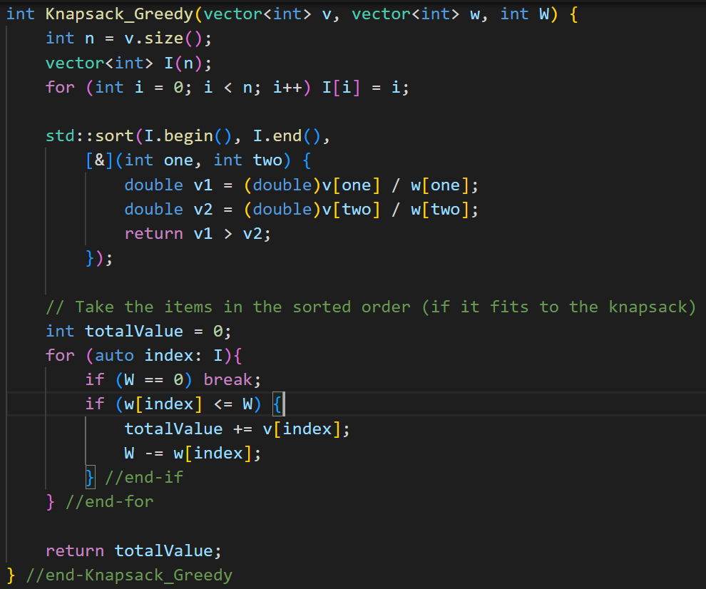
0-1 Knapsack: Greedy Algorithm

Slide 12
0-1 Knapsack: Recursive Formulation of the Problem
How about a divide & conquer strategy?
Items= {1, 2, 3, …, n-1, n}, S={}, W
Take the last item “n”
Leave the last item “n”
Items= {1, 2, 3, …, n-1},
S={v[n]}, W- w[n]
Items= {1, 2, 3, …, n-1},
S={}, W

Slide 13
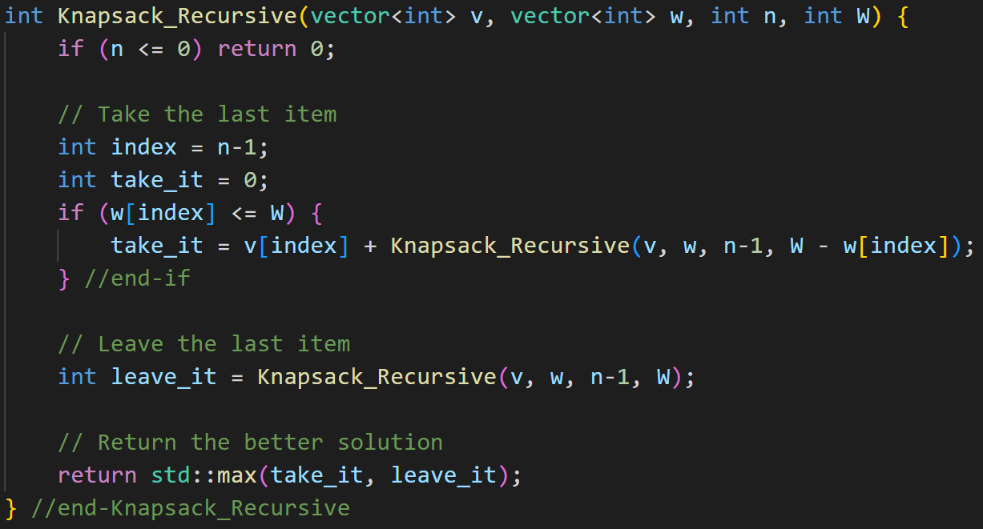
0-1 Knapsack: Recursive Algorithm
T(n) = T(n-1)+T(n-1)+1 = O(2^{n})

Slide 14
0-1 Knapsack: Top Down DP Solution
How to store solutions to subproblems?
Construct an array T[0..n+1][0..W+1]
For 0 <= i <= n, 0 <= j <= W, T[i][j] will store:
the maximum value of any subset of objects {1, 2, .., i} that can fit into a knapsack of capacity “j”
Finally, T[n][W] will contain the overall solution
How many different sub-problems do we have?
nxW

Slide 15
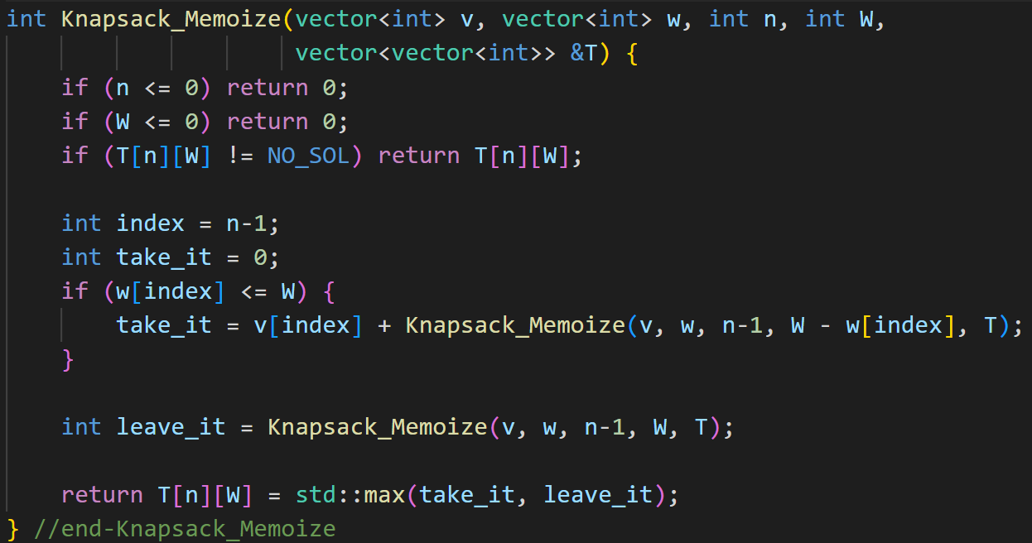
0-1 Knapsack: Top Down DP Algorithm

Slide 16
0-1 Knapsack: Bottom Up DP Formulation
It is possible to fill-up the solution table iteratively in a bottom-up manner as follows
When there are no items, the total value is 0 (Base Case)
When i^{th} item does NOT fit into the knapsack, the total value is T[i-1][j]
When i^{th} item fits into the knapsack, we take the maximum value of when we leave the i^{th} item or take it
{0 if i=0 and 0 <= j<= W
T[i][j] ={T[i-1][j] if wi > j
{max{T[i-1][j], vi+T[i-1][j-wi]} if wi<=j

Slide 17
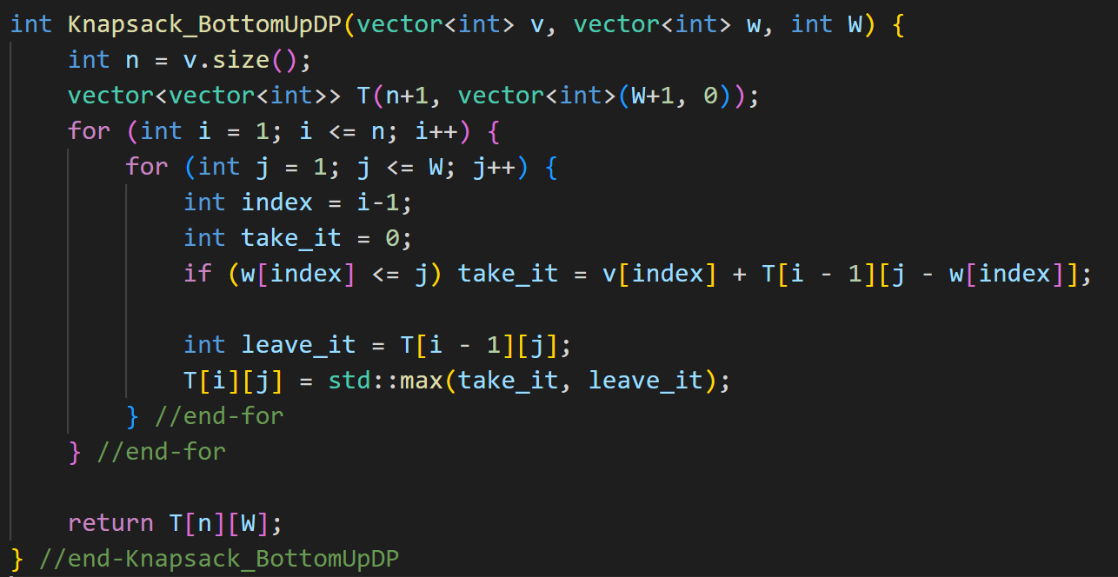
0-1 Knapsack: Bottom Up DP Algorithm

Slide 18
0-1 Knapsack: Bottom Up DP Example
Values of the objects are <10, 40, 30, 50>
Weights of the objects are <5, 4, 6, 3>
The capacity of the knapsack, W = 10
Capacity→
J = 0
1
2
3
4
5
6
7
8
9
10
Item
Value
Weight
0
0
0
0
0
0
0
0
0
0
0
1
10
5
0
0
0
0
0
10
10
10
10
10
10
2
40
4
0
0
0
0
40
40
40
40
40
50
50
3
30
6
0
0
0
0
40
40
40
40
40
50
70
4
50
3
0
0
0
50
50
50
50
90
90
90
90
Final result is T[4][10] = 90 (for taking items 2 and 4)

Slide 19
0-1 Knapsack: Finding the Selected Items
We will record each decision to take or leave an item in a table
take[i][j] = true (if item “i” is taken), false otherwise
Values of the objects are <10, 40, 30, 50>
Weights of the objects are <5, 4, 6, 3>
The capacity of the knapsack, W = 10
Capacity→
J = 0
1
2
3
4
5
6
7
8
9
10
Item
Value
Weight
-
-
-
-
-
-
-
-
-
-
-
1
10
5
-
-
-
-
-
T
T
T
T
T
T
2
40
4
-
-
-
-
T
T
T
T
T
T
T
3
30
6
-
-
-
-
-
-
-
-
-
-
T
4
50
3
-
-
-
T
T
T
T
T
T
T
T
Take items 4 and 2

Slide 20
0-1 Knapsack: Bottom Up DP - Saving Memory (1)
Capacity
Row 0
Row 1
Items
Row ..
Row i-1
Row i
Bottom-up DP fills the solution table row-by-row
When we are filling “Row i”, we ONLY need “Row i-1” results
This means that at any time during computation, we only need the results for the current row, and the results for the last row
Thus, we can reduce our space requirement to O(W) by just maintaining the results for two rows only
Can throw away the results for the other rows

Slide 21
0-1 Knapsack: Bottom Up DP - Saving Memory (2)
Capacity
Row i-1
Row i
Fill “Row i” in the backward direction
In fact, there is even a clever trick that let us to compute the result by maintaining only a single row of results
Instead of filling “Row i” in the forward direction as we did before, we will fill “Row i” in the backward direction
Notice that when we fill the last cell of “Row i”, we can directly save this result on top of “Row i-1” because we will NOT need the last cell of “Row i-1” ever again while computing the results for other cells of “Row i”
Thus, we can work with one buffer of length W to perform the entire computation

Slide 22
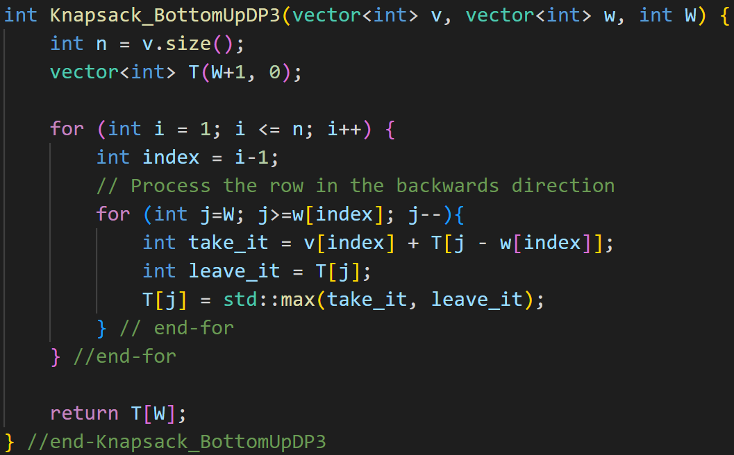
0-1 Knapsack: Bottom Up DP - Saving Memory (3)

Slide 23
Knapsack Problem Summary
Fractional Knapsack can optimally be solved using a greedy algo.
Takes O(NlogN), where N is the number of items
0-1 Knapsack is a difficult problem to solve
Greedy algorithm does NOT always give the optimal solution
Brute-force recursive solution takes O(2^{n}) time
Basically boils down to enumerating all subsets and taking the one that fits into the knapsack and has the maximum value
If the weights of the items are integers and are confined into a small range of values, then we can employ DP to solve the problem in O(NxW) time, where W is the knapsack capacity
General 0-1 Knapsack is a NP-Hard problem

Slide 24
LeetCode Problems
416. Partition Equal Subset Sum
1049. Last Stone Weight II
Reduced to Subset Sum

