Slide 1
Today’s Material
Longest Common Subsequence
Problem definition
Brute-force Recursive Solution
Top-Down DP Solution
Bottom-Up DP Solution
Extracting the actual sequence

Slide 2
Longest Common Subsequence (LCS)
Definition: Given a string X=<x1, x2, .., xm>
Z is a subsequence of X if there is a strictly increasing sequence of k indices <i1,i2,i3, …ik> (1<=i1<i2<i3<…<ik<=m) such that Z = <Xi1,Xi2,Xi3,…,Xik>
subsequence vs substring, which is a contiguous sequence of chars
X:
A
B
R
A
C
A
D
A
B
R
A
Z:
A
A
D
A
A
X:
A
B
R
A
C
A
D
A
B
R
A
Z:
R
A
C
D
B
R

Slide 3
Longest Common Subsequence (LCS)
Given two sequences X and Y, the LCS of X and Y is the longest sequence Z, which is both a sub-sequence of X and Y
X:
A
B
R
A
C
A
D
A
B
R
A
LCS:
A
B
A
D
A
B
A
Y:
Y
A
B
B
A
D
A
B
B
A
D
O
O

Slide 4
Longest Common Subsequence (LCS)
LCS does not have to be unique, but the maximum length is unique
X:
A
B
C
LCS:
A
C
Y:
B
A
C
X:
A
B
C
LCS:
B
C
Y:
B
A
C

Slide 5
LCS: Recursive Formulation (Base Cases)
int LCS(X, m, Y, n): // m: length(X), n: length(Y)
Base cases:
If m == 0 ➔ return 0
If n == 0 ➔ return 0
If any of the strings is empty, then LCS is empty

Slide 6
LCS: Recursive Formulation (Case 1)
X:
A
B
R
A
C
A
D
A
B
R
A
Length: m
Y:
Y
A
B
B
A
D
A
B
B
A
Length: n
int LCS(X, m, Y, n): // m: length(X), n: length(Y)
If (X[m-1] == Y[n-1]) then // If the last chars are equal
return 1 + LCS(X, m-1, Y, n-1)

Slide 7
LCS: Recursive Formulation (Case 2)
X:
A
B
R
A
C
A
D
A
B
R
A
Length: m
Y:
Y
A
B
B
A
D
A
B
B
A
D
O
O
Length: n
int LCS(X, m, Y, n): // m: length(X), n: length(Y)
If (X[m-1] != Y[n-1]) then // If the last chars are NOT equal
int length1 = LCS(X, m-1, Y, n);
int length2 = LCS(X, m, Y, n-1);
return max(length1, length2)

Slide 8
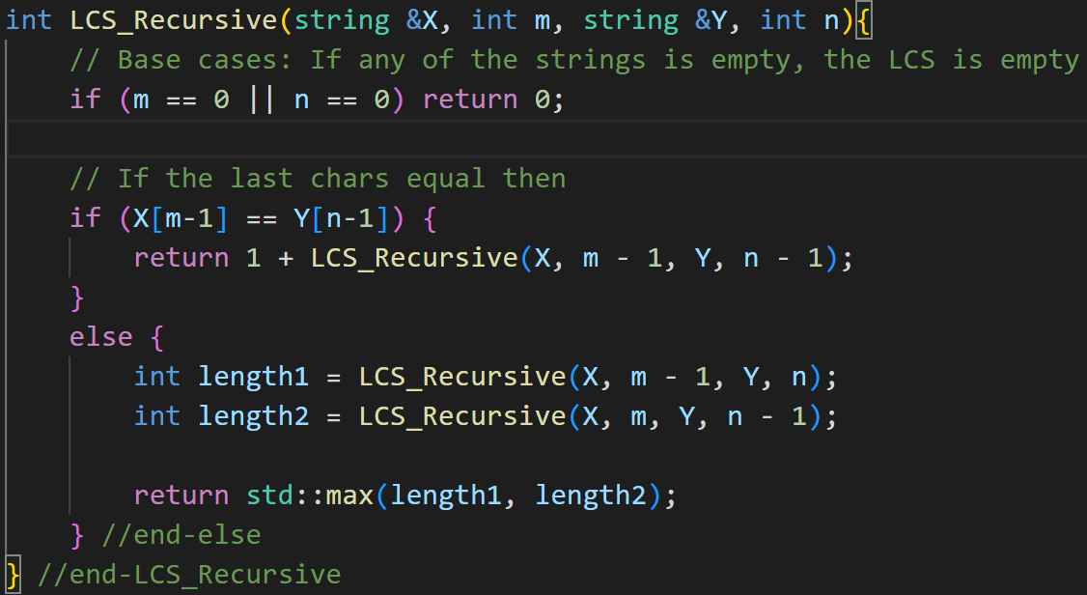
LCS: Recursive Algorithm
T(m, n) = T(m-1, n) + T(m, n-1)

Slide 9
LCS: Top Down DP Solution
How to store the solutions to subproblems?
Construct an array T[0..m+1][0..n+1]
T[i][j] represents the length of the LCS for X[0..i-1] & Y[0..j-1]
Finally, T[m][n] will contain the overall solution
How many distinct sub-problems do we have?
mxn

Slide 10
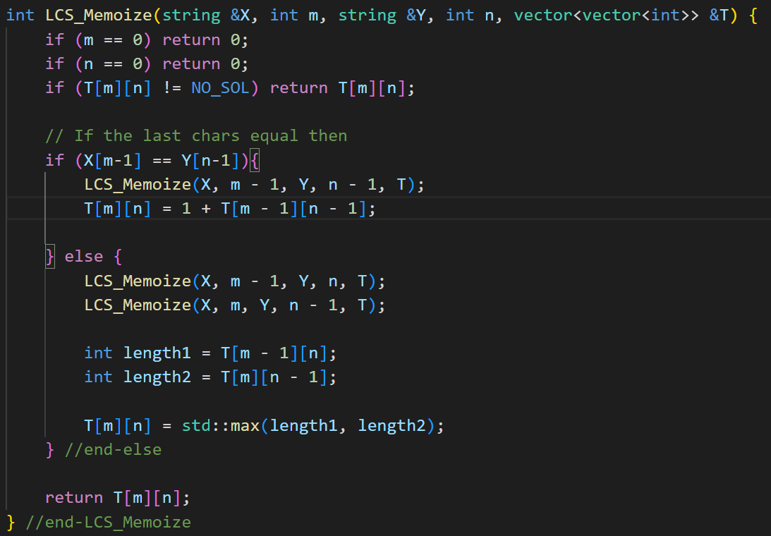
LCS: Top Down DP Algorithm

Slide 11
LCS: Bottom Up DP Solution
It is possible to fill-up the solution table iteratively in a bottom-up manner as follows
Let T[i][j] represent the length of the LCS for X[0..i-1] & Y[0..j-1]
Then here is the recursive formulation:
{0 if i = 0 or j=0
T[i][j] ={T[i-1][j-1] + 1 if i, j > 0 and xi = yj
{max{T[i-1][j], T[i][j-1]} if i, j > 0 and xi != yj

Slide 12
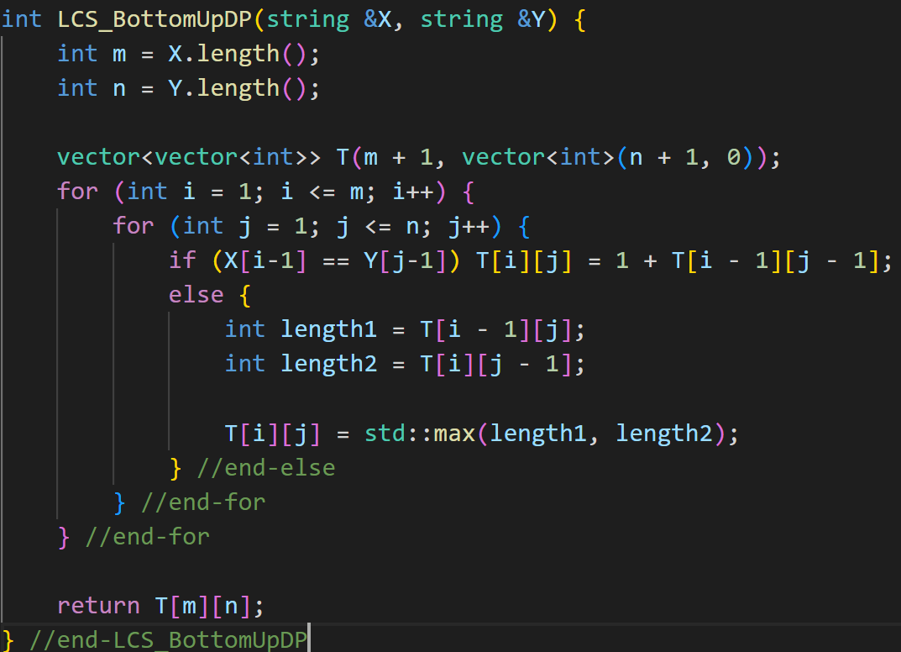
LCS: Bottom Up DP Algorithm

Slide 13
LCS: Bottom Up DP Example
X = <BACDB>
Y = <BDCB>
0 1 2 3 4
B D C B
0
0 0 0 0 0
1
B
0 1 1 1 1
2
A
0 1 1 1 1
3
C
0 1 1 2 2
4
D
0 1 2 2 2
5
B
0 1 2 2 3
LCS = <BCB>

Slide 14
LCS: Extracting the Actual Sequence
We will record each decision for each prefix in an array dir[i][j]
CROSS: We come here from (i-1, j-1)
UP: We come here from (i-1, j)
LEFT: We come here from (i, j-1)
Then starting at the final answer, dir[m][n], trace back to find how this answer was arrived at
Every time a diagonal step taken by the algorithm corresponds to one additional char being added to the LCS

Slide 15
LCS: Extracting the Actual Sequence
LCS(x[1..m], y[1..n]){
For i=0 to m do T[i][0] = 0; // Base case
For j=0 to n do T[0][j] = 0; // Base case
For i=1 to m do {
For j=1 to n do {
if (x[i-1] == y[j-1]){
T[i][j] = T[i-1][j-1] + 1; // Last chars eq
D[i][j] = CROSS; // Go diagonal
} else if (T[i-1][j] > T[i][j-1]){
T[i][j] = T[i-1][j]; // x[1..i-1] & y[1..j]
D[i][j] = UP; // Go up
} else {
T[i][j] = T[i][j-1]; //x[1..i] & y[1..j-1]
D[i][j] = LEFT; // Go left
} //end-else
} //end-for
} //end-for
return T[m][n];
} //end-LCS

Slide 16
LCS Applications
Used as a similarity metric
In document retrieval on the web, you compare two strings to see how similar they are
In genetics research for example you compare extremely long strings of genetic codes from DNA to determine how similar two strings are
Presumably this determines how closely related two species are
Another such similarity metric is the Edit distance
The minimum # of single character insertions, deletions or replacements necessary to convert one string to the other

Slide 17
LeetCode Problems
1143. Longest Common Subsequence
583. Delete Operation for Two Strings
1092. Shortest Common Supersequence
72. Edit Distance

