Slide 1
Today’s Material
Chain Matrix Multiplication
Problem definition
Brute-force Recursive Solution
Top-Down DP Solution
Bottom-Up DP Solution
Extracting the final sequence

Slide 2
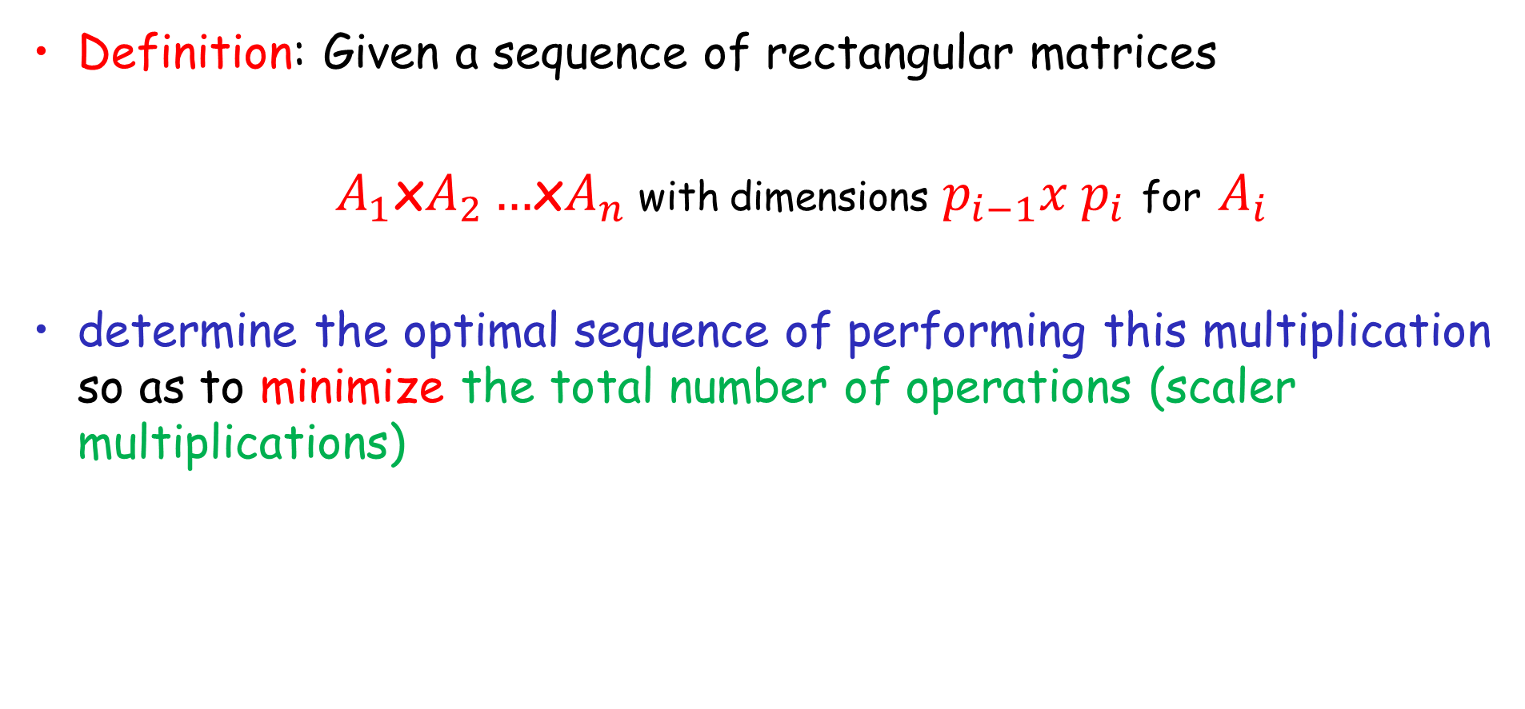
Chain Matrix Multiplication
Definition: Given a sequence of rectangular matrices
$A_{1}$x$A_{2}…$x$A_{n}$with dimensions $p_{i−1}x p_{i}$ for $A_{i}$
determine the optimal sequence of performing this multiplication so as to minimize the total number of operations (scaler multiplications)

Slide 3
Multiplying two Rectangular Matrices
Recall that in order to be able to multiply two rectangular matrices A x B, the number of columns in A must be equal to the number of rows in B
q
r
r
p
A
q
B
p
C
A
(pxq)
X
B
(qxr)
=
C
(pxr)

Slide 4
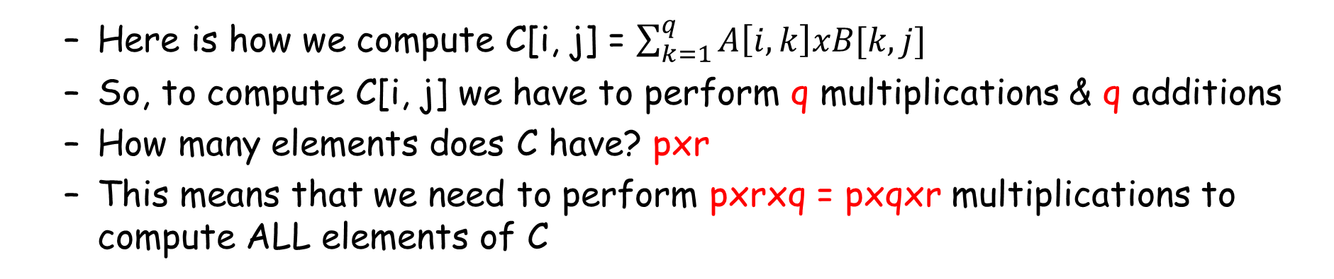
Multiplying two Rectangular Matrices
q
j
r
j
r
i
i
A
q
B
C
p
p
A
(pxq)
X
B
(qxr)
=
C
(pxr)
Here is how we compute C[i, j] = $\sum_{k=1}^{q}{A\left[i, k\right]xB[k, j]}$
So, to compute C[i, j] we have to perform q multiplications & q additions
How many elements does C have? pxr
This means that we need to perform pxrxq = pxqxr multiplications to compute ALL elements of C

Slide 5
Matrix Multiplication is Associative
Matrix multiplication is an associative operation
We are free to parenthesize the multiplication in any way we like
But we are NOT allowed to change the order of matrices (not commutative)
Ex: Multiply AxBxC
We can parenthesize this multiplication in two ways:
(AxB)xC → First multiply A with B, then multiply the result with C
Ax(BxC) → First multiply B with C, then multiply A with the result
Both of these will give the same final result
But the total number of multiplications required may be different!

Slide 6
Chain Matrix Multiplication Example
MultCost[AxBxC]?
Assume: A: 5x4, B: 4x6, C: 6x2
MultCost[(AxB)xC)] = 5x4x6 + 5x6x2 = 180
MultCost[(Ax(BxC)] = 4x6x2 + 5x4x2 = 84

Slide 7
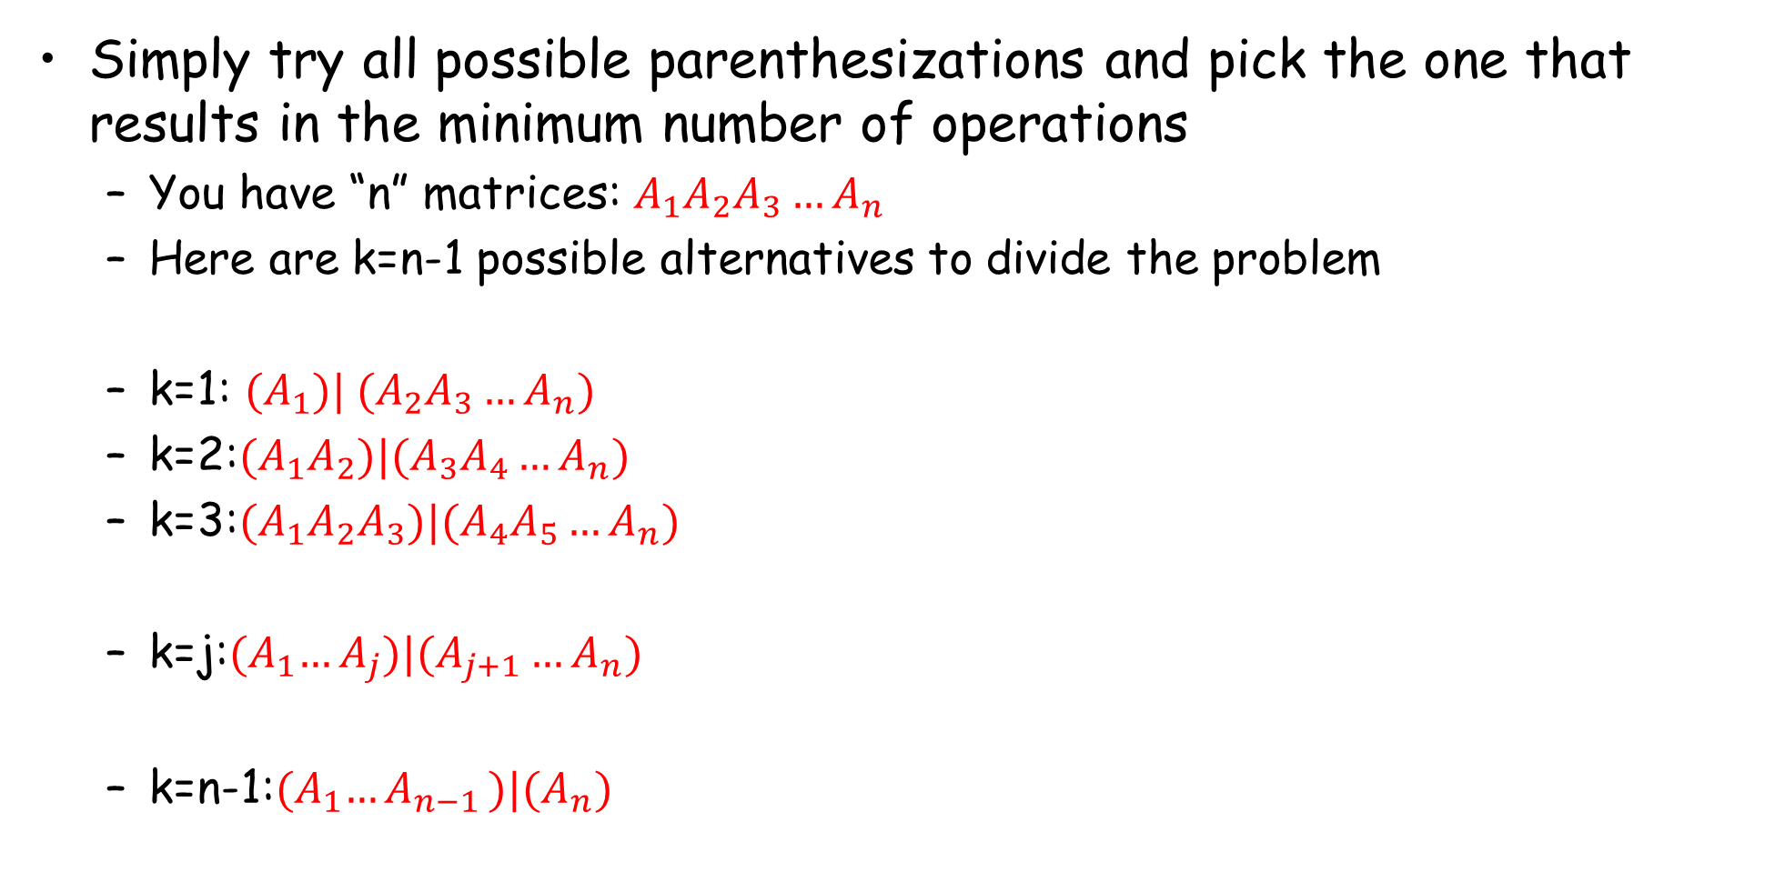
Brute-force Recursive Algorithm
Simply try all possible parenthesizations and pick the one that results in the minimum number of operations
You have “n” matrices: $A_{1}A_{2}A_{3}…A_{n}$
Here are k=n-1 possible alternatives to divide the problem
k=1: ${(A}_{1}){| (A}_{2}A_{3}…A_{n})$
k=2:${(A}_{1}A_{2})|(A_{3}A_{4}…A_{n})$
k=3:${(A}_{1}A_{2}A_{3})|(A_{4}A_{5}…A_{n})$
k=j:${(A}_{1}…A_{j})|(A_{j+1}…A_{n})$
k=n-1:${(A}_{1}{…A}_{n−1})|(A_{n})$
Compute the cost of each of these parenthesizations and take the one that gives the minimum number of operations

Slide 8

Recursive Formulation
What is the cost of a certain parenthesization for 1<=k<=n?
Base Case: MultCost[($A_{j}$)] = 0 for 1<=j<=n
MultCost[($A_{1}…A_{k})x(A_{k+1}…A_{n})]$ =
MultCost[($A_{1}…A_{k}$)] + MultCost[($A_{k+1}…A_{n}$)] + $p_{0} x p_{k} x p_{n}$

Slide 9
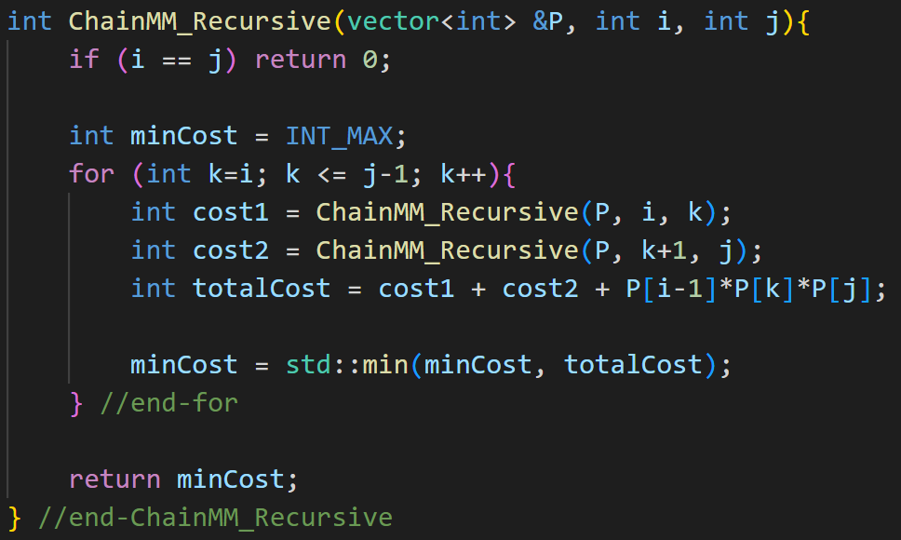
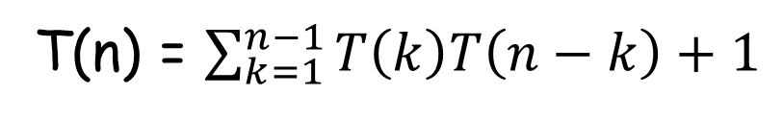
Chain Matrix Multiplication: Recursive Algorithm
T(n) = $\sum_{k=1}^{n−1}{T\left(k\right)T\left(n−k\right)+1}$

Slide 10
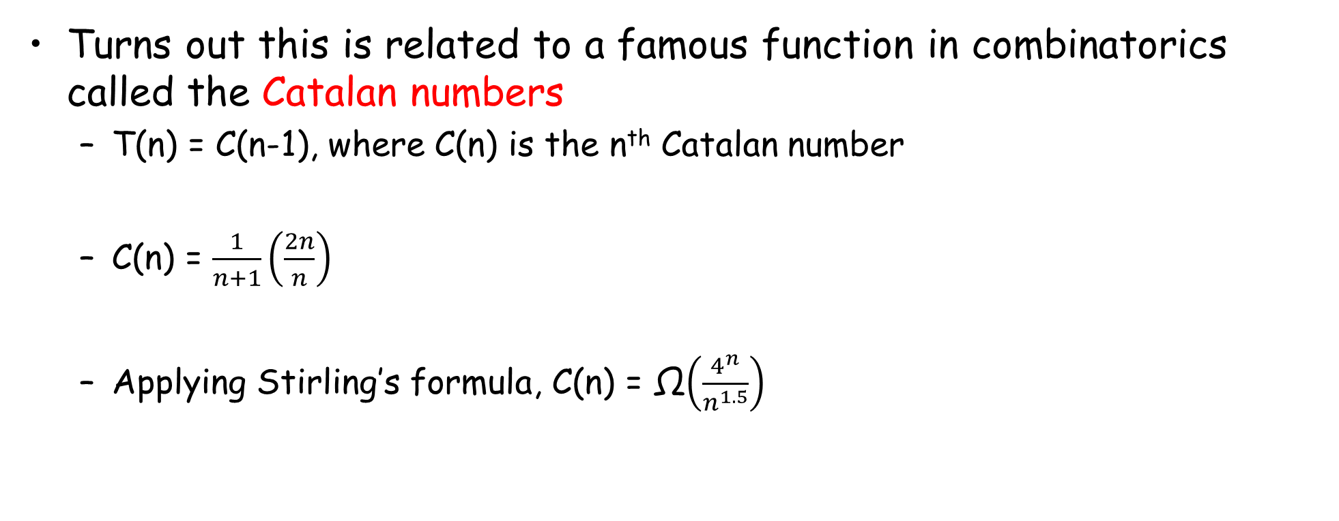
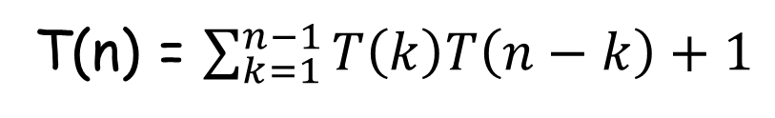
Running Time of Recursive Algorithm
T(n) = $\sum_{k=1}^{n−1}{T\left(k\right)T\left(n−k\right)+1}$
Turns out this is related to a famous function in combinatorics called the Catalan numbers
T(n) = C(n-1), where C(n) is the n^{th} Catalan number
C(n) = $\frac{1}{n+1}\left(\frac{2n}{n}\right)$
Applying Stirling’s formula, C(n) = Ω$\left(\frac{4^{n}}{n^{1.5}}\right)$

Slide 11
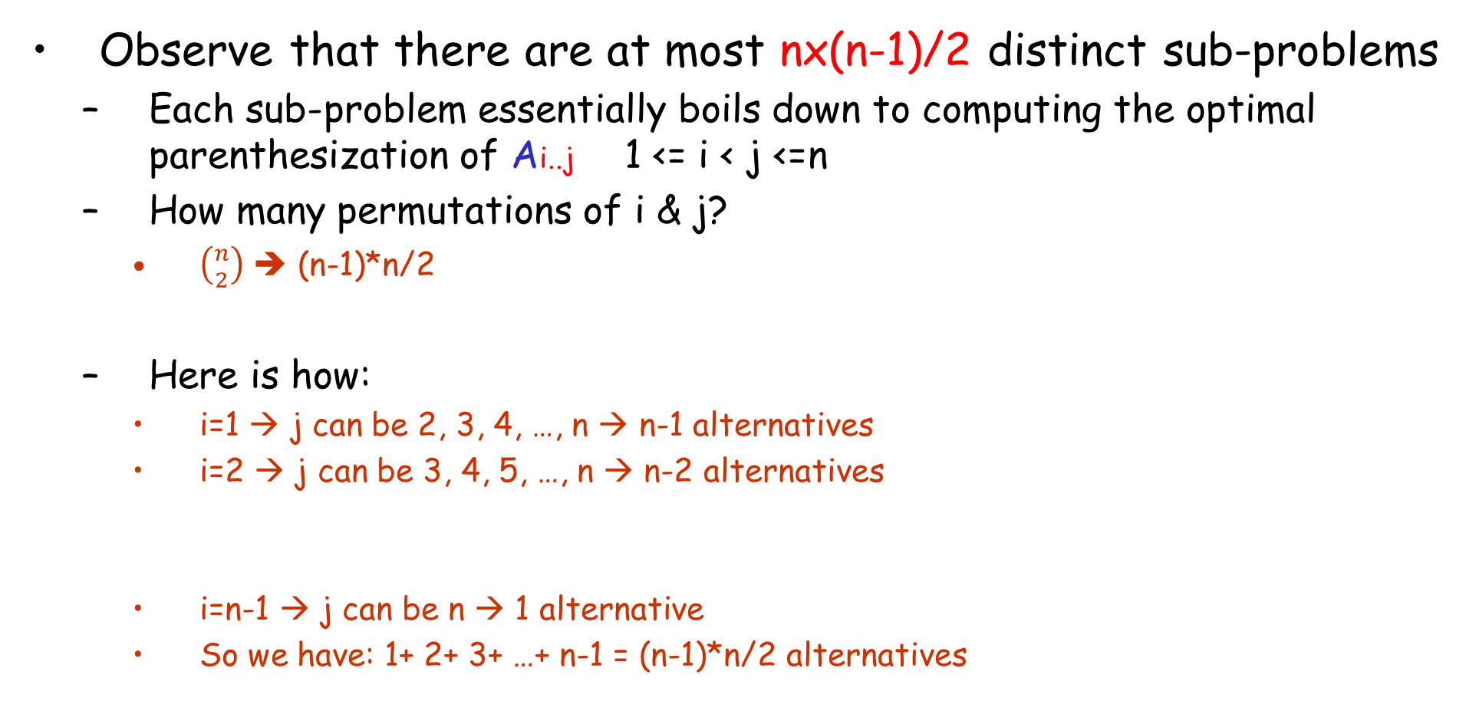
CMM: Top Down DP Solution
Observe that there are at most nx(n-1)/2 distinct sub-problems
Each sub-problem essentially boils down to computing the optimal parenthesization of Ai..j 1 <= i < j <=n
How many permutations of i & j?
$\left({n \atop 2}\right)$ ➔ (n-1)*n/2
Here is how:
i=1 → j can be 2, 3, 4, …, n → n-1 alternatives
i=2 → j can be 3, 4, 5, …, n → n-2 alternatives
i=n-1 → j can be n → 1 alternative
So we have: 1+ 2+ 3+ …+ n-1 = (n-1)*n/2 alternatives

Slide 12
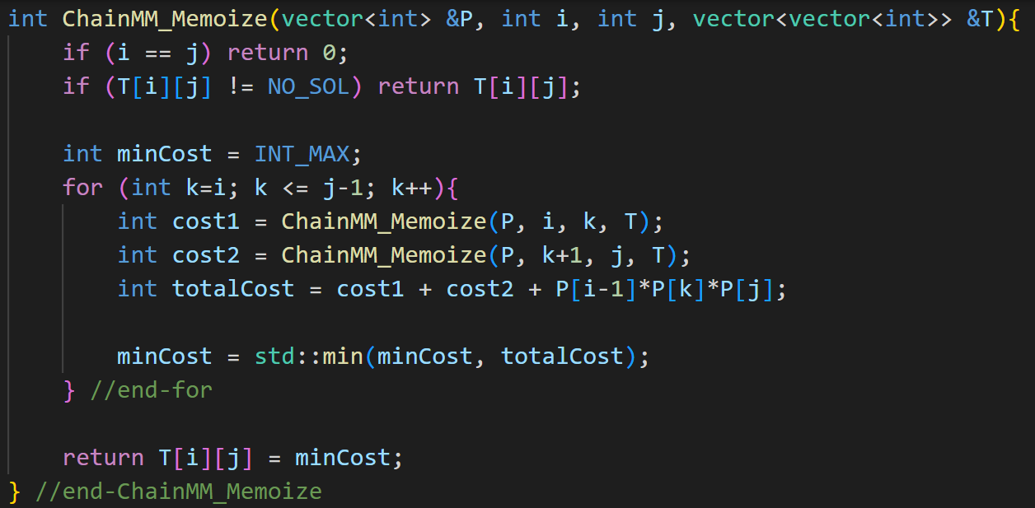
CMM: Top Down DP Algorithm

Slide 13






CMM: Bottom Up DP Solution
It is possible to fill-up the solution table iteratively in a bottom-up manner as follows:
Let T[i][j] represent the cost of multiplying $A_{i}…A_{j}$
$$A_{i}…A_{j}$$
$$i<j$$
$$A_{i}…A_{k}$$
$$?$$
$$A_{k+1}…A_{j}$$
T[i][j] = min{T[i][k] + T[k+1][j] + pi x pk x pj}
i <= k < j
T[i][i] = 0 (Base case)
Final solution in T[1][n]

Slide 14
CMM: Bottom Up DP Algorithm - Filling the Table
It is tricky to figure out how to fill out the table iteratively
It turns out, we need to build up by computing the solutions to sub-chains of length 2, 3, 4, .., n
The final answer will be stored in T[1][n]

Slide 15
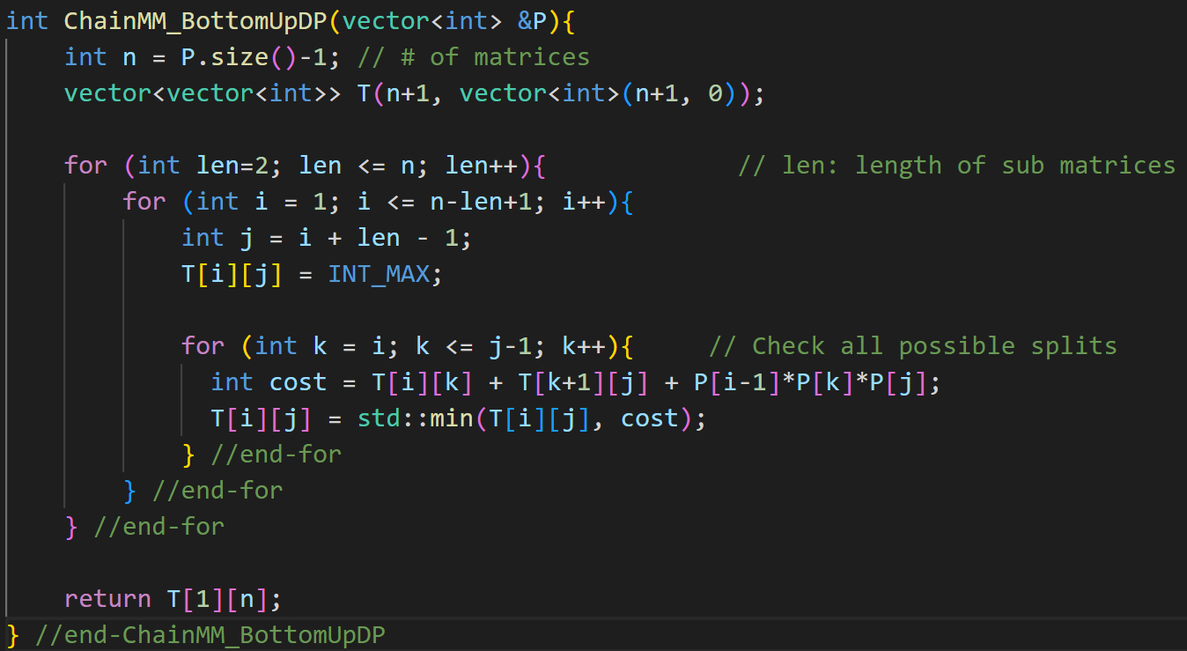
CMM: Bottom Up DP Algorithm

Slide 16
CMM Example
A1 (5x4), A2 (4x6), A3 (6x2), A4 (2x7)
T[i][j]
4
1
j
i
3
158
2
2
88
104
3
1
120
48
84
4
0
0
0
0

Slide 17
CMM: Extracting the Final Multiplication Sequence (1)
We need to maintain a “split marker” marking the best split
This is the “k” value that gives the minimum result for Ai..Aj
In addition to T[i][j], which stores the best result for Ai..Aj, we also maintain a parallel array s[i][j] in which we store the value of “k” providing the optimal split

Slide 18
CMM: Extracting the Final Multiplication Sequence (2)
Then the order of multiplication can be computed as follows:
MultOrder(i, j){
if (i == j) return A[i]; // base case
k = s[i][j];
X = MultOrder(i, k);
Y = MultOrder(k+1, j);
return X * Y;
} //end-MultOrder

Slide 19
CMM Example
A1 (5x4), A2 (4x6), A3 (6x2), A4(2x7)
Final Order
T[i][j]
s[i][j]
3
4
1
4
1
j
i
j
i
158
1
3
2
3
3
2
2
88
104
1
3
3
2
3
2
1
120
48
84
1
2
3
4
0
0
0
0
A1
A2
A3
A4
((A1 (A2 A3)) A4)

Slide 20
LeetCode Problems
1130. Minimum Cost Tree From Leaf Values
312. Burst Balloons
Both of these problems can be modeled as CMM

