Slide 1
Today’s Material
Graphs
Definition & Properties
Path, Cycle
Representation
Adjacency Matrix
Adjacency List
Breath First Search (BFS)

Slide 2
Graphs - Definition
A graph is simply a collection of nodes plus edges
Linked lists, trees, and heaps are all special cases of graphs
The nodes are known as vertices (node = “vertex”)
Formal Definition: A graph G is a pair (V, E) where
V is a set of vertices or nodes
E is a set of edges that connect vertices

Slide 3
Graphs – An Example
Here is a graph G = (V, E)
Each edge is a pair (v1, v2), where v1, v2 are vertices in V
V = {A, B, C, D, E, F}
E = {(A,B), (A,D), (B,C), (C,D), (C,E), (D,E)}
B
C
A
F
D
E

Slide 4
Directed vs Undirected Graphs
If the order of edge pairs (v1, v2) matters, the graph is directed (also called a digraph): (v1, v2) ≠ (v2, v1)
v1
v2
If the order of edge pairs (v1, v2) does not matter, the graph is undirected (v1, v2) = (v2, v1)
v1
v2

Slide 5
Weighted Graphs – An Example
Graph edges may have weights on them
The meaning of the weight is application dependent
E.g., Distance between cities
Bandwidth between routers etc.
20
B
C
10
A
30
F
50
5
15
D
E

Slide 6
Degree of a vertex
In an undirected graph, the degree of a vertex is the number of edges incident to it
degree(A) = 2
degree(B) = 2
degree(C) = 3
degree(D) = 3
degree(E) = 2
degree(F) = 0
B
C
A
F
D
E

Slide 7
In-Degree, Out-Degree of a vertex
For a directed graph, we talk about
in-degree: the number of incoming edges
out-degree: the number of outgoing edges
in-degree(A) = 0, out-degree(A) = 2
in-degree(B) = 1, out-degree(B) = 1
in-degree(C) = 1, out-degree(C) = 2
in-degree(D) = 2, out-degree(D) = 1
in-degree(E) = 2, out-degree(E) = 0
in-degree(F) = 0, out-degree(F) = 0
B
C
A
F
D
E

Slide 8
Graph Representations
Space and time are measured in terms of both:
Number of vertices = |V| = n
Number of edges = |E| = e
There are two ways of representing graphs:
The adjacency matrix representation
The adjacency list representation

Slide 9
Adjacency Matrix Representation
Adjacency matrix representation:
1 if (u, v) is in E
0 otherwise
M(u, v) =
 | A | B | C | D | E | F
A | 0 | 1 | 0 | 1 | 0 | 0
B | 0 | 0 | 1 | 0 | 0 | 0
C | 0 | 0 | 0 | 1 | 1 | 0
D | 0 | 0 | 0 | 0 | 1 | 0
E | 0 | 0 | 0 | 0 | 0 | 0
F | 0 | 0 | 0 | 0 | 0 | 0
B
C
A
F
D
E
Space?
O(n²)

Slide 10
Adjacency Matrix Representation
Adjacency matrix repr. of a weighted graph:
weight(u, v) if (u, v) is in E
∞ otherwise
M(u, v) =
 | A | B | C | D | E | F
A | ∞ | 10 | ∞ | 5 | ∞ | ∞
B | ∞ | ∞ | 20 | ∞ | ∞ | ∞
C | ∞ | ∞ | ∞ | 30 | 50 | ∞
D | ∞ | ∞ | ∞ | ∞ | 15 | ∞
E | ∞ | ∞ | ∞ | ∞ | ∞ | ∞
F | ∞ | ∞ | ∞ | ∞ | ∞ | ∞
B
20
C
10
A
30
F
50
5
D
15
E

Slide 11
Adjacency List Representation
Adjacency list representation: For each v in V, L(v) = list of w such that (v, w) is in E
A
B
D
B
C
B
A
C
A
F
B
C
D
E
D
E
D
A
C
E
E
C
D
F
b
a
Space?
n*a + b*2*e = O(n+e)

Slide 12
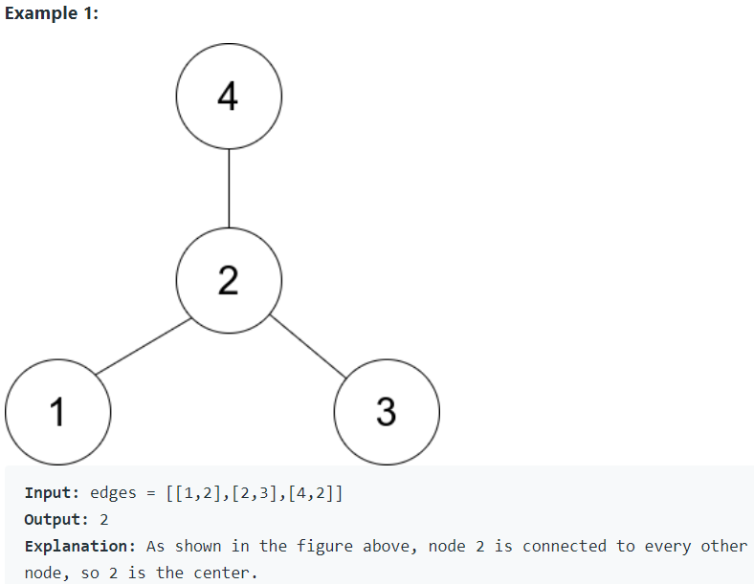
LeetCode 1791. Find Center of Star Graph
There is an undirected star graph consisting of n nodes labeled from 1 to n
A star graph is a graph where there is one center node and exactly n - 1 edges that connect the center node with every other node
You are given a 2D integer array edges where each edges[i] = [ui, vi] indicates that there is an edge between the nodes ui and vi. Return the center of the given star graph

Slide 13
Graph Traversals
In many graph problems, we need to traverse the vertices of the graph in some order
Recall tree traversals
2 graph traversal methods
Breath-First Search (BFS):
Starting at a node visit ALL of your neighbors
Then visit the neighbors of your neighbors and so on
Like a wave-front expanding outwards from a source node
Depth-First Search (DFS)
Starting at a node, follow a path all the way until you cannot move any further
Then backtrack and try another branch
Do this until all nodes have been visited

Slide 14
Breath-First Search - Idea
3
2
3
1
2
2
s
3
2
1
2
1
2
3
3
Given a graph G = (V, E), start at the source vertex “s” and discover which vertices are reachable from s
At any time there is a “frontier” of vertices that have been discovered, but not yet processed (gray vertices)
Next pick the nodes in the frontier in sequence and discover their neighbors, forming a new “frontier”
Breadth-first search is so named because it visits vertices across the entire breadth of this frontier before moving on

Slide 15
BFS - Continued
Represent the final result as follows:
For each vertex v ε V, we will store d[v] which is the distance (length of shortest path) from s to v
Distance between a vertex “v” and “s” is defined to be the minimum number of edges on a path from “s” to “v”
Note that d[s] = 0
We will also store a predecessor (or parent) pointer pred[v], which indicates the first vertex along the shortest path if we walk from v backwards to s
We will let pred[s] = 0
Notice that these predecessor pointers are sufficient to reconstruct the shortest path to any vertex

Slide 16
BFS – Implementation
2
1
2
s
2
s
s
1
2
2
1
2
Initially all vertices (except the source) is colored white, meaning they have not been discovered just yet
When a vertex is first discovered, it is colored gray (and is part of the frontier)
When a gray vertex is processed, it becomes black

Slide 17
BFS - Implementation
2
1
2
s
2
s
s
1
2
2
1
2
The search makes use of a FIFO queue, Q
We also maintain arrays
color[u], which holds the color of vertex u
either white, gray, black
pred[u], which points to the predecessor of u
The vertex that discovered u
d[u], the distance from s to u

Slide 18
BFS – Implementation
BFS(G, s){
for each u in V- {s} { // Initialization
color[u] = white;
d[u] = INFINITY;
pred[u] = NULL;
} //end-for
color[s] = GRAY; // initialize source s
d[s] = 0;
pred[s] = NULL;
Q = {s}; // Put s in the queue
while (Q is nonempty){
u = Dequeue(Q); // u is the next vertex to visit
for each v in Adj[u] {
if (color[v] == white){ // if neighbor v undiscovered
color[v] = gray; // … mark is discovered
d[v] = d[u] + 1; // … set its distance
pred[v] = u; // … set its predecessor
Enqueue(v); //… put it in the queue
} //end-if
} //end-for
color[u] = black; // we are done with u
} //end-while
} //end-BFS
O(n)
Running Time?
O(n + e)
n times
O(1)
O(e)

Slide 19
BFS - Example
u
v
w
u
v
w
u
v
w
2
1
∞
1
∞
1
2
∞
∞
2
∞
2
∞
0
1
∞
0
1
∞
0
1
t
s
∞
t
s
x
t
s
x
x
Q: s
Q: v, x
Q: x, u, w
u
v
w
u
v
w
u
v
w
1
2
2
2
1
2
2
2
1
3
3
0
∞
0
1
3
0
1
t
s
1
t
s
x
t
s
x
x
Q: w, t
Q: u, w
Q:

Slide 20
BFS Tree
s
u
v
w
0
2
1
2
v
1
1
x
3
0
1
t
x
u
w
2
2
t
3
The predecessor pointers of the BFS define an inverted tree
If we reverse these edges, we get a rooted, unordered tree called a BFS tree for G
There are many potential BFS trees for a graph depending on where the search starts and in what order vertices are placed on the queue
These edges of G are called the tree edges, and the remaining edges are called the cross edges

Slide 21
BFS Tree
s
w
0
u
v
2
1
2
v
x
1
1
3
0
1
u
2
2
w
t
x
t
3
It is not hard to prove that if G is an undirected graph, then cross edges always go between two nodes that are at most ONE level apart in the BFS tree
The reason is that if any cross edge spanned two or more levels, then when the vertex at the higher level (closer to the root) was being processed, it would have discovered the other vertex, implying that the other vertex would appear on the next level of the tree, a contradiction
In a directed graph, cross edges may come up at an arbitrary number of levels

Slide 22
BFS Traversal Example
0
Run BFS for this undirected graph starting at vertex 0
Compute d[u] & pred[u] for each vertex
Look at the example C++ code
1
3
2
4
5
6
7
8
9

Slide 23
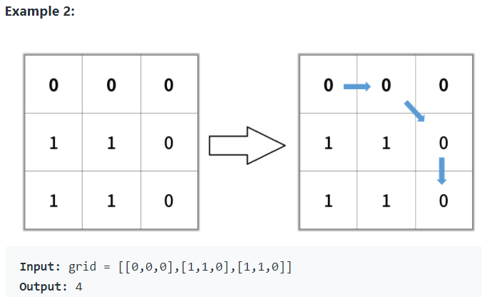
LeetCode 1091. Shortest Path in Binary Matrix
Given an n x n binary matrix grid, return the length of the shortest clear path in the matrix. If there is no clear path, return -1
A clear path in a binary matrix is a path from the top-left cell (i.e., (0, 0)) to the bottom-right cell (i.e., (n - 1, n - 1)) such that:
All the visited cells of the path are 0
All the adjacent cells of the path are 8-directionally connected (i.e., they are different and they share an edge or a corner)
The length of a clear path is the number of visited cells of this path

Slide 24
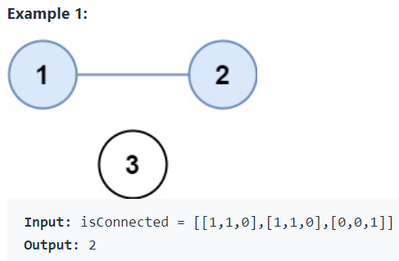
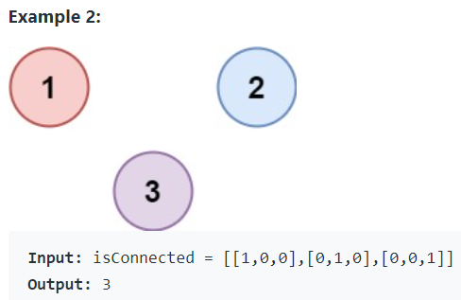
LeetCode 547. Number of Provinces
There are n cities. Some of them are connected, while some are not. If city a is connected directly with city b, and city b is connected directly with city c, then city a is connected indirectly with city c.
A province is a group of directly or indirectly connected cities and no other cities outside of the group.
You are given an n x n matrix isConnected where isConnected[i][j] = 1 if the ith city and the jth city are directly connected, and isConnected[i][j] = 0 otherwise.
Return the total number of provinces.

Slide 25
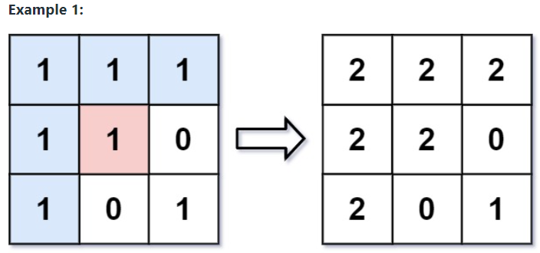
LeetCode 733. Flood Fill
An image is represented by an m x n integer grid image where image[i][j] represents the pixel value of the image
You are also given three integers sr, sc, and newColor. You should perform a flood fill on the image starting from the pixel image[sr][sc]
To perform a flood fill, consider the starting pixel, plus any pixels connected 4-directionally to the starting pixel of the same color as the starting pixel, plus any pixels connected 4-directionally to those pixels (also with the same color), and so on. Replace the color of all of the aforementioned pixels with newColor
Return the modified image after performing the flood fill

Slide 26
LeetCode 785. Is Graph Bipartite?
There is an undirected graph with n nodes, where each node is numbered between 0 and n - 1. You are given a 2D array graph, where graph[u] is an array of nodes that node u is adjacent to. More formally, for each v in graph[u], there is an undirected edge between node u and node v. The graph has the following properties:
There are no self-edges (graph[u] does not contain u)
There are no parallel edges (graph[u] does not contain duplicate values)
If v is in graph[u], then u is in graph[v] (the graph is undirected)
The graph may not be connected, meaning there may be two nodes u and v such that there is no path between them
A graph is bipartite if the nodes can be partitioned into two independent sets A and B such that every edge in the graph connects a node in set A and a node in set B
Return true if and only if it is bipartite

Slide 27
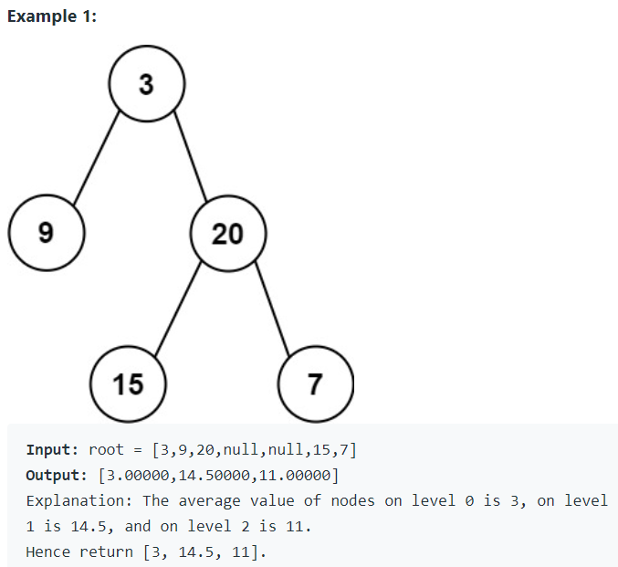
LeetCode 637. Average of Levels in Binary Tree
Given the root of a binary tree, return the average value of the nodes on each level in the form of an array.
Answers within 10⁻⁵ of the actual answer will be accepted

Slide 28
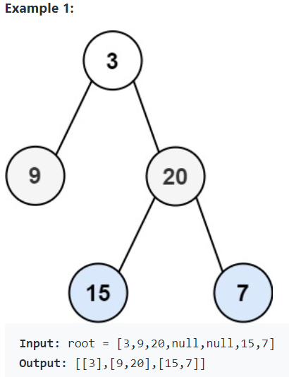
LC 102. Binary Tree Level Order Traversal
Given the root of a binary tree, return the level order traversal of its nodes' values. (i.e., from left to right, level by level).

