Slide 1
Today’s Material
Depth-First Search (DFS)

Slide 2
Depth-First Search
Idea:
Starting at a node, follow a path all the way down the tree until you cannot move any further
Then backtrack and try another branch
Do this until all nodes have been visited
Similar to finding a route in a maze

Slide 3
DFS - Example
DFS(a) tree
b
f
b
b
f
a
f
a
a
a
c
c
c
g
g
g
b
f
c
g
e
e
d
e
d
d
d
e

Slide 4
DFS - Implementation
Assume you are given a digraph G = (V, E)
The same algorithm works for undirected graphs but the resulting structure imposed on the graph is different
We use 4 auxiliary arrays
color[u]
White – undiscovered
Gray – discovered but not yet processed
Black – finished processing
pred[u], which points to the predecessor of u
The vertex that discovered u
2 timestamps: Purpose will be explained later
d[u]: Time at which the vertex was discovered
Not to be confused with distance of u in BFS!
f[u]: Time at which the processing of the vertex was finished

Slide 5
DFS – Implementation
DFS(G, s){
for each u in V { // Initialization
color[u] = white;
pred[u] = NULL;
} //end-for
time = 0;
for each u in V
if (color[u] == white) // Found an undiscovered vertex
DFSVisit(u); // Start a new search there
} // end-DFS
DFSVisit(u){ // Start a new search at u
color[u] = gray; // Mark u visited
d[u] = ++time;
for each v in Adj[u] {
if (color[v] == white){ // if neighbor v undiscovered
pred[v] = u; // … set its predecessor
DFSVisit(v); // …visit v
} //end-if
} //end-for
color[u] = black; // we are done with u
f[u] = ++time;
} //end-while
} //end-DFSVisit
O(n)
Running Time?
O(n + e)
O(e)

Slide 6
DFS Example1
0
Run DFS for this directed graph
Compute d[u], f[u] & pred[u] for each vertex
Look at the example C++ code
1
3
2
4
5
6
7
8
9

Slide 7
DFS Example1
0
0
1/16
T
T
1
3
1
2/11
F
3
17/20
2
2
12/15
T
C
T
T
4
5
4
2/11
5
9/10
6
7
6
13/14
7
18/19
T
F
C
C
4/7
8
B
8
9
9
5/6

Slide 8
DFS Example2
1/10
d
e
a
C
d
11/14
2/5
6/9
b
a
f
b
f
C
e
F
12/13
B
c
g
c
g
7/8
C
3/4
DFS imposes a tree structure (actually a collection of trees or a forest) on the structure of the graph
This is just the recursion tree, where the edge (u, v) arises when processing vertex “u” we call DFSVisit(v) for some neighbor v

Slide 9
DFS Tree – Directed Graphs
1/10
d
e
a
C
d
11/14
2/5
6/9
b
a
f
b
f
C
e
F
12/13
B
c
g
c
g
7/8
C
3/4
For digraphs, non-tree edges can be classified as follows:
Back Edges: (u, v) where v is ancestor of u in the tree
Thus a self-loop is considered to be a back-edge
Forward Edges: (u, v) where v is a proper descendant of u in the tree
Cross Edges: (u, v) where u and v are not ancestors or descendants of one another in the tree (in fact, the edge may go between different trees in the forest)

Slide 10
Parenthesis Structure
1/10
a
C
d
11/14
a
d
2/5
6/9
b
f
C
e
F
12/13
b
f
e
B
c
g
c
g
C
7/8
3/4
2
3
4
5
6
7
8
9
10
11
12
13
14
1
There is also a nice structure to the timestamps. In CLRS this is referred to as the parenthesis structure
If we represent d[u] with a left parethesis “(“ and f[u] with a right parenthesis “)”, then the history of discoveries and finishings makes a well-formed expression in the sense that the parentheses are properly nested

Slide 11
Parenthesis Lemma
Another way stating the parenthesis structure is with the following lemma:
Parenthesis Lemma: Given a digraph G = (V, E), and any DFS tree for G and any two vertices u, v ε V, exactly one of the following conditions hold:
The intervals [d[u], f[u]] and [d[v], f[v]] are entirely disjoint
Neither u nor v is a descendent of the other in the DFS forest
The interval [d[u], f[u]] is contained entirely within [d[v], f[v]]
u is a descendent of v in a DFS tree, or put another way, v is an ancestor of u in a DFS tree
The interval [d[v], f[v]] is contained entirely within [d[u], f[u]]
v is a descendent of u in a DFS tree, or put another way, u is an ancestor of v in a DFS tree

Slide 12
Timestamp Structure Lemma
Lemma: Given a digraph G = (V, E), consider any DFS forest of G, and consider any edge (u, v) ε E.
If this edge is a tree, forward, or cross edge, then f[u] > f[v].
If the edge is a back edge, then f[u] < f[v]
Proof:
For tree, forward, and back edges the proof follows directly from the parenthesis lemma
E.g., for a forward edge (u, v), v is a descendant of u, and so v’s start finish interval is contained within u’s, implying that v has an earlier finish time
For a cross edge (u, v) we know that the two time intervals are disjoint. When we were processing u, v was not white (otherwise (u, v) would be a tree edge), implying that v was started before u. Because the intervals are disjoint, v must have also finished before u

Slide 13
Cycles
Timestamps given by DFS allow us to determine a number of things about a graph or digraph.
For example, suppose you are given a graph or digraph. You run DFS.
You can determine whether the graph contains any cycles very easily.
We will do this with the help of the following lemma—next slide

Slide 14
Cycles
Lemma: Consider a digraph G = (V, E) and any DFS forest for G. G has a cycle iff DFS forest has a back edge
Proof:
If there is a back edge (u, v), then v is an ancestor of u. By following tree edges from v to u, we get a cycle
→ We show the contrapositive. Assume that there are no back edges. By the lemma in the previous slide, each of the remaining types of edges, tree, forward and cross, all have the property that they go from vertices with higher finishing time to vertices with lower finishing time. Thus along any path, finish times decrease monotonically, implying there can be no cycles

Slide 15
Cycles & Back Edges
There is no simple relationship between the number of back edges and the number of cycles.
For example, DFS may only have a single back edge, but there may be an exponential number of simple cycles in the graph
A similar theorem applies to undirected graphs

Slide 16
DFS Tree – Undirected Graphs
For undirected graphs, there are some important differences in the structure of the DFS tree
There is really no distinction between forward and back edges. So by convention, they are all called back edges
Furthermore it can be shown that there can be NO cross edges

Slide 17
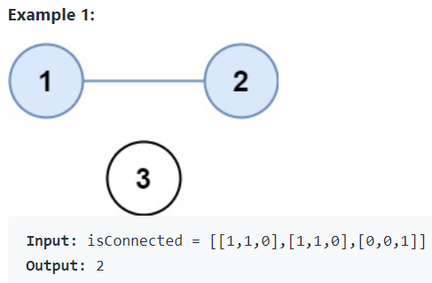
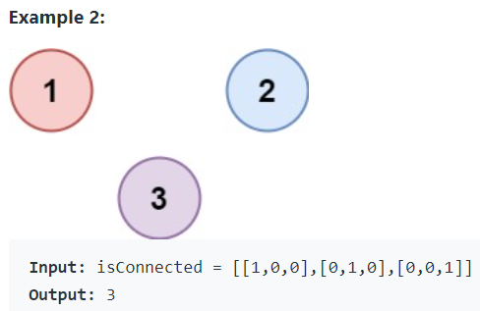
LeetCode 547. Number of Provinces
There are n cities. Some of them are connected, while some are not. If city a is connected directly with city b, and city b is connected directly with city c, then city a is connected indirectly with city c.
A province is a group of directly or indirectly connected cities and no other cities outside of the group.
You are given an n x n matrix isConnected where isConnected[i][j] = 1 if the ith city and the jth city are directly connected, and isConnected[i][j] = 0 otherwise.
Return the total number of provinces.

Slide 18
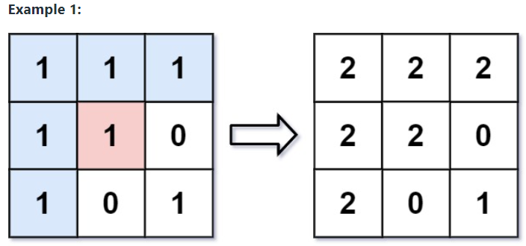
LeetCode 733. Flood Fill
An image is represented by an m x n integer grid image where image[i][j] represents the pixel value of the image
You are also given three integers sr, sc, and newColor. You should perform a flood fill on the image starting from the pixel image[sr][sc]
2 solutions by DFS: (1) Using recursion, (2) Iteratively using a stack

Slide 19
LeetCode 785. Is Graph Bipartite?
There is an undirected graph with n nodes, where each node is numbered between 0 and n - 1. You are given a 2D array graph, where graph[u] is an array of nodes that node u is adjacent to. More formally, for each v in graph[u], there is an undirected edge between node u and node v. The graph has the following properties:
There are no self-edges (graph[u] does not contain u)
There are no parallel edges (graph[u] does not contain duplicate values)
If v is in graph[u], then u is in graph[v] (the graph is undirected)
The graph may not be connected, meaning there may be two nodes u and v such that there is no path between them
A graph is bipartite if the nodes can be partitioned into two independent sets A and B such that every edge in the graph connects a node in set A and a node in set B
Return true if and only if it is bipartite

Slide 20
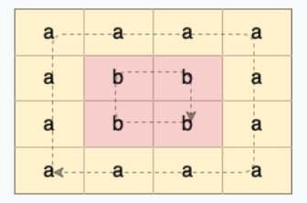
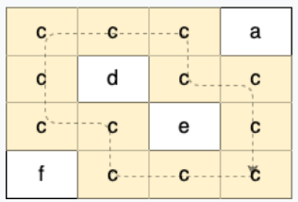
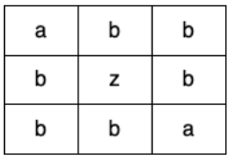
LeetCode 1559. Detect Cycles in 2D Grid
Given a 2D array of characters grid of size m x n, you need to find if there exists any cycle consisting of the same value in grid
A cycle is a path of length 4 or more in the grid that starts and ends at the same cell. From a given cell, you can move to one of the cells adjacent to it - in one of the four directions (up, down, left, or right), if it has the same value of the current cell
Also, you cannot move to the cell that you visited in your last move. For example, the cycle (1, 1) -> (1, 2) -> (1, 1) is invalid because from (1, 2) we visited (1, 1) which was the last visited cell
Return true if any cycle of the same value exists in grid, otherwise, return false

Slide 21
Trees & DFS
A
dfs(BinaryTreeNode *root){
if (root == NULL) return;
dfs(root->left);
dfs(root->right);
} //end-dfs
B
C
E
F
D
DFS walk order over this tree (assuming we follow the left link first)
A, B, D, C, E, G, H, I, J, F
G
H
I
J

Slide 22
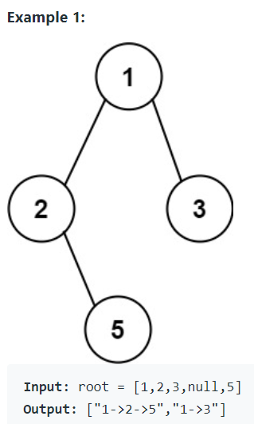
LeetCode 257. Binary Tree Paths
Given the root of a binary tree, return all root-to-leaf paths in any order.
A leaf is a node with no children

Slide 23
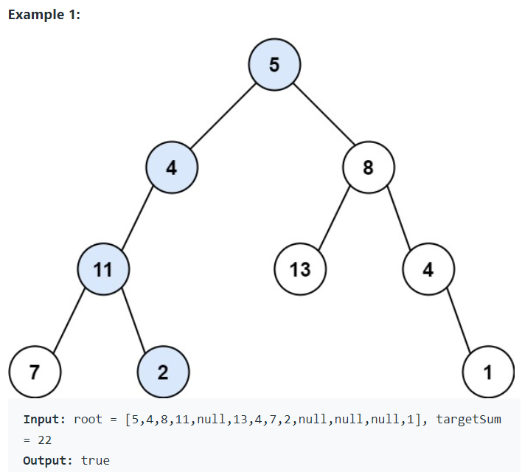
LeetCode 112. Path Sum
Given the root of a binary tree and an integer targetSum, return true if the tree has a root-to-leaf path such that adding up all the values along the path equals targetSum
A leaf is a node with no children.

Slide 24
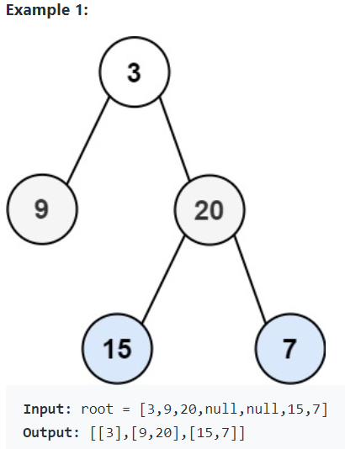
LC 102. Binary Tree Level Order Traversal
Given the root of a binary tree, return the level order traversal of its nodes' values. (i.e., from left to right, level by level).

Slide 25
DFS & MiniMax Game Trees
DFS is also widely employed in game tree search in AI
Consider the classical Tic-Tac-Toe game
We have 9x9 board
Player vs Computer
The player starts first, and places a “X” at an empty location
The computer then makes a counter move and places an “0”
This continues until either “X” wins, “O” wins, or we have draw
In order to have the computer make the optimal move, it computes what is known as the minimax game tree and searches it using DFS

Slide 26
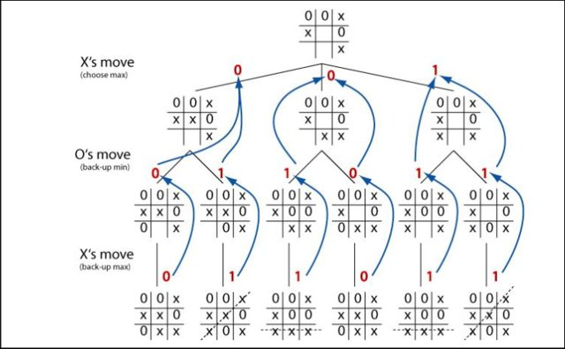
DFS & MiniMax Game Tree for Tic-Tac-Toe

