Slide 1
Today’s Material
Topological Sort
Problem definition
Solutions

Slide 2
Topological Sort: Definition
Consider the following graph of course prerequisities
201
306
427
111
123
213
304
446
205
Problem: Find an order
in which all these
courses can be taken.
220
302
402
Example: 111, 123, 201, 213, 304, 306, 427, 205, 446, 220, 302, 402
To take a course, all of its prerequisites must be taken first

Slide 3
Topological Sorting Problem
Given digraph G = (V, E), find a linear ordering of its vertices such that: for any edge (u, v) in E, u precedes v in the ordering
C
How would you topo-sort this graph given an adjacency list representation of G=(V, E)?
B
A
F
D
E

Slide 4
Topological Sorting Problem
Given digraph G = (V, E), find a linear ordering of its vertices such that: for any edge (u, v) in E, u precedes v in the ordering
Any linear ordering in which all arrows go to the right is a valid ordering
B
C
A
F
D
E
A
B
F
C
D
E

Slide 5
Topological Sort
Given digraph G = (V, E), find a linear ordering of its vertices such that: for any edge (u, v) in E, u precedes v in the ordering
B
C
A
F
Not a valid topological sort
D
E
A
B
F
D
C
E

Slide 6
Topological Sort Algorithm
Step1: Identify vertices that have no incoming edge
in-degree of these vertices is 0
B
C
A
F
D
E

Slide 7
Topological Sort Algorithm
Step1: Identify vertices that have no incoming edge
If no such vertices, the graph has cycles (cyclic)
Cyclic graphs cannot be topo-sort
Only Directed Acyclic Graphs (DAG) can be topo-sort
B
C
A
An example cyclic graph:
No vertex with in-degree = 0
D

Slide 8
Topological Sort Algorithm
Step1: Identify vertices that have no incoming edge
Select one such vertex
B
C
Select
A
F
D
E

Slide 9
Topological Sort Algorithm
Step 2: Output the vertex
Delete this vertex and all of its outgoing edges from the graph
B
C
A
F
D
E
B
C
F
Output:
A
D
E

Slide 10
Topological Sort Algorithm
Repeat Steps 1 & 2 until the graph is empty
Select
Delete B & all its outgoing edges
B
C
C
F
F
D
E
D
E
Output:
A
B

Slide 11
Topological Sort Algorithm
Repeat Steps 1 & 2 until the graph is empty
Select
C
Delete F & all its outgoing edges
C
F
D
E
D
E
Output:
A
B
F

Slide 12
Topological Sort Algorithm
Repeat Steps 1 & 2 until the graph is empty
Select
C
Delete C & all its outgoing edges
D
E
D
E
Output:
A
B
F
C

Slide 13
Topological Sort Algorithm
Repeat Steps 1 & 2 until the graph is empty
Select
Delete D & all its outgoing edges
D
E
E
Output:
A
B
F
C
D

Slide 14
Topological Sort Algorithm
Repeat Steps 1 & 2 until the graph is empty
Select
Delete E & all its outgoing edges
E
Empty Graph
Output:
A
B
F
C
D
E

Slide 15
Summary of Top-Sort Algorithm
Store each vertex’s in-degree (# of incoming edges) in an array
while (there are vertices remaining) {
Find a vertex with In-Degree zero and output it
Reduce in-degree of all vertices adjacent to it by 1
Mark this vertex deleted (in-degree = -1)
} /* end=while */
B
C
A
F
D
E
in-
degree
0
A
B
D
1
B
C
1
C
D
E
2
D
E
2
E
0
F

Slide 16
Running Time Analysis
For input graph G = (V,E), Running Time = ?
Break down into total time required to:
Initialize In-Degree array: O(n+e)
Find vertex with in-degree 0: O(n)
N vertices, each takes O(n) to search In-Degree array. Total time = O(n²)
Reduce In-Degree of all vertices adjacent to a vertex: O(e)
Output and mark vertex: O(n)
Total time = O(n² + e) - Quadratic time!
Can we do better than this?
Problem: Need a faster way to find a vertex with in-degree = 0

Slide 17
Making Top-Sort Faster
Key idea: Initialize and maintain a queue (or stack) of vertices with in-degree 0
in-
degree
Queue:
A
F
0
A
B
D
1
B
C
B
C
1
C
D
E
A
F
2
D
E
2
E
D
E
0
F

Slide 18
Making Top-Sort Faster
After each vertex is output, update In-Degree array, and enqueue any vertex whose in-degree has become zero
Enqueue
Queue:
F
B
in-
degree
Dequeue
0
A
B
D
Output:
A
0
B
C
B
C
1
C
D
E
A
F
1
D
E
2
E
D
E
0
F

Slide 19
Fast Top-Sort Algorithm
Store each vertex’s in-degree in an array
2. Initialize a queue with all in-degree zero vertices
3. while (there are vertices remaining in the queue) {
3.1. Dequeue and output a vertex
3.2. Reduce In-Degree of all vertices
adjacent to it by 1
3.3. Enqueue any of these vertices whose In-Degree
became zero
} //end-while
Running Time Analysis:
Step 1 – Initialization - O(n+e)
Step 2 – Initialize Q – O(n)
Step 3.1 – O(1) – n times – O(n)
Step 3.2 + 3.3 – O(e)
Total Running Time – O(n+e) - Linear

Slide 20
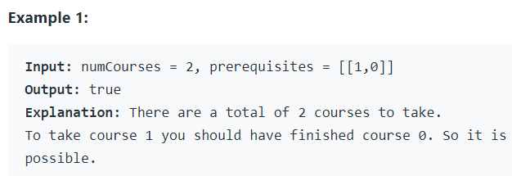
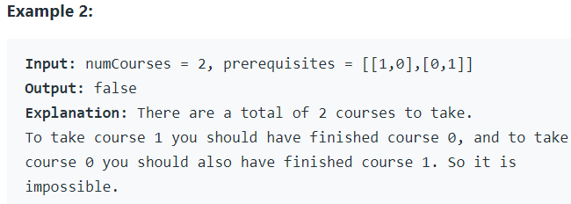
LeetCode 207. Course Schedule
There are a total of numCourses courses you have to take, labeled from 0 to numCourses - 1. You are given an array prerequisites where prerequisites[i] = [ai, bi] indicates that you must take course bi first if you want to take course ai.
For example, the pair [0, 1], indicates that to take course 0 you have to first take course 1.
Return true if you can finish all courses. Otherwise, return false.

Slide 21
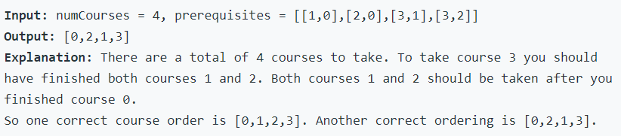
LeetCode 210. Course Schedule II
There are a total of numCourses courses you have to take, labeled from 0 to numCourses - 1. You are given an array prerequisites where prerequisites[i] = [ai, bi] indicates that you must take course bi first if you want to take course ai
For example, the pair [0, 1], indicates that to take course 0 you have to first take course 1
Return the ordering of courses you should take to finish all courses. If there are many valid answers, return any of them. If it is impossible to finish all courses, return an empty array

Slide 22
Topological Sort – Using DFS
There is another O(n+e) algorithm for topological sort that is based on the DFS
Think about how DFS works
We start from a vertex, and go all the way down the graph until we can go no further
This means that the node deepest down the tree must come last in topological order, followed by its ancestors and so on
To state this in another way, for every edge (u, v) in a DAG, the finish time of u is greater than the finish time of v.
Thus it suffices to output the vertices in reverse order of finishing time.

Slide 23
Topological Sort – based on DFS
TopSort(G){
for each u in V { // Initialization
color[u] = white;
} //end-for
L = new linked_list; // L is an empty linked list
for each u in V
if (color[u] == white)
TopVisit(u);
return L; // L gives the final order
} // end-TopSort
TopVisit(u){ // Start a new search at u
color[u] = gray; // Mark u visited
for each v in Adj[u] {
if (color[v] == white){ // if neighbor v undiscovered
TopVisit(v); // …visit v
} //end-if
} //end-for
color[u] = black; // we are done with u
Put u to the front of L; // on finishing add u to the list
} //end-TopVisit

Slide 24
Topological Sort - Example
Example: Professor Bumstead’s order of dressing
socks
shorts (1/10)
shirt (11/14)
socks (15/16)
shorts
pants
shoes
pants (2/9)
tie (12/13)
shirt
belt
belt (3/6)
shoes (7/8)
tie
jacket (4/5)
jacket
Final order: socks, shirt, tie, shorts, pants, shoes, belt, jacket
Total Running Time: O(n+e)

Slide 25
LeetCode 207 & 210
207. Course Schedule (with DFS)
210. Course Schedule II (with DFS)
2115. Find All Possible Recipes from Given Supplies (with BFS)
2049. Count Nodes With the Highest Score (with BFS)
2192. All Ancestors of a Node in a Directed Acyclic Graph (with BFS)

Slide 26
Euler Tours and Circuits
Consider the problem of drawing the following shapes without lifting your pen, drawing each line only once
Euler Tour: The start and end points may be different
Euler Circuit: Must start and end at the same point

Slide 27
Graph Representation of the Puzzle
Junctions: Vertices
Line Segments: Edges
Euler Circuit Problem: Can you find a cycle that traverses all edges exactly once, starting and ending at the same vertex?
Euler Tour Problem: A path that traverses all edges exactly once
A
B
C
G
D
E
F

Slide 28
Euler Circuit and Tour: Observations
Observation 1: An Euler circuit exists only if the graph is connected, and each vertex has even degree
Why? At every vertex, we need one edge to get out and one edge to get in
Observation 2: A graph has an Euler tour only if it is connected and all vertices except two have even degrees, and exactly two has odd degrees
A
B
C
G
D
E
F

Slide 29
How to find Euler Circuits?
Given a graph G = (V, E), find an Euler Circuit in G
Can check if one exists in O(n+e) time
How? Simply go over the adjacency list of each vertex, and see if each vertex has even degree
If all vertices have even degree, an Euler Circuit exists
Otherwise, an Euler circuit does not exist
How to compute the Euler circuit?

Slide 30
Computing the Euler Circuit
(1) Do a DFS from a vertex until you are back at this vertex
Instead of coloring vertices as done in regular DFS, we will color edges so that the same edge is not visited again (Alternatively, the visited edge is deleted)
(2) Pick another vertex having an unmarked edge and redo step (1)
(3) Combine all cycles together to get the final Euler circuit
Running time: O(n+e)

Slide 31
Example
DFS(A):
ABDFECA
Delete these edges from the graph
A
A
B
C
B
C
G
G
D
E
D
E
F
F

Slide 32
Example (continued)
DFS(B):
BGCB
Delete these edges from the graph
A
A
B
C
B
C
G
G
D
E
D
E
F
F

Slide 33
Example (continued)
DFS(D):
DEGD
Delete these edges from the graph
A
A
B
C
B
C
G
G
D
E
D
E
F
F

Slide 34
Example (continued)
We have 3 cycles
DFS(A): ABDFECA
DFS(B): BGCB
DFS(D): DEGD
Combine these together
Step 1: ABGCBDFECA
Step 2: ABGCBDEGDFECA
A
B
C
G
D
E
F

Slide 35
Final Euler Circuit
A
1
12
B
4
C
2
3
5
G
11
8
7
D
6
E
9
10
F
ABGCBDEGDFECA

Slide 36
Euler Circuit Algorithm
EulerCircuit(G){
List = []
dfs(Some initial vertex, G, List)
} // end-EulerCircuit
dfs(u, G, List){
for each (v in Adj[u]) {
Delete v from Adj[u] // Delete or mark edge (u, v)
Delete u from Adj[v] // Delete or mark edge (v, u)
dfs(v, G, List)
} //end-for
Add “u” to the front of the List
} //end-dfs

Slide 37
Euler Circuit Algorithm in Action
A
B
A
D
F
B
C
E
C
G
A
B
D
E
G
C
D
F
E
ABDFECBGDEGCA
G

Slide 38
LeetCode 332
332. Reconstruct Itinerary
Euler Circuit

Slide 39
Hamiltonian Cycle
Euler Circuit: A cycle that goes through each edge exactly once
Hamiltonian cycle: A cycle that goes through each vertex exactly once
B
C
B
C
G
G
D
E
D
E
Which of these graphs have
An Euler cycle?
A Hamiltonian cycle?

Slide 40
How to find an Hamiltonian Cycle?
Is there a simple way to check if the graph contains a Hamiltonian cycle?
No known easy algorithm to find a Hamiltonian Cycle (HC)
The best known solution is to enumerate ALL cycles in the graph and see if one of the cycles is a HC
How many cycles in a graph?
Exponential! If each vertex has degree “k”, then we have up to O(k^{n}) cycles
B
C
G
D
E

