Slide 1
Today’s Material
Disjoint-Set (Union-Find) ADT
Definition & Operations
Array-based implementation
Linked list-based implementation
Up-Trees and using up-trees to implement Disjoint Set ADT

Slide 2
Disjoint Set ADT: Formal Definition
Given a set U = {a1, a2, … , an}
Maintain a partition of U, a set of subsets (or equivalence classes) of U denoted by {S1, S2, …, Sk} such that:
each pair of subsets Si and Sj are disjoint
together, the subsets cover U
each subset has a unique name
Two operations:
Union(a, b) creates a new subset combining a’s subset and b’s subset
Find(a) returns the unique name for a’s subset

Slide 3
Disjoint Set ADT Properties
Disjoint set equivalence property: every element of a DS ADT belongs to exactly one set (its equivalence class)
Dynamic equivalence property: the set of an element can change after execution of a union
Example:
Initial Classes = {1,4,8}, {2,3}, {6}, {7}, {5,9,10}
Name of equiv. class underlined
Disjoint Set ADT
{1,4,8} {6}
{7}
{5,9,10}
{2,3}
Find(4)
{6}
8
{2,3,6}
Union(6, 2)
{2,3}

Slide 4
Implementation Ideas and Tradeoffs
How about an array implementation?
N element array A: A[i] holds the class name for element i
E.g. Assume we have the following set: {8, 4, 3}
pick 3 as class name and set A[8] = A[4] = A[3] = 3
0
1
2
3
4
5
6
7
8
9
A
0
1
1
3
3
1
6
6
3
1
Sets: {0}, {1, 2, 5, 9}, {3, 4, 8}, {6, 7}
Running time for Find(i)?
O(1) (just return A[i])
Running time for Union(i, j)?
O(N)

Slide 5
Implementation Ideas and Tradeoffs
How about linked lists?
One linked list for each equivalence class
Class name = head of list
E.g.: Sets: {0}, {1, 2, 5, 9}, {3, 4, 8}, {6, 7}
0
Running time for Union(i, j) ?
E.g. Union(1, 3)
O(1) – Simply append one list to the end of the other
1
2
5
9
3
4
8
6
7
Running time for Find(i) = ?
O(N) – Must scan all lists in the worst case

Slide 6
Implementation Ideas and Tradeoffs
 | Array Implementation | Linked List Implementation
Find(i) | O(1) | O(N)
Union(i, j) | O(N) | O(1)
Tradeoff between Union-Find: Can we do both in O(1) time?
N-1 Unions (the maximum possible) and M Finds
O(N² + M) for array
O(N + MN) for linked list implementation
Can we do this in O(M + N) time?

Slide 7
Up-Trees: Towards a new Data Structure
Intuition: Finding the representative member (= class name) for an element is like the opposite of searching for a key in a given set
So, instead of trees with pointers from each node to its children, let’s use trees with a pointer from each node to its parent
Such trees are known as Up-Trees

Slide 8
Up-Tree Data Structure
Each equivalence class (or discrete set) is an up-tree with its root as its representative member
All members of a given set are nodes in that set’s uptree
NULL
NULL
NULL
a
c
h
d
g
b
f
e
{a, d, g, b, e}
{c, f}
{h}
Up-Trees are not necessarily binary

Slide 9
Implementing Up-Trees
Forest of up-trees can easily be stored in an array
(call it “up”)
up[X] = parent of X;
= -1 if root
NULL
NULL
NULL
NULL
a
c
g
h
{g}
b
d
f
i
{c, f}
{h, i}
e
{a, b, d, e}
0(a)
1(b)
2(c)
3(d)
4(e)
5(f)
6(g)
7(h)
8(i)
Array up:
-1
0
-1
0
1
2
-1
-1
7

Slide 10
Example Find
Find(x): Just follow parent pointers to the root
Find(e) = a
Find(f) = c
Find(g) = g
NULL
NULL
NULL
NULL
a
c
g
h
{g}
b
d
f
i
{c, f}
{h, i}
e
{a, b, d, e}
0(a)
1(b)
2(c)
3(d)
4(e)
5(f)
6(g)
7(h)
8(i)
Array up:
-1
0
-1
0
1
2
-1
-1
7
Find(e)

Slide 11
Implementing Find(x)
#define N 9
int up[N];
/* Returns setid of “x”*/
int Find(int x){
while (up[x] >= 0){
x = up[x];
} /* end-while */
return x;
} /* end-Find */
NULL
NULL
NULL
NULL
a
c
g
h
{g}
b
d
f
i
{c, f}
{h, i}
e
{a, b, d, e}
Running time?
O(maxHeight)
0(a)
1(b)
2(c)
3(d)
4(e)
5(f)
6(g)
7(h)
8(i)
Array up:
-1
0
-1
0
1
2
-1
-1
7
Find(4)

Slide 12
Recursive Find(x)
#define N 9
int up[N];
/* Returns setid of “x”*/
int Find(int x){
if (up[x] < 0)
return x;
return Find(up[x]);
} /* end-Find */
NULL
NULL
NULL
NULL
a
c
g
h
{g}
b
d
f
i
{c, f}
{h, i}
e
{a, b, d, e}
0(a)
1(b)
2(c)
3(d)
4(e)
5(f)
6(g)
7(h)
8(i)
Array up:
-1
0
-1
0
1
2
-1
-1
7
Find(4)

Slide 13
Example Union
Union(x, y): Just hang one root from the other!
Union(c, a)
NULL
NULL
NULL
NULL
a
c
g
h
{g}
b
d
f
i
{h, i}
e
{a, b, d, e, c, f}
0(a)
1(b)
2(c)
3(d)
4(e)
5(f)
6(g)
7(h)
8(i)
Array up:
2
0
-1
0
1
2
-1
-1
7
-1

Slide 14
Implementing Union(x, y)
#define N 9
int up[N];
/* Joins two sets */
int Union(int x, int y){
assert(up[x] < 0);
assert(up[y] < 0);
up[y] = x;
} /* end-Union */
NULL
NULL
NULL
NULL
a
c
g
h
{g}
b
d
f
i
{h, i}
e
{a, b, d, e, c, f}
Running time?
O(1)
0(a)
1(b)
2(c)
3(d)
4(e)
5(f)
6(g)
7(h)
8(i)
Array up:
2
0
-1
0
1
2
-1
-1
7

Slide 15
MakeSet(): Creating initial sets
NULL
NULL
NULL
NULL
NULL
NULL
NULL
NULL
NULL
a
b
c
d
e
f
g
h
i
{a}
{b}
{c}
{d}
{e}
{f}
{g}
{h}
{i}
#define N 9
int up[N];
/* Make initial sets */
void MakeSets(){
int i;
for (i=0; i<N; i++){
up[i] = -1;
} /* end-for */
} /* end-MakeSets */

Slide 16
Detailed Example
Initial Sets
a
b
e
f
g
h
i
b
c
d
e
{a}
{b}
{c}
{d}
{e}
{f}
{g}
{h}
{i}
Union(b, e)
a
b
c
d
f
g
h
i
{a}
{c}
{d}
{f}
{g}
{h}
{i}
e
{b, e}

Slide 17
Detailed Example
a
b
c
d
f
g
h
i
{a}
{c}
{d}
{f}
{g}
{h}
{i}
e
{b, e}
Union(a, d)
a
b
c
f
g
h
i
{c}
{f}
{g}
{h}
{i}
d
e
{a, d}
{b, e}

Slide 18
Detailed Example
a
b
c
f
g
h
i
{c}
{f}
{g}
{h}
{i}
d
e
{a, d}
{b, e}
Union(a, b)
a
c
f
g
h
i
b
{c}
{f}
{g}
{h}
{i}
d
e
{a, d, b, e}

Slide 19
Detailed Example
a
c
f
g
h
i
d
{c}
{f}
{g}
{h}
{i}
b
e
{a, d, b, e}
Union(h, i)
a
c
f
g
h
d
{c}
{f}
{g}
b
i
e
{a, d, b, e}
{h, i}

Slide 20
Detailed Example
a
c
f
g
h
d
{c}
{f}
{g}
b
i
e
{a, d, b, e}
{h, i}
Union(c, f)
a
c
g
h
d
{g}
b
f
i
e
{c, f}
{h, i}
{a, d, b, e}

Slide 21
Detailed Example
a
c
g
h
d
{g}
b
f
i
e
{c, f}
{h, i}
{a, d, b, e}
c
g
h
{g}
Union(c, a)
f
i
a
{h, i}
Q: Can we do a better job on this union for faster finds in the future?
d
b
e
{a, d, b, e, c, f}

Slide 22
Implementation of Find & Union
#define N 9
int up[N];
/* Joins two sets */
int Union(int x, int y){
assert(up[x] < 0);
assett(up[y] < 0);
up[y] = x;
} /* end-Union */
#define N 9
int up[N];
/* Returns setid of “x”*/
int Find(int x){
if (up[x] < 0)
return x;
return Find(up[x]);
} /* end-Find */
Running time:
O(1)
Running time:
O(MaxHeight)
Height depends on previous unions
Best Case: 1-2, 1-4, 1-5, … - O(1)
Worst Case: 2-1, 3-2, 4-3, … - O(N)
Q: Can we do a better?

Slide 23
Let’s look back at our example
a
c
g
h
d
{g}
b
f
i
e
{c, f}
{h, i}
{a, d, b, e}
c
g
h
{g}
Union(c, a)
f
i
a
{h, i}
Q: Can we do a better job on this union for faster finds in the future?
How can we make the new tree shallow?
d
b
e
{a, d, b, e, c, f}

Slide 24
Speeding up Find: Union-by-Size
Idea: In Union, always make the root of the larger tree the new root – union-by-size
c
g
h
a
{g}
a
g
h
c
g
h
f
i
a
{g}
d
{g}
{h, i}
b
c
i
b
f
i
d
d
b
{h, i}
e
{c, f}
{h, i}
e
f
e
{a, d, b, e}
{a, d, b, e, c, f}
{a, d, b, e, c, f}
Initial Sets
After Union(c, a)
After Union(c, a)
with
Union-by-size

Slide 25
Trick for Storing Size Information
Instead of storing -1 in root, store up-tree size as negative value in root node
a
c
g
h
{g}
i
b
d
f
{c, f}
{h, i}
e
{a, b, d, e}
0(a)
1(b)
2(c)
3(d)
4(e)
5(f)
6(g)
7(h)
8(i)
Array up:
-4
0
-2
0
1
2
-1
-2
7

Slide 26
Implementing Union-by-Size
#define N 9
int up[N];
/* Joins two sets. Assumes x & y are roots */
int Union(int x, int y){
assert(up[x] < 0);
assert(up[y] < 0);
if (up[x] < up[y]){
// x is bigger. Join y to x
up[x] += up[y];
up[y] = x;
} else {
// y is bigger. Join x to y
up[y] += up[x];
up[x] = y;
} /* end-else */
} /* end-Union */
Running time?
O(1)

Slide 27
Running Time for Find with Union-by-Size
Finds are O(MaxHeight) for a forest of up-trees containing N nodes
Theorem: Number of nodes in an up-tree of height h using union-by-size is ≥ 2^{h}
Pick up-tree with MaxHeight
Then, 2^{MaxHeight} ≤ N
MaxHeight ≤ log N
Find takes O(log N)
Proof by Induction
Base case: h = 0, tree has 2⁰ = 1 node
Induction hypothesis: Assume true for h < h′
Induction Step: New tree of height h′ was formed via union of two trees of height h′-1 .
Each tree then has ≥ 2^{h’-1} nodes by the induction hypothesis
So, total nodes ≥ 2^{h’-1} + 2^{h’-1} = 2^{h’}
Therefore, True for all h

Slide 28
Union-by-Height
An alternative strategy is Union-by-height
Keep track of height of each up-tree in the root nodes
Union makes root of up-tree with greater height the new root
Same results and similar implementation as Union-by-Size
Find is O(log N) and Union is O(1)

Slide 29
Can we make Find go faster?
Can we make Find(g) do something so that future Find(g) calls will run faster?
Right now, M Find(g) calls run in total O(M*logN) time
Can we reduce this to O(M)?
a
c
h
b
d
f
i
{c, f}
{h, i}
e
g
{a, b, d, e, g}
Idea: Make Find have side-effects so that future Finds will run faster.

Slide 30
Introducing Path Compression
Path Compression: Point everything along path of a Find to root
Reduces height of entire access path to 1
Finds get faster!
a
c
h
a
c
h
Find(g)
b
d
f
i
e
g
d
f
i
b
{c, f}
{h, i}
{a, b, d, e, g}
{c, f}
{h, i}
e
g
{a, b, d, e, g}

Slide 31
Another Path Compression Example
a
c
a
c
b
h
f
Find(g)
e
g
b
h
f
{c, f}
{c, f}
e
d
i
d
{a, b, d, h, e, i, g}
i
g
{a, b, d, h, e, i, g}

Slide 32
Implementing Path Compression
Path Compression: Point everything along path of a Find to root
Reduces height of entire access path to 1
Finds get faster!
#define N …
int up[N];
/* Returns setid of “x” */
int Find(int x){
if (up[x] < 0)
return x;
int root = Find(up[x]);
up[x] = root; /* Point to
the root */
return root;
} /* end-Find */
Running time:
O(MaxHeight)
But, what happens to the tree height over time?
It gets smaller
What’s the total running time if we do M Finds?
Turns out this is equal to O(M*InvAccerman(M, N))

Slide 33
Running time of Find with Path Compression
What’s the total running time if we do M Finds?
Turns out this is equal to O(M*InvAccerman(M, N))
InverseAccerman(M, N) <= 4 for all practical values of M and N
So, total running time of M Finds <= 4*M=O(M)
Meaning that the amortized running time of Find with path compression is O(1)

Slide 34
Summary of Disjoint Set ADT
The Disjoint Set ADT allows us to represent objects that fall into different equivalence classes or sets
Two main operations:
Union of two classes and Find class name for a given element
Up-Tree data structure allows efficient array implementation
Unions take O(1) worst case time, Finds can take O(N)
Union-by-Size (or by-Height) reduces worst case time for Find to O(log N)
If we use both Union-by-Size/Height & Path Compression
Any sequence of M Union/Find operations results in O(1) amortized time per operation (for all practical purposes)

Slide 35
Applications of Disjoint Set ADT
Disjoint sets can be used to represent:
Cities on a map (disjoint sets of connected cities)
Electrical components on chip
Computers connected in a network
Groups of people related to each other by blood
Textbook example: Maze generation using Union/Find:
Start with walls everywhere and each cell in a set by itself
Knock down walls randomly and Union cells that become connected
Use Find to find out if two cells are already connected
Terminate when starting and ending cell are in same set i.e. connected (or when all cells are in same set)

Slide 36
Disjoint Set ADT Declaration & Operations
class DisjointSet {
private:
int *up; // Up links array
int N; // Number of sets
public:
DisjointSet(int n); // Creates N sets
~DisjointSet(){delete up;}
int Find(int x);
void Union(int x, int y);
};

Slide 37
Operations: DisjointSet, Find
/* Create N sets */
DisjointSet::DisjointSet(int n){
int i;
N = n;
up = new int[N];
for (i=0; i<N; i++) up[i] = -1;
} //end-DisjointSet
/* Returns setid of “x” */
int DisjointSet::Find(int x){
if (up[x] < 0)
return x;
int root = Find(up[x]);
up[x] = root; /* Point to
the root */
return root;
} /* end-Find */

Slide 38
Operations: Union (by size)
/* Joins two sets. Assumes x & y are roots */
int DisjointSet::Union(int x, int y){
assert(up[x] < 0);
assert(up[y] < 0);
if (up[x] < up[y]){
// x is bigger. Join y to x
up[x] += up[y];
up[y] = x;
} else {
// y is bigger. Join x to y
up[y] += up[x];
up[x] = y;
} /* end-else */
} /* end-Union */

Slide 39
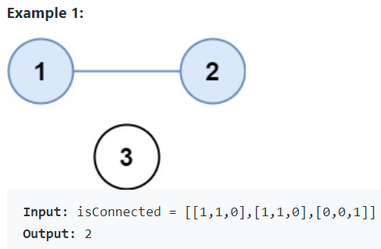
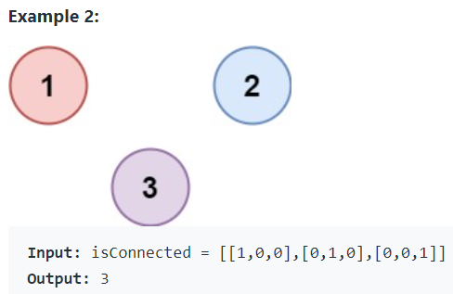
LeetCode 547. Number of Provinces
There are n cities. Some of them are connected, while some are not. If city a is connected directly with city b, and city b is connected directly with city c, then city a is connected indirectly with city c.
A province is a group of directly or indirectly connected cities and no other cities outside of the group.
You are given an n x n matrix isConnected where isConnected[i][j] = 1 if the ith city and the jth city are directly connected, and isConnected[i][j] = 0 otherwise.
Return the total number of provinces.

Slide 40
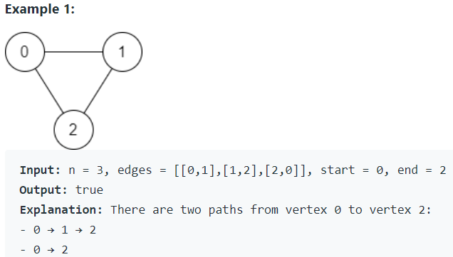
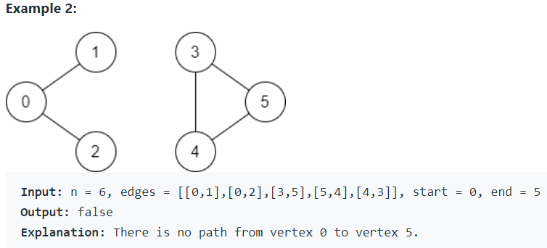
LeetCode 1971. Find if Path Exists in Graph
There is a bi-directional graph with n vertices, where each vertex is labeled from 0 to n - 1 (inclusive). The edges in the graph are represented as a 2D integer array edges, where each edges[i] = [ui, vi] denotes a bi-directional edge between vertex ui and vertex vi. Every vertex pair is connected by at most one edge, and no vertex has an edge to itself
You want to determine if there is a valid path that exists from vertex start to vertex end
Given edges and the integers n, start, and end, return true if there is a valid path from start to end, or false otherwise

Slide 41
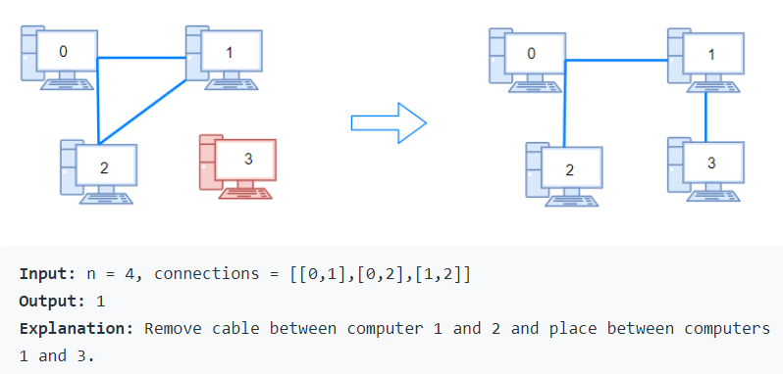
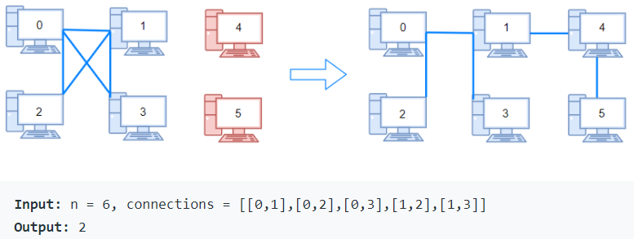
LC 1319. Number of Operations to Make Network Connected
There are n computers numbered from 0 to n-1 connected by ethernet cables connections forming a network where connections[i] = [a, b] represents a connection between computers a and b. Any computer can reach any other computer directly or indirectly through the network.
Given an initial computer network connections. You can extract certain cables between two directly connected computers, and place them between any pair of disconnected computers to make them directly connected. Return the minimum number of times you need to do this in order to make all the computers connected. If it's not possible, return -1.

Slide 42
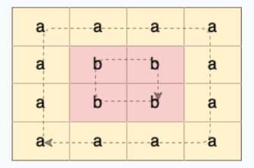
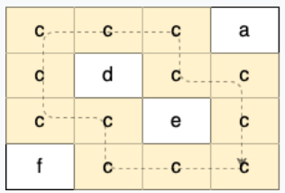
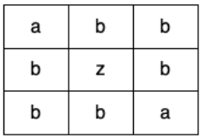
LeetCode 1559. Detect Cycles in 2D Grid
Given a 2D array of characters grid of size m x n, you need to find if there exists any cycle consisting of the same value in grid
A cycle is a path of length 4 or more in the grid that starts and ends at the same cell. From a given cell, you can move to one of the cells adjacent to it - in one of the four directions (up, down, left, or right), if it has the same value of the current cell
Also, you cannot move to the cell that you visited in your last move. For example, the cycle (1, 1) -> (1, 2) -> (1, 1) is invalid because from (1, 2) we visited (1, 1) which was the last visited cell
Return true if any cycle of the same value exists in grid, otherwise, return false

