Slide 1
Today’s Material
Minimum Spanning Trees
Problem definition
Kruskal’s MST Algorithm

Slide 2
Spanning Tree: Definition
A Spanning tree: a subset of edges from a connected undirected graph that:
touches all vertices in the graph (spans the graph)
forms a tree (is connected and contains no cycles)
A
A
A
A
5
9
9
9
B
1
C
B
C
B
1
C
B
C
2
2
4
4
7
7
7
7
4
D
D
D
D
A weighted undirected graph
Three spanning trees
Minimum Spanning Tree: Spanning tree with the least total edge cost

Slide 3
MST Problem
Given a weighted, undirected graph G=(V, E), compute the minimum cost spanning tree
MST may not be unique (unless all edge weights are distinct)
8
7
b
c
d
4
2
9
4
14
Cost = 37
a
11
i
e
7
6
8
10
h
g
f
1
2
8
7
b
c
d
4
2
9
4
14
Cost = 37
a
11
i
e
7
6
8
10
h
g
f
1
2

Slide 4
Why Compute MST?
Minimize length of gas pipelines between cities
Find cheapest way to wire a house (with minimum cable)
Find a way to connect various routers on a network that minimizes total delay
Eliminate loops in a switched LAN so that broadcast packets will not circle around indefinitely

Slide 5
Some Basic Facts about Free Trees
Notice: An MST is a free tree
A free tree with “n” vertices has exactly “n-1” edges
There exists a unique path between any two vertices of a free tree
Adding any edge to a free tree creates a unique cycle. Breaking any edge on this cycle restores a free tree

Slide 6
Computing MST–Unweighted Graphs
What if the graph is unweighted or all edge weights are equal?
Simply run BFS or DFS and the resulting tree is a MST
A
A
A
DFS(A)
BFS(A)
B
B
C
B
E
C
C
D
E
E
D
D

Slide 7
Computing MST – Weighted Graphs
We will present a greedy algorithm for computing MSTs in weighted graphs
Kruskal’s Algorithm
A greedy algorithm
always makes choices that currently seem the best
Short-sighted – no consideration of long-term or global issues
Locally optimal does not always mean globally optimal. but works in some cases, e.g., MST, shortest-paths, Huffman coding, …

Slide 8
Greedy MST Algorithms
Let G = (V, E) be an undirected, connected graph whose edges have numeric edge weights, which may be positive, negative or zero
The intuition behind the greedy algorithms is simple:
Maintain a subset of edges A, initially empty
Add edges to A one-by-one until A equals the MST
A <- EmptySet
One-by-one add a “safe” edge to A, until A equals the MST

Slide 9
When is an Edge Safe?
Let S be a subset of the vertices S ⊆ V
A cut (S, V-S) is just a bipartition of the vertices into two disjoint subsets
An edge (u, v) crosses the cut if one endpoint is in S and the other is in V-S
b
c
d
S
e
V-S
a
i
h
g
f

Slide 10
MST Lemma
Let G = (V, E) be a connected, undirected graph with real-valued weights on the edges
Let (S, V-S) be any cut
Let (u, v) be an edge that crosses this cut & has the minimum weight, i.e., (u, v) is the light edge
Then edge (u, v) is a safe edge
b
c
d
S
e
V-S
a
i
h
g
f

Slide 11
MST Lemma: Proof
9
4
u
4
u
4
u
v
v
v
7
6
x
x
x
8
8
y
y
y
A
T + (u,v)
T’ = T – (x,y) + (u,v)
Let us assume that all edge weights are distinct
Let T denote the MST
If T contains (u, v) we are done
If not, there must be another edge (x, y) that crosses the cut and is part of the MST
Let us now add (u, v) to T, thus creating a cycle
Now remove (x, y). We get another spanning tree, call it T’

Slide 12
MST Lemma: Proof
9
4
u
4
u
4
u
v
v
v
7
6
x
x
x
8
8
y
y
y
A
T + (u,v)
T’ = T – (x,y) + (u,v)
We have w(T’) = w(T) – w(x, y) + w(u, v)
Since (u, v) is the lightest edge crossing the cut, we have w(u, v) < w(x, y) Thus w(T’) < w(T) contradicting the assumption that T was an MST

Slide 13
Kruskal’s Algorithm
Generic MST Algorithm
A <- EmptySet
One-by-one add a “safe” edge to A, until A equals the MST
Kruskal’s Algorithm works by attempting to add edges to A in increasing order of weight (lightest edges first).
If the next edge does not induce a cycle among the current set of edges, then it is added to A
If it does, then this edge is passed over, and we consider the next edge in order

Slide 14
Kruskal’s Algorithm
Kruskal(G = (V, E)){
A = {}; // Initially A is empty
Sort E in increasing order by weight w;
for each ((u, v) from the sorted list){
if (adding (u, v) does not induce a cycle in A){ Add (u, v) to A;
} //end-if
} //end-for
return A; // A is the MST
} //end-Kruskal

Slide 15
Kruskal’s Algorithm: Example
8
7
b
c
d
4
2
9
4
14
a
11
i
e
7
6
8
10
h
g
f
1
2
Sorted Edge List
(i, h)
(i, g)
(i, h)
(a, b)
(c, f)
(i, g)
(h, g)
(i, c)
(g, f)
(a, b)
(c, f)
(h, g)
(i, c)
(g, f)
(d, f)
(e, f)
(b, h)
(d, f)
(d, e)
(e, f)
(b, h)
(a, h)
(b, c)
(d, e)
(c, d)
(a, h)
(b, c)
(c, d)

Slide 16
Kruskal’s Algorithm: Example
8
7
b
c
d
4
2
9
4
14
a
11
i
e
7
6
8
10
h
g
f
1
2
As this algorithm runs, the edges of A will induce a forest on the vertices
As the algorithm continues, the trees of this forest are merged together, until we have a single tree containing all the vertices

Slide 17
Kruskal’s Algorithm: Correctness
Observe that the strategy leads to a correct algorithm. Why?
Consider the edge (u, v) that Kruskal’s algorithm seeks to add next and suppose that this edge does not induce a cycle in A
Let A’ denote the tree of the forest A that contains vertex u
Consider the cut (A’, V-A’)
Every edge crossing the cut is not in A’, and (u, v) is the light edge across the cut (because any lighter edge would have been considered earlier by the algorithm)
Thus by the MST Lemma, (u, v) is safe

Slide 18
Kruskal’s Algo: Implementation
Kruskal(G = (V, E)){
A = {}; // Initially A is empty
Sort E in increasing order by weight w;
for each ((u, v) from the sorted list){
if (adding (u, v) does not induce a cycle in A){ Add (u, v) to A;
} //end-if
} //end-for
return A; // A is the MST
} //end-Kruskal
How to detect
the cycle?
The only tricky part in the algorithm is how to detect whether the addition of an edge will create a cycle in A

Slide 19
Kruskal’s Algo: Implementation
This can be done by the disjoint set (Union-Find) data structure, which supports 3 operations
CreateSet(u): Create a set containing a single item u
Find(u): Find the set that contains a given item u
Union(u, v): Merge the set containing u and the set containing v into a common set

Slide 20
Kruskal’s Algo: Implementation
In Kruskal’s Algorithm, the vertices of the graph will be the elements to be stored in the sets
The sets will be vertices in each tree of A
The set A can be stored as a simple list of edges

Slide 21
Kruskal’s Algo: Final Version
Kruskal(G = (V, E)){
A = {}; // Initially A is empty
for each (u in V)
CreateSet(u); // Create a set for each vertex
Sort E in increasing order by weight w; // O(eloge):
// e <= n^2→ loge < 2logn
for each ((u, v) from the sorted list){ // O(elogn)
if (Find(u) != Find(v)) { // if u and v are in
Add (u, v) to A; // different trees
Union(u, v);
} //end-if
} //end-for
return A;
} //end-Kruskal

Slide 22
Kruskal’s Algorithm: Example
(h, g)
(h, g)
8
7
(i, c)
b
c
d
(i, c)
4
2
9
(g, f)
4
(g, f)
14
a
11
i
e
(a, b)
7
6
(a, b)
10
8
(c, f)
g
f
(c, f)
h
1
2
(i, g)
(i, g)
(i, h)
(i, h)
i
i
c
d
g
i
i
i
b
g
i
a
g
h
a
e
f
(c, d)
(c, d)
e
a
d
a
d
d
g
g
c
g
c
f
h
c
g
c
b
h
c
(a, h)
(a, h)
b
b
h
h
f
h
f
f
h
(b, c)
f
(b, c)
(d, e)
(d, e)
(e, f)
(e, f)
(b, h)
(b, h)
(d, f)
(d, f)

Slide 23
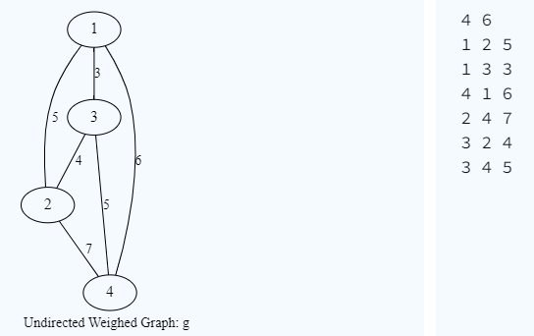
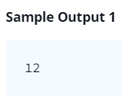
HackerRank: Kruskal (MST): Really Special Subtree
Given an undirected weighted connected graph, find the Really Special SubTree in it. The Really Special SubTree is defined as a subgraph consisting of all the nodes in the graph and:
There is only one exclusive path from a node to every other node.
The subgraph is of minimum overall weight (sum of all edges) among all such subgraphs.
No cycles are formed

Slide 24
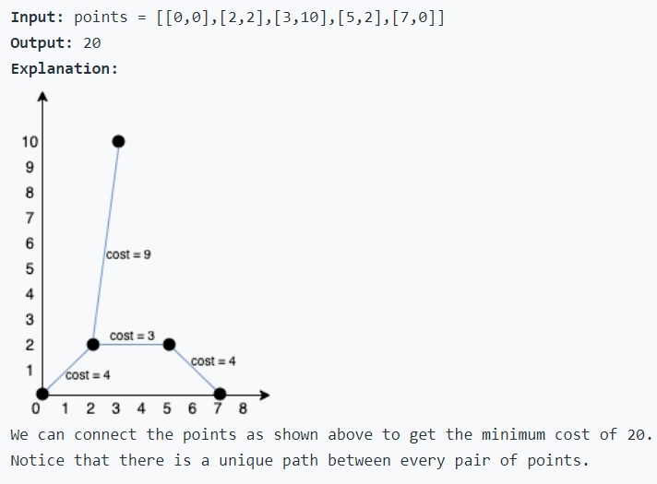
LeetCode 1584. Min Cost to Connect All Points
You are given an array points representing integer coordinates of some points on a 2D-plane, where points[i] = [xi, yi].
The cost of connecting two points [xi, yi] and [xj, yj] is the manhattan distance between them: |xi - xj| + |yi - yj|, where |val| denotes the absolute value of val.
Return the minimum cost to make all points connected. All points are connected if there is exactly one simple path between any two points.

