Slide 1
Today’s Material
Minimum Spanning Trees
Prim’s MST Algorithm

Slide 2
MST Problem
Given a weighted, undirected graph G=(V, E), compute the minimum cost spanning tree
MST may not be unique (unless all edge weights are distinct)
8
7
b
c
d
4
2
9
4
14
Cost = 37
a
11
i
e
7
6
8
10
h
g
f
1
2
8
7
b
c
d
4
2
9
4
14
Cost = 37
a
11
i
e
7
6
8
10
h
g
f
1
2

Slide 3
Kruskal’s Algorithm
Kruskal(G = (V, E)){
A = {}; // Initially A is empty
Sort E in increasing order by weight w;
for each ((u, v) from the sorted list){
if (adding (u, v) does not induce a cycle in A){ Add (u, v) to A;
} //end-if
} //end-for
return A; // A is the MST
} //end-Kruskal

Slide 4
Kruskal’s Algorithm: Example
(h, g)
(h, g)
8
7
(i, c)
b
c
d
(i, c)
4
2
9
(g, f)
4
(g, f)
14
a
11
i
e
(a, b)
7
6
(a, b)
10
8
(c, f)
g
f
(c, f)
h
1
2
(i, g)
(i, g)
(i, h)
(i, h)
i
i
c
d
g
i
i
i
b
g
i
a
g
h
a
e
f
(c, d)
(c, d)
e
a
d
a
d
d
g
g
c
g
c
f
h
c
g
c
b
h
c
(a, h)
(a, h)
b
b
h
h
f
h
f
f
h
(b, c)
f
(b, c)
(d, e)
(d, e)
(e, f)
(e, f)
(b, h)
(b, h)
(d, f)
(d, f)

Slide 5
Prim’s Algorithm
Prim’s Algorithm is another greedy algorithm for MST
Differs from Kruskal’s Algorithm only in how it selects the next “safe edge” to add at each step

Slide 6
Why study Prim’s Algorithm?
2 reasons to study Prim’s Algorithm
To show that there is more than one way to solve a problem
An important lesson to learn in algorithm design
Prim’s algorithm looks very much like another Greedy Algorithm, called Dijkstra’s Algorithm used to compute shortest paths
Thus not only Prim’s algorithm is a different way to solve a different problem, it is also the same way to solve a different problem

Slide 7
Prim’s Algorithm: Pseudocode
Prim(G = (V, E)) {
Start with a root vertex “r” (any vertex in the graph)
A = {r};
for (i=1; i<=n-1; i++) {
1. Consider the cut (A, V-A)
2. Let (u, v) be the light edge that crosses the cut
such that u Є A & v Є V-A
3. Add v to A, i.e., A = A U {v};
} //end-for
return A; // A is the MST
} //end-Prim

Slide 8
Prim’s Algo: Growing the Tree
12
12
10
10
6
6
r
7
r
7
11
3
u
4
u
u
9
5
5
Current Tree Vertices (A)
After “u” is added

Slide 9
Prim’s Algo: Growing the Tree
Observe that we consider the set of vertices A current part of the tree, and its complement (V-A)
We have a cut of the graph (A, V-A)
Which edge should we add next?
MST Lemma tells us that it is safe to add the light edge

Slide 10
Prim’s Algorithm: Example
8
7
4
2
9
4
14
11
7
6
8
10
1
2

Slide 11
Prim’s Algo: Implementation
Prim(G = (V, E)) {
A = {r};
for (i=1; i<=n-1; i++) {
1. Consider the cut (A, V-A)
2. Let (u, v) be the light edge that crosses the cut
such that u Є A & v Є V-A
3. Add v to A, i.e., A = A U {v};
} //end-for
return A; // A is the MST
} //end-Prim
The key question in the efficient implementation of Prim’s algorithm is
how to update the cut efficiently
how to determine the light edge quickly

Slide 12
Prim’s Algo: Implementation - I
Prim(G = (V, E)) {
for all u in V do color[u] = white;
color[r] = black;
for (i=1; i<=n-1; i++) {
min = INFINITY; // cost of the light edge
(x, y) = (?, ?); // light edge
for all (u, v) in E do {
if (color[u] == black && color[v] == white &&
w(u,v) < min){
(x, y) = (u, v); // (u, v) is current light edge
min = w(u, v);
} //end-if
} //end-for
color[y] = black; // Add y to A
} //end-for
return A; // A is the MST
} //end-Prim
n times
O(e)
Running Time?
O(nxe)

Slide 13
Prim’s Algo: Implementation - II
For faster implementation, we will make use of your favorite DS, the Priority Queue
Recall that a PQ stores a set of items, where each item is associated with a key value, and supports 3 operations (all can be implemented in O(logn))
Insert(Q, u, key): Insert u with key value key in Q
u = Extract_Min(Q): Extract the item with the minimum key value in Q
Decrease_Key(Q, u, new_key): Decrease the value of u’s key value to new_key

Slide 14
Prim’s Algo: Implementation
What do we store in the priority queue?
The idea is the following:
For each vertex in u ε V-A (i.e. not part of the current spanning tree), we associate u with a key value key[u], which is the weight of the lightest edge going from u to any vertex in A
We also store in pred[u] the end of this edge in A
If there is no edge from u to a vertex in V-A, then we set its key value to +infinity
We also need to know which vertices are in A
We do this by coloring the vertices in A black
Here is the algorithm…

Slide 15
Prim’s Algo: Implementation
Prim(G, w, r){
For each (u in V) { // Initialization
key[u] = +infinity;
color[u] = white;
} //end-for
key[r] = 0; // Start at root
Pred[r] = nil;
Q = build initial queue with all vertices;
while (Non_Empty(Q)){ // Until all vertices in MST
u = Extract_Min(Q); // Vertex with lightest edge
for each (v in Adj[u]) {
if (color[v] == white && (w(u, v) < key[v])){
key[v] = w(u, v); // New lighter edge out of v
Decrease_Key(Q, v, key[v]);
pred[v] = u;
} //end-if
} //end-for
color[u] = black;
} //end-while
[prev pointers define the MST as an inverted tree rooted at r]
} //end-Prim
n times
O(logn)
e times
O(logn)
Running Time?
O(nlogn + elogn)

Slide 16
Prim’s Algorithm: Example
4
8
7
∞
∞
∞
4
2
9
0
∞
4
0
11
14
∞
7
6
8
10
8
∞
∞
∞
1
2
4
8
∞
7
∞
4
2
9
0
11
∞
4
14
∞
7
6
8
10
8
∞
∞
1
2

Slide 17
Prim’s Algorithm: Example
4
8
8
7
∞
4
∞
4
2
9
0
11
∞
4
14
∞
7
6
8
10
8
∞
∞
1
2
4
8
8
7
∞
4
2
9
0
11
∞
4
14
∞
7
6
8
10
8
∞
∞
1
2

Slide 18
Prim’s Algorithm: Example
8
8
7
∞
4
8
7
4
2
9
2
4
0
11
∞
14
∞
7
6
8
10
4
8
∞
∞
1
2
4
8
8
7
7
4
2
9
0
11
2
4
14
∞
7
6
8
10
8
∞
4
1
2

Slide 19
Prim’s Algorithm: Example
4
8
8
7
7
4
2
9
2
4
0
11
2
14
∞
7
6
8
10
7
6
4
8
∞
1
2
4
8
8
7
7
4
2
9
0
11
2
4
14
10
7
6
8
10
7
6
4
1
2

Slide 20
Prim’s Algorithm: Example
4
8
8
7
7
4
2
9
0
11
2
4
14
∞
10
7
6
8
10
4
7
2
4
6
1
2
4
8
8
7
7
4
2
9
0
11
2
4
14
10
7
6
8
10
7
2
4
1
2

Slide 21
Prim’s Algorithm: Example
4
8
8
7
7
4
2
9
0
11
2
4
14
10
7
6
8
10
1
4
7
2
2
1
2
4
8
8
7
7
4
2
9
0
11
2
4
14
10
7
6
8
10
1
2
4
1
2

Slide 22
Prim’s Algorithm: Example
4
8
8
7
7
4
2
9
0
11
2
4
14
10
7
6
8
10
1
2
4
1
1
2
4
8
8
7
7
4
2
9
0
11
2
4
14
10
7
6
8
10
1
2
4
1
2

Slide 23
Prim’s Algorithm: Example
8
7
7
4
8
7
4
2
9
0
11
2
4
14
10
9
7
6
8
10
1
2
4
1
2
4
8
8
7
7
4
2
9
0
11
2
4
14
9
7
6
8
10
1
2
4
1
2

Slide 24
Prim’s Algorithm: Example
4
8
8
7
7
4
2
9
0
11
2
4
14
9
9
7
6
8
10
1
2
4
1
2
4
8
8
7
7
4
2
9
0
11
2
4
14
9
7
6
8
10
1
2
4
1
2

Slide 25
Prim’s Algorithm: Example
4
8
8
7
7
4
2
9
0
11
2
4
14
9
7
6
8
10
1
2
4
1
2
prev pointers define the MST as an inverted tree rooted at r
4
8
8
7
7
4
2
9
0
2
4
9
1
2
4
1
2

Slide 26
Implementing Prim’s Algorithm in C++
C++ priority_queue class has 3 operations only:
top(): to get the top element without removing
pop(): Remove the top element
push(element): Push the element to the PQ
As you can see, there is NO decrease_key method!
In order to implement Prim’s algorithm using C++ priority_queue, we will re-insert the vertex into the PQ with the vertex’s new key
This means that when we pop() the top element from the PQ, it may have already been processed
We will check whether this vertex has already been added to MST by coloring the vertices
Look at the sample C++ code

Slide 27
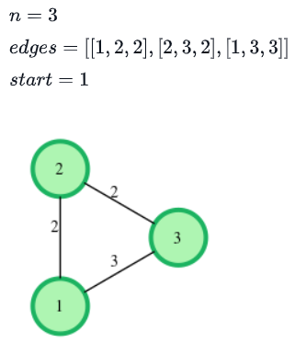
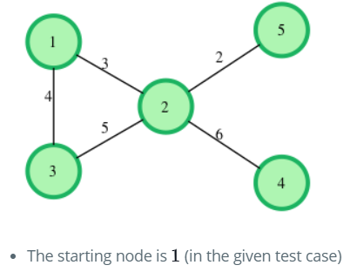
HackerRank: Prims (MST): Special Subtree
Given a graph which consists of several edges connecting its nodes, find a subgraph of the given graph with the following properties:
The subgraph contains all the nodes present in the original graph.
The subgraph is of minimum overall weight (sum of all edges) among all such subgraphs.
There is exactly one, exclusive path between any two nodes of the subgraph.
One specific node is fixed as the starting point of finding the subgraph using the Prim's algorithm.
Find the total weight or the sum of all edges in the subgraph.

Slide 28
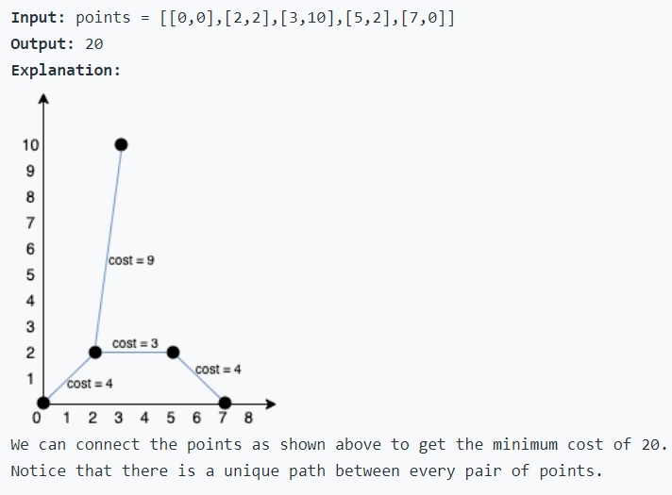
LeetCode 1584. Min Cost to Connect All Points
You are given an array points representing integer coordinates of some points on a 2D-plane, where points[i] = [xi, yi].
The cost of connecting two points [xi, yi] and [xj, yj] is the manhattan distance between them: |xi - xj| + |yi - yj|, where |val| denotes the absolute value of val.
Return the minimum cost to make all points connected. All points are connected if there is exactly one simple path between any two points.

