Slide 1
Today’s Material
Single Source Shortest Path Problem
Preliminary Definitions
Path, Cycle, Path Length, Path Cost
Problem Description
Dijkstra’s Algorithm
Bellman-Ford Algorithm

Slide 2
Paths
A path is a list of vertices {v1, v2, …, vn} such that (vi, vi+1) is in E for all 1 ≤ i < n.
p = {A, E, B, C}
p = {B, A, E, C, D}
p = {D, E, B, A, E, C}
A
B
E
D
C
A simple path repeats no vertices
p = {A, E, B, C}
p = {D, A, E, B, C}

Slide 3
Cycles
A cycle is a path that starts and ends at the same vertex
p = {A, E, B, C, D, A}
p = {B, A, E, B}
p = {D, E, B, A, E, C, D}
A
B
E
D
C
A simple cycle repeats no vertices except the first vertex is also the last
p = {A, E, B, C, D, A}
p = {B, A, E, B}

Slide 4
Path Length and Path Cost
Path length: the number of edges in the path
Path cost: the sum of the costs of each edge
Note: Path length = unweighted path cost (edge weight = 1)
2
B
A
3
6
4
E
8
7
1
D
C
5
P = {B, A, E, C, D}
Length(p) = 4
Cost(p) = 2+3+1+5=11

Slide 5
Single Source Shortest Path Problem
Given a graph G = (V, E) and a “source” vertex s in V, find the minimum cost paths from s to every vertex in V
Different variations
unweighted vs. weighted
positive weights only vs. negative weights allowed
…

Slide 6
Why study Shortest Path Problem?
Optimizing traveling routes
What is the shortest path from Queens to city X?
What is the most fuel-efficient path from Queens to city X?
Optimizing routing of packets on the Internet:
Vertices = routers, edges = network links with different delays
What is the routing path with smallest total delay?

Slide 7
Unweighted Shortest Path Problem
Problem: Given a “source” vertex s in an unweighted graph G = (V,E), find the shortest path from s to all vertices in G
A
B
F
H
C
Source
G
D
E
Compute shortest path from C to:
A, B, D, E, F, G, H

Slide 8
Solution Based on BFS
Basic Idea: Starting at node s, find vertices that can be reached using 0, 1, 2, 3, …, N-1 edges (works even for cyclic graphs!)
C
A
B
F
H
A
D
E
C
Source
G
B
G
D
E
F
BFS Tree
rooted at C
Running Time?
O(n+e)
H

Slide 9
What if the edges have weights?
Does BFS still work on this graph?
No. Minimum cost path is typically different than the minimum length path (path cost vs path length)
2
B
Minimum length path from C to A:
C->A (length: 1, cost: 9)
Computed by BFS
Minimum cost path from C to A:
C->E->D->A (length: 3, cost: 8)
How do we compute this?
A
1
1
9
3
C
8
2
D
E
3

Slide 10
Dijkstra’s Algorithm for Weighted Shortest Path (Minimum Cost Path)
Classic algorithm for computing shortest paths in weighted graphs (without negative weights)
Example of a greedy algorithm
Irrevocably makes decisions without considering future consequences
Not necessarily the best life strategy, but works in some cases (e.g. Huffman encoding)

Slide 11
Dijkstra’s Algorithm
Basic idea is similar to BFS
Each vertex stores a cost for path from source
Vertex to be expanded is the one with least path cost seen so far
Greedy choice – always select current best vertex
Update costs of all neighbors of selected vertex
While BFS expands the wave on path length, Dijkstra extends the wave on path cost

Slide 12
Dijkstra’s Algorithm - Sketch
Maintain a set of vertices for which the final cost of the shortest path is known
Initially only the cost of the shortest path to the source vertex is known – equal to 0
Repeat until costs of all vertices are known:
Select the current best vertex from among the unknown vertices, i.e., the vertex with the smallest cost, and add this vertex to the set of known vertices
Update costs of the neighbors of the selected vertex

Slide 13
Relaxation
Let u be the vertex selected at step 1
Updating costs of neighbors of u is called relaxation, and is done as follows:
There are two ways to go from s to v:
Either follow the red path with a cost of 11
Or, follow the blue path: First go from s to u with a cost of 3, and then take the edge (u, v) with a cost of 5 for a total cost of 8
u
u
5
v
5
v
s
3
s
3
Relax(u, v)
8
11
0
0

Slide 14
Relaxation - Pseudocode
u
u
5
v
5
v
s
3
s
3
Relax(u, v)
8
11
0
0
Relax(u, v){
if (cost[u] + w(u, v) < cost[v]){ // Is the path through u shorter?
cost[v] = cost[u] + w(u, v); // Yes. Then take it
pred[v] = u; // Record that we came from u
} //end-if
} //end-Relax

Slide 15
Dijkstra’s Algorithm in action
2
∞
∞
A
9
B
Select current best vertex – C
Add it to the known vertex set
Update costs of all neighbors of the selected vertex
1
1
9
C
3
0
0
8
2
8
∞
∞
D
2
E
3
Neighbor A: 0 + 9 < ∞ → cost(A) = 9
Neighbor D: 0 + 8 < ∞ → cost(D) = 8
Neighbor E: 0 + 2 < ∞ → cost(E) = 2

Slide 16
Dijkstra’s Algorithm in action
2
∞
A
9
B
1
Select current best vertex – E
Add it to the known vertex set
Update costs of all neighbors of the selected vertex
1
9
C
3
0
8
2
8
5
2
D
2
E
3
Neighbor D: 2 + 3 = 5 < 8 → cost(D) = 5

Slide 17
Dijkstra’s Algorithm in action
8
2
∞
A
9
B
Select current best vertex – D
Add it to the known vertex set
Update costs of all neighbors of the selected vertex
1
1
9
C
3
0
8
2
5
5
2
D
2
E
3
Neighbor A: 5 + 3 = 8 < 9 → cost(A) = 8

Slide 18
Dijkstra’s Algorithm in action
2
∞
Select current best vertex – A
Add it to the known vertex set
Update costs of all neighbors of the selected vertex
8
10
A
8
B
1
1
9
C
3
0
8
2
D
5
2
E
3
Neighbor B: 8 + 2 = 10 < ∞ → cost(B) = 10

Slide 19
Dijkstra’s Algorithm in action
2
10
Select current best vertex – B
Add it to the known vertex set
Update costs of all neighbors of the selected vertex
A
8
10
B
1
1
9
C
3
0
8
2
D
5
2
E
3

Slide 20
Pseudocode for Dijkstra’s Algorithm
1. for all u in V do
cost[u] = ∞; pred[u] = null;
end-for
2. cost[s] = 0;
3. While there are unknown nodes left in the graph do
- u = Unknown node with the lowest cost
- Mark u as known
- For each node v adjacent to u do
If (cost[u] + w(u, v) < cost[v]){
cost[v] = cost[u] + w(u, v);
pred[v] = u;
end-if
end-for
end-while
O(n)
n times
O(n)
O(e)
Running Time?
O(n+ n*n + e) = O(n² + e)
Dense Graph: e = O(n²) →
O(n² + e) = O(n²) = O(e)
Sparse Graph: e = O(n) →
O(n² + e) = O(n²) = O(e²)

Slide 21
Speeding up Dijkstra’s Algorithm
1. for all u in V do
cost[u] = ∞; pred[u] = null;
end-for
2. cost[s] = 0;
3. While there are unknown nodes left in the graph do
- u = Unknown node with the lowest cost
- Mark u as known
- For each node v adjacent to u do
If (cost[u] + w(u, v) < cost[v]){
cost[v] = cost[u] + w(u, v);
pred[v] = u;
end-if
end-for
end-while
DeleteMin: O(logn)
DecreaseKey
O(logn)
Running Time: O(nlogn + elogn)
Can we implement this algorithm faster?
Use a heap to select the lowest cost vertex →O(logn)
You now have to update the heap when the cost of the vertex changes: DecreaseKey→O(logn)

Slide 22
Dijkstra’s Algorithm: Fast Implementation
1. for all u in V do
cost[u] = ∞; pred[u] = null;
end-for
2. cost[s] = 0;
3. H = MakeHeap(V);
4. While there are unknown nodes left in the graph do
- u = DeleteMin(H);
- Mark u as known
- For each node v adjacent to u do
If (cost[u] + w(u, v) < cost[v]){
cost[v] = cost[u] + w(u, v);
DecreaseKey(H, v);
pred[v] = u;
end-if
end-for
end-while

Slide 23
Implementing Dijkstra’s Algorithm in C++
C++ priority_queue class has 3 operations only:
top(): to get the top element without removing
pop(): Remove the top element
push(element): Push the element to the PQ
As you can see, there is NO decrease_key method!
In order to implement Dijkstra’s algorithm using C++ priority_queue, we will re-insert the vertex into the PQ with the vertex’s new key
This means that when we pop() the top element from the PQ, it may have already been processed
We will check whether this vertex has already been added to MST by coloring the vertices
Look at the sample C++ code

Slide 24
Does Dijkstra’s algorithm always work?
Dijkstra’s algorithm is an example of a greedy algorithm
Greedy algorithms always make choices that currently seem the best
Short-sighted – no consideration of long-term or global issues
Locally optimal does not always mean globally optimal
In Dijkstra’s case – choose the least cost node, but what if there is another path through other vertices that is cheaper?
Can prove: Never happens if all edge weights are positive

Slide 25
Informal Proof of Correctness
Known Cloud
y
s
u
Assume u is the next vertex added to the known cloud
We know that cost(u) is the minimum among unknown vertices
We claim that cost(u) is the cost of the shortest path (red path) from s to u at the point when u is added to the known cloud
Assume to the contrary that this is not true
Then there must be another path that is shorter (e.g., blue path)
For this to be true, cost(y) must be smaller than cost(u) at the time when u is added to the known cloud. Why? Because all edge weights are positive! This is a contradiction. QED.

Slide 26
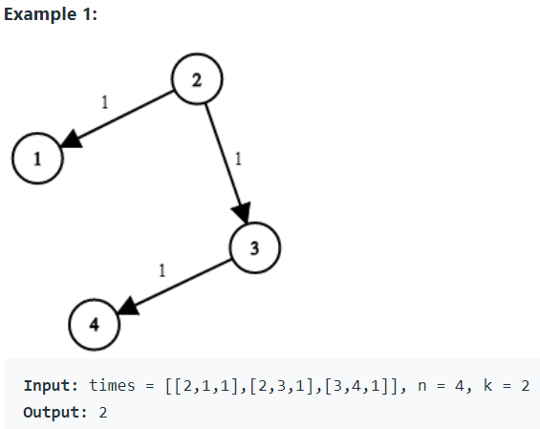
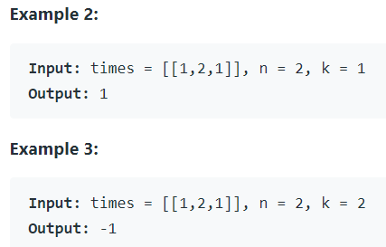
LeetCode 743. Network Delay Time
You are given a network of n nodes, labeled from 1 to n. You are also given times, a list of travel times as directed edges times[i] = (ui, vi, wi), where ui is the source node, vi is the target node, and wi is the time it takes for a signal to travel from source to target.
We will send a signal from a given node k. Return the time it takes for all the n nodes to receive the signal. If it is impossible for all the n nodes to receive the signal, return -1.

Slide 27
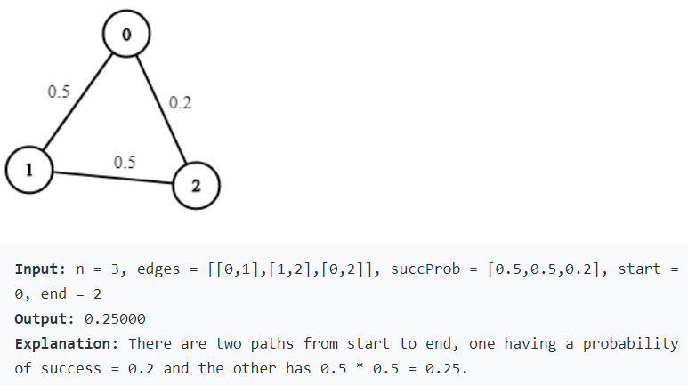
LeetCode 1514. Path with Maximum Probability
You are given an undirected weighted graph of n nodes (0-indexed), represented by an edge list where edges[i] = [a, b] is an undirected edge connecting the nodes a and b with a probability of success of traversing that edge succProb[i].
Given two nodes start and end, find the path with the maximum probability of success to go from start to end and return its success probability
If there is no path from start to end, return 0. Your answer will be accepted if it differs from the correct answer by at most 1e-5.

Slide 28
Dijkstra with Negative Weights
Dijkstra fails to compute shortest cost paths if there are edges with negative weights
Shortest path from A to C
Dijkstra computes: A->C, cost: 2
Real shortest path: A->B->C, cost: 1
What if we add a positive constant to all edge weights?
A
3
B
2
-2
C

Slide 29
Dijkstra with Negative Weights
What if we add a positive constant to all edge weights and run Dijkstra on the new graph?
3
A
5
A
B
B
Add 2 to
all edge
weights
2
4
0
-2
C
C
Shortest path from A to C
Dijkstra still computes: A->C
Real shortest path: A->B->C

Slide 30
Shortest Path on Graphs with Negative Edge Weights?
We know that Dijkstra fails to work on graphs with negative edge weights
How do compute shortest paths on graphs with negative edge weights?
Bellman-Ford: Repeated Relaxation

Slide 31
Negative Cost Cycles
If the graph has a negative cost cycle, then the shortest paths are not defined
A
1
B
2
-8
C
4
D
What’s the least cost path from A to D?
Or to B or C?
Least cost paths are undefined for this graph since there is a negative cost cycle: A->B-C->A

Slide 32
Bellman-Ford Algorithm
Based on the notion of performing repeated relaxations
Basic Idea:
Maintain a distance estimate for each vertex
Initially set cost(s) = 0, cost(u)=∞ for all other vertices
Progressively perform relaxation over all edges until shortest cost paths are computed
The algorithm also finds whether the graph has any negative weight cycles

Slide 33
Belman-Ford Algorithm Implementation
BellmanFord(G, w, s){
For each (u in V) { // Initialization
cost[u] = +∞
prev[u] = nil
} //end-for
cost[s] = 0;
for i=1 to n-1 do {
for each edge (u, v) ε E {
if (cost[u] + w(u, v) < cost[v]) { // Relax
cost[v] = cost[u] + w(u, v);
pred[v] = u;
} //end-if
} //end-for
} //end-for
for each edge (u, v) ε E do{
if (cost[v] > cost[u] + w(u, v)) then
return FALSE;
} //end-for
return TRUE;
} //end-BellmanFord
Running Time?
n-1 times
O(n*e)
O(e)

Slide 34
Bellman-Ford Algorithm: Example
B
Vertex
Cost
Pred
0
4
∞
A
4
-3
A
0
-
B
∞
4
-
-2
∞
A
2
1
E
3
3
A
C
2
B
∞
-
1
∞
-1
2
6
∞
3
D
∞
-
C
D
6
B
E
1
B
∞
-
(B, D)
(B, D)
(B, E)
(B, E)
(D, E)
(C, D)
(D, E)
(C, D)
(A, B)
(A, B)
(A, C)
(A, C)
(B, C)
(B, C)
First Iteration

Slide 35
Bellman-Ford Algorithm: Example
B
Vertex
Cost
Pred
0
4
4
A
-3
A
0
-
-2
2
1
E
B
4
A
3
C
2
B
1
6
-1
2
3
D
3
C
C
D
6
B
E
1
B
(B, D)
(B, D)
(B, E)
(B, E)
(D, E)
(C, D)
(D, E)
(C, D)
(A, B)
(A, B)
(A, C)
(A, C)
(B, C)
(B, C)
Second Iteration

Slide 36
Bellman-Ford Algorithm: Example
B
Vertex
Cost
Pred
0
4
4
A
-3
A
0
-
-2
2
1
E
B
4
A
3
C
2
B
1
3
-1
C
2
D
3
C
D
E
1
B
(B, D)
(B, D)
(B, E)
(B, E)
(D, E)
(C, D)
(D, E)
(C, D)
(A, B)
(A, B)
(A, C)
(A, C)
(B, C)
(B, C)
Third & Fourth Iteration

Slide 37
Bellman-Ford Algorithm: Final Result
4
B
0
A
0
4
-3
A
-2
1
E
4
3
2
-1
B
4
2
1
3
-3
C
D
-2
C
2
1
E
Vertex
Cost
Pred
1
A
0
-
D
3
B
4
A
C
2
B
D
3
C
E
1
B

Slide 38
LeetCode 743. Network Delay Time
You are given a network of n nodes, labeled from 1 to n. You are also given times, a list of travel times as directed edges times[i] = (ui, vi, wi), where ui is the source node, vi is the target node, and wi is the time it takes for a signal to travel from source to target.
We will send a signal from a given node k. Return the time it takes for all the n nodes to receive the signal. If it is impossible for all the n nodes to receive the signal, return -1.

