Slide 1
ComplaintPro: Complaint Management System of Barangay Kingking
A Console-Based Mini Information System for Efficient Complaint Management

Slide 2
Project Overview:
Description: ComplaintPro is a console-based mini information system developed in Kotlin to automate barangay complaint management, addressing manual inefficiencies like delayed responses and misplaced records.
Problem Addressed: Traditional methods (logbooks/paper forms) lead to disorganized tracking, officer conflicts, and slow resolutions.
Solution: Organizes resident info, urgency, officer assignments, histories, and statuses for streamlined operations.

Slide 3
Objectives:
General Objective:
To develop a console-based mini-system that helps the barangay manage complaints efficiently, allowing residents to report issues and officers to track, assign, and resolve them in an organized and timely manner, improving complaint handling and community communication.
Specific Objectives:
Manage submission of complaints with resident details.
Determine urgency and seriousness of each complaint.
Schedule settlements with time only if required (Amicable Settlement or Hearing).
Allow immediate resolution of minor complaints without meetings.
Assign officers to complaints and track their availability.
Update complaint status (Pending, In Progress, Resolved).
Edit Complaint easily.
Maintain a history of resolved complaints for record-keeping.

Slide 4
Significance of the study:
To Residents: Organized, transparent process for submitting complaints; urgent issues are tracked, minor ones resolved immediately, and unresolved escalated to Amicable Settlements/hearings.
To Barangay Officers: Structured assignments prevent double-booking, allowing efficient focus on resolutions.
To Barangay Administrators: Improved efficiency, reduced workload, and better record organization (histories, schedules, updates).
To Communities: Faster responses, accountability, and systematic handling foster trust and responsive operations.

Slide 5
System Design and Architecture:
Architecture: Modular console-based design with classes for ComplaintManager, OfficerManager, and InputHelper.
Data Structures:
Resident: Name, contact, address.
Complaint: ID, resident, description, status, settlement type/date, assigned officer.
Officer: ID, name, availability.
Key Classes:
ComplaintManager: Handles submission, viewing, updates, and history.
OfficerManager: Manages assignments and availability.
InputHelper: Validates inputs (e.g., dates, contacts).

Slide 6
Implementation Details - Core Features:
Complaint Submission: Multi-step with validation (e.g., 11-digit contacts, future dates); determines seriousness and schedules hearings/settlements.
Viewing and Filtering: Displays complaints by status; shows messages if empty (e.g., "No pending complaints").
Officer Assignment: Assigns only to unassigned complaints; changes require prior assignment.
Editing Complaint: it can edit all complaints data.
Status Updates: Updates with duplicate checks (e.g., "Status is already Pending"); resolves and archives.
History: Maintains resolved complaints for records.

Slide 7
Validation Rules: Contacts (11 digits), dates (MM/DD/YYYY, future-only), non-empty fields; yes/no with shortcuts (y/n).
Error Messages: "Date cannot be in the past," "Complaint not found," "No officer assigned."
Navigation: Consistent "b" (back) and “c" (menu) for seamless flow.
Input Validation and Error Handling:

Slide 8
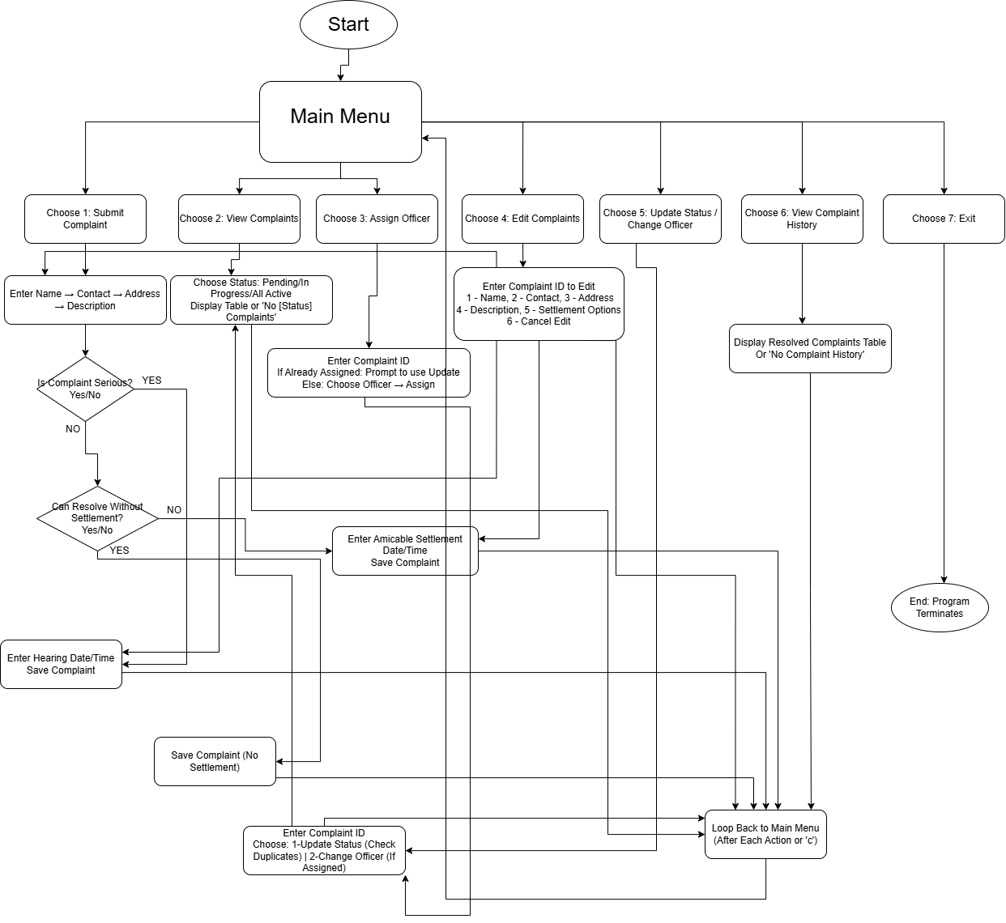
Flowchart:

Slide 9
ComplaintPro successfully delivers an efficient, Kotlin-based console system for barangay complaint management, fulfilling all objectives and enhancing community responsiveness through automated, organized processes.
Conclusion:

