Slide 1
Towards a smart city: An air quality monitoring system in Perheim
Pervasive Computing
Notes:
Air pollution is becoming more important as the focus on serious health issues and environmental pollution caused by particulate matter and industrial gases increases.
This is from pressing importance for the city of Perheim since one of Germanies biggest chemical companies is within a radius of 5 km.
Despite the growing importance, there is currently almost no possibility for the general public to gain information on the current air pollution in their surroundings.
Therefore we are proposing the implementation of an air quality monitoring system which is accessible for everybody.

Slide 2
Agenda
Introduction
Sensor Based Air Quality Monitoring
Use Cases
Economic Feasibility
Technical Implementation
Conclusion
Notes:
First we want to provide some more information what Air Qauility.
Before we start with the use cases we are briefly discussion why we chose an air quality monitoring system that used sensors.

Slide 3
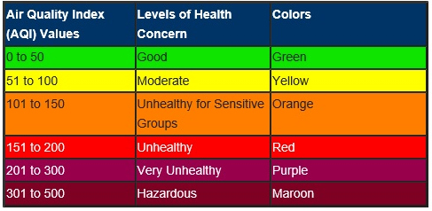
Introduction – Air Quality
Measuring the Air Quality:
The Air Quality Index is a standard index which is used to classify the air pollution within a certain region.
Risks caused by air pollution:
Health risks that lead to a total mortality of 6 % due to various diseases.
Environmental changes
Notes:
Poor air quality caused by industry and daily life leads to health risks and adversely impacts the environment. Inhabitants of big cities are particularly affected by air pollutants, which might manifest themselves in smog or an industrial smell
As air quality declines, the risk of stroke, heart disease, lung cancer, and chronic and acute respiratory diseases, including asthma, increases for the people who live in them.
PM 2.5 – Fine Particles

Slide 4
Sensor Based Air Quality Monitoring
Existing approaches are focusing on:
Air Quality Monitoring for the City of Perheim
Low-cost crowd sensing sensors
Combination of sensors with video monitoring of traffic
Using a neural network to predict future air pollution
Small number of existing sensors to measure the air pollution

Slide 5

Use Cases
Source: SAP Image Library

Slide 6
Use Cases
Managing health risks
Environmental damage
Get information about most toxic air pollution
Recommendation when to leave the house
Sensor for windows when to open and close
Get information about most toxic air pollution
Recommendation when to leave the house
Sensor for windows when to open and close
Enabling law execution
Psychological effect
Use measurements to execute the current law
Biggest sector: industry and car traffic
The direct confrontation with the monitored air quality can lead to a higher ecological awareness

Slide 7

Economic Feasibility
Tax-payer funded service
Subscription-based service
Voluntary contribution
Data as a product
Source: SAP Image Library

Slide 8

Technical Implementation Hardware
Building the air quality sensors
The focus of the first generation is to provide a cheap solution to reduce the entry barrier:
Using Arduino hardware and software as foundation
Add several sensor for measuring different toxics
Ozone: SainSmart MQ131
Particulate matter: Grove Dust Sensor
Sulfur dioxide: Mq2 Gas Sensor
Carbon monoxide: Mq9 Gas Sensor
Nitrous oxide: MICS-2714
Sensor will be placed in weatherproof box
Source: SAP Image Library
Notes:
Focus on the Approximate costs for one: 150€

Slide 9
Technical Implementation Backend for data processing
Backend Characteristics:
Accessible through API
Main functionalities:
Receive, process, store and handle incoming data: The data set will be a JSON object that contains:
Measurement
Timestamp
Location
Additional functionalities:
Provision of second API that provides the following features:
Accept GET requests and return the currently set measurement interval
Accept PUT and POST request to set a new measurement interval
Error handling in case of a wrong request format
Authorization and authentication checks for each request

Slide 10
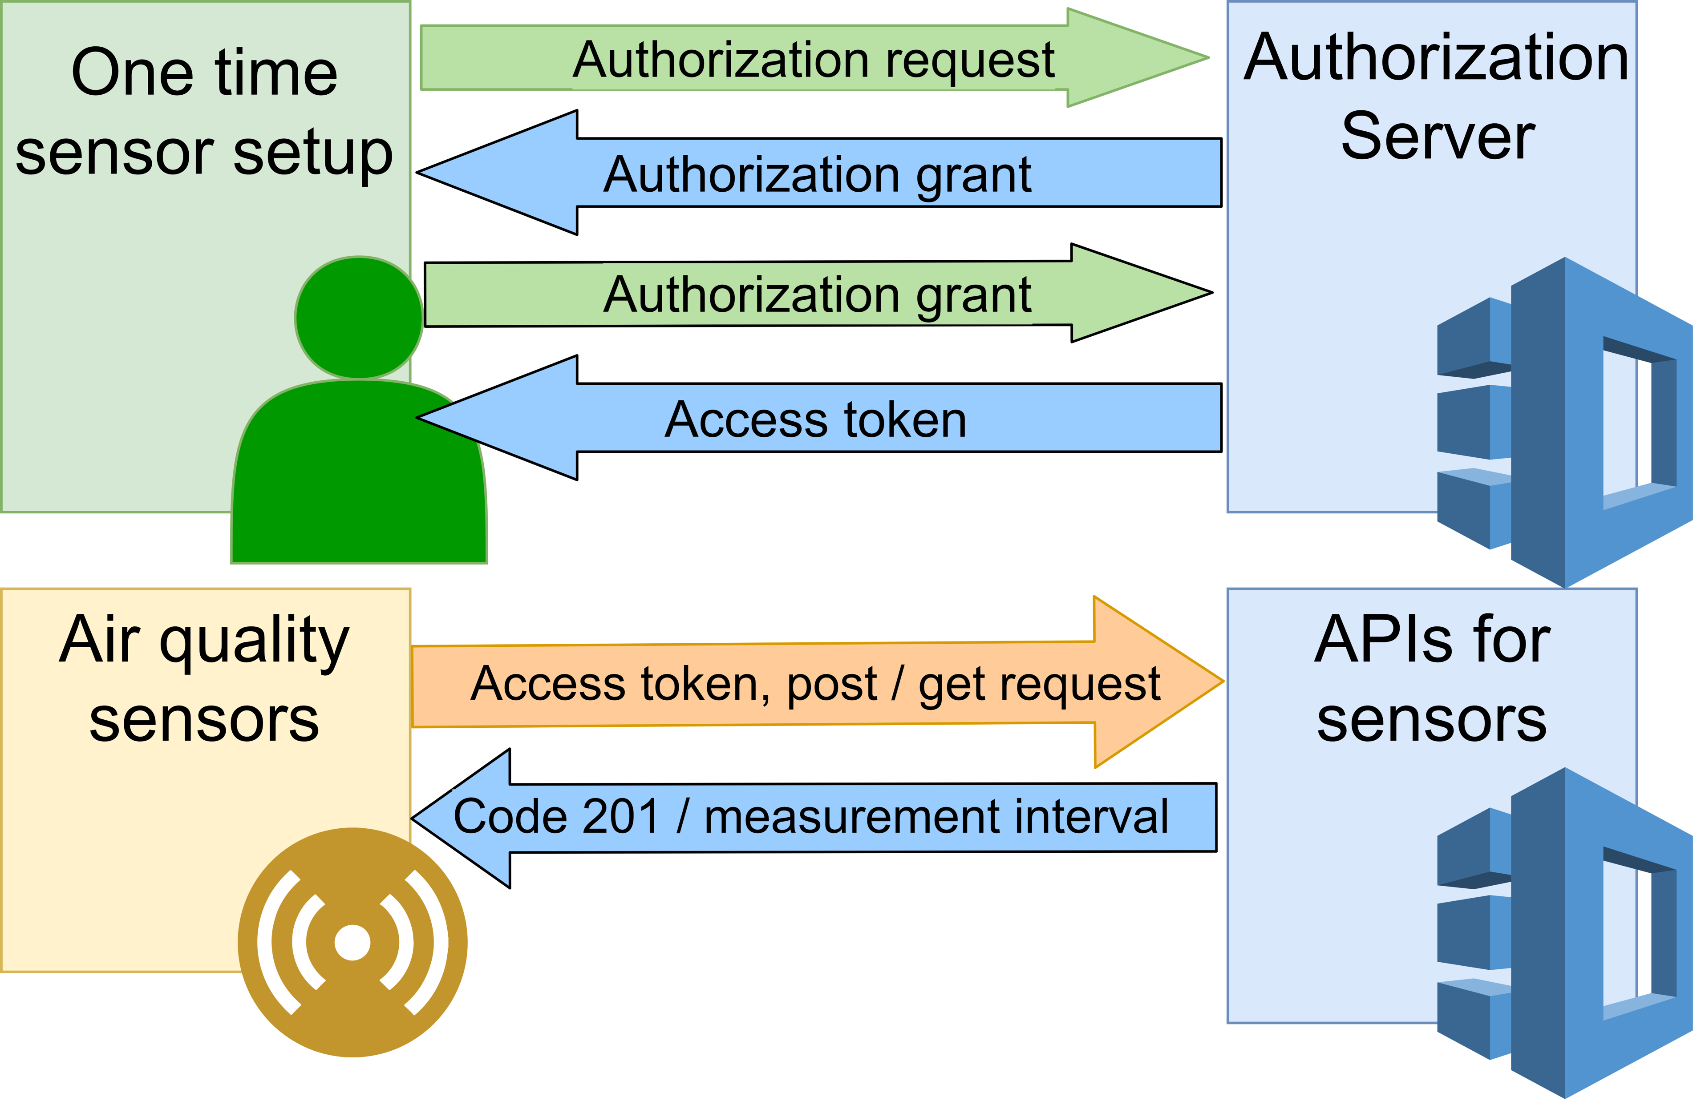
Technical Implementation Backend for data processing - Authentication

Slide 11
Technical Implementation Frontend application
Maps of Perheim with the air pollution per region
Detailed information about the different toxic - levels

Slide 12


Conclusion
Affordable Hardware?
With hardware costs of 150 Euro/ Sensor the hardware is affordable
Accessible for the public?
Web browser application makes it accessible for the public
Implementation Effort
Rather low, by using such a simple architecture
Source: SAP Image Library

Slide 13
References
Effects of air pollution:
[1] https://www.sciencedirect.com/science/article/pii/S0140673600026532
[2] https://www.tandfonline.com/doi/abs/10.1080/15287390590936166
[3} https://www.sciencedirect.com/science/article/pii/S0269749107002849
[4] https://www.who.int/air-pollution/news-and-events/how-air-pollution-is-destroying-our-health
Existing approaches:
[5] S. Nagaraj and R. V. Biradar, “Applications of wireless sensor networks in the real-time ambient air pollution monitoring and air quality in metropolitan cities — a survey,” in 2017 International Conference On Smart Technologies For Smart Nation (SmartTechCon). IEEE, 17.08.2017 - 19.08.2017, pp. 1393–1398.
[6] J. Dutta, F. Gazi, S. Roy, and C. Chowdhury, “Airsense: Opportunistic crowd-sensing based air quality monitoring system for smart city,” in 2016 IEEE SENSORS. IEEE, 30.10.2016 - 03.11.2016, pp. 1–3.
[7] Y. Mehta, M. M. M. Pai, S. Mallissery, and S. Singh, “Cloud enabled air quality detection, analysis and prediction - a smart city application for smart health,” in 2016 3rd MEC International Conference on Big Data and Smart City (ICBDSC). IEEE, 15.03.2016 - 16.03.2016, pp. 1–7.
[8] I. Kok, M. U. Simsek, and S. Ozdemir, “A deep learning model for air quality prediction in smart cities,” in 2017 IEEE International Conference on Big Data (Big Data). IEEE, 11.12.2017 - 14.12.2017, pp. 1983–1990.
[9] L. Mittal and T. Baker, “London air quality net-
work summary report 2017,” 2018. [Online]. Avail- able: https://www.londonair.org.uk/london/reports/2017 LAQN Sum- mary Report.pdf
[10] L. Adler, “Monitoring air quality and the impacts of pollution: Three cities are harnessing new technologies to enhance their understanding of where pollutants emerge & monitor health impacts.” 2015. [Online]. Available: https://datasmart.ash.harvard.edu/news/article/monitoring- air-quality-and-the-impacts-of-pollution-679
[11] Landesanstalt fu ̈r Umwelt Baden-Wu ̈rttemberg, “U ̈berwachung von luftschadstoffen: Wie misst die lubw? (faqs).” [Online]. Available: https://www.lubw.baden-wuerttemberg.de/luft/wie-misst-die-lubw-faqs

Slide 14
References

