Slide 1
Towards a smart city: An air quality monitoring system in Perheim
Pervasive Computing
Notes:
Air pollution is becoming more important as the focus on serious health issues and environmental pollution caused by particulate matter and industrial gases increases.
This is from pressing importance for the city of Perheim since one of Germanies biggest chemical companies is within a radius of 5 km.
Despite the growing importance, there is currently almost no possibility for the general public to gain information on the current air pollution in their surroundings.
Therefore we are proposing the implementation of an air quality monitoring system which is accessible for everybody.

Slide 2
Agenda
Introduction
Sensor Based Air Quality Monitoring
Use Cases
Economic Feasibility
Technical Implementation
Conclusion
Notes:
First we want to provide some more information what Air Qauility.
Before we start with the use cases we are briefly discussion why we chose an air quality monitoring system that used sensors.

Slide 3
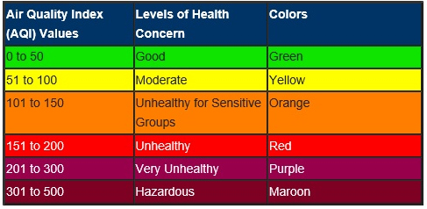
Introduction – Air Quality
Measuring the Air Quality:
The Air Quality Index is a standard index which is used to classify the air pollution within a certain region.
Risks caused by air pollution:
Health risks that lead to a total mortality of 6 % due to various diseases.
Environmental changes
Notes:
Poor air quality caused by industry and daily life leads to health risks and adversely impacts the environment. Inhabitants of big cities are particularly affected by air pollutants, which might manifest themselves in smog or an industrial smell
As air quality declines, the risk of stroke, heart disease, lung cancer, and chronic and acute respiratory diseases, including asthma, increases for the people who live in them.
PM 2.5 – Fine Particles

Slide 4
Sensor Based Air Quality Monitoring
Existing approaches are focusing on:
Air Quality Monitoring for the City of Perheim
Low-cost crowd sensing sensors
Combination of sensors with video monitoring of traffic
Using a neural network to predict future air pollution
Small number of existing sensors to measure the air pollution

Slide 5

Use Cases
Source: SAP Image Library

Slide 6
Use Cases
Managing health risks
Environmental damage
Get information about most toxic air pollution
Recommendation when to leave the house
Sensor for windows when to open and close
Get information about most toxic air pollution
Recommendation when to leave the house
Sensor for windows when to open and close
Enabling law execution
Psychological effect
Use measurements to execute the current law
Biggest sector: industry and car traffic
The direct confrontation with the monitored air quality can lead to a higher ecological awareness

Slide 7

Economic Feasibility
Tax-payer funded service
Subscription-based service
Voluntary contribution
Data as a product
Source: SAP Image Library

Slide 8

Technical Implementation Hardware
Building the air quality sensors
Using Arduino hardware and software as foundation
Add several sensor for measuring different toxics
Focus for the first generation is to be cheap
Sensor will be placed in weatherproof box
Source: SAP Image Library
Notes:
Approximate costs for one: 150€

Slide 9
Technical Implementation Backend for data processing
Main functionalities
Additional functionalities
Receive measurements in JSOM format
Save these
Propagate crucial measurements
Authorization and authentication check
GET request, to return current measurements
PUT and POST for setting a different measurements interval
Error handling

Slide 10
Technical Implementation Frontend application
Maps of Perheim with the air pollution per region
Detailed information about the different toxic - levels

Slide 11

Conclusion
Source: SAP Image Library

Slide 13
References
Effects of air pollution:
[1] https://www.sciencedirect.com/science/article/pii/S0140673600026532
[2] https://www.tandfonline.com/doi/abs/10.1080/15287390590936166
[3} https://www.sciencedirect.com/science/article/pii/S0269749107002849
[4] https://www.who.int/air-pollution/news-and-events/how-air-pollution-is-destroying-our-health

