Slide 1
Sommaire
Github
google drive
Cdcf
UML
Gantt
CRA
Recette
Matérielle

Slide 2
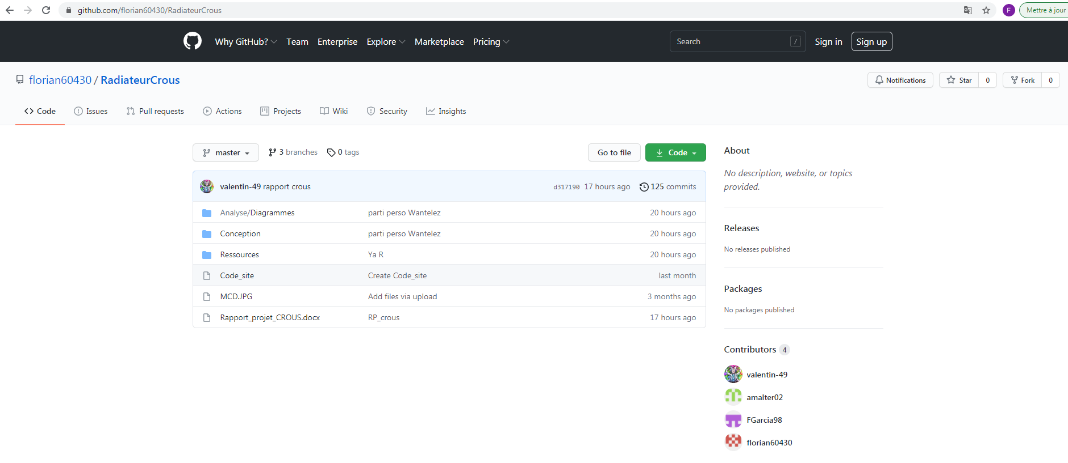
https://github.com/florian60430/RadiateurCrous
Github

Slide 3
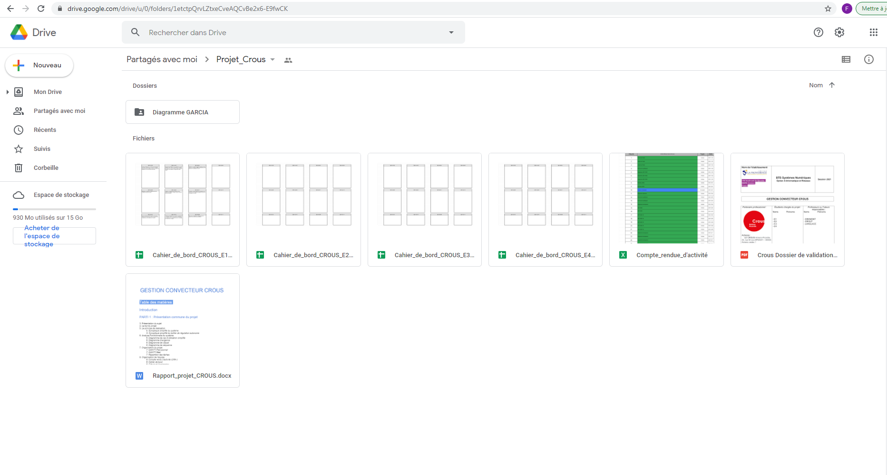
https://drive.google.com/drive/u/0/folders/1etctpQrvLZtxeCveAQCvBe2x6-E9fwCK
Google drive

Slide 4
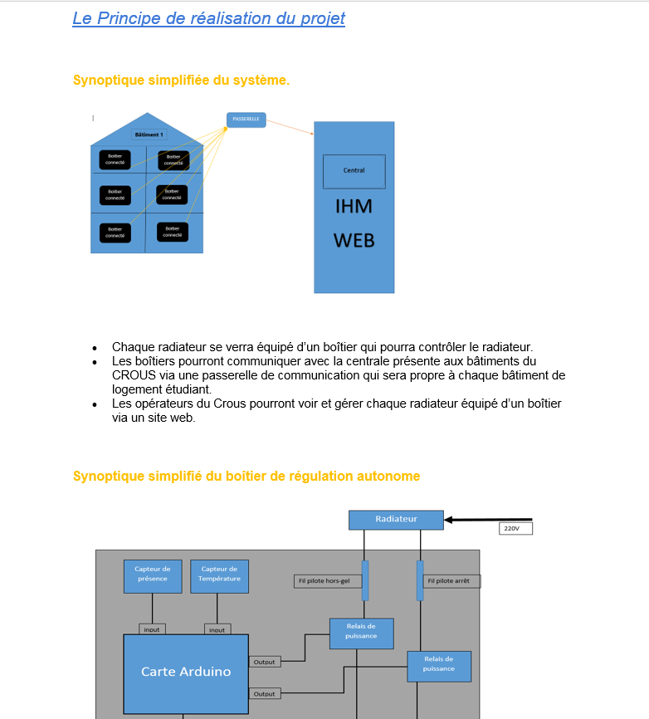
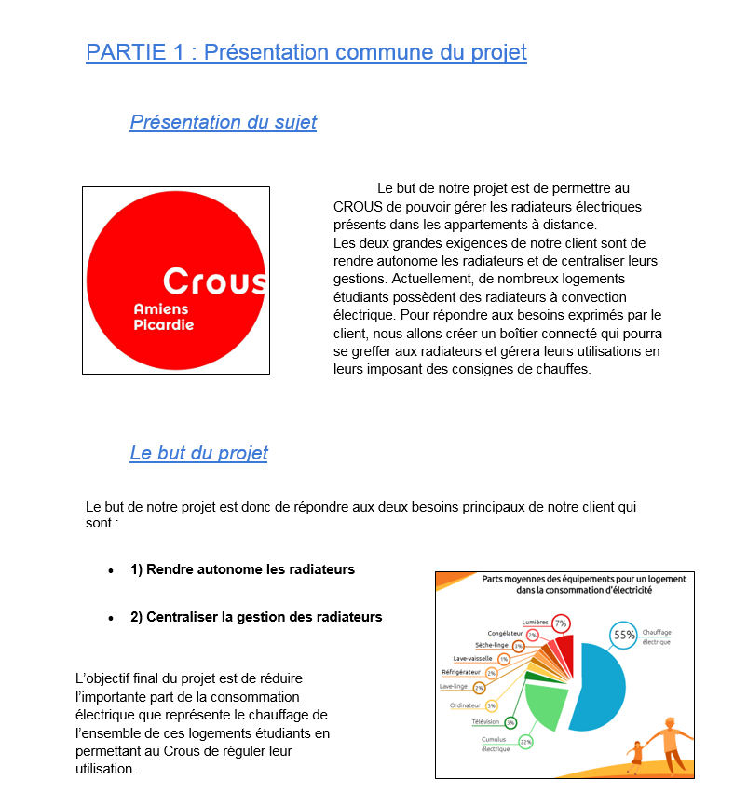
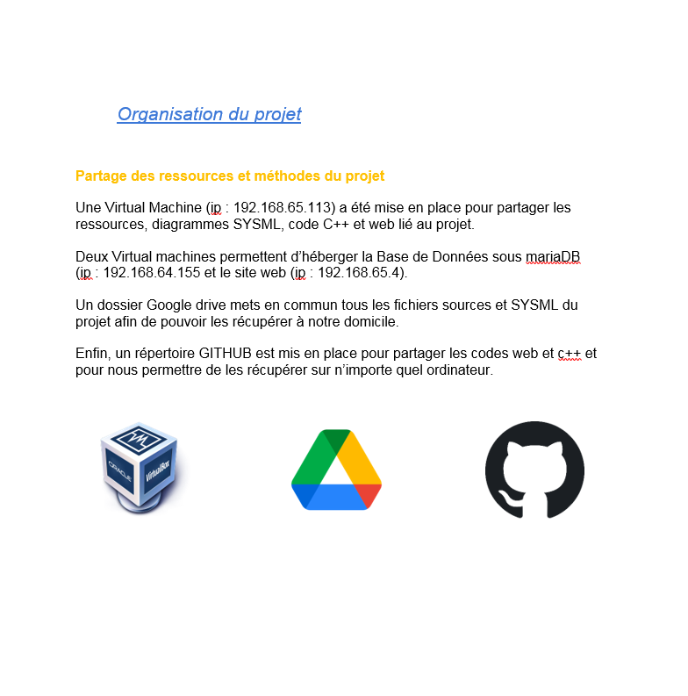
CDCF

Slide 5
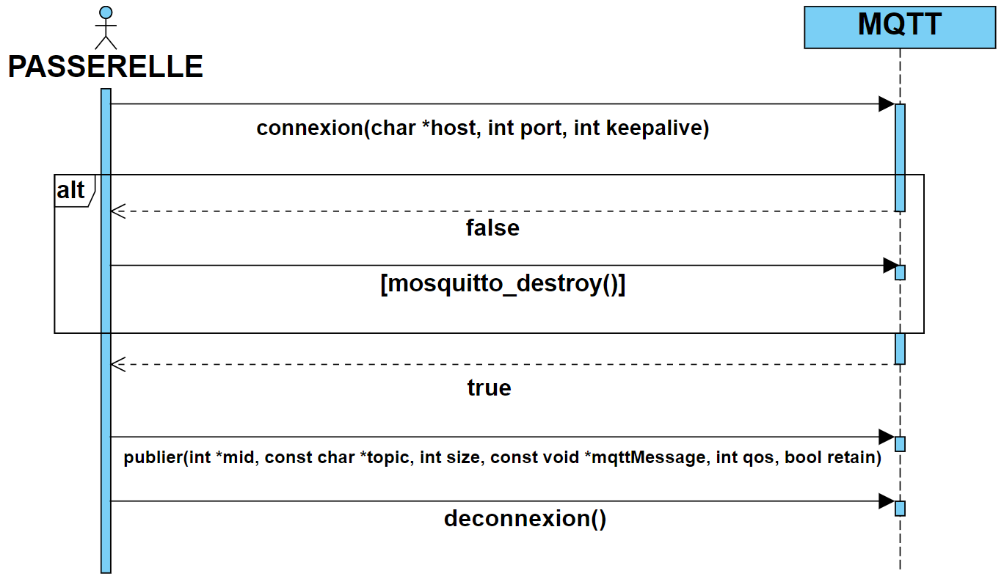
UML

Slide 6
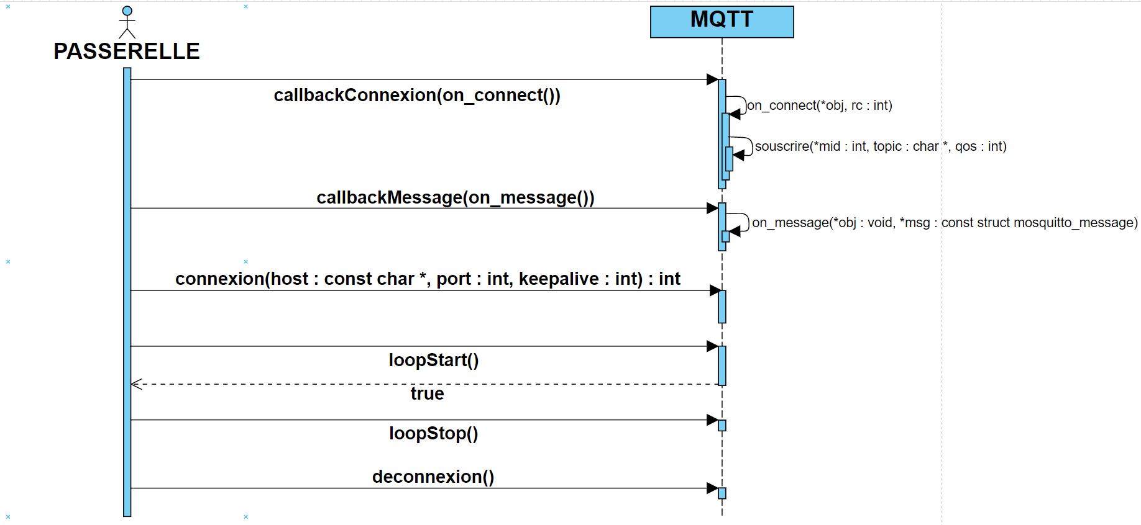
UML

Slide 7
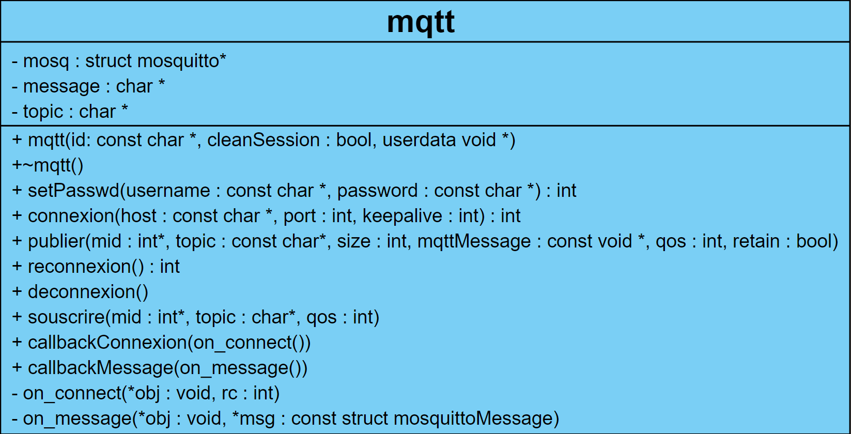
UML

Slide 8
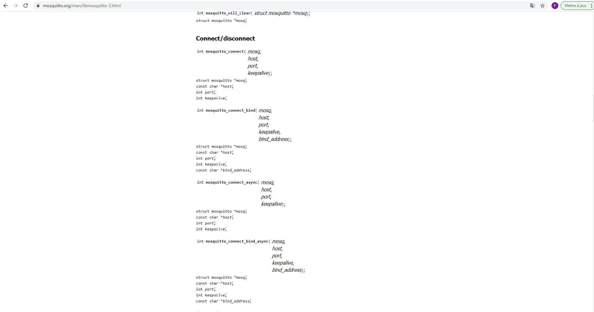
Librairie mosquitto
https://mosquitto.org/man/libmosquitto-3.html

Slide 9
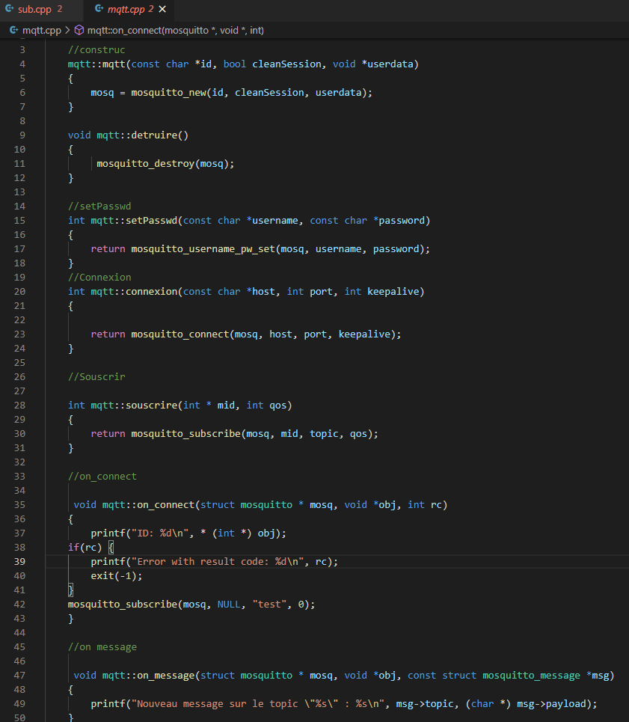
Définition

Slide 10
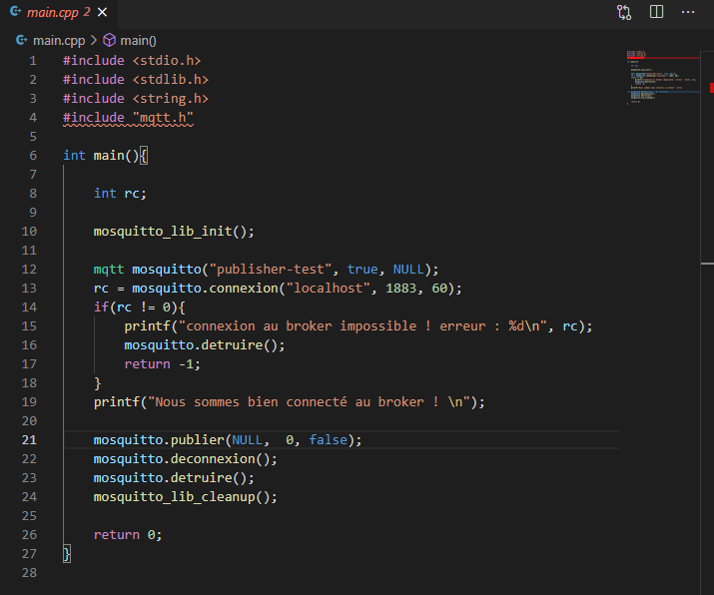
Programme (pub)

Slide 11
Test (pub)

Slide 12
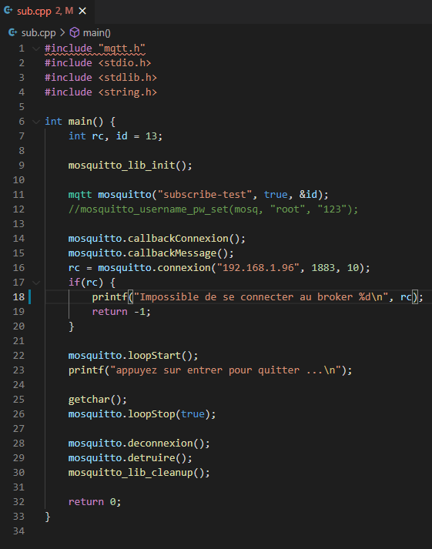
Programme (sub)

Slide 13
Test (sub)

Slide 14
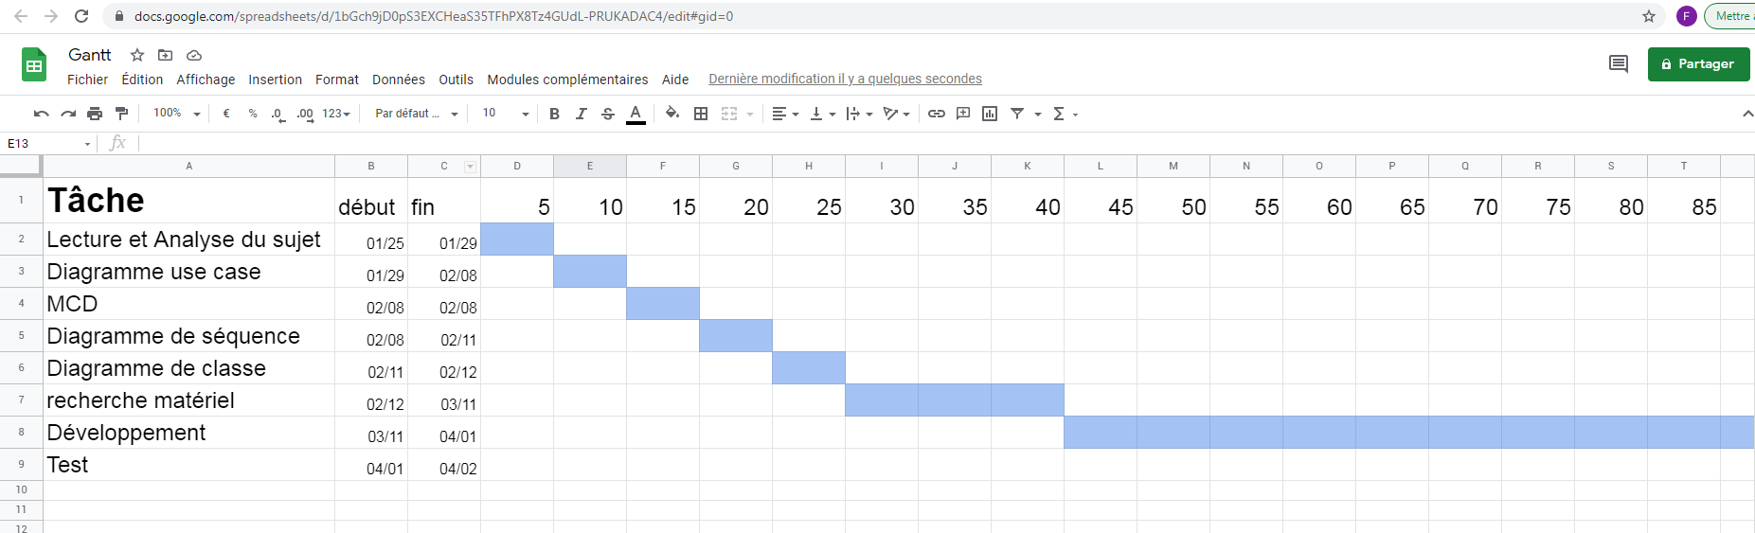
https://docs.google.com/spreadsheets/d/1bGch9jD0pS3EXCHeaS35TFhPX8Tz4GUdL-PRUKADAC4/edit#gid=0
Gantt prévisionelle

Slide 15
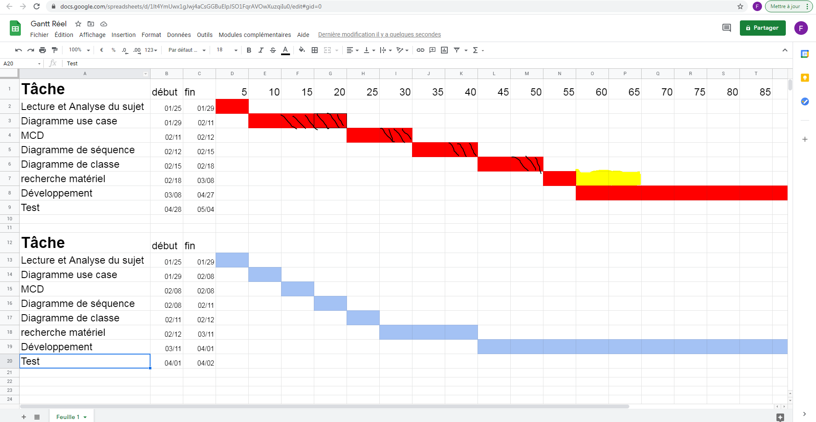
https://docs.google.com/spreadsheets/d/1lt4YmUwx1gJwj4aCsGGBuElpJSO1FqrAVOwXuzqiIu0/edit#gid=0
Gantt réel

Slide 16
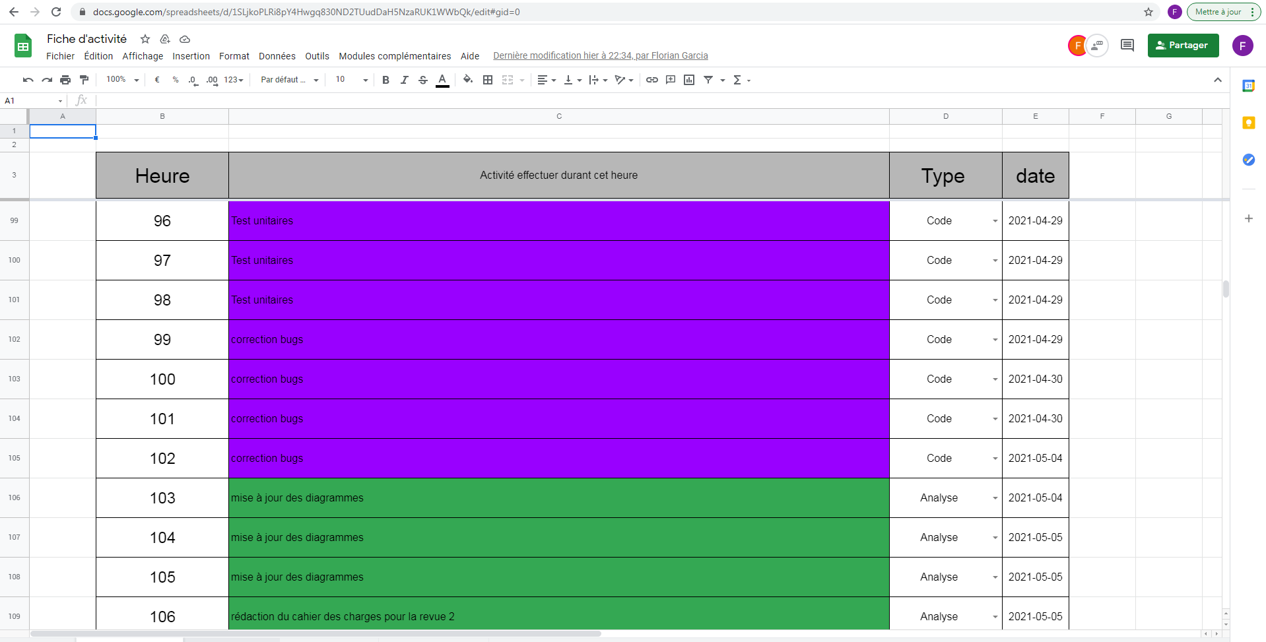
CRA
https://docs.google.com/spreadsheets/d/1SLjkoPLRi8pY4Hwgq830ND2TUudDaH5NzaRUK1WWbQk/edit#gid=0

Slide 17
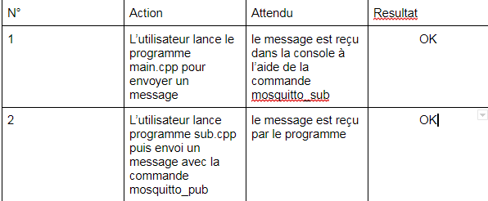
recette

Slide 18
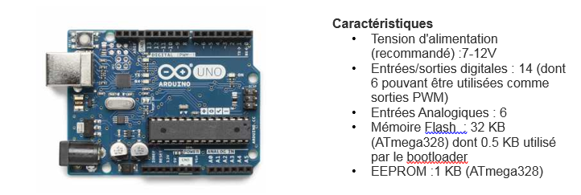
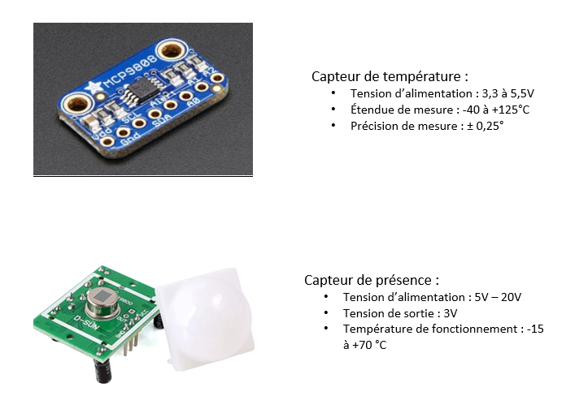
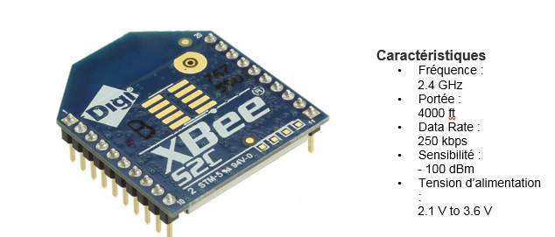
Matériel

Slide 19
https://github.com/florian60430/RadiateurCrous
https://drive.google.com/drive/u/0/folders/1etctpQrvLZtxeCveAQCvBe2x6-E9fwCK
Gantt : https://docs.google.com/spreadsheets/d/1bGch9jD0pS3EXCHeaS35TFhPX8Tz4GUdL-PRUKADAC4/edit#gid=0
Gantt Réel : https://docs.google.com/spreadsheets/d/1lt4YmUwx1gJwj4aCsGGBuElpJSO1FqrAVOwXuzqiIu0/edit#gid=0

