Slide 1
Sommaire
Github
google drive
Cdcf
UML
Code
Gantt
CRA
Recette
Matérielle

Slide 2
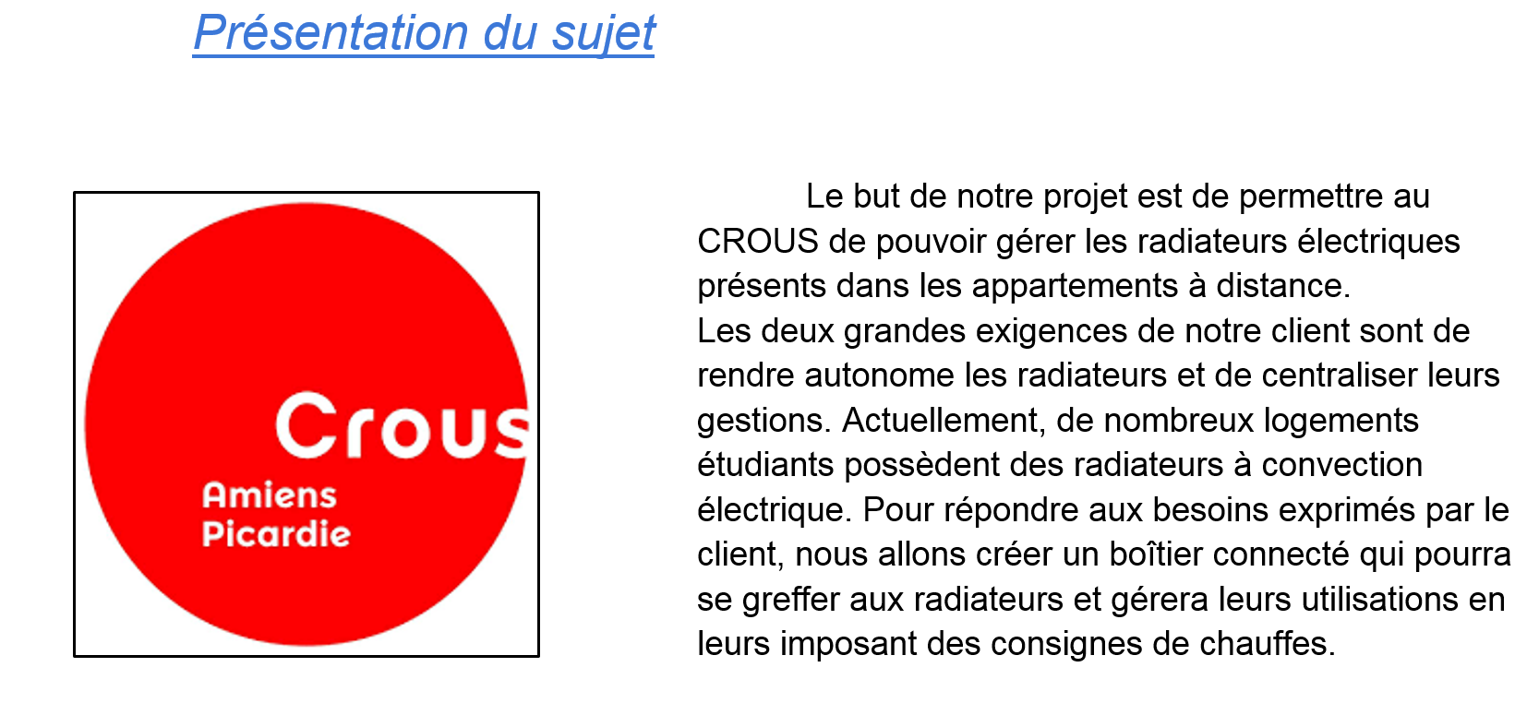
Introduction

Slide 3
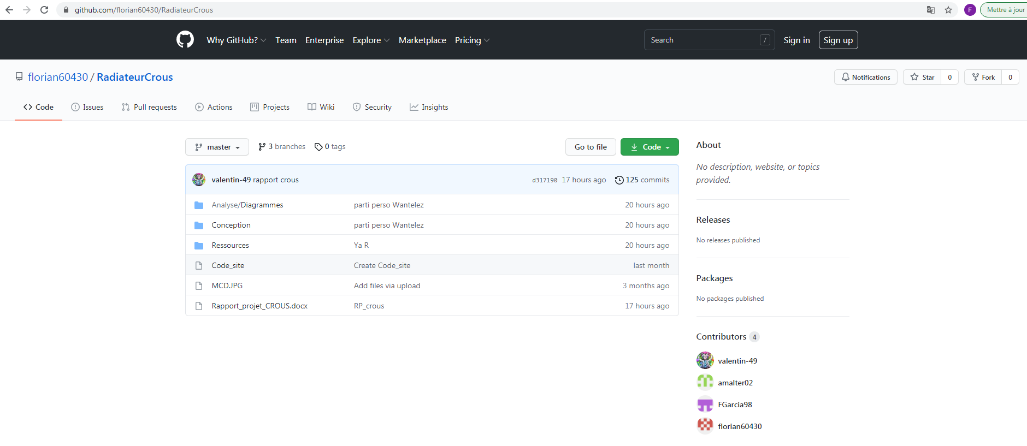
https://github.com/florian60430/RadiateurCrous
Github

Slide 4
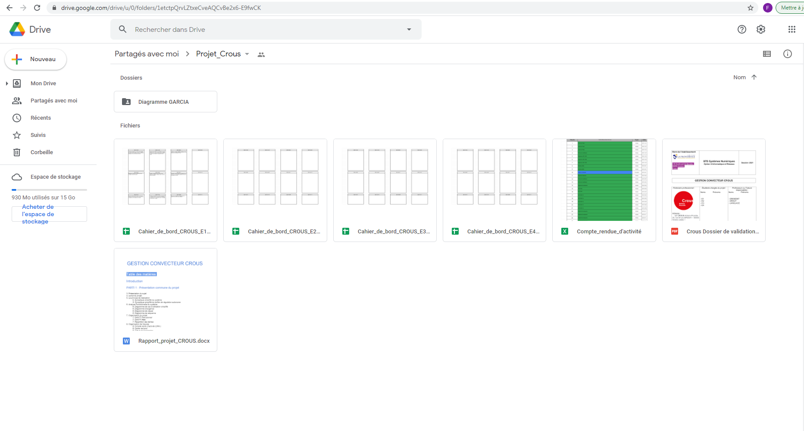
https://drive.google.com/drive/u/0/folders/1etctpQrvLZtxeCveAQCvBe2x6-E9fwCK
Google drive

Slide 5
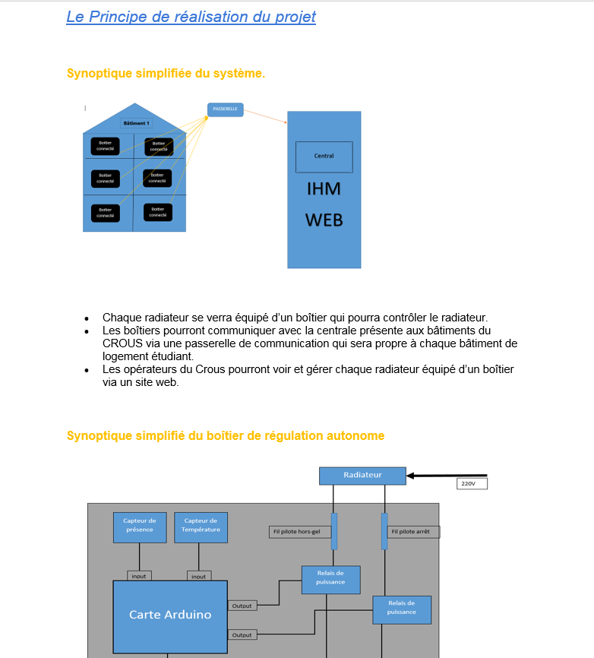
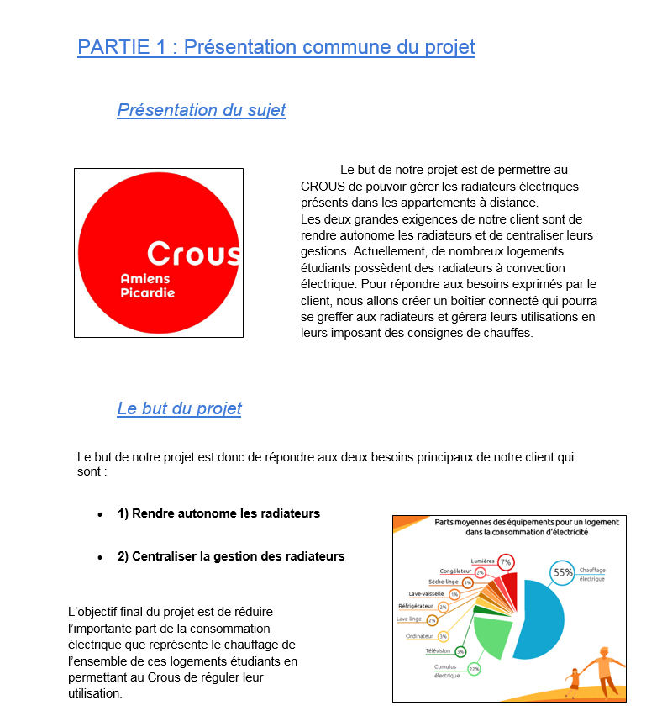
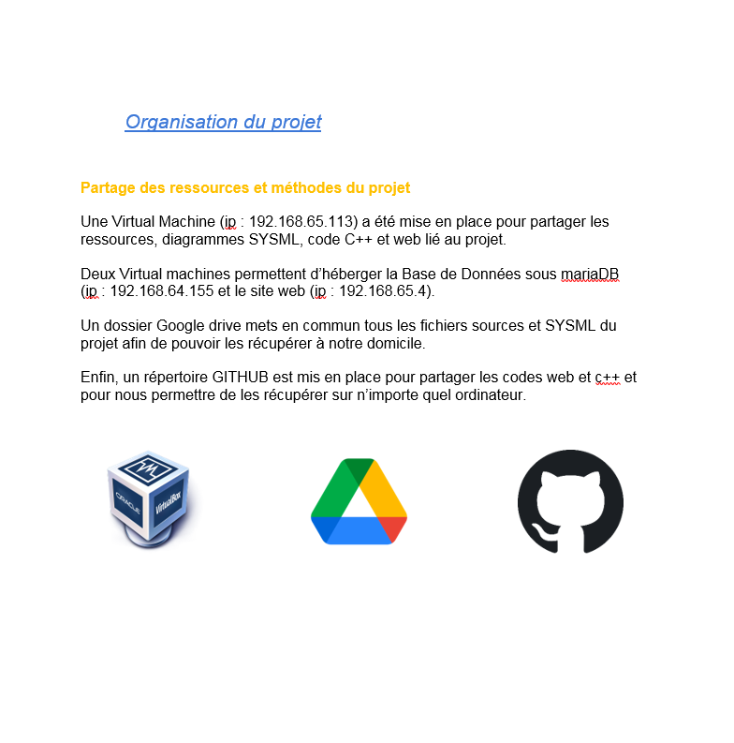
CDCF

Slide 6
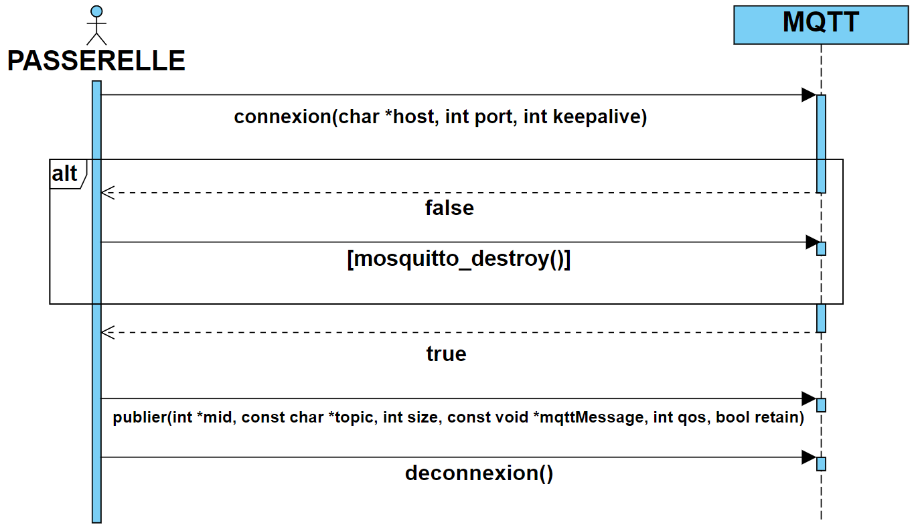
UML

Slide 7
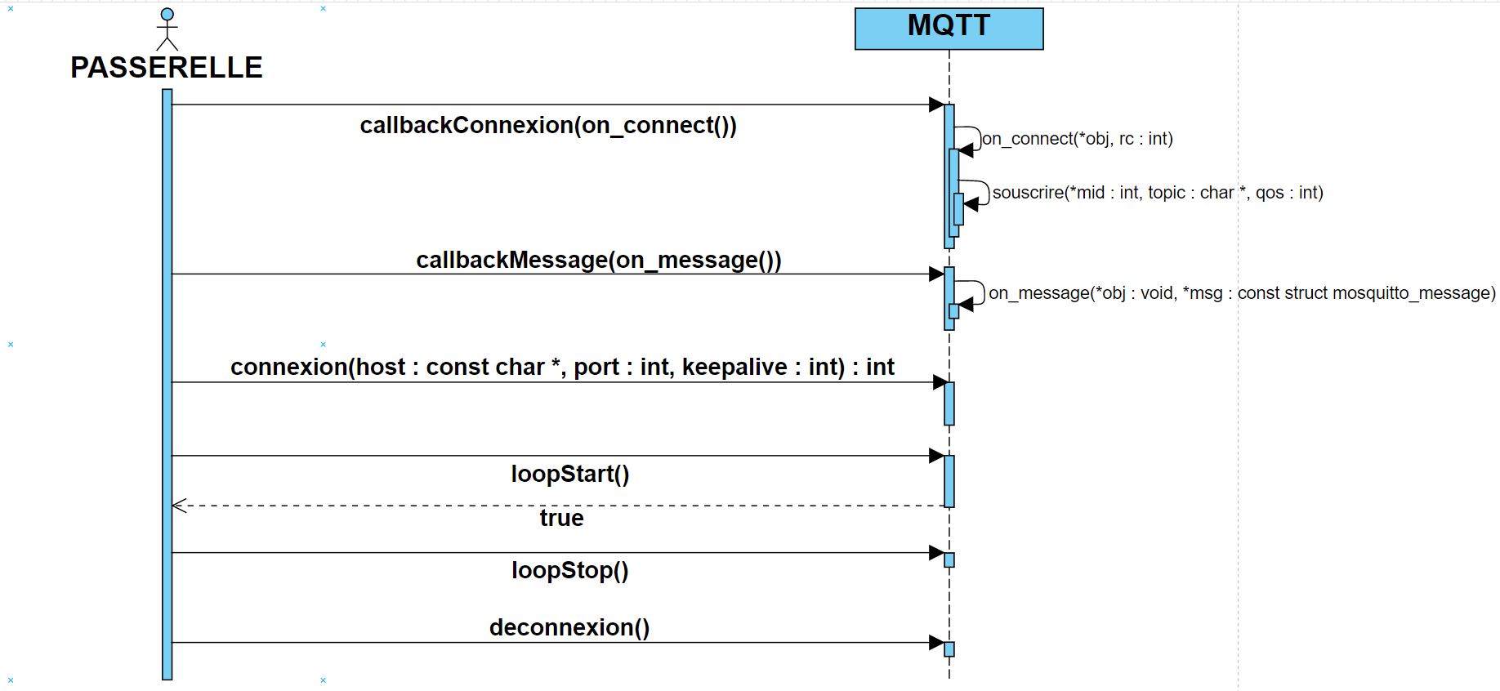
UML

Slide 8
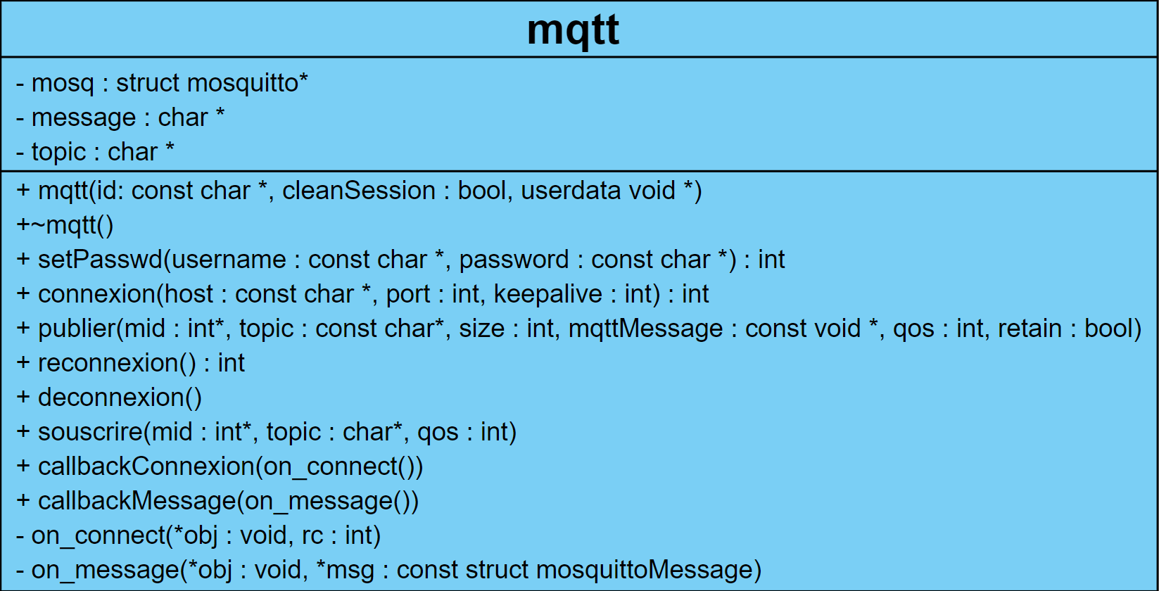
UML

Slide 9
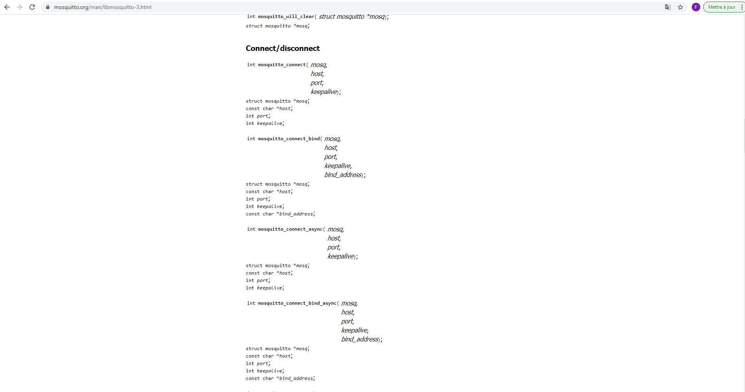
Librairie mosquitto
https://mosquitto.org/man/libmosquitto-3.html

Slide 10
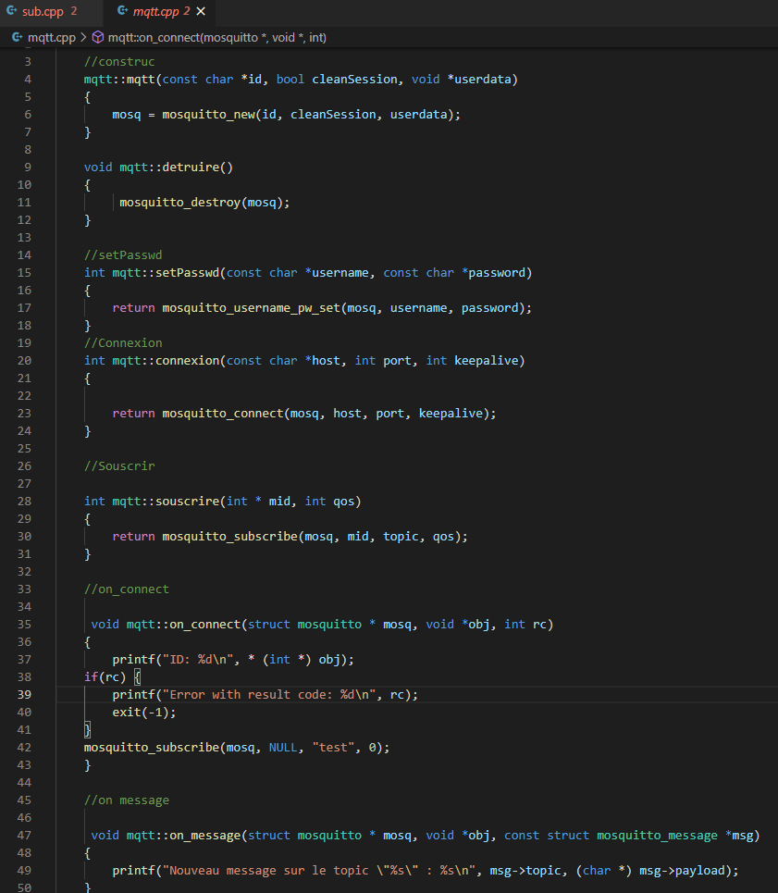
Définition

Slide 11
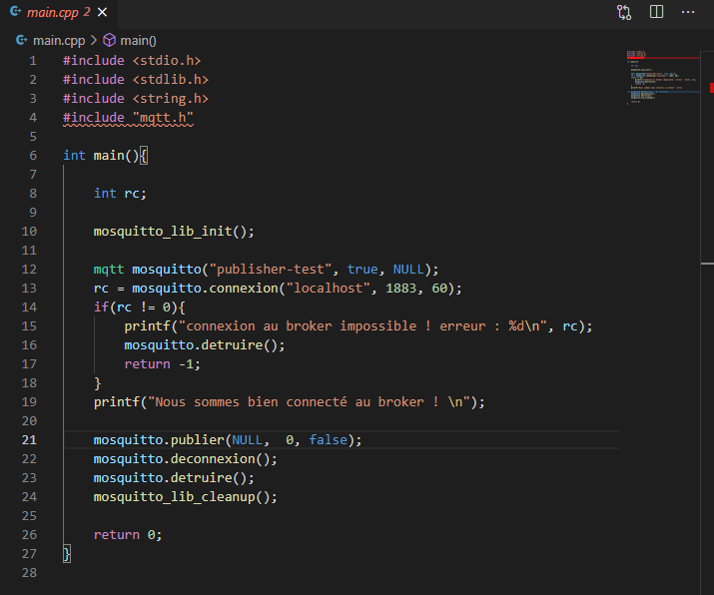
Programme (pub)

Slide 12
Test (pub)

Slide 13
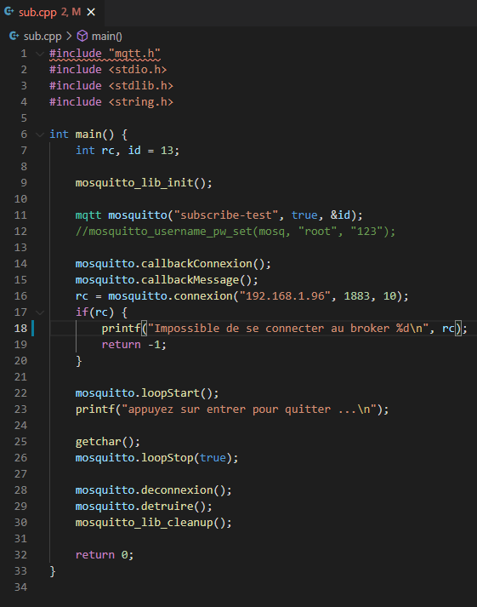
Programme (sub)

Slide 14
Test (sub)

Slide 15
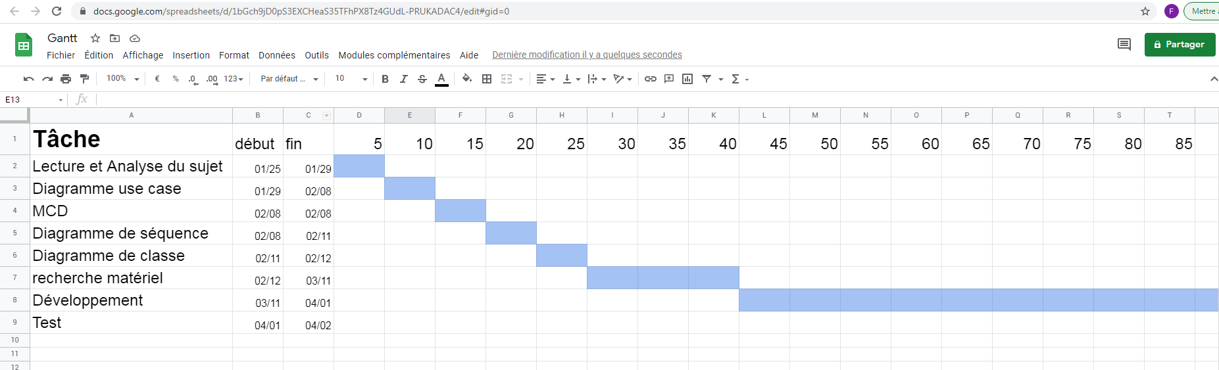
https://docs.google.com/spreadsheets/d/1bGch9jD0pS3EXCHeaS35TFhPX8Tz4GUdL-PRUKADAC4/edit#gid=0
Gantt prévisionnelle

Slide 16
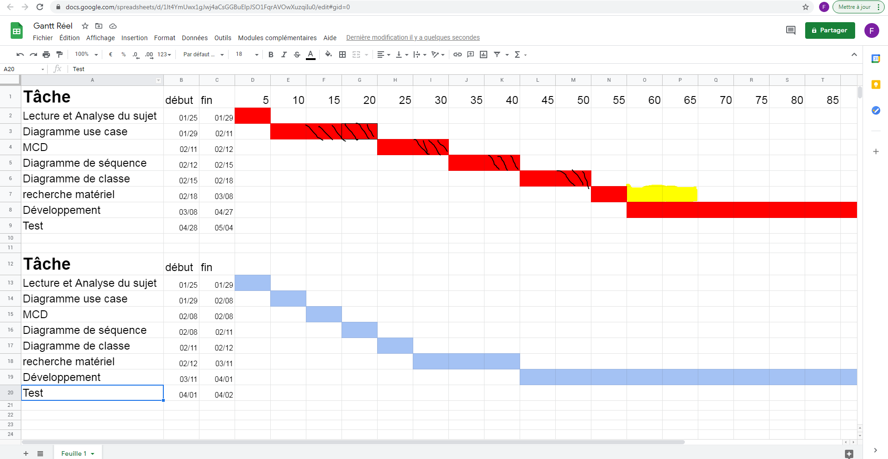
https://docs.google.com/spreadsheets/d/1lt4YmUwx1gJwj4aCsGGBuElpJSO1FqrAVOwXuzqiIu0/edit#gid=0
Gantt réel

Slide 17
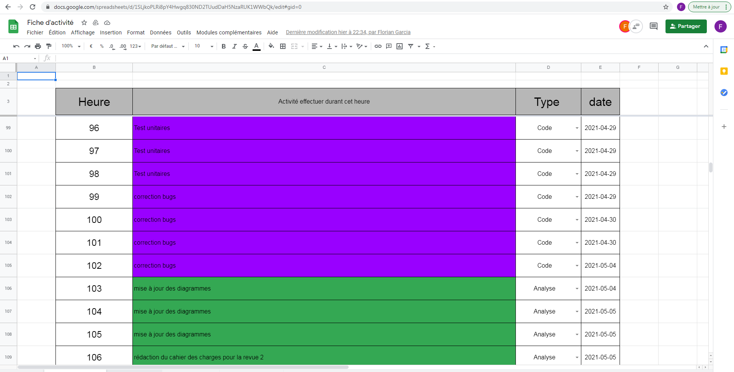
CRA
https://docs.google.com/spreadsheets/d/1SLjkoPLRi8pY4Hwgq830ND2TUudDaH5NzaRUK1WWbQk/edit#gid=0

Slide 18
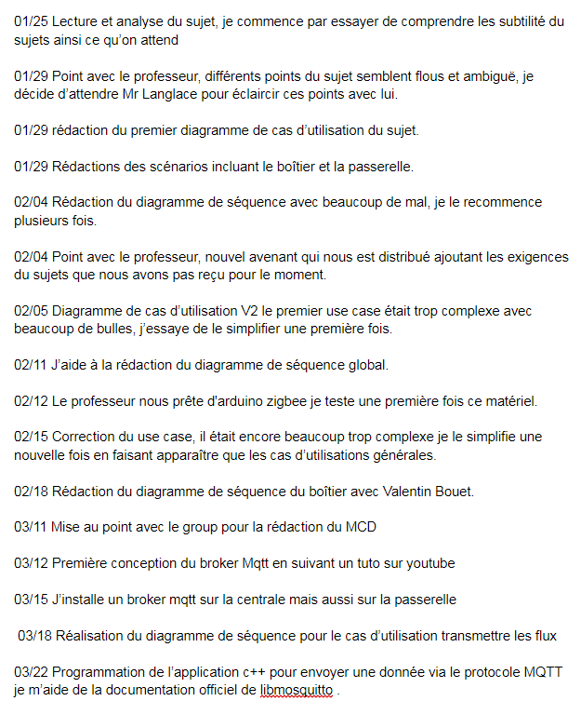
Cahier de bord
https://docs.google.com/document/d/1yb8ICADPck8xJuGNnGfKUmQQP96kw9k8fe0idGPh9sM/edit

Slide 19
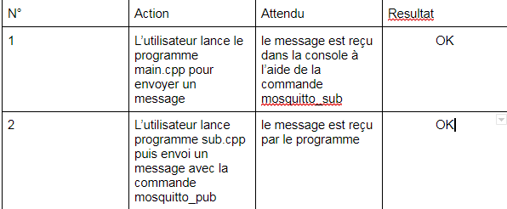
Recette

Slide 20
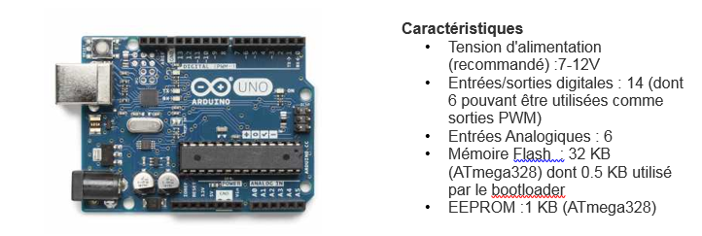
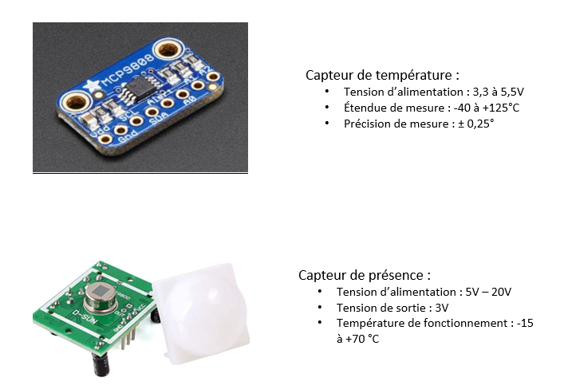
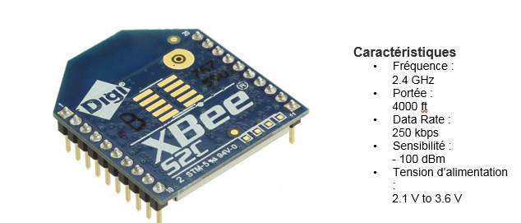
Matériel

Slide 21
Liens
https://github.com/florian60430/RadiateurCrous
https://drive.google.com/drive/u/0/folders/1etctpQrvLZtxeCveAQCvBe2x6-E9fwCK
Gantt : https://docs.google.com/spreadsheets/d/1bGch9jD0pS3EXCHeaS35TFhPX8Tz4GUdL-PRUKADAC4/edit#gid=0
Gantt Réel : https://docs.google.com/spreadsheets/d/1lt4YmUwx1gJwj4aCsGGBuElpJSO1FqrAVOwXuzqiIu0/edit#gid=0
https://docs.google.com/spreadsheets/d/1SLjkoPLRi8pY4Hwgq830ND2TUudDaH5NzaRUK1WWbQk/edit#gid=0
https://docs.google.com/document/d/1yb8ICADPck8xJuGNnGfKUmQQP96kw9k8fe0idGPh9sM/edit

