Slide 1
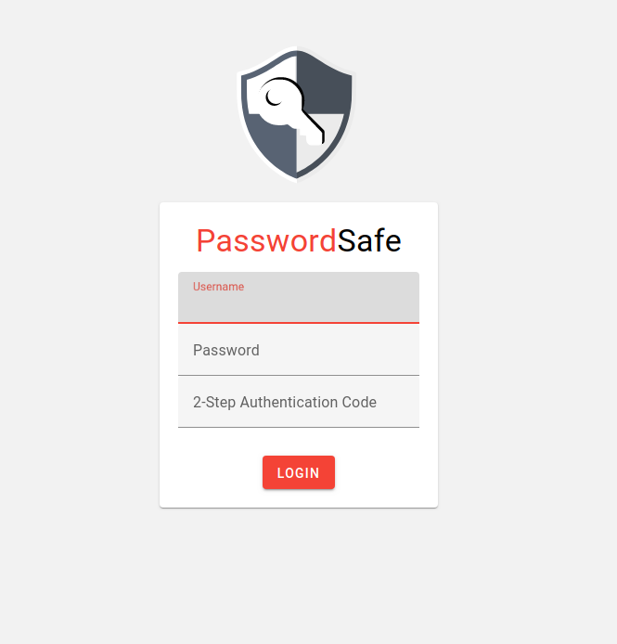
PasswordSafe
web application to store passwords and other information securely

Slide 2
Features
independent self-hostable application
2-Factor authentication with e.g. Google Authenticator
sharing of passwords with other users
PasswordSafe Inheritance/Trust person
Material Design Style

Slide 3
Technology
PHP with Symfony
MySQL database (handled by Doctrine)
Plain JS + SASS
@material packages from Google
Webserver with SSL needed for operation

Slide 4
Security
Basics #1: You need a good password! And don't forget it, you can't restore your data.
Basics #2: If your server is compromised, your safety is gone, cause your memory is not safe.
Password hashing: SHA256 via PBKDF2 (number of iterations is a server and client setting – time consuming)
Data encryption with password+salt via Salsa20 (AES256 used in v1)
TwoFactor Authentication
Notes:
PBKDF2 (Password-Based Key Derivation Function 2) – multiple iterations to retrieve passwords, which makes successful BruteForce attacks against a password more unlikely
Salsa20 vs AES256: https://cr.yp.to/streamciphers/why.html Streamciphers like Salsa20 are standardized as AES and used for years but provide higher bit sizes and therefore are harder to crack

Slide 5
Security - EncryptionService
Cryptography functions provided by PHP security module
Encryption versioning with prefix
Encrypted data is saved as one blob - encrypting short data would make cracking easier
For saving, data structure is json encoded. After encryption the data is saved as hex in the database as encrypted data has binary format

Slide 6
Security – Two Factor (TOTP)
Two factor is based on a random key (128bit) which is saved on the server side
The key is initially shared with the user (mostly as a QR-Code)
The algorithm to create a six digit string from it together with the current time has been standardized in an RFC
Notes:
Time-based One-time Password Algorithmus (TOTP)

Slide 7
Security - Sessions
The session is only valid for the browser lifetime and limited to eight hours
The password is initially transferred to the server and there encrypted with a session based random key – this key is transferred to the client as a cookie

Slide 8
Data(base) Structure
Custom data structure is saved in one blob to database
Data is an array of rows
  Three types of row object currently exists
    UsernamePasswordRow
    TextRow
    MetaRow (used for saving configurations and personalization)
  Searching/Ordering/Editing of rows is done in PHP

Slide 9
Sharing
A custom RSA key (4096bit) is generated per user and securely saved in the encrypted data
The public key is available unencrypted
A shared password is encrypted with the RSA public key and saved in a SharedPasswords table with origin and receiver

Slide 10
Security Considerations
Passwords or cleartext data is only available during the request processing. Sessions are encrypted
Saved passwords are only transferred on request – no general transfer of all passwords

