Slide 1

What I was asked
I was asked to do a work based on a document
- The document is an overall description of how a Tokenise payment system works.
- But we can clearly see the « déjà mobile » presence in the system
- « déjà mobile » is the center of the payment system
- It handle the data from the bank, and from the payments schemes (sensitive information)

Slide 2
The provided document
First of all, I would like to make a few comments on the document itself.
- As it said itself it is very broad, there is few information
A list of software and technologies
A diagram
A description of the system
And a list of features
- I was ask something broad as well
- I’ve noticed a few mistakes on the diagram (next slide)

Slide 3
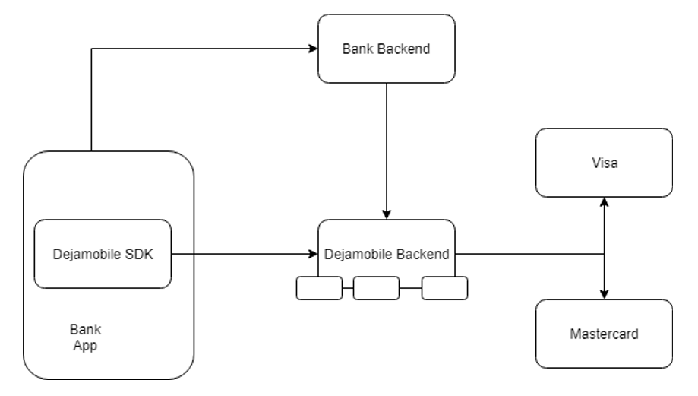

Slide 4
What I’ve decided to do
Here is what I’ve decide to do with what I’ve got in hand
- I will explain the flow of a typical transaction throught this diagram (with modification)
- I will explain the technologies and used software a each step of the transaction
- I will also explain what kind of data is transmited at each moment between the different actors

Slide 5
At this step, the user of the mobile App (client of the bank) can ask for a new card :
- On the mobile it-self, the user log on its bank application and authentifie himself to his bank
- Then on a menu, he should be able to be able to enable payment with his smartphone
- When he enable this option, the smartphone sends a request to the bank
- The Data sent on this step are quite sensitive, there is security informations, bank account number, things like that.
Then we go to the next step

Slide 6
At this step, the user’s request arrive at the bank servers (Déjà mobile client), it’s managed internally :
- The bank server will assure itself that the user is correctly anthentified
- Then, once the security steps are passed, the server will search on his database the client
- Once the server found thoses data, it will encrypt it, and send it to the déjà mobile servers
- The data transmitted at this point are very sensitive, it’s all the bank information of the customer (name, PAN, expiration date), thoses data have to be enciphered.
- It also contains the customer request (here add a card)
Then we go to the next step

Slide 7
At this point the, data are received by the Déjà mobile servers
- The data is stored in a MySQL database, which is manage by Cassadra to allow minimal latence and maximum safety
- Once the data is correctly stored, a process (like Kafka) will prepare a message on the correct format to send to the payment schemes (here visa or mastercard)
- The data are the same as between the bank and déjà mobile servers, but in a format that the payments schemes network will be able to understand
- And the request of the customer

Slide 8
At this point the payments scheme have received the request and will sent their response
- The servers will send a virtulazied card in the shape of tokens of payments which can be used only once
- This information is sent back to the déjà mobile servers, it’s stored on the same Mysql database
- Then the message process will send those tokens directly to the user mobile through the Déjà Mobile SDK
-Those data are sensitive, with a token you are able to pay on a terminal.

Slide 9
When the tokens are sent back to the mobile
- The new card is created, the token are stored on the mobile
- Now when the customer will do a payment with his mobile, the mobile will be sent on the reader
- The reader will then go online and ask to the Visa/mastercard network if this token exist and is correct
- On its side the mobile will send through the SDK the used token on the déjà mobile servers to check it

