Slide 1



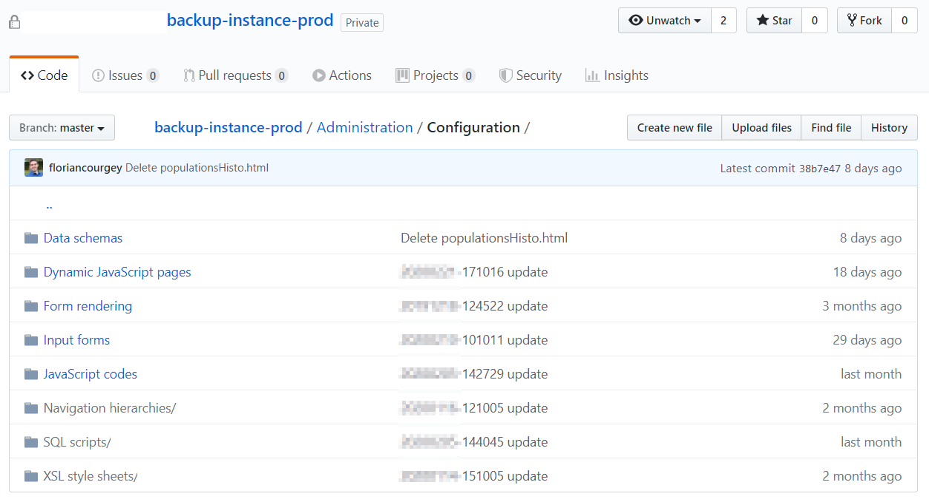
Your ACC instance
node src/download.js
node src/git.js

