Slide 1



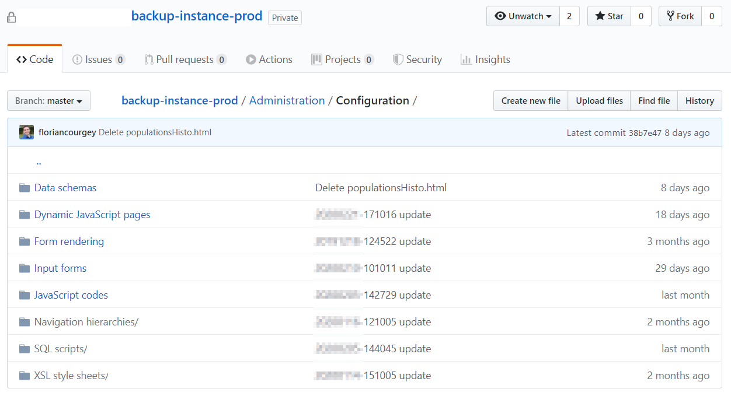
XML package
Your ACC instance
node src/download.js
node src/git.js
Folders and files as .html .xml .js

