Slide 1

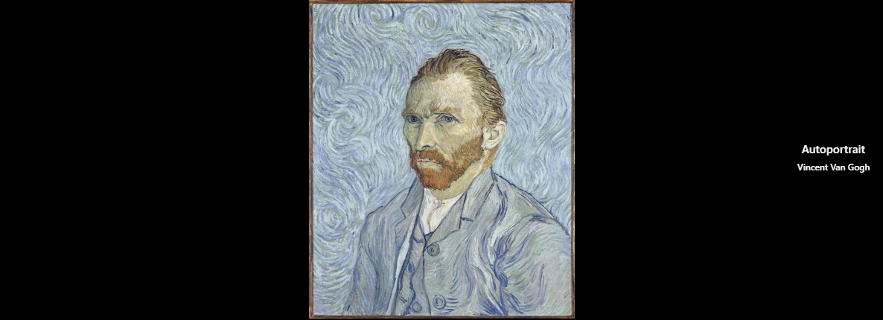







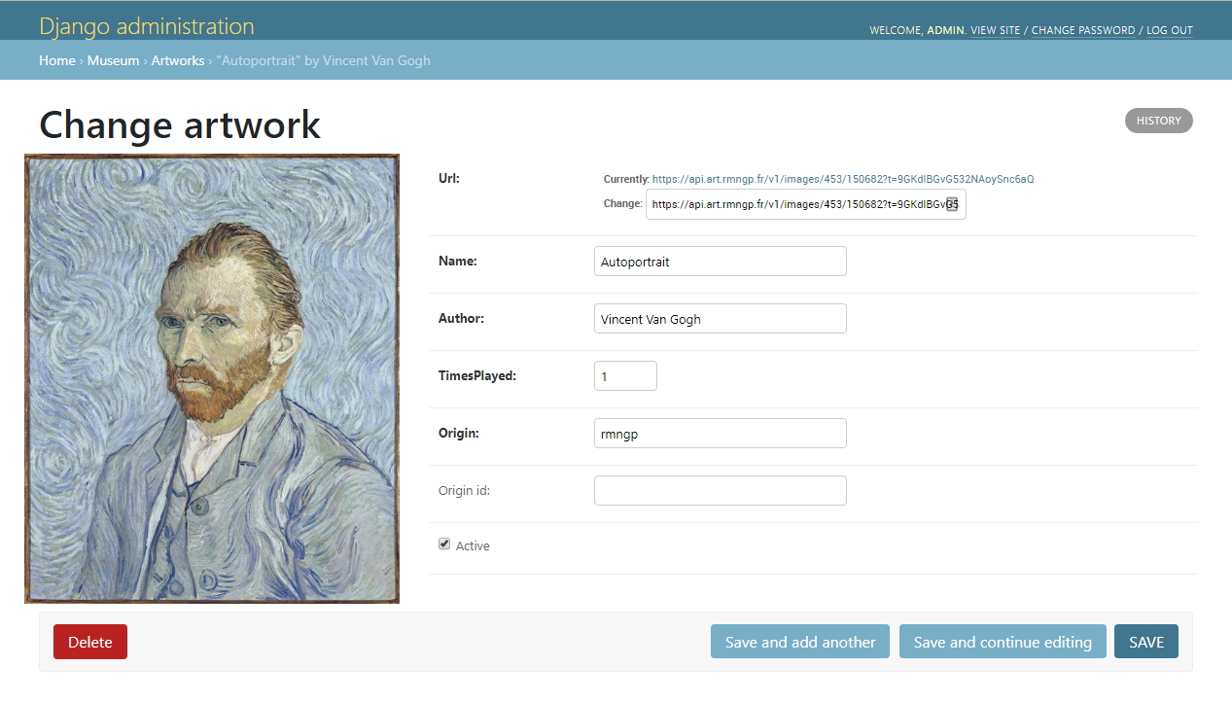

http://localhost:8000/
http://raspberry.local:8000/admin/

