Slide 1
Boxes.py
More than a Box generator
Florian Festi
2014/04/05
Backspace e.V.
Hackerspace Bamberg, Germany

Slide 2
Outline
Overview
Showing existing generators
How to use the generators
Software architecture and how to use it
Outlook

Slide 3
Motivation
Boxes for the Lasercutter
Drawing (finger) joints in CAD is a drag
Online box generators only allow fixed styles
No flexible opensource generators found

Slide 4
What?
Box generator
Written in Python
Creates SVG
Several supported models
Library for own creations
Supports flex, finger and flat dovetail joints
Can be used to create more complicated things than a simple box

Slide 5
Features
Flex
Finger joints
Slots
Dovetail joints (flat only)
Holes in honey comb pattern
Multiple Generators
  Easy to add more

Slide 6
History
Started April 2014
One year of development
Two years break – had to leave laser cutter behind
Picked up development again 2016
  Command line and web interface
  Proper Python project layout
  Traylayout generator
  Doc strings and docs
  Hackaday.io page

Slide 7
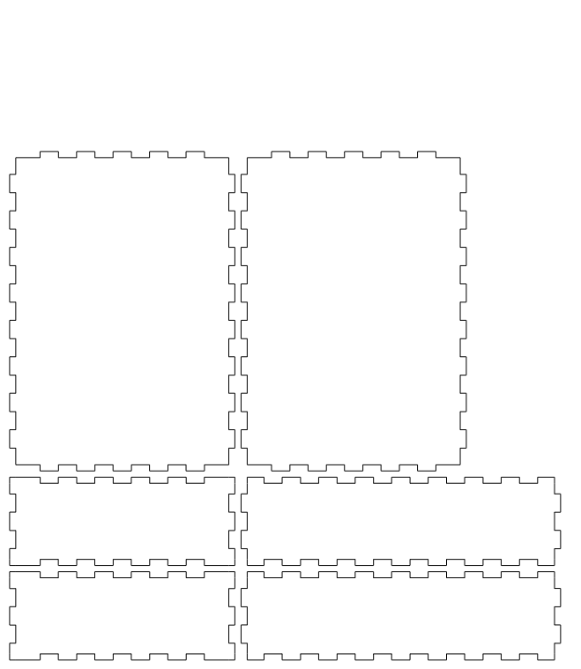
Box.py

Slide 8
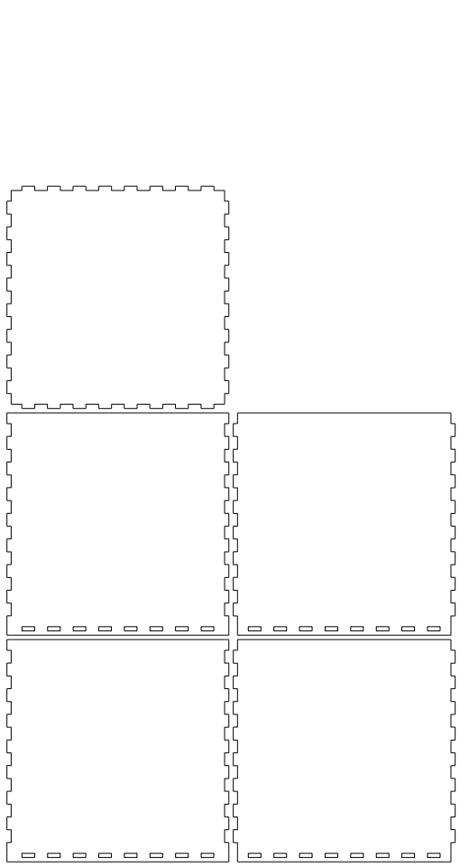
Box2.py

Slide 9
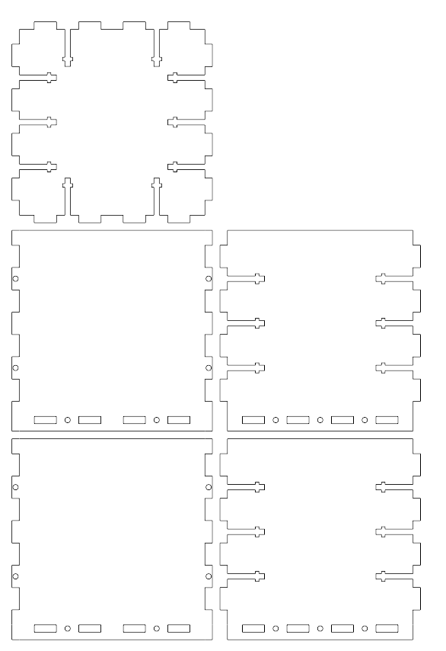
Box2.py with bedbolts

Slide 10
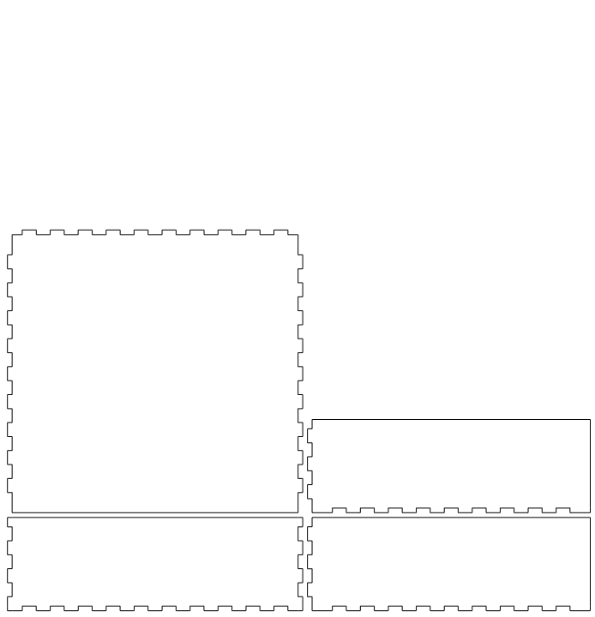
Box3.py

Slide 11
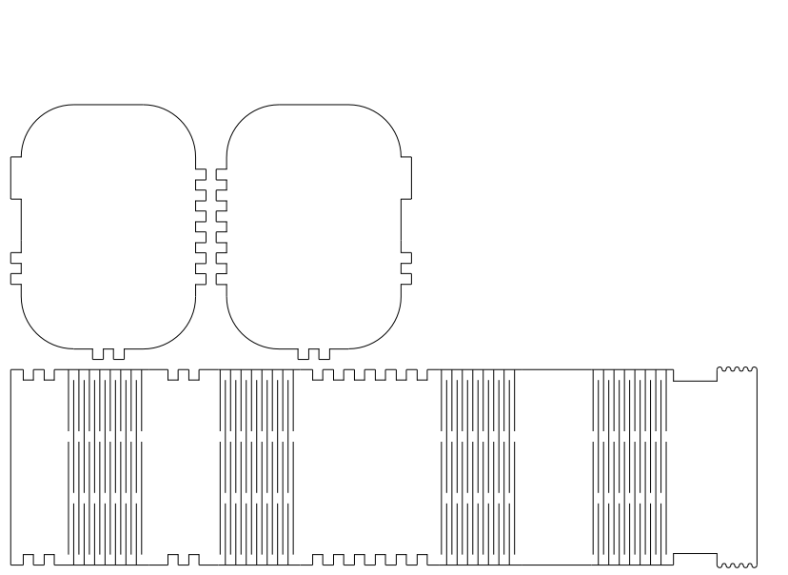
Flexbox.py

Slide 12
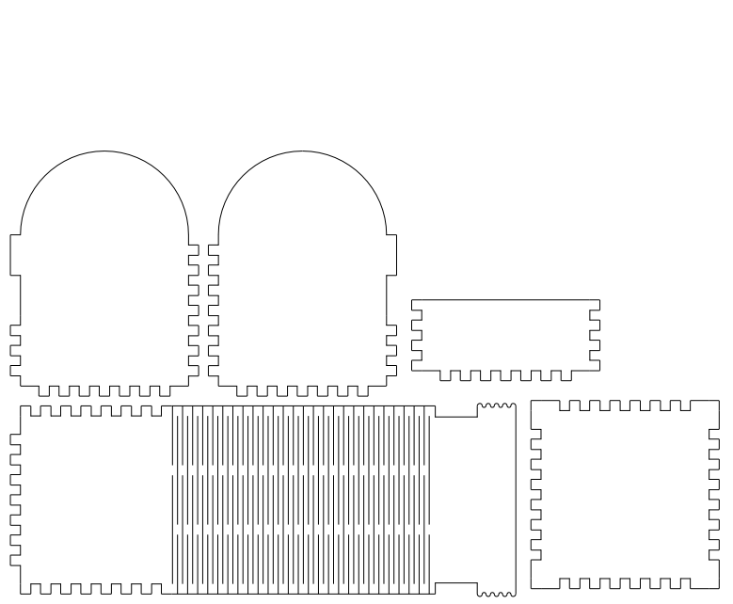
Flexbox2.py

Slide 13
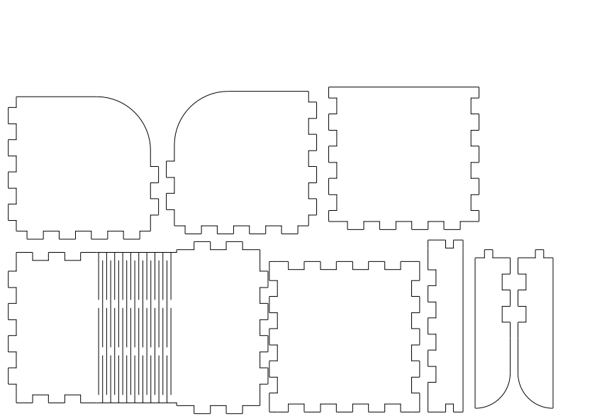
Flexbox3.py

Slide 14
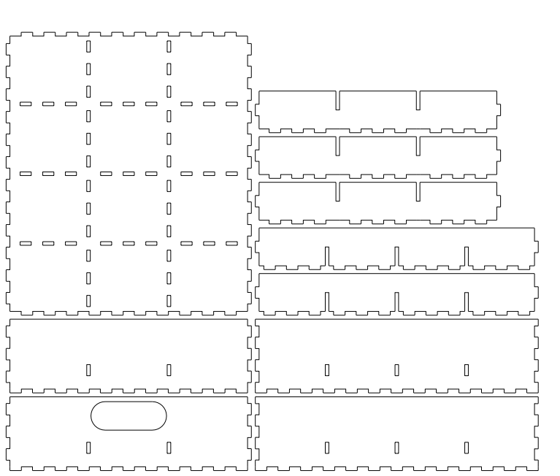
Typetray

Slide 15
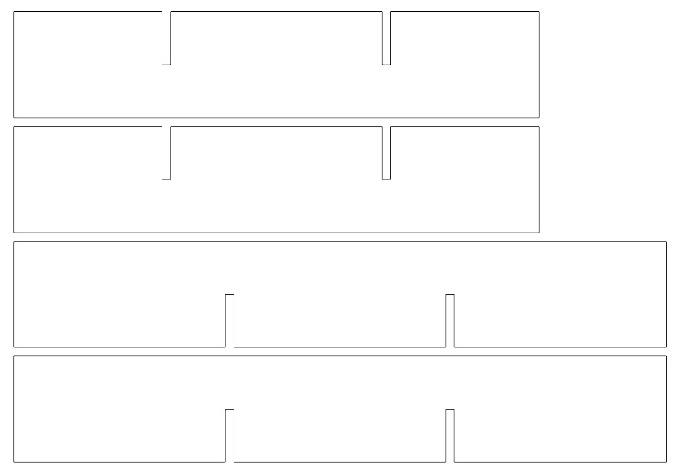
Trayinsert

Slide 16
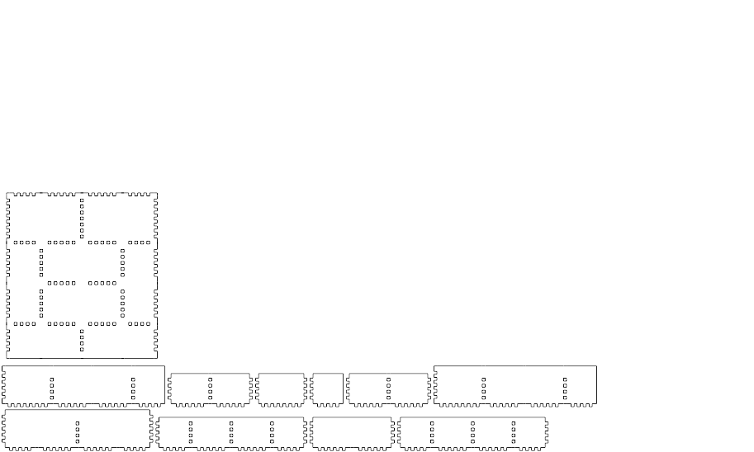
Traylayout

Slide 17
Traylayout
,> 40.0mm
| ,> 50.0mm
| | ,> 50.0mm
| | | ,> 40.0mm
+-+-+-+-+
| | | 60.0mm
+-+-+-+-+
| | | | 50.0mm
+ +-+-+ +
| | | | 50.0mm
+-+-+-+-+
| | | 40.0mm
+ + + + +

Slide 18
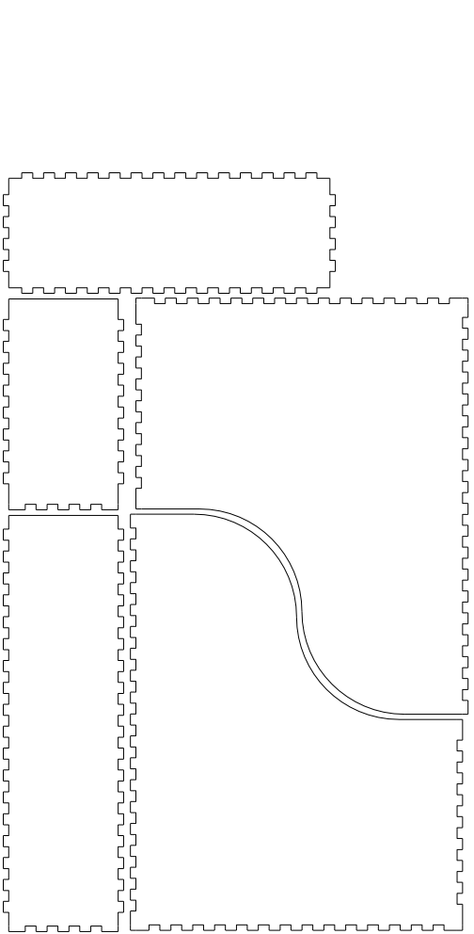
Magazinefile.py

Slide 19
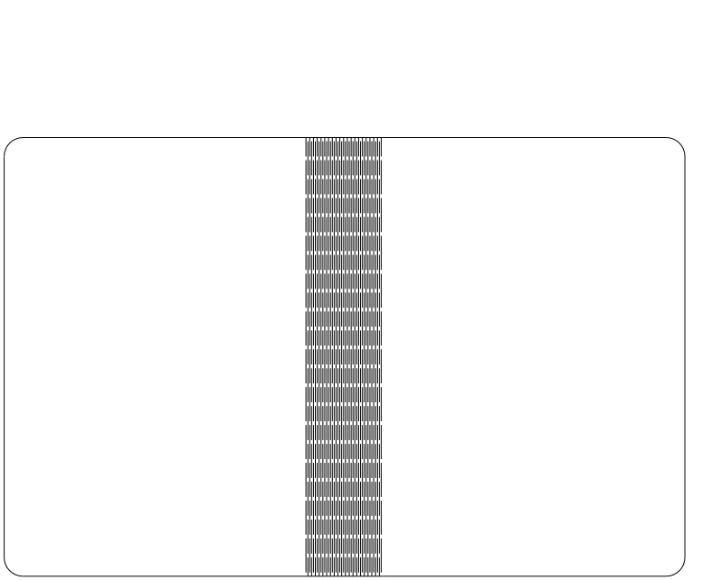
Folder.py

Slide 20
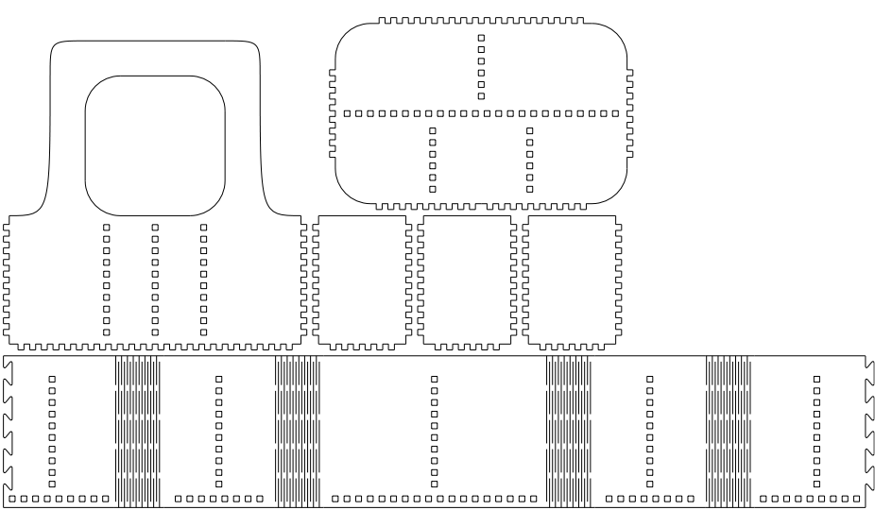
Silverwarebox

Slide 21
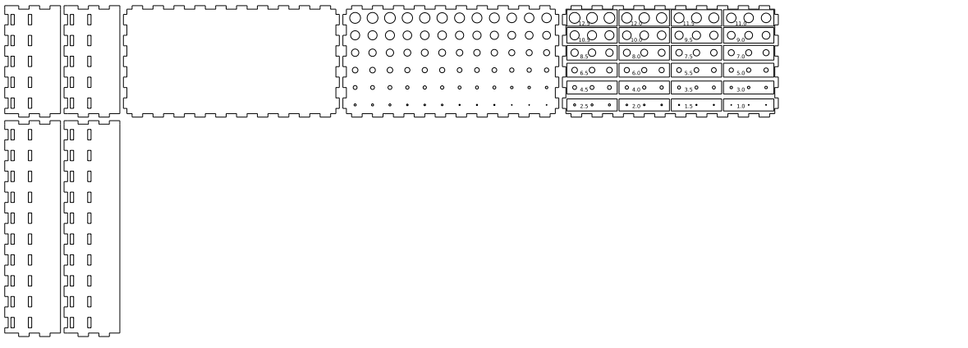
Drillbox.py

Slide 22
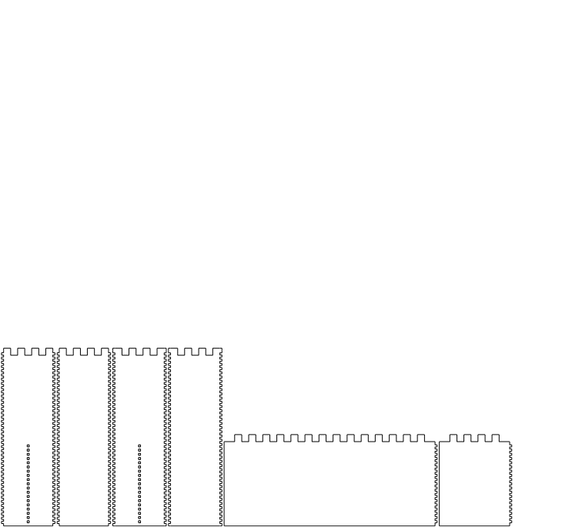
Castle.py

Slide 23
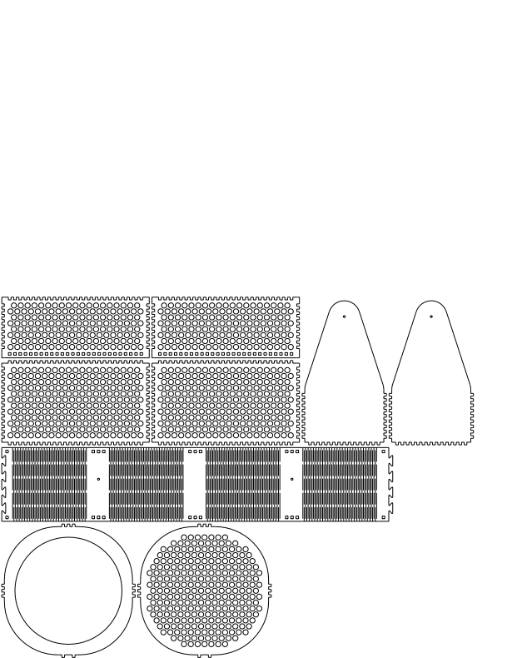
Lamp.py

Slide 24
Getting started
Get from https://github.com/florianfesti/boxes
  Git clone
  Or download
Requires Python 3
And Pycairo
  Package pycairo, python-cairo or python3-cairo
  Windows install instructions still wanted

Slide 25
Using boxes.py
scripts/boxes --list
  Gives names of available generators
scripts/boxes NAME --help
  Gives description and options
Or use scripts/boxesserver
  Web interface on localhost:8000
Write your own generators

Slide 26
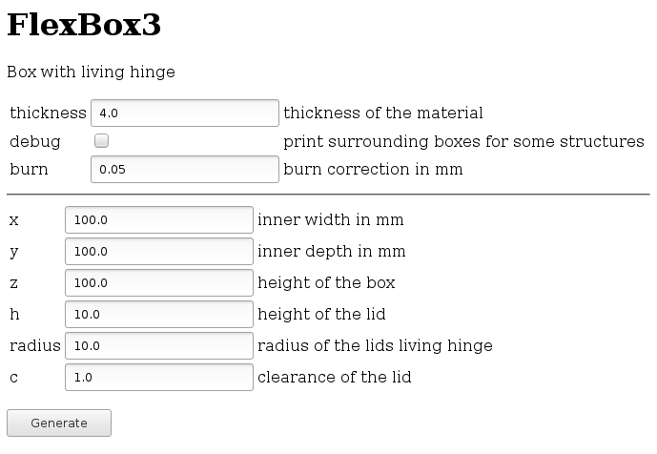
Web Interface

Slide 27
./scripts/boxes flexbox3 --help
usage: boxes flexbox3 [-h] [--thickness THICKNESS] [--output OUTPUT] [--debug]
[--burn BURN] [--x X] [--y Y] [--z Z] [--h H]
[--radius RADIUS] [--c D]
Box with living hinge
optional arguments:
-h, --help show this help message and exit
--thickness THICKNESS
thickness of the material
--output OUTPUT name of resulting file
--debug print surrounding boxes for some structures
--burn BURN burn correction in mm
--x X inner width in mm
--y Y inner depth in mm
--z Z height of the box
--h H height of the lid
--radius RADIUS radius of the lids living hinge
--c D clearance of the lid

Slide 28
Typical Parameters
All sizes in mm
x, y, z, h: inner sizes
  Often x,y is the side view and z width
r: radius of corners
thickness: strength of the material used
  Influences how joints are made
burn: correction for the beam width
  This is the radius of the beam
  Typically 0.05 to 0.1 mm

Slide 29
Burn correction
Keep straight edges same length
Increase radius by burn correction
Treat corners as circle arcs with radius zero
Decrease radius for inner corners
Need solution for negative radius
  Hard problem – sharp corners vs round tool
  Flip over arc for negativ radius works

Slide 30
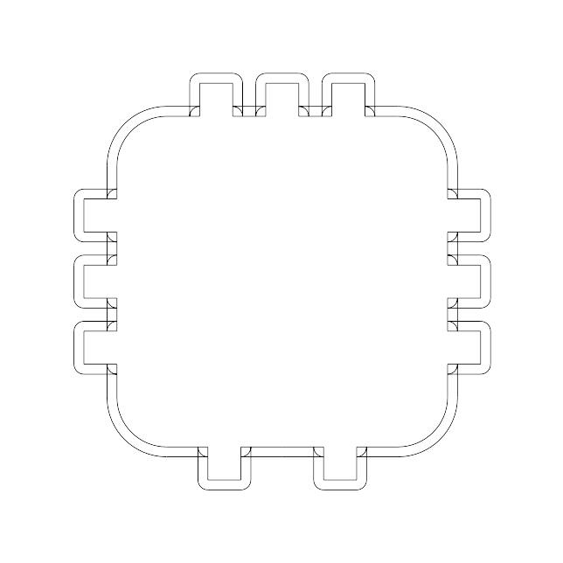
Burn correction example

Slide 31
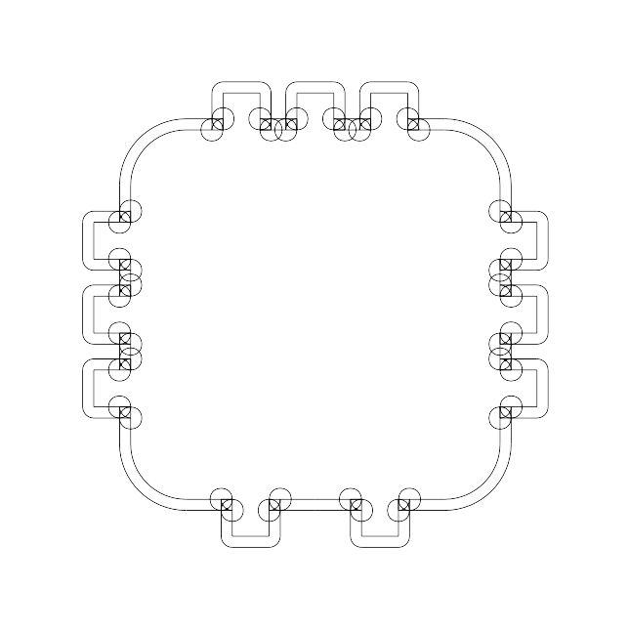
Over cuts

Slide 32
Using the boxes Framework
Several layers of abstraction
Base class Boxes in boxes/__init__.py
Scripts sub class Boxes
See boxes/generators/_template.py
Choose CLI params
Implement your own .render() method

Slide 33
Primitives and Building blocks
Cairo primitives (on self.ctx)
Building blocks
  Get coordinates passed to them
  Text and all kind of holes
self.moveTo(x, y, dir)
  Change coordinate system to given point
self.ctx.save()
self.ctx.restore()
  To return to previous positions

Slide 34
Turtle Graphics Commands
.edges(), Edges and .corner()
Start at 0, 0 heading right
Move coordinate system to their endpoint
And their end orientation
Part is above the X Axis
  Go to right and turn mathematically positive
  to get a closed part
Automatically do burn correction

Slide 35
Edges
Classes on their own
Separate Settings classes
Allow sharing of settings among both sides
Boxes.edges[char] and Boxes.name
width: outset needed to begin this edge
margin: additional space needed (e.g. fingers)

Slide 36
Edge Settings
b.edges["f"].settings.setValues(
b.thickness, space=3, finger=3, surroundingspaces=1)
Space: width in between fingers
Finger: width of fingers
Surroundingspaces: width at the end of the edge
All in multiples of thickness
  as passed as first param

Slide 37
Parts
Walls and pieces
  rectangularWall()
  roundedPlate()
  surroundingWall()
move parameter
  right, left, up, down, only
Callback for all sides
  To put holes and other building blocks
  Pass either single function or list of callables

Slide 38
Edges parameter
Iterable with characters or Edge objects
e, E: straight edge, normal and outset
f, F: Finger joints
h: Straight edge with holes for finger joint
d, D: Dovetails joints
X: Flex edge
You can register your own edges
Or pass them as Objects

Slide 39
What's next?
More generators
  Treasure Chests with rounded lid
CLI params for bed bolts
CLI params for Edge settings
API Doumentation with Sphinx
Support for Edges other than 90°
See documentation/TODO.txt
Patches welcome!

Slide 40
Questions?

