Slide 1
Boxes.py
More than a Box generator
Florian Festi

Slide 2
Outline
Brief overview
Showing existing objects
How to use and adjust
Software architecture and how to use it
Outlook

Slide 3
Motivation
Boxes for the Lasercutter
Drawing (finger) joints in CAD is a drag
Online box generators only allow fixed styles
No flexible opensource generators found

Slide 4
What?
Box generator
Written in Python
Creates SVG
Several supported models
Library for own creations
Supports flex, finger and flat dovetail joints
Can be use to create more complicated things than a simple box

Slide 5
Features
Flex
Finger joints
Dovetail joints (flat only)
Holes in honey comb pattern
Several finished Models

Slide 6
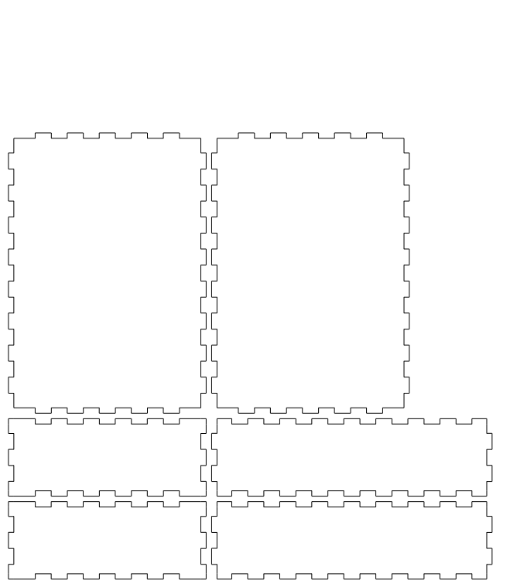
Box.py

Slide 7
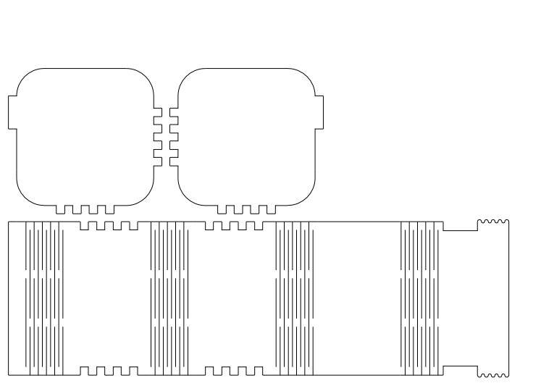
Flexbox.py

Slide 8
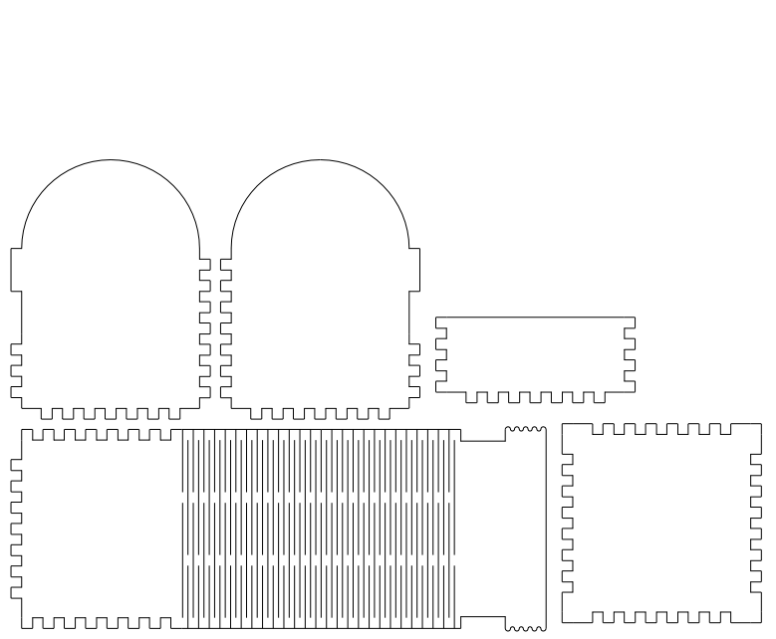
Flexbox2.py

Slide 9
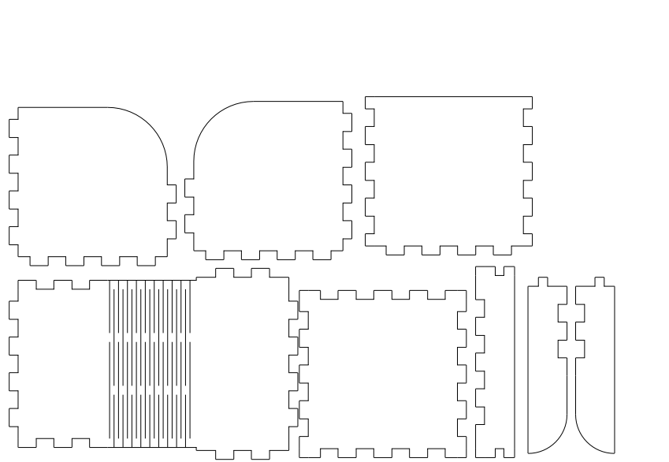
Flexbox3.py

Slide 10
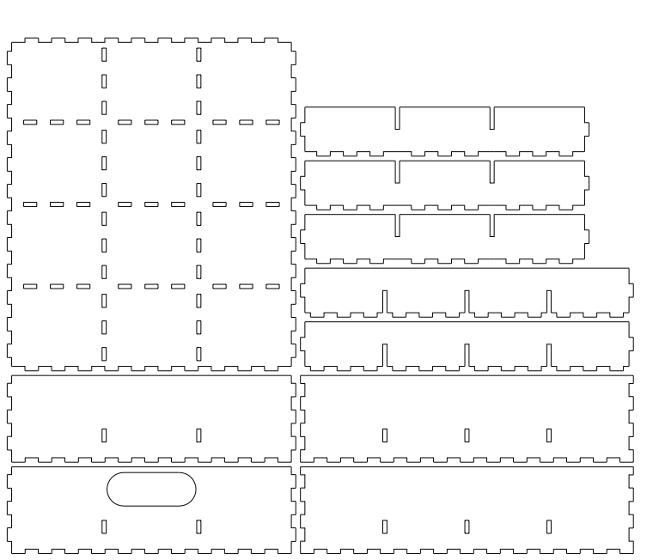
Typetray

Slide 11
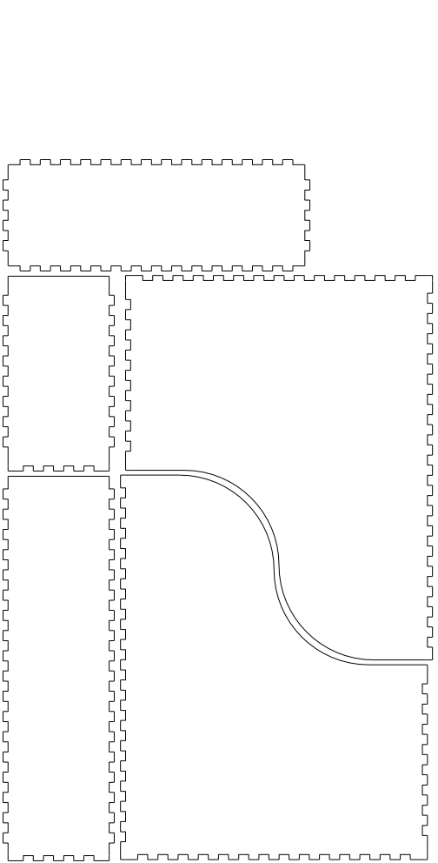
Magazinefile

Slide 12
Special Pieces
Silverwarebox
Drillbox
Lamp (needs to be redone without flex)
Printer (still under construction)

Slide 13
Getting started
Get from https://github.com/florianfesti/boxes
  Git clone
  Or download
Requires Python 2 or 3
  Defaults to /usr/bin/python
And Pycairo
  Package pycairo, python-cairo or python3-cairo
  Windows install instructions still wanted

Slide 14
Using boxes.py
Select script you want to use
  You don't want boxes.py
Adjust sizes and parameters
Execute script
Find result in box.svg

Slide 15
Adjusting Sizes
Skip to the end of the file
Edit params given
E.g. in Flexbox2.py:
if __name__=="__main__":
b = FlexBox(50, 70, 50, r=25,
thickness=3.0)
b.render()

Slide 16
Typical Parameters
x, y, z, h: inner sizes
  Often x,y is the side view and z width
r: radius of corners
thickness: strength of the wood
  Influences how joints are made
burn: correction for the beam width
  This is the radius of the beam
  the amount of the offset at one side

Slide 17
Using the boxes Framework
Several layers

Slide 18
Primitives and Building blocks
Cairo primitives (on self.ctx)
Building blocks
  Get coordinates passed to them
  Text and all kind of holes
self.moveTo(x, y, dir)
  Change coordinate system to given point
self.ctx.save()
self.ctx.restore()
  To return to previous positions

Slide 19
Turtle Graphics Commands
Edges and corners
Start at 0, 0 heading right
Move coordinate system to their endpoint
And their end orientation
Part is above the X Axis
  Go to right and turn mathematically positive
  to get a closed part
Automatically do burn correction

Slide 20
Edges

Slide 21
Parts
Walls and pieces
  rectangularWall()
  roundedPlate()
  surroundingWall()
move parameter
  right, left up, down, only
Callback for all sides
  To put holes and other building blocks
  Pass either single function or list of callables

Slide 22
Edges parameter
Iterable with characters or Edge objects
e, E: straight edge, normal and outset
f, F: Finger joints
h: Straight edge with holes for finger joint
d, D: Dovetails joints
X: Flex edge
You can register your own edges
Or pass them as Objects

Slide 23
Still missing
Command line interface
Smarter output file name (scriptname + params)
Support for Edges other than 90°
  Switch lamp.py over to hexagonal head
Patches welcome!

