Slide 1
Boxes.py
Programming Guide
Florian Festi
2019/02
Backspace e.V.
Hackerspace Bamberg, Germany

Slide 2
Outline
Documentation
Architecture Overview
Top to bottom walk through
Bottom to top look at API
How to get things done
Special topics
  Burn correction
  Tabs

Slide 3
Documentation
GitHub for Issues
Hackaday.io for Blog
Sphinx based documentation
  User, Installation and API docs
  Follow along during this talk
Links at the bottom of the web instance

Slide 4
Architecture
User Interfaces – scripts/*
Generators – boxes/generators/*
Parts
Edges
Graphics primitives

Slide 5
User Interfaces
boxesserver
  Standalone http server
  Wsgi
  Docker container
boxes CLI
Jupyter notebook
Inkscape Interface
  boxes2inx + boxes script
boxes2rst

Slide 6
Generator
Creates one drawing e.g. SVG file
Sub class of boxes.Boxes (boxes/__init__.py)
In boxes/generators/
Extends .__init__() for parameters
Implements .render()
.group attribute (see web UI)
Doc string and .description
boxes.generators._template.py

Slide 7
Parameters
Based on argparse standard lib
Default parameters added automatically
.buildArgParser()
.addSettingsArgs()
  Adds group for Edge type
Manually add arguments to .argparser

Slide 8
Supported Argument Types
Basic types
  str, int, float, boxes.boolarg
str supports choices argument
  Generates drop down box in web UI
boxes.argparseSections()
boxes.argParseEdgeType()
  Selection of edges
Support .html() and .xml() methods

Slide 9
Parts
Draws something at the current position
Some params for dimensions
  x, y, r, h, ...
move parameter for placement
edges parameter
  Iterable of chars or Edge objects
callback parameter

Slide 10
List of Parts
.rectangularWall
.flangedWall
.rectangularTriangle
.trapazoidWall
.regularPolygonWall
.roundedPlate
.surroundingWall
.polygonWall
.polygonWalls

Slide 11
More Parts
.parts.disc
.parts.waivyKnob
.parts.concaveKnob
.parts.ringSegment
.gears
.gears.gearCarrier
.pulley

Slide 12
Edges parameter
Iterable with characters or Edge objects
See Misc → AllEdges
You can register your own edges
Or pass them as Objects

Slide 13
Callback Parameter
Executed at given position
  Center, along edge, ...
Single callback for center (rare)
Multiple callbacks enumerated
  Callable with one nr param (int)
  List of callables (None to fill up positions)
  Dict int → callable
Use lambda expressions
Use .cc() to implement

Slide 14
Placement
Current position
Coordinates move
Pointing along X axis
Part above X axis
Positive angles close part
Negative angles for inner corners

Slide 15
Move Parameter
Place parts
String with words, white space separated
  right, left, up, down, only, mirror, rotated
Order: left, down, only/mirror+draw, up, right
Use self.move to implement parts
Needs size of part (for now)
Call before and after drawing part

Slide 16
.partsMatrix
Place multiple parts at once
Parts need to support move param
move param for whole block

Slide 17
Edges
Classes on their own
Separate Settings classes
Allow sharing of settings among both sides
Boxes.edges[char]
  See generator Misc →AllEdges
startwidth: outset needed to begin this edge
endwidth: outset at the end of this edge
margin: additional space needed (e.g. fingers)

Slide 18
Settings Classes
Shared settings for related Classes
Create arguments for UI
  Pass defaults to Boxes.addSettingsArgs()
Create related Edge instances
Absolute and relative (to thickness) Settings

Slide 19
Edge Settings
b.edges["f"].settings.setValues(
b.thickness, space=3, finger=3, surroundingspaces=1)
Space: width in between fingers
Finger: width of fingers
Surroundingspaces: width at the end of the edge
All in multiples of thickness
  as passed as first param

Slide 20
Turtle Graphics Commands
.edge(), Edges, .corner() and .polyline()
  Some more – see Docs
Start at 0, 0 heading right
Move coordinate system to their endpoint
And their end orientation
Part is above the X Axis
  Go to right and turn mathematically positive
  to get a closed part
Automatically do burn correction

Slide 21
Primitives and Building blocks
Cairo inspired primitives (on self.ctx)
Building blocks
  Get coordinates passed to them
  Text and all kind of holes
self.moveTo(x, y, dir)
  Change coordinate system to given point
To return to previous positions
  with self.saved_context():
  self.ctx.save() + self.ctx.restore()

Slide 22
Implement
Callbacks on existing parts
Custom Edge Class
Custom part
New generator

Slide 23
Examples
See Docs

Slide 24
Burn correction
Keep straight edges same length
Increase corner radius by burn correction
Treat corners as circle arcs with radius zero
Decrease radius for inner corners
Need solution for negative radius
  Hard problem – sharp corners vs round tool
  Flipping over arc for negative radius works

Slide 25
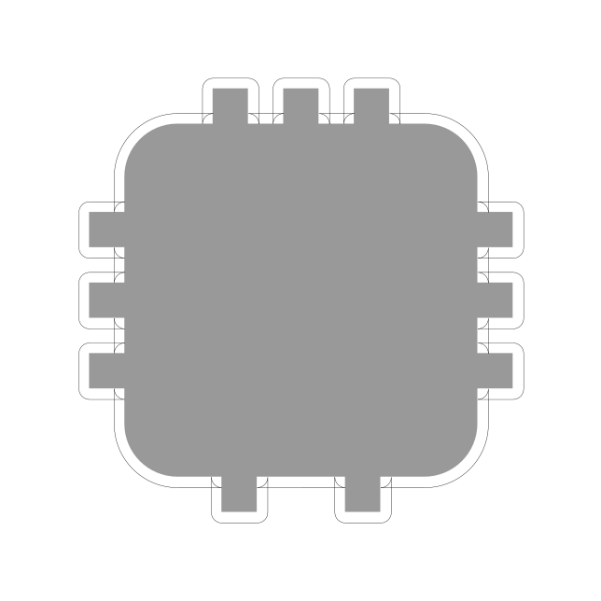
Burn correction example

Slide 26
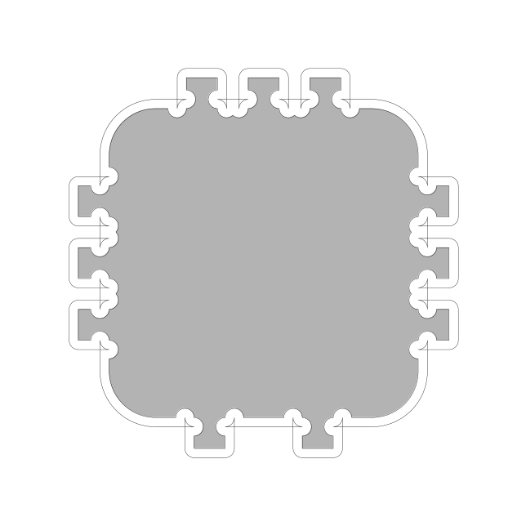
Over cuts

Slide 27

Replace Arcs by Loops

Slide 28
Burn Correction
Don’t need to care most of the time
Outside CCW, holes CW!
.moveTo inside a part
  Outer and inner correction!
Outer in Y direction
Inner depending on direction
Y param of .cc() – if passed

Slide 29
Tabs
tabs standard parameter
Keeps parts from falling out
Most Edge classes create ~2 tabs per edge
  Many parts don’t need to bother
Tabs argument for turtle graphics commands
  Defaults to 0
  .corner()
  .edge()
  .polyline() – edge parts only

Slide 30
Getting started
Get from https://github.com/florianfesti/boxes
  Git clone or download
Requires Python 3
requirements.txt, requirements_dev.txt
Markdown, lxml, setuptools, ps2edit
Start scripts/boxesserver
  open localhost:8000

Slide 31
Links
https://hackaday.io/project/10649-boxespy
https://github.com/florianfesti/boxes
http://florianfesti.github.io/boxes/html/index.html
http://festi.info/boxes.py/index.html

Slide 32
Questions?

