Slide 1
My Own Box
Florian Festi
IGERla 2024

Slide 2
Just not the right Box?
Often just a feature missing
Can’t adjust that one thing
Need something for a special use case
Build something vaquely box like
Laser cutting is easy – 3D modelling not quite

Slide 3

How boxy is your Problem?

Slide 4
Considerations
Boxes.py is very specialized
Not a general graphics library
Likes right angles
Turtle Graphics on Steroids
For angles and lengths you are on your own

Slide 5
Edit with Inkscape
Add holes and engravings
Move or delete Features
Turn straight edges into design
Make sure the drawing is right before editing!
  Messure Material (thickness)!

Slide 6
Examples
Turn IntegratedHingBox into cute animal head
Glue or place Trays into Boxes
Copy FingerHole patterns to combine boxes
Glue different boxes together

Slide 7
Combining Different Models
Advanced Inkscape Foo
Copy FingerHoles pattern to attach parts
Glue sides to sides
Add Trays or TrayInserts (inside) to subdivide

Slide 8
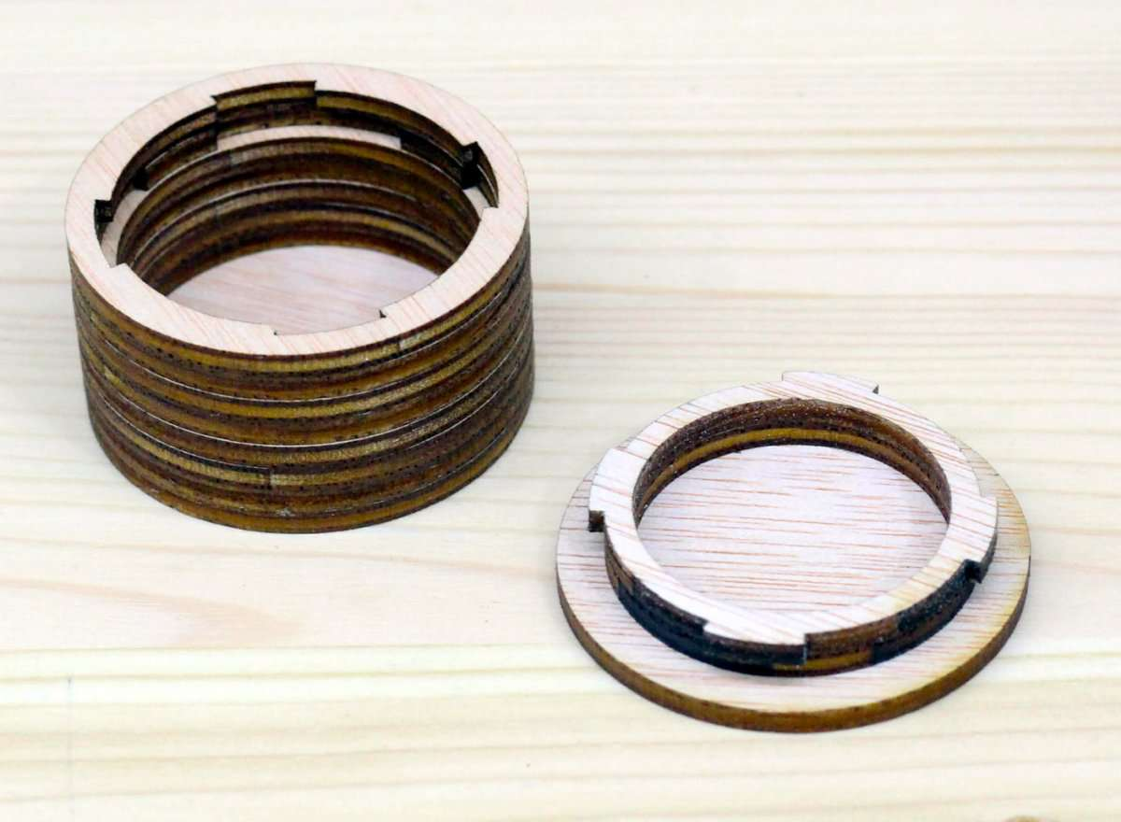
Building Blocks
Parts and Samples
  Concave and WavyKnob
  Gears
  LBeam
  RectangularWall
  NemaBracket
Hole Patterns
AllEdges
BayonetBox

Slide 9
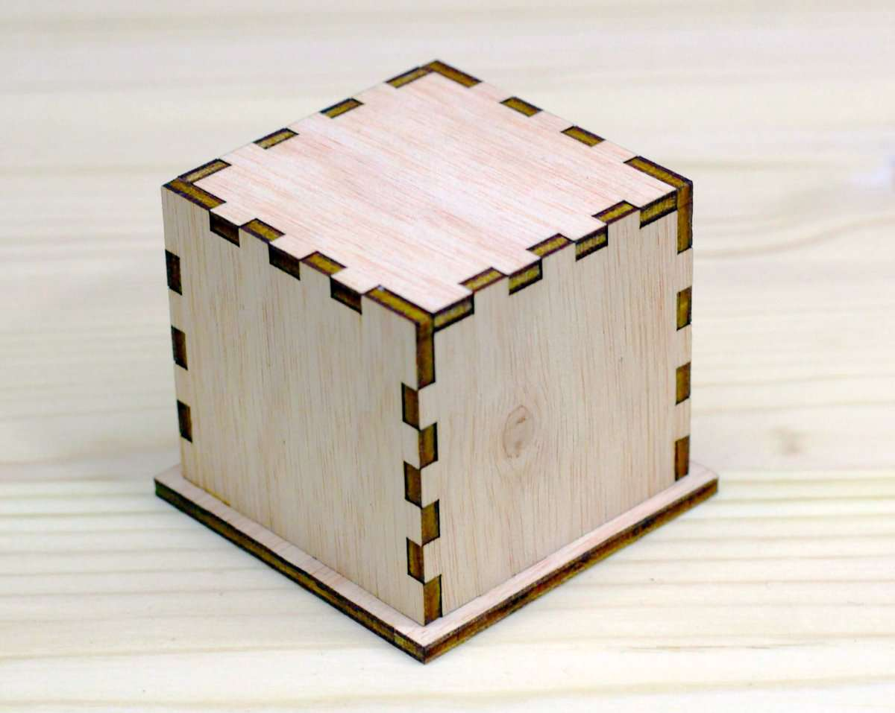
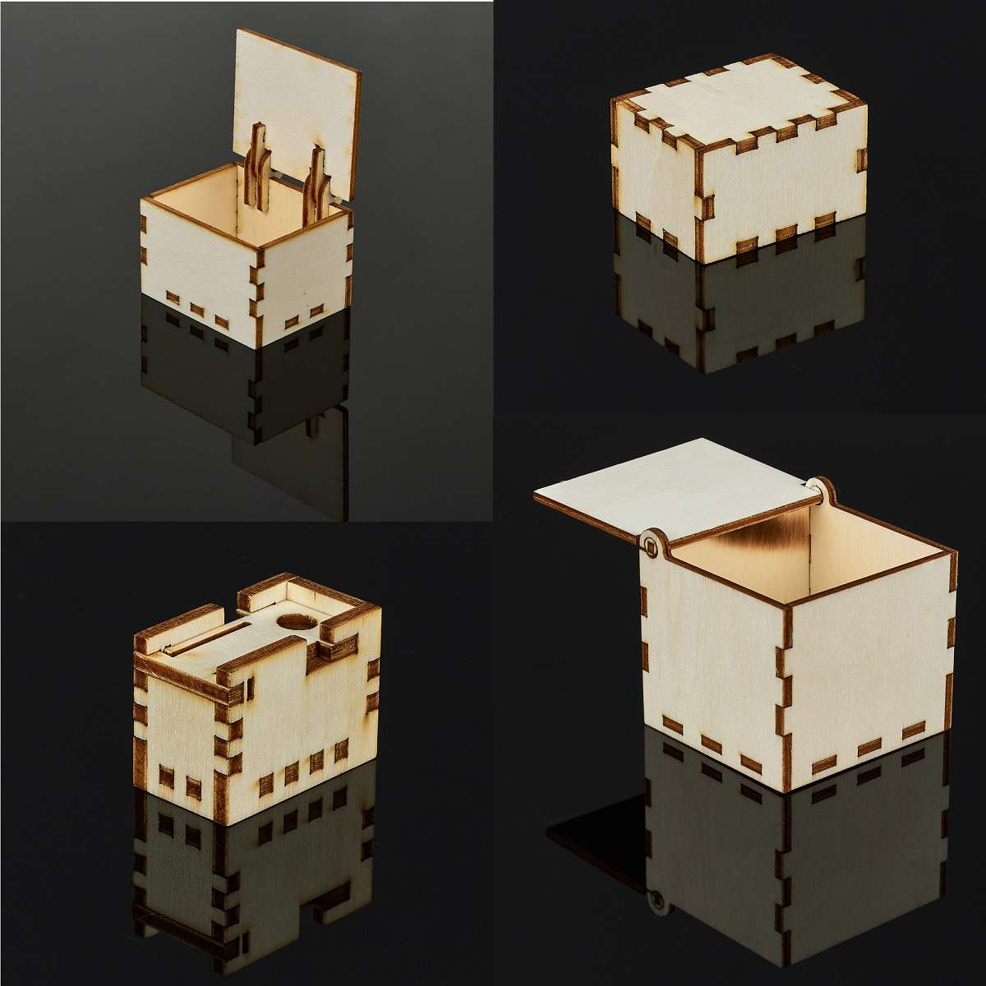
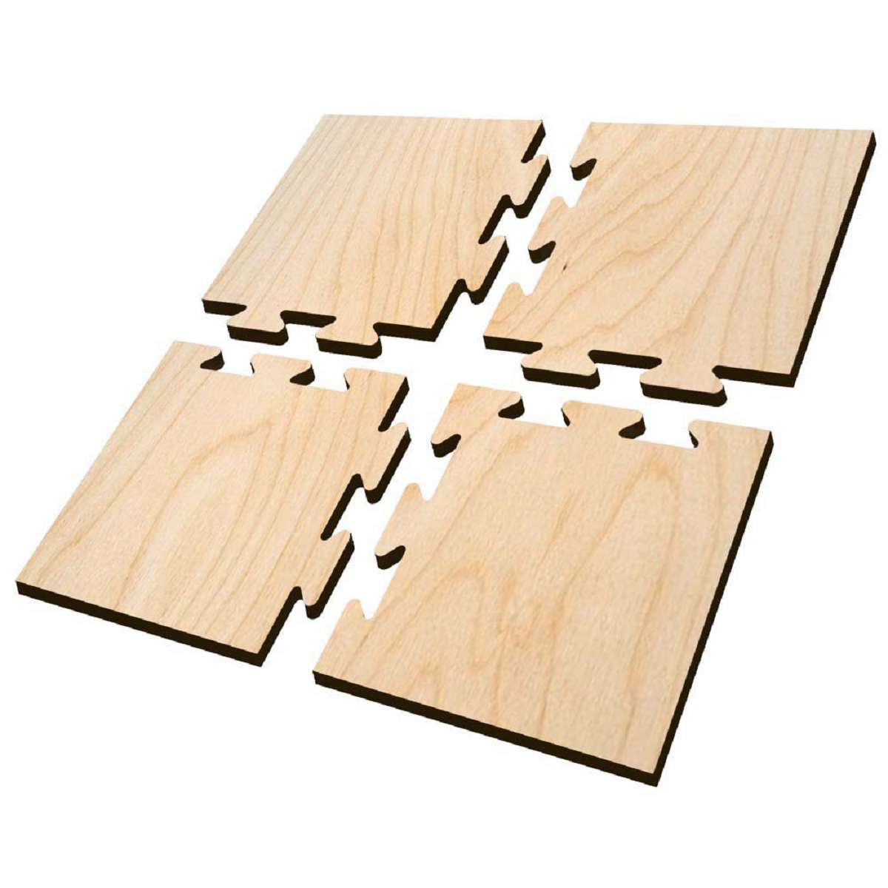
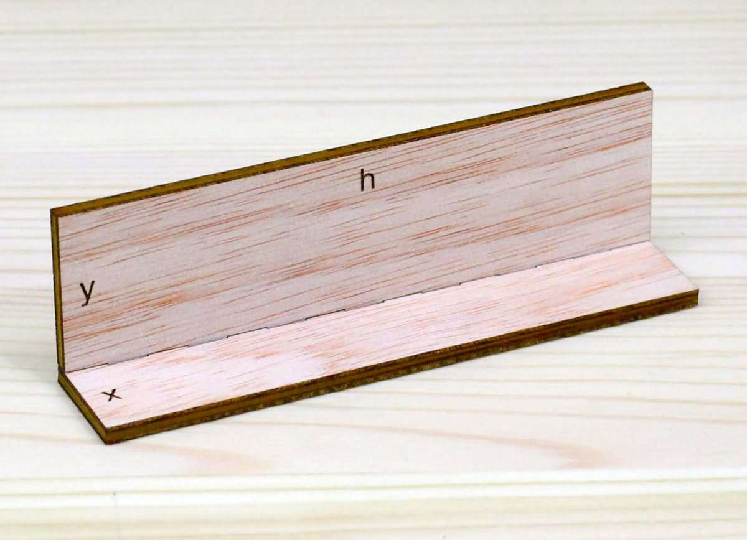
BuildingBlocks
CloseBox
TypeTray “f” top
UniversalBox “f” top
BasedBox
JointPanel

Slide 10
Extend existing Model
Is your use case of general interest?
Open an issue on Git Hub
  Ask for the best way of doing things
  Upstream responses vary
Look for good starting points / Similar features

Slide 11
Extend Existing Model
Add new parameters
Change parameters to more general ones
Implement the changes
  Make Edges selectable
  Turn length into sections
  Add new feature if selected
Try to keep default behaviour the same

Slide 12
Turn Model into something else
Copy and Rename
Drop / Hard code unnecessary arguments
Add new features
  Callbacks for Holes / Engravings
  Add new parts
  Modify Edge Types
  Grab features from other Models

Slide 13
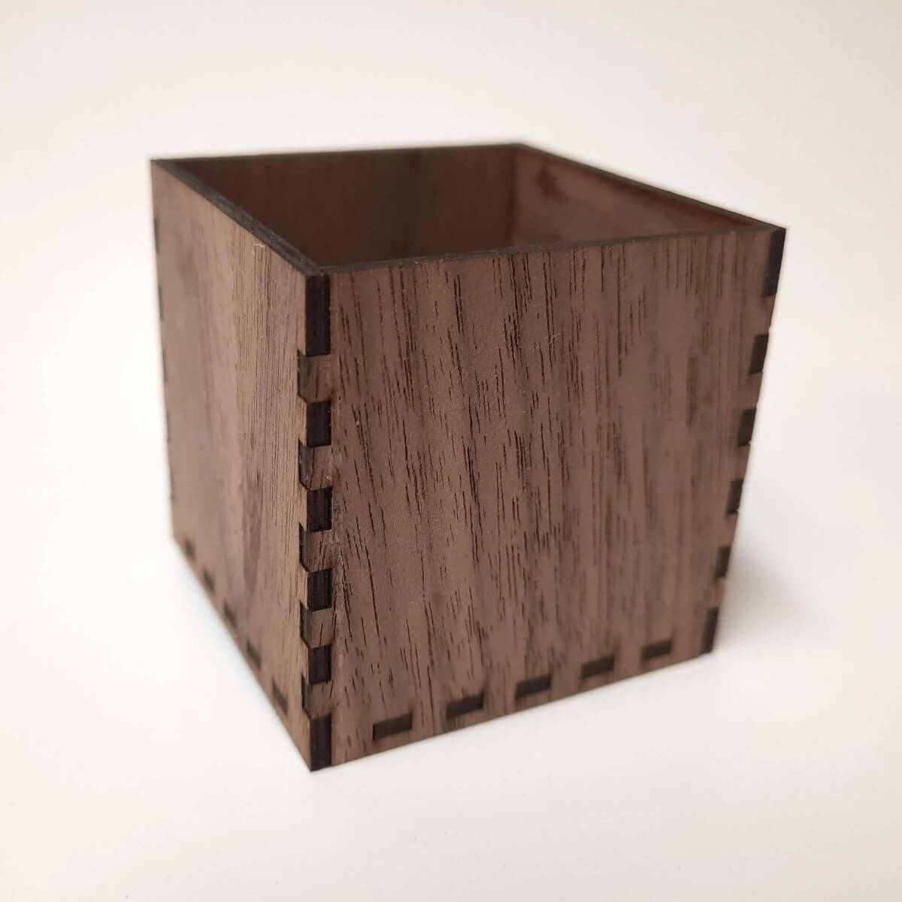
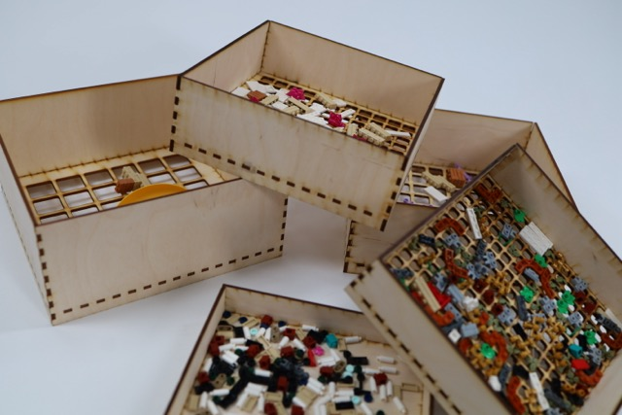
A Box / Brick Sorter

Slide 14
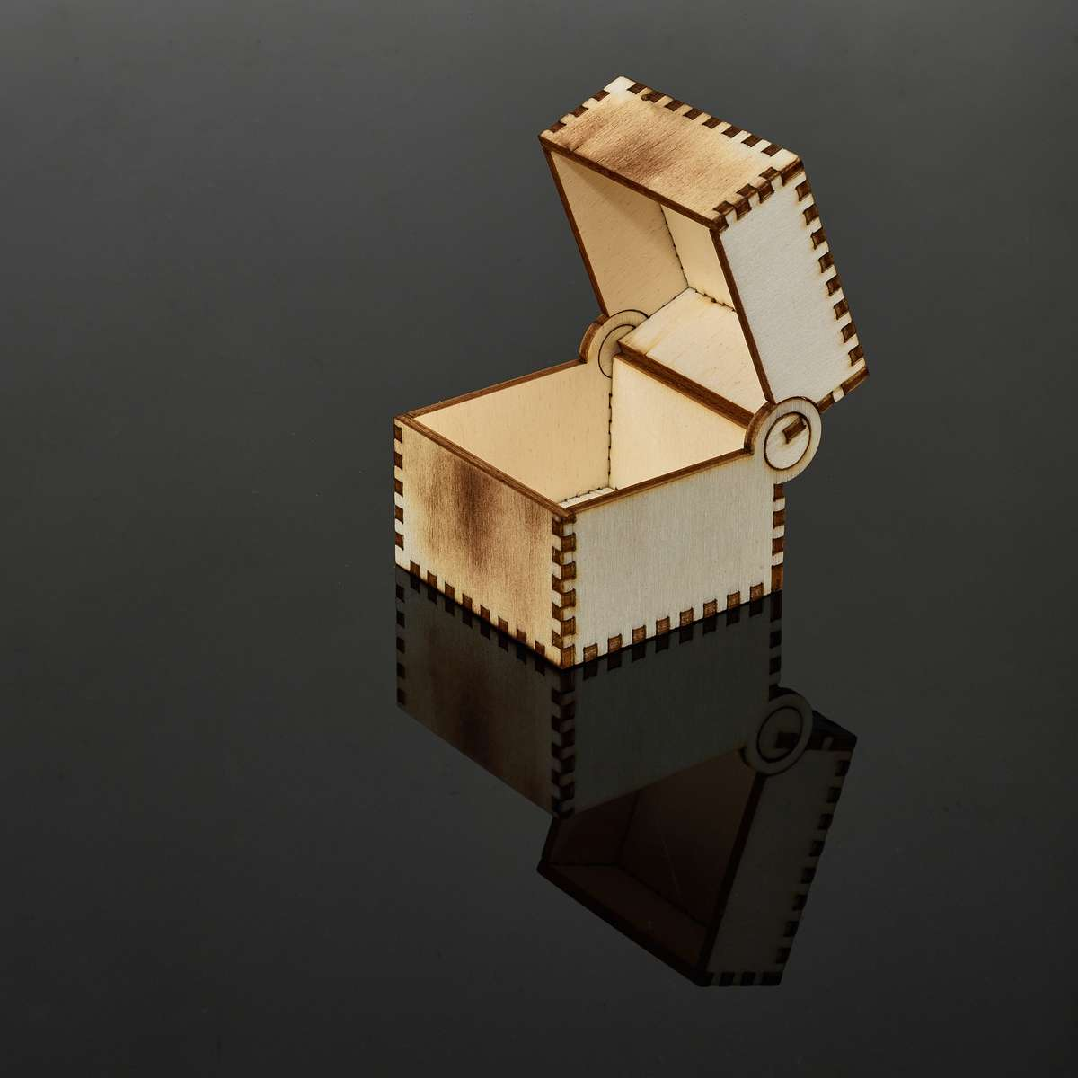
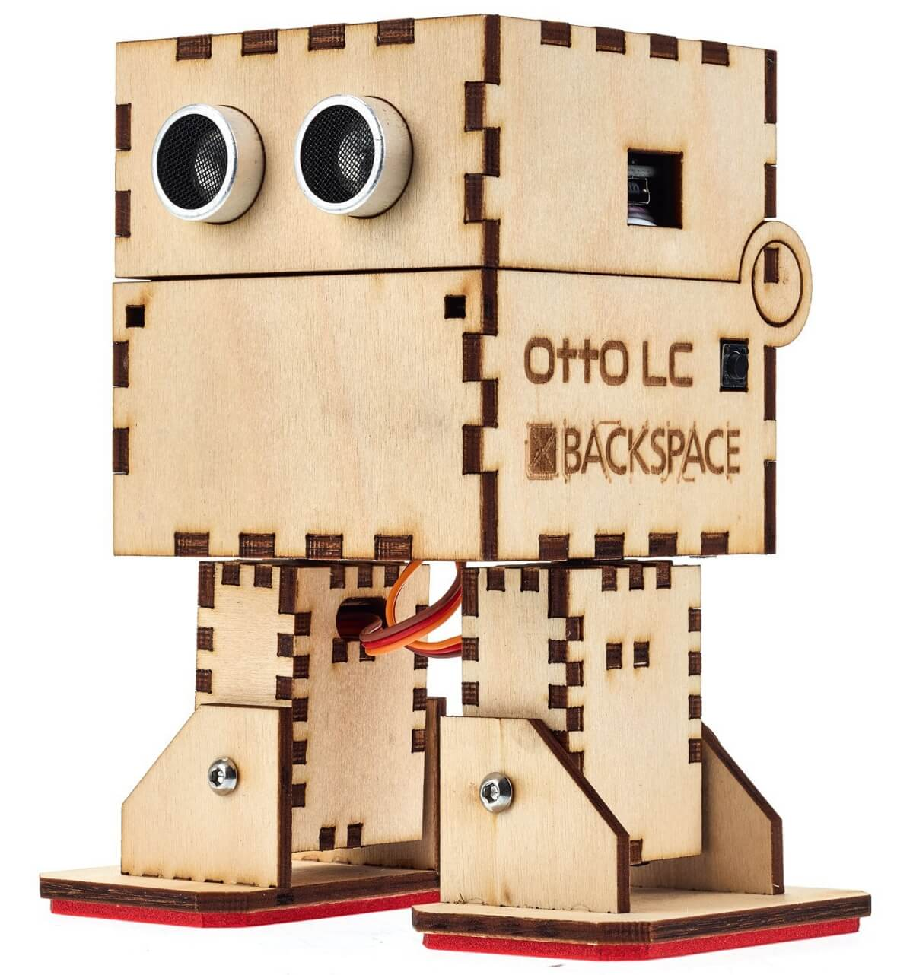
Integrated Hinge Box / Otto Bot

Slide 15
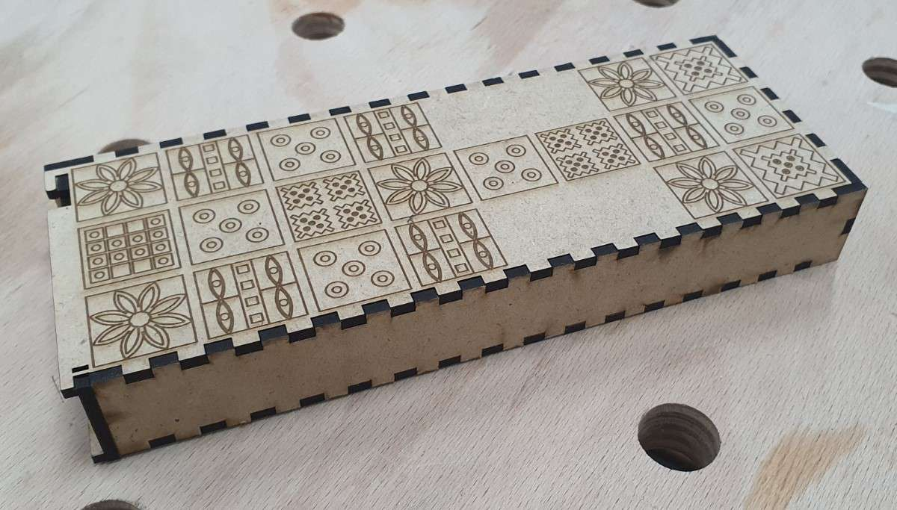
Universal Box / Royal Game

Slide 16
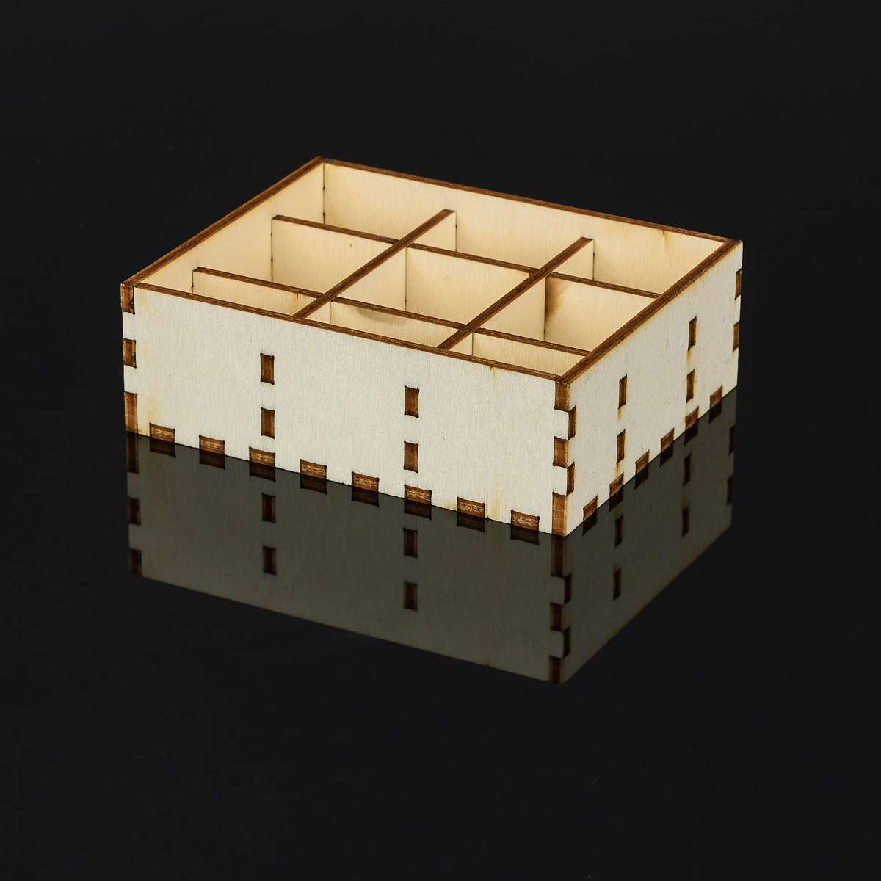
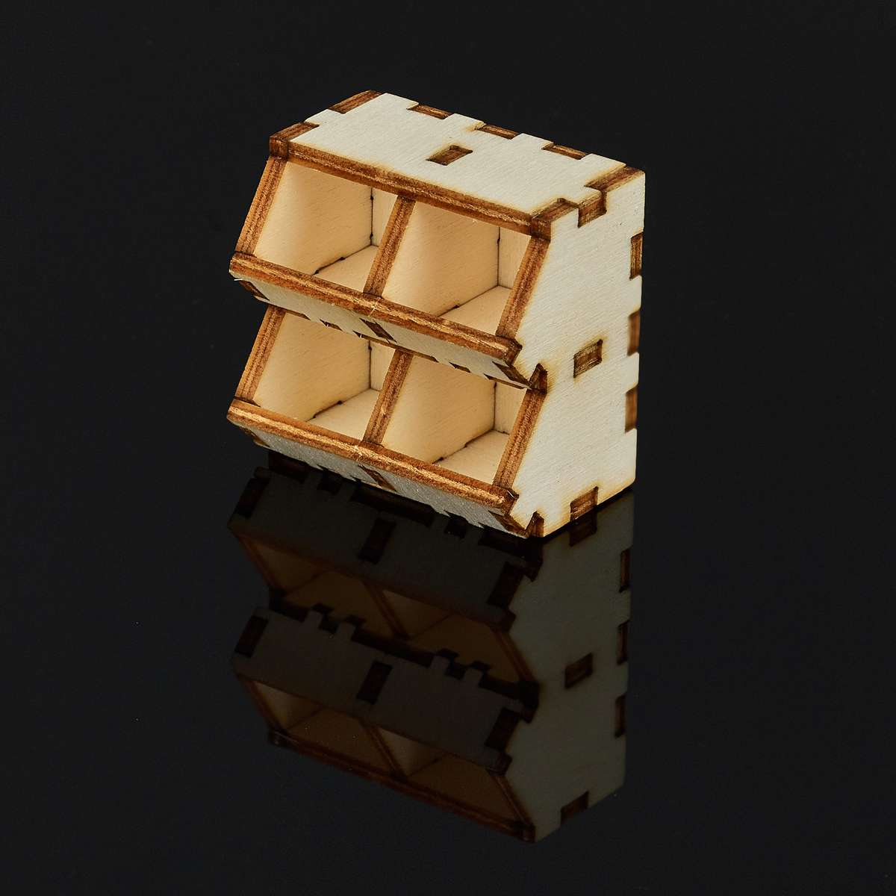
Type Tray / Bin Tray

Slide 17
Bin Tray Transformation
Drop inner_height, grip hole, labeling
Switch slots / dimmensions
Add new Edge type for front
Add front pieces, holes for hanging

Slide 18
Continue with API Docs

