Slide 1
Stack Buffer Overflows
Attacks and defense mechanisms

Slide 2
Table of contents
Introduction
Stack layout and Stack Buffer Overflows
Exploiting Stack Buffer Overflows
Defending against Stack Buffer Overflow exploits
Conclusion

Slide 3
Introduction
Famous paper / tutorial: Smashing the Stack for Fun and Profit
Game of cat-and-mouse between attackers and defenders
Main questions:
What is a stack buffer overflow?
How can it be exploited?
How can stack buffer overflow exploits be mitigated?
Notes:
Smashing the Stack for Fun and Profit: Aleph One, 1996, Phrack
32 bits, no protection mechanisms
Famous example: Morris worm, 1988
Spread partly via a stack buffer overflow in the finger daemon (finger: network protocol to exchange status information about a computer and user information)
Stack buffer overflow allowed overwriting a string with the program to execute => /bin/sh instead of the original /usr/ucb/finger
Cat-and-mouse:
New defense mechanisms lead to new attacks lead to new defense mechanisms
Data execution prevention / NX bit => code reuse attacks such as ret2libc, ROP
Code reuse => ASLR
Current status: stack buffer overflows hard to exploit but not impossible

Slide 4
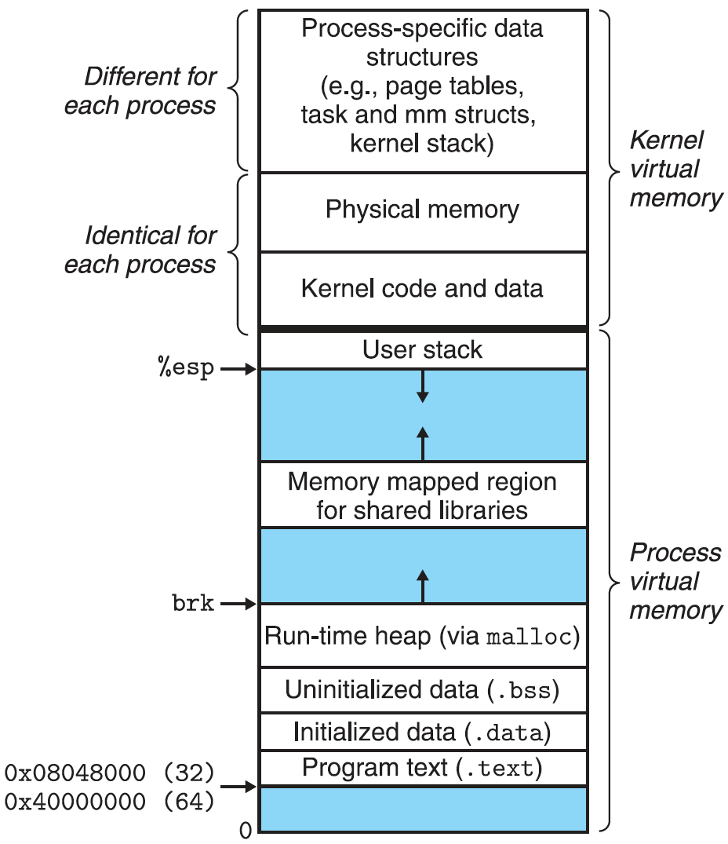
Stack layout and Stack Buffer Overflows
Memory regions with fixed size
.text, .data, .bss sections
Memory regions with dynamic size
Stack (e.g. char buf[32];)
Heap (e.g. char *buf = malloc(32);)
Stack frame
Function-local data with fixed size
Control flow information

Slide 5
Stack layout and Stack Buffer Overflows
stack frame of function calling copy
return address
saved frame pointer
buf
length
stack frame of strlen / strcpy
size_t copy(char *s) {
char buf[32];
size_t length;
length = strlen(s);
strcpy(buf, s);
return length;
}
towards higher memory addresses
towards the top of the stack

Slide 6
Stack layout and Stack Buffer Overflows
stack frame of function calling copy
attacker-controlled return address
padding
length
stack frame of strlen / strcpy
size_t copy(char *s) {
char buf[32];
size_t length;
length = strlen(s);
strcpy(buf, s);
return length;
}
towards higher memory addresses
towards the top of the stack

Slide 7
Exploiting Stack Buffer Overflows – Code injection
stack frame of function calling copy
attacker-controlled return address
\x48\x31\xf6\x56\x48\xbf\x2f\x62 \x69\x6e\x2f\x2f\x73\x68\x57\x54 \x5f\xb0\x3b\x99\x0f\x05 (execve(“/bin/sh”, NULL, NULL);)
length
stack frame of strlen / strcpy
size_t copy(char *s) {
char buf[32];
size_t length;
length = strlen(s);
strcpy(buf, s);
return length;
}
towards higher memory addresses
towards the top of the stack

Slide 8
Exploiting Stack Buffer Overflows – Code reuse
stack frame of function calling copy
attacker-controlled return address
padding
length
stack frame of strlen / strcpy
size_t copy(char *s) {
char buf[32];
size_t length;
length = strlen(s);
strcpy(buf, s);
return length;
}
void spawnShell(void) {
execve(“/bin/sh”,
NULL, NULL);
}
towards higher memory addresses
towards the top of the stack

Slide 9
Defending against Stack Buffer Overflow exploits – Data execution prevention
On Windows: mostly referred to as DEP (Data Execution Prevention)
On Linux: mostly referred to as non-executable stack
Implementation:
OS marks memory pages / areas as non-executable
Hardware support: processor refuses to execute code from non-executable regions
Separation of code and data
Notes:
Von Neumann computer architecture: code and data located in same memory
NX bit not physically but virtually separates code and data

Slide 10
Defending against Stack Buffer Overflow exploits – ASLR
ASLR = Address Space Layout Randomization
Base addresses of memory regions are randomized
Data regions such as stack, heap
Code regions such as .text
Memory mapped regions such as libraries
Weaknesses:
Re-randomization only on process instantiation
Fixed offsets inside memory regions
Solution:
Frequent re-randomization
Randomization with higher granularity
Notes:
Stochastic approach => cannot deterministically prevent code reuse attacks but makes them a lot harder to achieve
Weaknesses:
No re-randomization e.g. on fork => child process has same memory layout as parent process
Fixed offsets: leaking one address allows calculating other addresses
Solutions:
Re-randomization => pointer tracking necessary, replace all pointers => high performance overhead
Randomization with higher granularity:
Function reordering
At compile time, no overhead
At runtime, low overhead (store locations in memory and use indirect jumps instead of direct jumps)
Divide into more separate memory regions to randomize, e.g. offset2lib => .text section independent from libraries, libraries independent from each other

Slide 11

Defending against Stack Buffer Overflow exploits – Stack canaries
stack frame of function calling copy
return address
saved frame pointer
stack canary
buf
length
stack frame of strlen / strcpy
size_t copy(char *s) {
char buf[32];
size_t length;
length = strlen(s);
strcpy(buf, s);
return length;
}
Canary value put on the stack at the start of the function
Canary value checked before returning $⇒$ changed: abort
towards higher memory addresses
towards the top of the stack
Notes:
Put on the stack in function prologue, checked in function epilogue
Not visible in source code but emitted by the compiler
Different kinds of canaries:
Terminator canary => line breaks, 0x00 bytes, end of file bytes, etc.
Random canary => random values
Most implementations: most significant byte (at lowest memory address because of little endian) is 0x00, other 7 bytes (x64) are randomized
Just like ASLR: stochastic approach

Slide 12
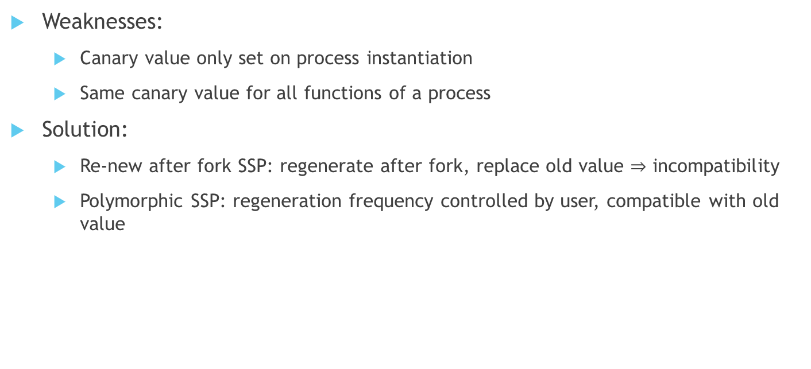
Defending against Stack Buffer Overflow exploits – Stack canaries
Weaknesses:
Canary value only set on process instantiation
Same canary value for all functions of a process
Solution:
Re-new after fork SSP: regenerate after fork, replace old value $⇒$ incompatibility
Polymorphic SSP: regeneration frequency controlled by user, compatible with old value
Notes:
Weaknesses:
Canary value only set on process instantiation => same canary value e.g. across forks
Same canary value for all functions => information leak in one function can lead to exploitable vulnerability in second function
Solutions:
Renew after fork SSP:
After fork, set new protected reference value
Previous functions protected by the old value not reachable anymore
Polymorphic SSP:
Shadow canary: $C_{0}⊕C_{1}=C$
Shadow canary as reference value, copied onto the stack and checked via XOR
Easily regenerate shadow canary value pair as XOR check still succeeds
Even possible to randomize on every function call: new pair $C_{0},C_{1}$ for every function (performance overhead!)

Slide 13
Defending against Stack Buffer Overflow exploits – Control Flow Integrity
Idea: jump and return destination integrity is checked
Forward edge (jumps, calls, etc.): only to valid destinations, e.g. marked by labels
Backward edge (return): only to valid return address, e.g. stored on a shadow stack
Intel Control-flow Enforcement Technology (CET):
Hardware support, to be released in 11th gen Core i Tiger Lake microprocessors
Forward edge: valid destinations marked by endbr{32,64} instruction
Backward edge: shadow stack for return addresses
Notes:
Idea:
Prefetch label before jump, compare, if valid: jump
Store return address on stack and shadow stack
On return: either take address from shadow stack or compare and abort if addresses differ
Intel CET:
New processor instructions endbr{32,64}
Like a NOP on processors not implementing those instructions
No label validity but at least only valid targets => calling a different function or branch still possible, but ROP gadget chaining not possible anymore
Shadow stack
Stored on memory pages marked as shadow stack (dirty, but not writable)
Can only be modified by call and ret instructions => user cannot manipulate shadow stack
Return addresses are compared, process abortion if differing
Low performance overhead, as directly implemented in hardware

Slide 14
Conclusion
Each security measure alone does not provide extensive protection
Combination of security measures can prevent a lot of Stack Buffer Overflow exploits
Still improvements possible
Notes:
Narrow scope:
x86(_64) Linux
Stack buffers
A lot of other possibilities:
Windows, macOS
Heap buffers
String format vulnerabilities
Other memory vulnerabilities

Slide 15
References
All graphical representations and information in this presentation were taken from the corresponding report or created by myself.
Please refer to the report for actual references.

