Slide 1
Kubernetes
Architecture, Setup, Usage

Slide 2

Kubernetes Architecture
API
Node 1
Master
Node 2
UI
Node 3
CLI
Node 4

Slide 3
Kubernetes Architecture
Master
etcd (key value)
User
Controller Manager
Node
API Server REST API
Scheduler

Slide 4
Kubernetes Architecture
Master
etcd (key value)
User
Controller Manager
Node
API Server REST API
Scheduler

Slide 5
Kubernetes Architecture
API Server
The API Server is the main management point of the entire cluster.
It processes REST operations, validates them, and updates the corresponding objects in etcd.
The API Server serves up the Kubernetes API.
The API Server is the only Kubernetes component that connects to etcd, all the other components must go through the API Server to work with the cluster state.
The API Server is also responsible for the authentication and authorization mechanism.

Slide 6
Kubernetes Architecture
Master
etcd (key value)
User
Controller Manager
Node
API Server REST API
Scheduler

Slide 7
Kubernetes Architecture
etcd
distributed, consistent key-value store used for configuration management, service discovery, and coordinating distributed work..
etcd reliably stores the configuration data of the Kubernetes cluster, representing the state of the cluster.
Etcd is written in Go and uses the Raft consensus algorithm to manage a highly-available replicated log.
http://play.etcd.io/play
http://kanaka.github.io/raft.js/

Slide 8
Kubernetes Architecture
Master
etcd (key value)
User
Controller Manager
Node
API Server REST API
Scheduler

Slide 9
Kubernetes Architecture
Scheduler
The Scheduler watches for unscheduled pods and binds them to nodes.
The Scheduler considers the availability of the requested resources, quality of service requirements, affinity and anti-affinity specifications, and other constraints.
The scheduler watches the state in etcd over the API server and writes the changes back into etcd.

Slide 10
Kubernetes Architecture
Master
etcd (key value)
User
Controller Manager
Node
API Server REST API
Scheduler

Slide 11
Kubernetes Architecture
Controller Manager
Similar to the scheduler, but applies more sophisticated concepts.
core control loops
In Kubernetes, a controller is a control loop that watches the shared state of the cluster through the apiserver and makes changes attempting to move the current state towards the desired state.

Slide 12
Kubernetes Architecture
Node
Kube Proxy
IP Tables
API Server REST API
CNI
Network Plugin
CRI
Kubelet
Container Runtime
Volume
OS (Kernel)

Slide 13
Kubernetes Architecture
Node
Kube Proxy
IP Tables
API Server REST API
CNI
Network Plugin
CRI
Kubelet
Container Runtime
Volume
OS (Kernel)

Slide 14
Kubernetes Architecture
Kubelet
Watching the API Server for changes on pods, that are bound to its node.
Report the status of the node and each pod to the API Server.
Run container probes.
Retrieve container metrics from cAdvisor, aggregate and expose them through the Kubelet Summary API.
Exposes some endpoints (mostly for debugging, stats, and for one-off container operations such as kubectl logs or kubectl exec), such as /metrics, /pods, /spec, and so on.

Slide 15
Kubernetes Architecture
Node
Kube Proxy
IP Tables
API Server REST API
CNI
Network Plugin
CRI
Kubelet
Container Runtime
Volume
OS (Kernel)

Slide 16
Kubernetes Architecture
Kube Proxy
Exposes Kubernetes services and manipulates iptables rules to trap access to services IPs and redirect them to the correct backends, uses https://netfilter.org/ .
Creates the rules for loadbalancing (service → pod)
Watching the API Server for changes on services and pods definitions to maintain the network configuration up to date.
Can be userspace or iptables (ipvs in Beta). Default to iptables, since its faster than userspace.

Slide 17
Kubernetes Architecture
Node
Kube Proxy
IP Tables
API Server REST API
CNI
Network Plugin
CRI
Kubelet
Container Runtime
Volume
OS (Kernel)

Slide 18
Kubernetes Architecture
Network Plugin (Overlay Network)
Provides Ips for the Pods and connects them over an overlay network.
Make sure your pods can send network requests outside your cluster.
Keep a stable mapping of nodes to subnets and keep every node in your cluster updated with that mapping. Do the right thing when nodes are added & removed.

Slide 19
Kubernetes Architecture
Node
Kube Proxy
IP Tables
API Server REST API
CNI
Network Plugin
CRI
Kubelet
Container Runtime
Volume
OS (Kernel)

Slide 20
Kubernetes Architecture
Volume
a directory accessible to all containers running in a pod.
the data in volumes is preserved across container restarts.
Can be of different types:
  node-local types such as emptyDir or hostPath
  file-sharing types such as nfs
  cloud provider-specific types like awsElasticBlockStore, azureDisk, or gcePersistentDisk
  distributed file system types, for example glusterfs or cephfs.

Slide 21
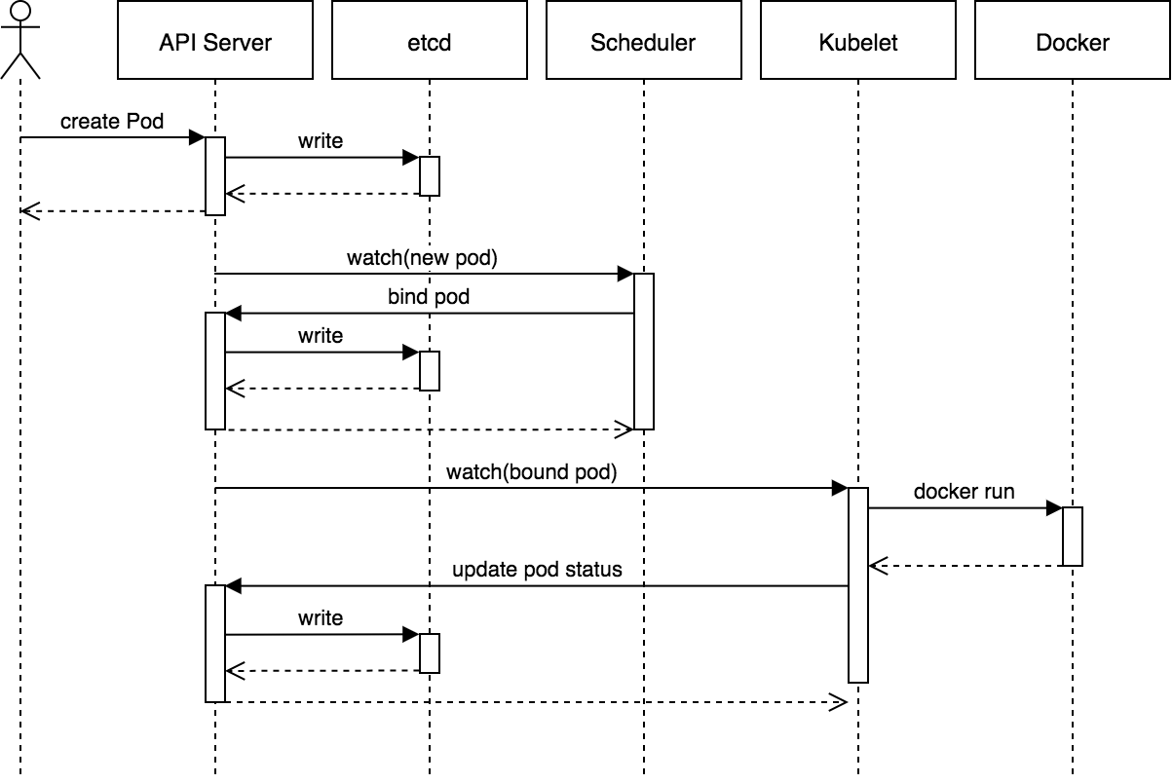
Kubernetes Architecture

Slide 22
Kubernetes Setup
No «One Way» to setup Kubernetes
Different scaling / ha models.
Components (services) can be exchanged by alternative suppliers.
Security setup.
Components have a bazillion of configuration options.

Slide 23
Kubernetes Setup
Kubernetes the Hardway
https://github.com/kelseyhightower/kubernetes-the-hard-way

Slide 24
Kubernetes Setup
No «One Way» to setup Kubernetes
Different scaling / ha models.
Components (services) can be exchanged by alternative suppliers.
Security setup.
Components have a bazillion of configuration options.

Slide 25
Kubernetes Setup
Setup Kubernetes with HA and Security

Slide 26
Kubernetes Setup
PKI Infrastructure
etcd, kube-apiserver, kube-controller-manager, kube-scheduler, kubelet, and kube-proxy need TLS Certificates
CloudFlare's PKI toolkit, cfssl can be used

Slide 27
Kubernetes Setup
Data Encryption Config
Kubernetes stores secrets.
Encrypt the secrets before storing in etcd.

Slide 28
Kubernetes Setup
etcd
3 node cluster
Failover is done by the clients
Traffic encrypted with 2 way TLS

Slide 29
Kubernetes Setup
Bootstrapping the Kubernetes Control Plane
Kubernetes API Server, Scheduler, and Controller Manager
Exposes the API over the API Server
Needs external Loadbalancer
3 compute instances for HA
Install the components as systemd services, could also installed as docker containers
Traffic encrypted with 2 way TLS

Slide 30
Kubernetes Setup
Bootstrapping the Kubernetes Worker Nodes
runc, gVisor, container networking plugins, containerd, kubelet, and kube-proxy.
runc: CLI tool for spawning and running containers according to the OCI specification. Open sourced by docker.
containerd: an industry-standard container runtime with an emphasis on simplicity, robustness and portability. Open sourced by docker.
gVisor: provides an isolation boundary between the application and the host kernel
Point to loadbalancer to reach the API Server
Traffic encrypted with 2 way TLS

Slide 31
Kubernetes Setup
Provisioning Pod Network Routes
Pods scheduled to a node receive an IP address from the node's Pod CIDR range.
At this point pods can not communicate with other pods running on different nodes due to missing network routes..
Create network routes for each worker instance.
There are other ways to implement the Kubernetes networking model. A popular one is canal.

Slide 32
Kubernetes Setup
Deploying the DNS Cluster Add-on
Deploy the DNS add-on which provides DNS based service discovery to applications running inside the Kubernetes cluster.
kubectl create -f
https://storage.googleapis.com/kubernetes-the-hard-way/kube-dns.yaml

Slide 33
Kubernetes Setup
Bootstrapping the Kubernetes Worker Nodes
runc, gVisor, container networking plugins, containerd, kubelet, and kube-proxy.
runc: CLI tool for spawning and running containers according to the OCI specification. Open sourced by docker.
containerd: an industry-standard container runtime with an emphasis on simplicity, robustness and portability. Open sourced by docker.
gVisor: provides an isolation boundary between the application and the host kernel
Point to loadbalancer to reach the API Server
Traffic encrypted with 2 way TLS

Slide 34
Kubernetes Example
Kubernetes
User
Node
Port
Worker Node (VM)
Ingress Service
Ingress Controller
Service
Pod

Slide 35
Kubernetes Conclusion
Kubernetes Benefits
One consistent API
Create Infrastracture Objects in seconds
Problems solved on a higher infrastracture level, somewhere between Openstack (IaaS) and Cloudfoundry (PaaS)
Enabler for GitOps

Slide 36
Kubernetes Conclusion
Kubernetes Benefits
Backed by Cloud Native Computing Foundation
Fast paced development, lots of Special Interest Groups
More and more infrastracture problems get solved (storage, network, security, encryption)
Interesting frameworks on top of kuberenetes like istio, conduit
Custom Controller

