Slide 1
Multiplayer Pac-Man
Johannes Beck
Linus Fessler
Markus Hauptner
Florian Morath
Stefan Oancea
Tiziano Zamaroni

Slide 2
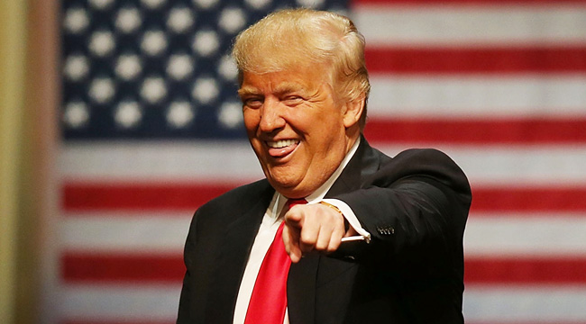
Make Pac-Man Great Again

Slide 3
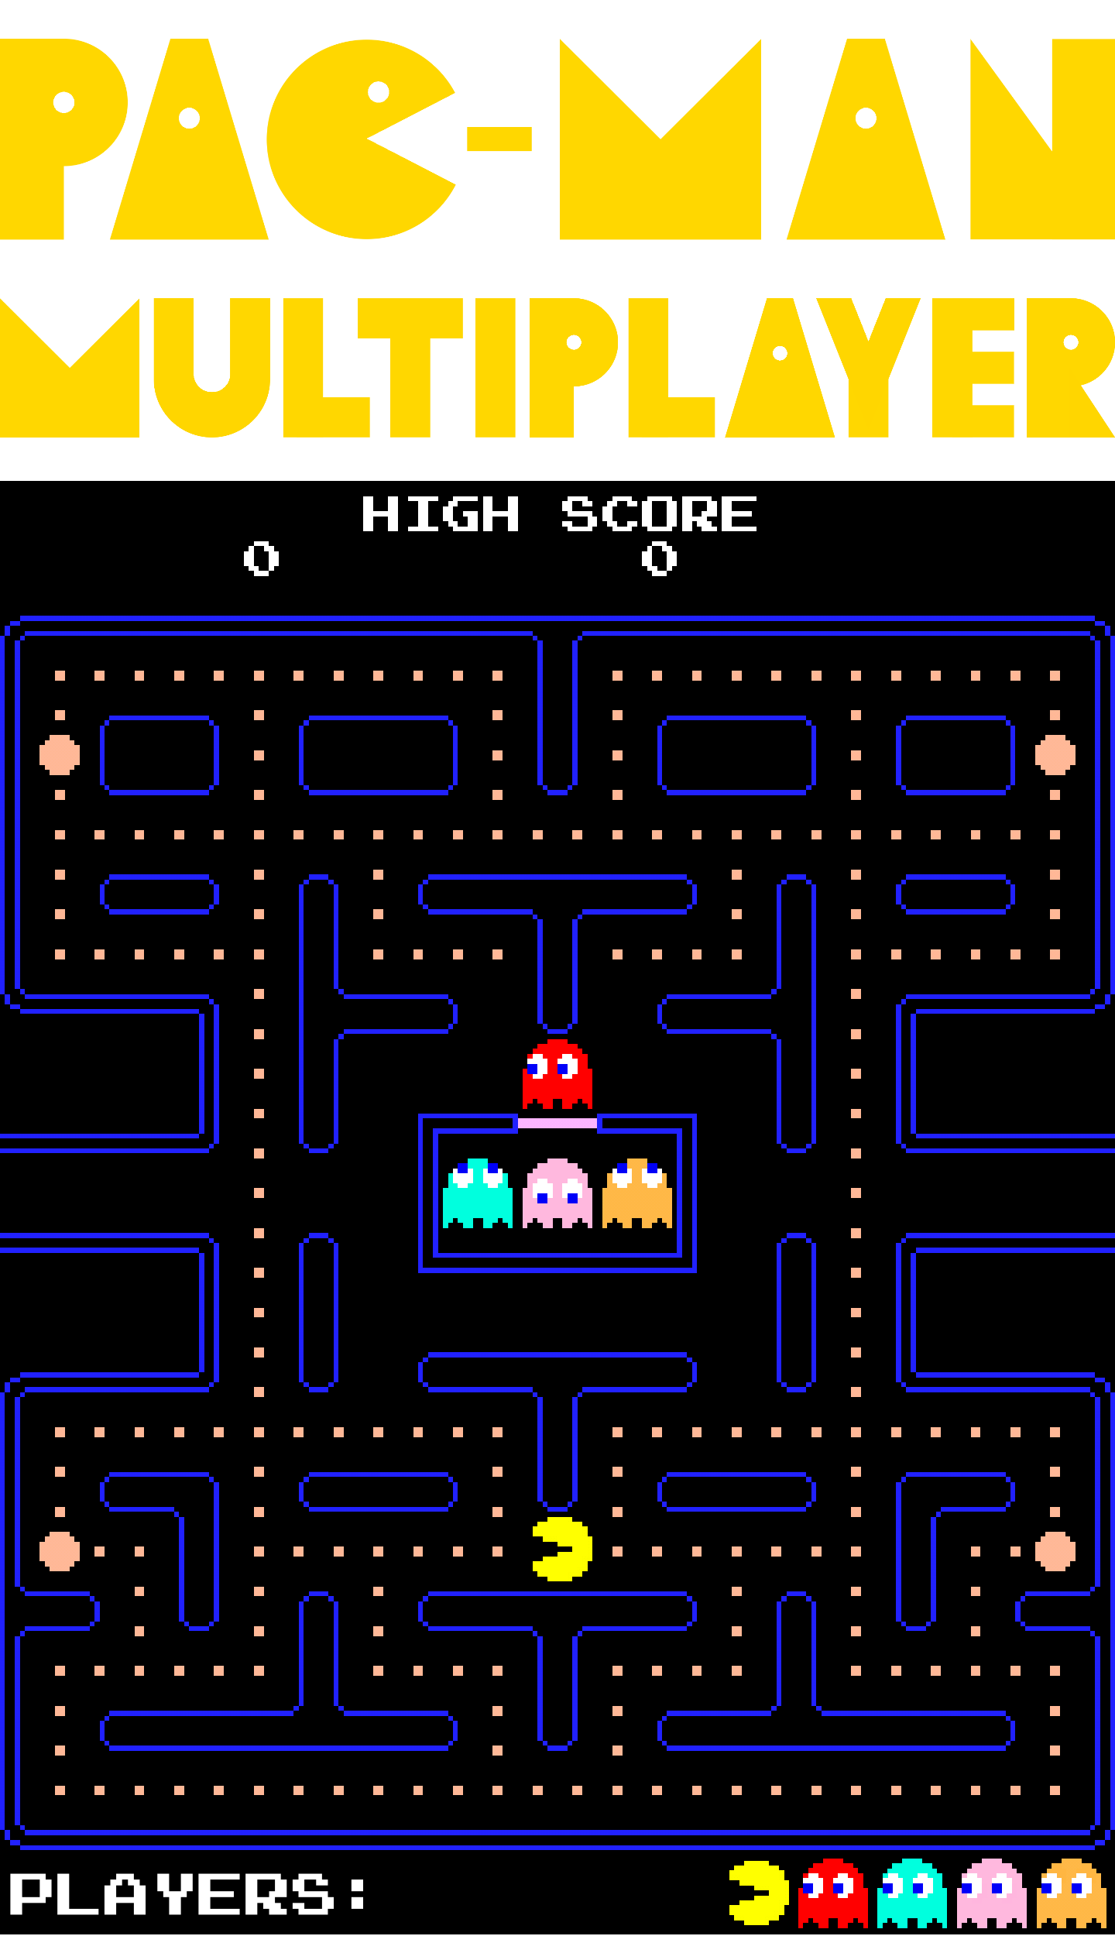
Gameplay

Slide 4
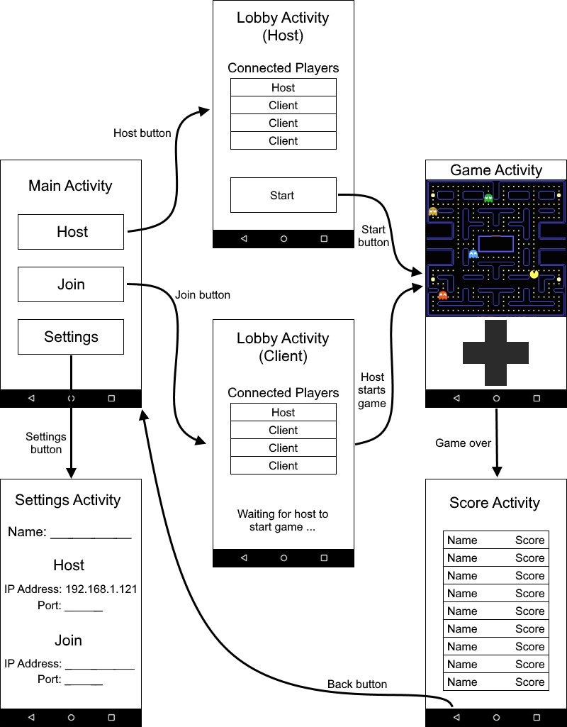
User-friendly Interface

Slide 5
So what’s new?
Implementation via LibGDX
Also, it’s more fun
Why?
You can now play it in multiplayer mode
You can play it on your mobile phone
What could you ask more?!

Slide 6

Thank you for your atention
PACMAN

