Slide 1
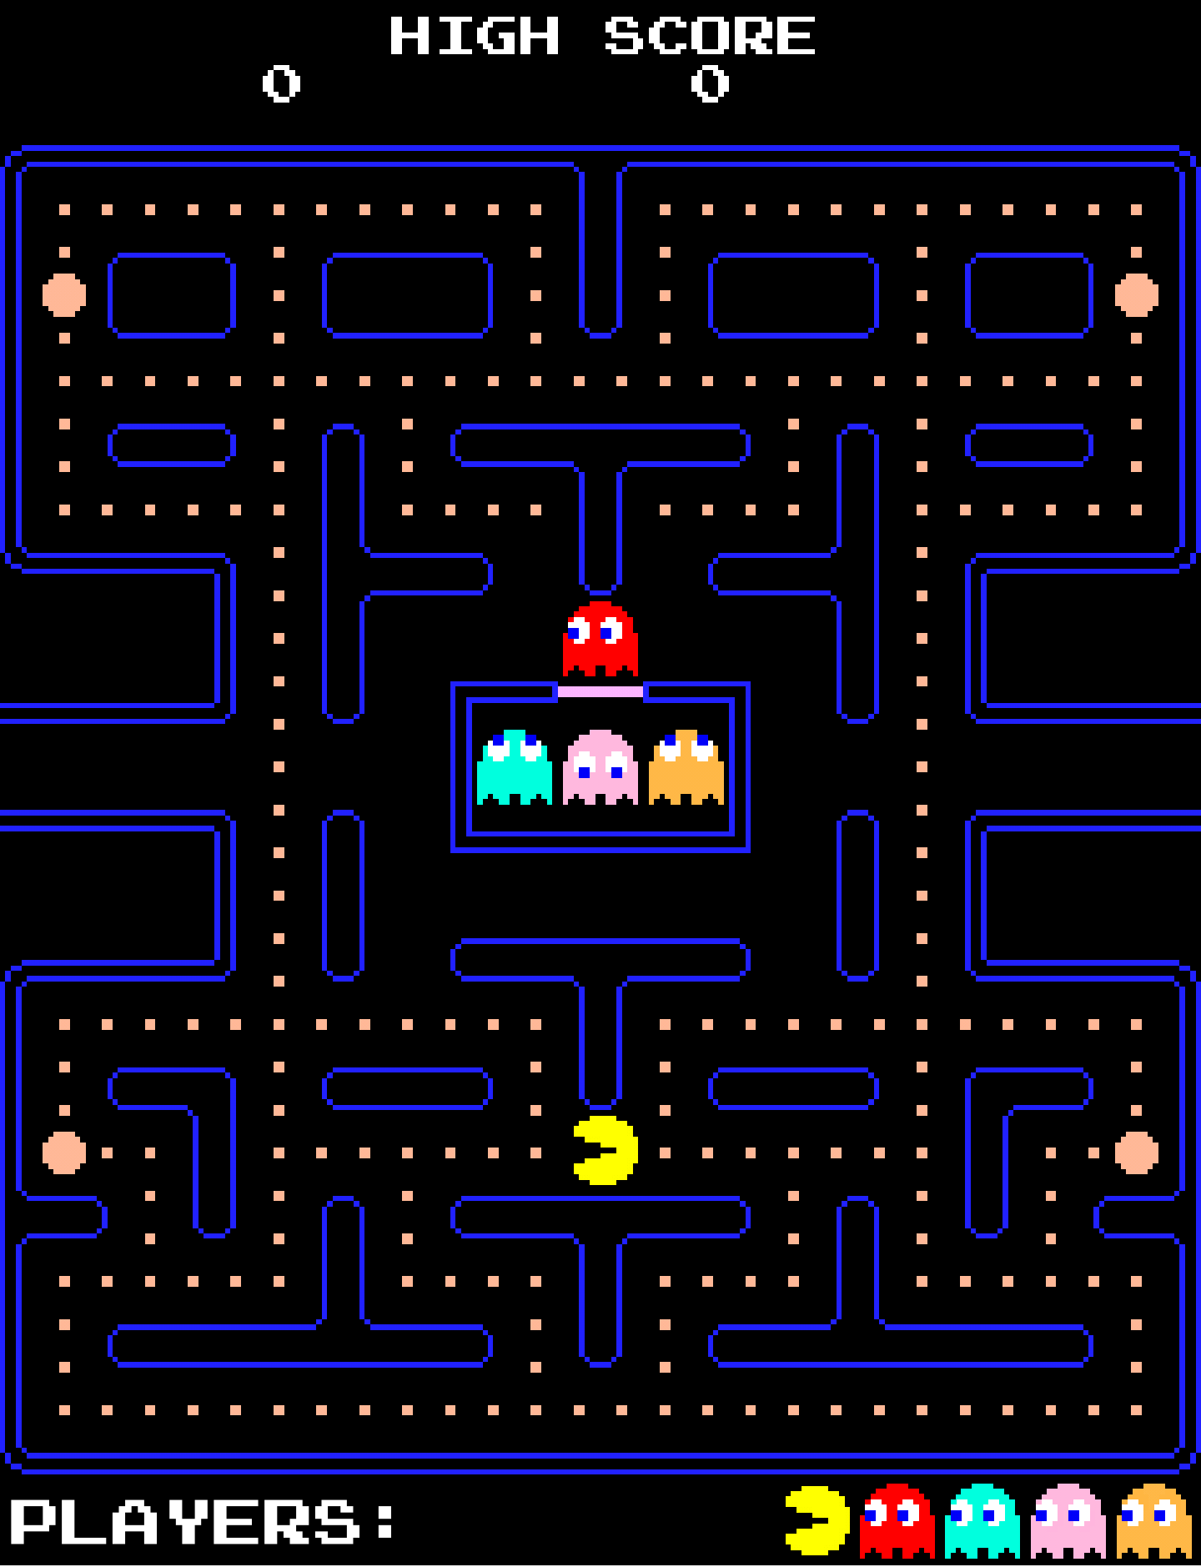
Multiplayer Pac-Man
Johannes Beck
Linus Fessler
Markus Hauptner
Florian Morath
Stefan Oancea
Tiziano Zamaroni

Slide 2
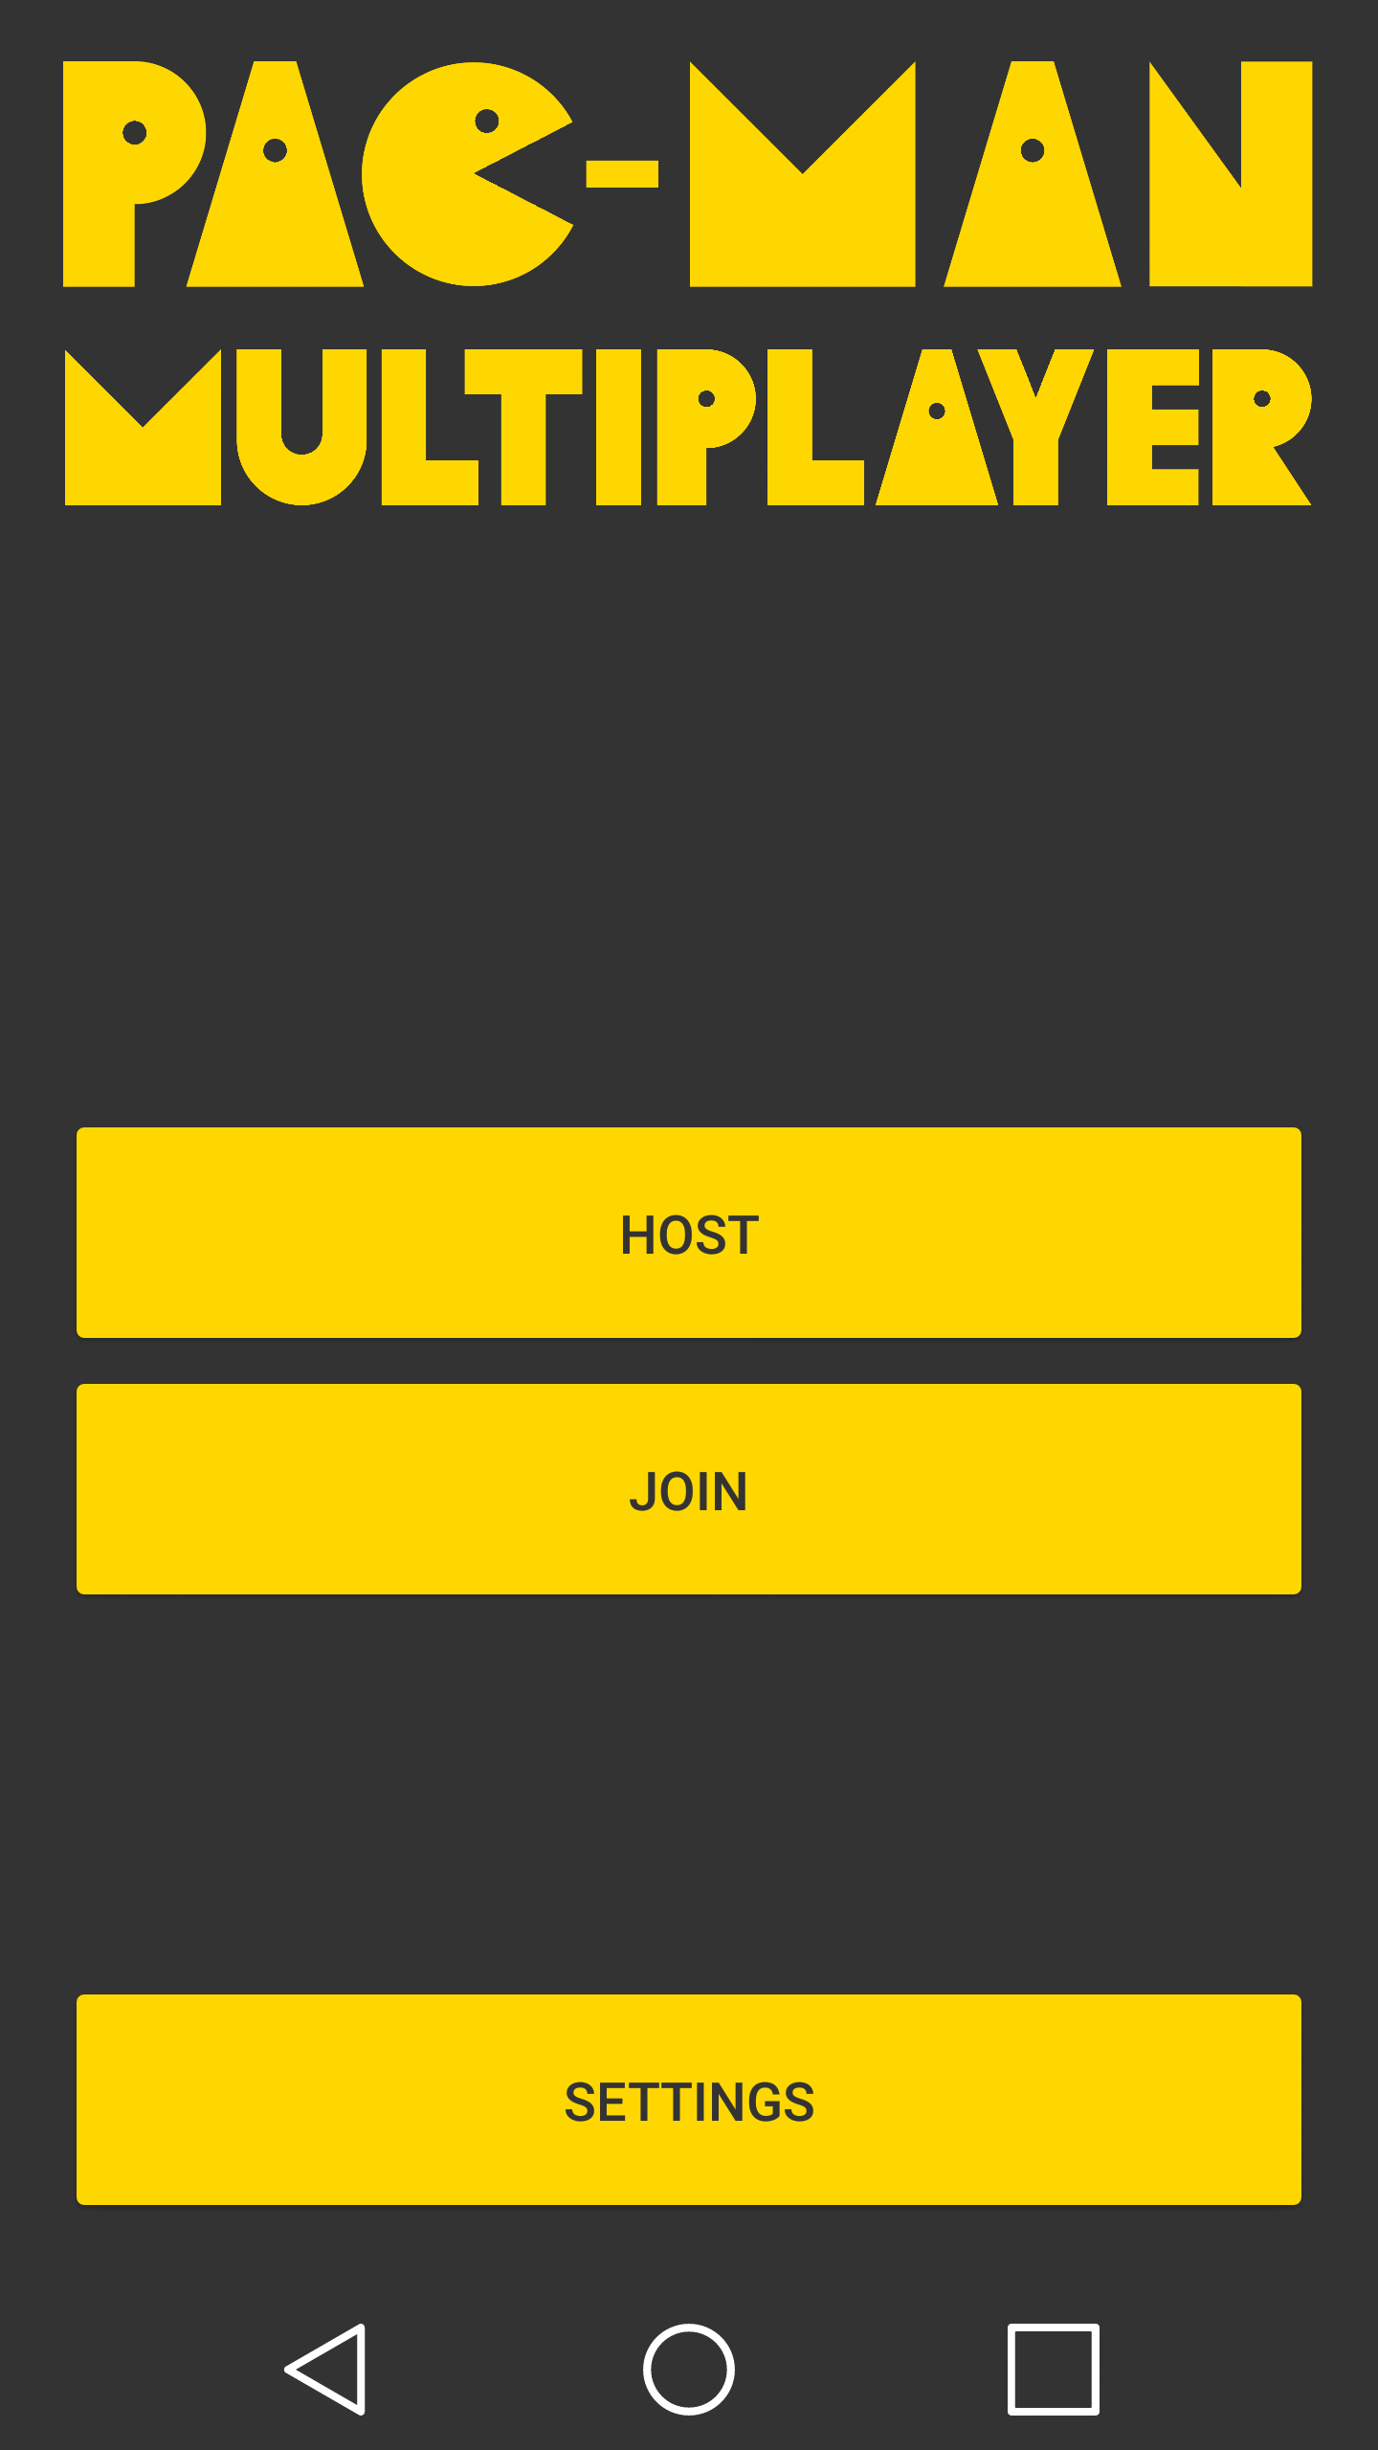
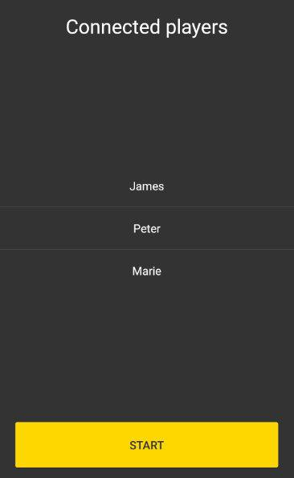

Slide 3
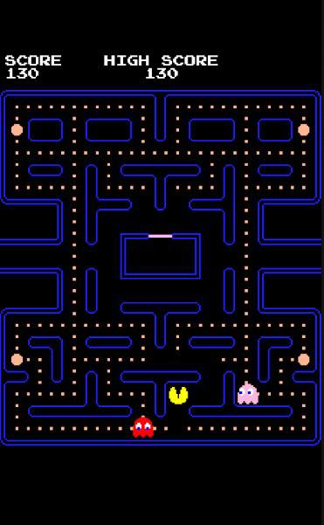
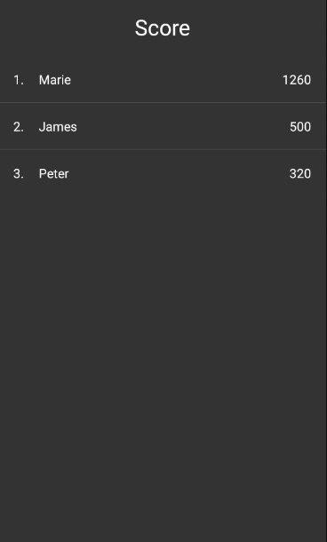

Slide 4
Thank you

