Slide 2
Agenda
About me

Slide 3
Research interests
Societal impact of IS
Data analytics
Technology acceptance
Start of dissertation, never heard of replication crisis.
While planning experimental work on algorithms, came across work by Dietvorst et al. on experimental aversion, preregistered studies, started to incorporate it into my own work.

Slide 4
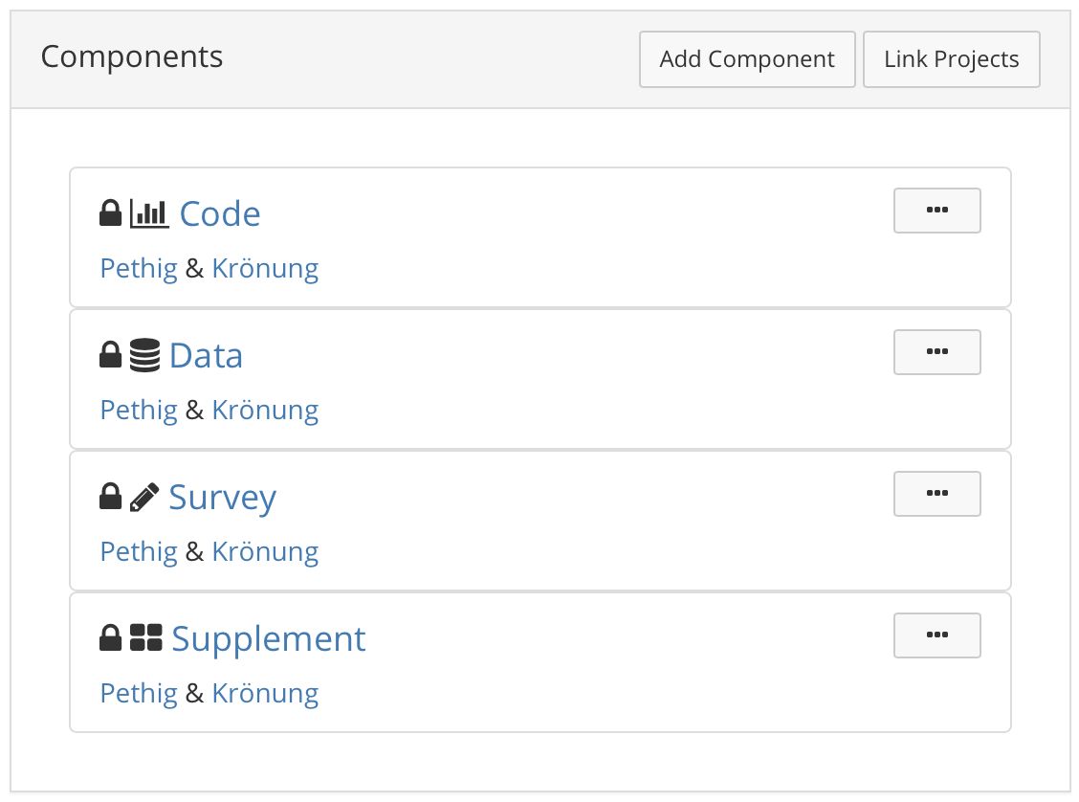

Slide 5
Question
How many preregistered studies are currently published in the top 8 information systems journals (“Basket of 8“)?
1 (published this month ☺) – not my study though.

Slide 6
So few people care about preregistrations in IS?
They do, but slowly.
Important milestones:
2015: AIS Transactions on Replication Research
2018: Replication project
2019: Business Information Systems & Engineering introduced registered reports (however, no publication found to date)
2021: New guidelines for research transparency in MIS Quarterly

Slide 7
We looked a bit further into management and marketing with some more success:

Slide 8
