Slide 1
3D - UEDLA
Jäger Thomas
Schweitzer Florian
IT 2014

Slide 2
Content
Iterative design process
Technical details
Conclusion

Slide 3
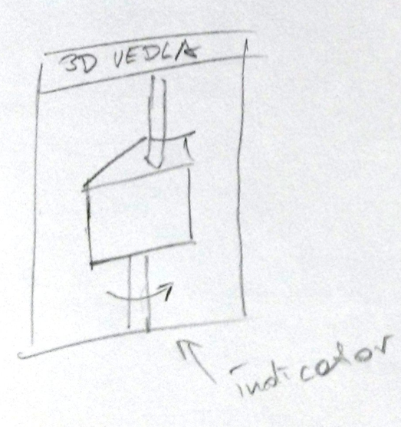
Iterative design process Cycle 1

Slide 4
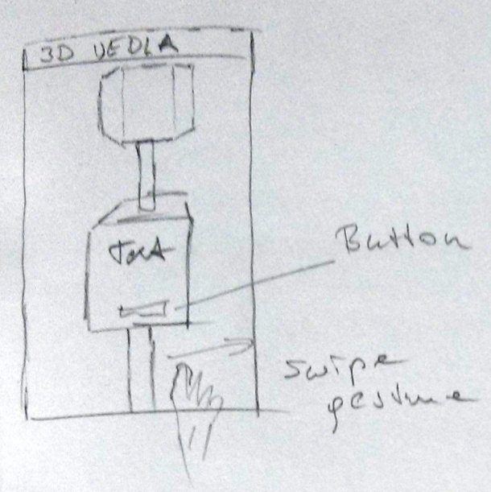
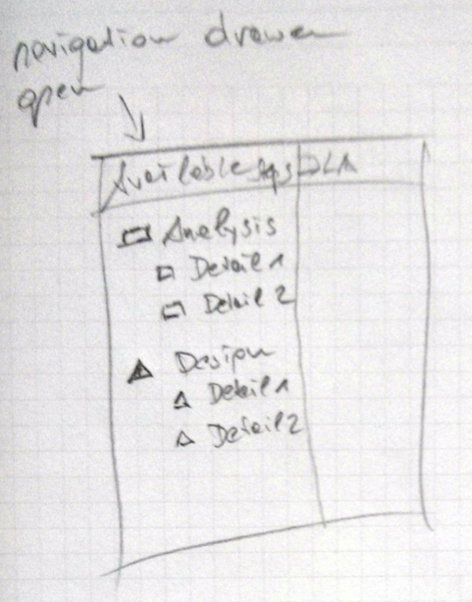
Iterative design process Cycle 2

Slide 5
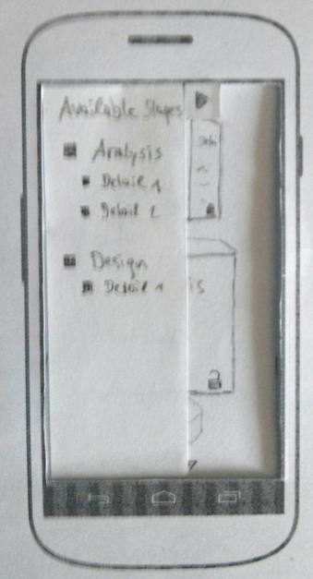
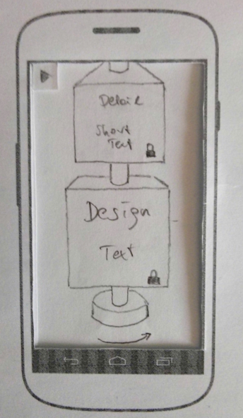
Iterative design process Cycle 3

Slide 6
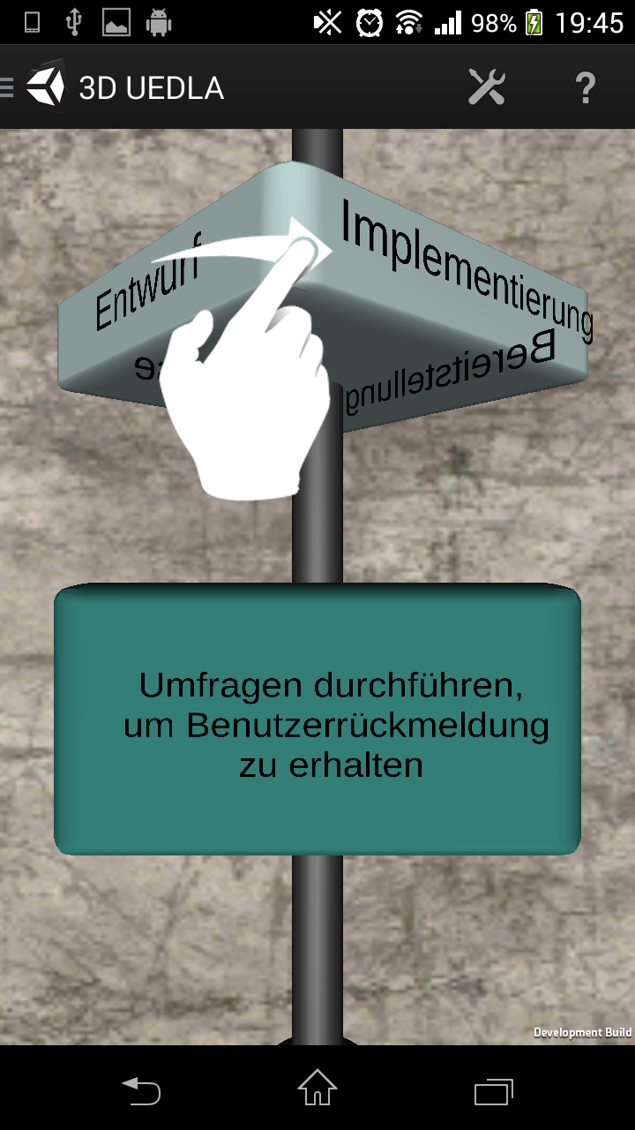
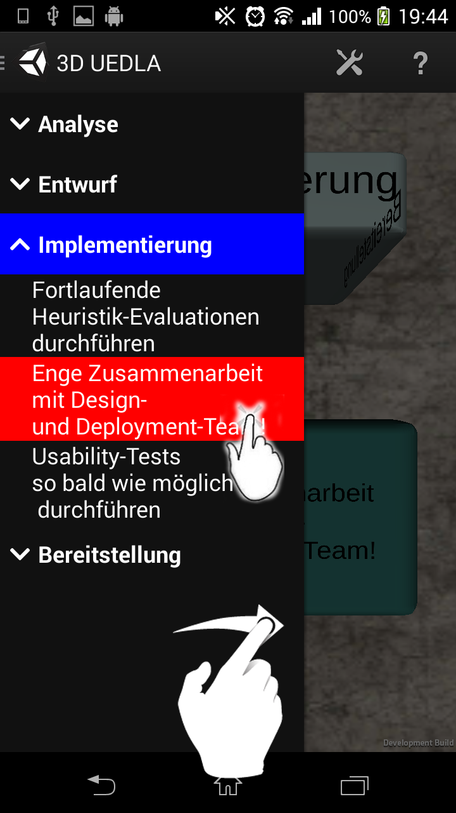
Iterative design process Cycle 4

Slide 7
Technical Details
Android 4.0
Unity 3D-Scenes
Implemented native in
Activites
Fragments

Slide 8
Conclusion
3D-Paper Prototypes are hard to imagine or build
Unity 3D is bad for GIT handling (binary files)

Slide 9
Thank you for your attention
Any questions?

