Slide 1


ΑΡΙΣΤΟΤΕΛΕΙΟ ΠΑΝΕΠΙΣΤΗΜΙΟ ΘΕΣΣΑΛΟΝΙΚΗΣ
ΣΧΟΛΗ ΘΕΤΙΚΩΝ ΕΠΙΣΤΗΜΩΝ
ΤΜΗΜΑ ΜΑΘΗΜΑΤΙΚΩΝ
A study of the Euclidean attack on RSA
ΦΛΩΡΙΑΣ ΠΑΠΑΔΟΠΟΥΛΟΣ

Slide 2







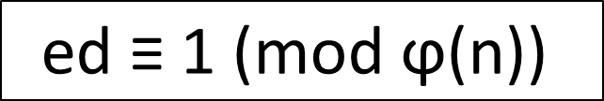
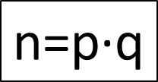
RSA Cryptosystem
Primes, > 2 of the same size
$$\text{K} \text{= }\text{\{}\text{k} \text{∈ }ℤ\text{| }\text{1 }\text{< }\text{k}\text{ < }\text{ϕ}\text{(}\text{n}\text{) \& }\text{gcd}\text{(}\text{k}\text{, }\text{ϕ}\text{(}\text{n}\text{))}\text{\}}$$
$$\text{n}\text{=}\text{p}\text{·}\text{q}$$
$$\text{ed}\text{ ≡ 1 (}\text{mod} \text{ϕ}\text{(}\text{n}\text{))}$$
E_{e} = x^{e} mod n
D_{d} = x^{d} mod n
m
E_{e} (m)
D_{d}(E_{e}(m))
Encryption
Decryption
Public Key (Bob)
Secret Key (Bob)
Publication of (n,e)
A study of the Euclidean attack on RSA
Φλωριάς Παπαδόπουλος
Notes:
\

Slide 3
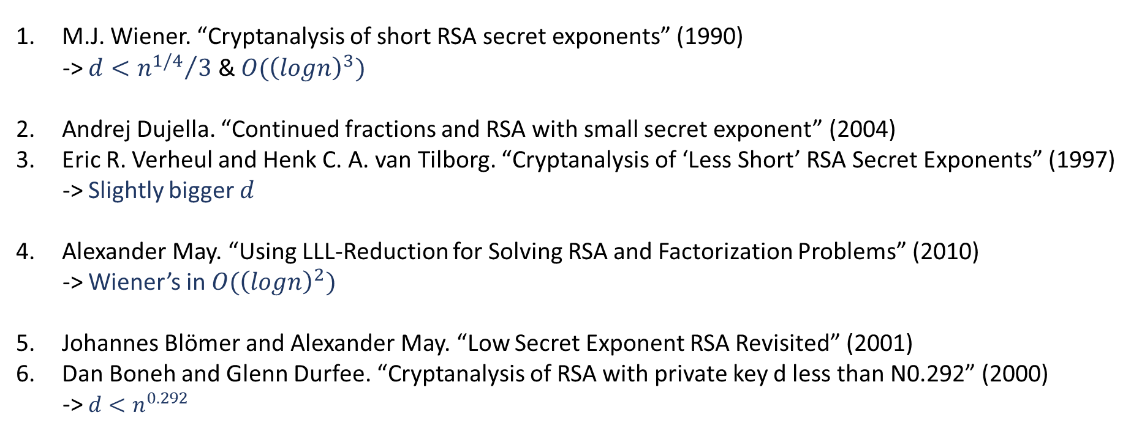
Small exponent attacks on RSA
M.J. Wiener. “Cryptanalysis of short RSA secret exponents” (1990)
-> $d<{n^{1/4}}/3$ & $O({\left(logn\right)}^{3})$
Andrej Dujella. “Continued fractions and RSA with small secret exponent” (2004)
Eric R. Verheul and Henk C. A. van Tilborg. “Cryptanalysis of ‘Less Short’ RSA Secret Exponents” (1997)
-> Slightly bigger $d$
Alexander May. “Using LLL-Reduction for Solving RSA and Factorization Problems” (2010)
-> Wiener’s in $O({\left(logn\right)}^{2})$
Johannes Blömer and Alexander May. “Low Secret Exponent RSA Revisited” (2001)
Dan Boneh and Glenn Durfee. “Cryptanalysis of RSA with private key d less than N0.292” (2000)
-> $d<n^{0.292}$
A study of the Euclidean attack on RSA
Φλωριάς Παπαδόπουλος

Slide 4
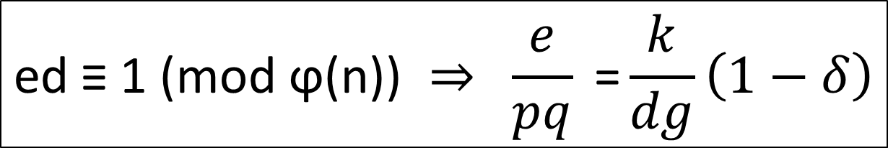
Wiener’s Attack
$$\text{ed}\text{ ≡ 1 (}\text{mod} \text{ϕ}\text{(}\text{n}\text{)) }⇒ \frac{e}{pq}\text{ =}\frac{k}{dg}\left(1−δ\right)$$
public information
&
close underestimate of 𝛿
A study of the Euclidean attack on RSA
Φλωριάς Παπαδόπουλος
Notes:
$\frac{e}{pq}$ public information & close underestimate of k/dg, if δ is small enough Wiener’s attack
then works by generating the continued fraction expansion of e/pq until its close underestimate
k/dg can be found using his continued fraction algorithm.

Slide 5
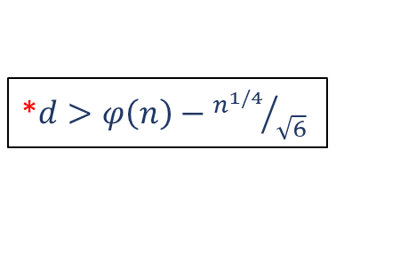

What about (very) large exponents ?
M. Jason Hinek “(Very) Large RSA Private Exponent Vulnerabilities ” (2004)
Wiener’s attack works for $\sqrt{6}\left(φ\left(n\right)−d\right)<n^{1/4}$.
*
If [5], [6] work for all $d<n^{δ}$, then they work for all $d>φ\left(n\right)−n^{δ}$.
$$d<n^{0.292}$$
*$d>φ\left(n\right)−{n^{1/4}}/{\sqrt{6}}$
A study of the Euclidean attack on RSA
Φλωριάς Παπαδόπουλος

Slide 6

Euclidean Attack on RSA

Slide 7
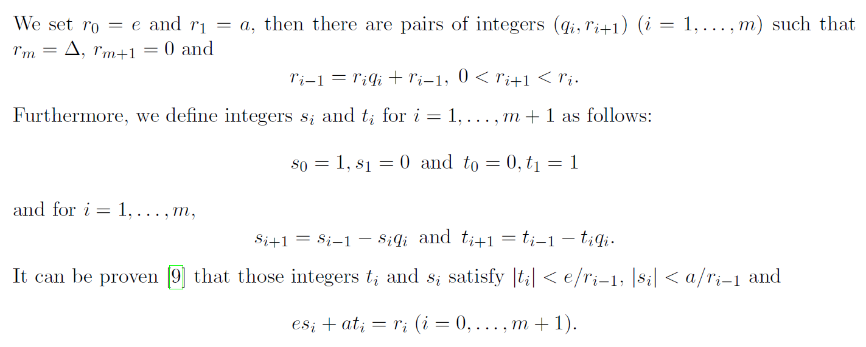
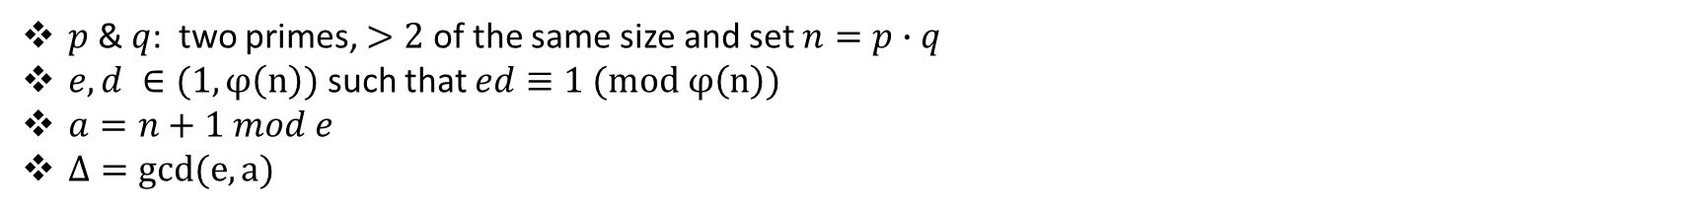
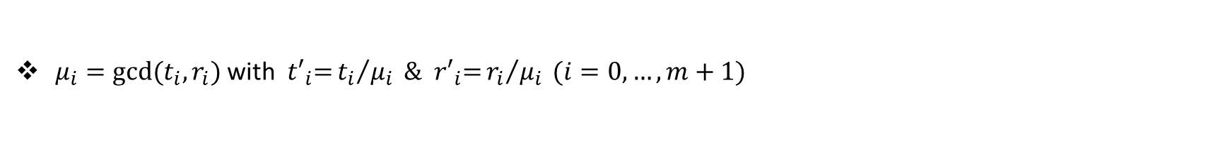
Preliminaries
$p$ & $q$: two primes, $>2$ of the same size and set $n=p∙q$
$e, d ∈(1,φ\left(n\right))$ such that $ed≡1 (mod φ\left(n\right))$
$a=n+1 mod e$
$Δ=gcd(e,a)$
$μ_{i}=gcd⁡(t_{i},r_{i})$ with ${t′}_{i}\text{=}{t_{i}}/{μ_{i} }\text{\&} { r′}_{i}\text{=}{r_{i}}/{μ_{i}} (i=0,…,m+1)$
A study of the Euclidean attack on RSA
Φλωριάς Παπαδόπουλος

Slide 8
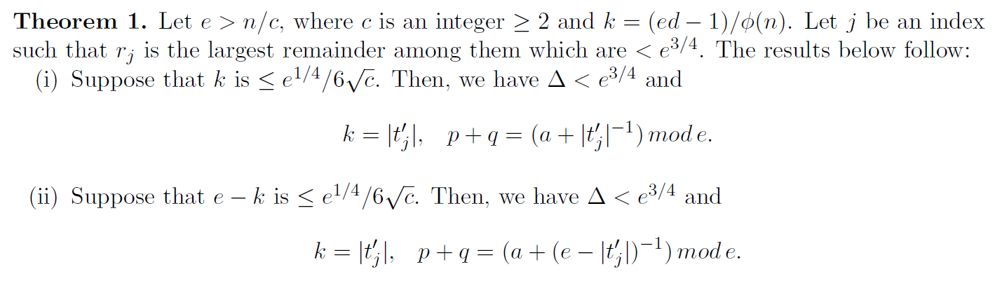

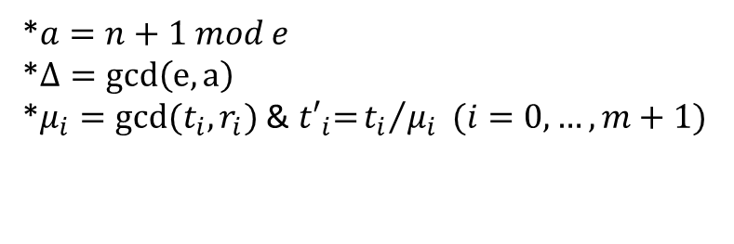
Main Theorem
$$\text{ed}\text{ ≡ 1 (}\text{mod} \text{ϕ}\text{(}\text{n}\text{))}$$
*$a=n+1 mod e$
*$Δ=gcd\left(e,a\right)$
*$μ_{i}=gcd⁡(t_{i},r_{i})$ &${t′}_{i}\text{=}{t_{i}}/{μ_{i} }(i=0,…,m+1)$
A study of the Euclidean attack on RSA
Φλωριάς Παπαδόπουλος

Slide 9
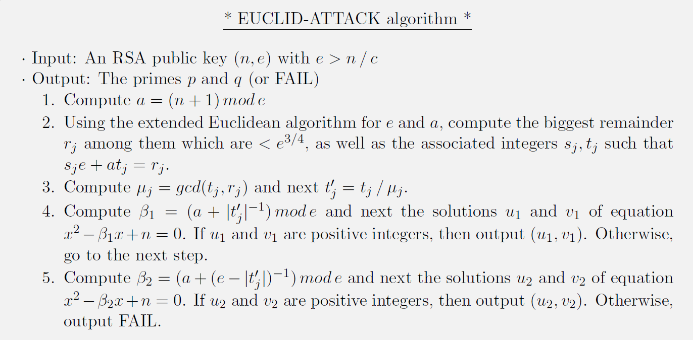

EUCLID-ATTACK Algorithm
Time Complexity: $O({\left(loge\right)}^{2})$
A study of the Euclidean attack on RSA
Φλωριάς Παπαδόπουλος

Slide 10


Python Implementation:
EUCLID-ATTACK
Notes:
A GUI for the program was created here, but it has not been uploaded on the website.

