Slide 1



AST Data Management Efforts
burt.walsh@ast.myflorida.com
michael.avello@ast.myflorida.com
June 26, 2018

Slide 2

Data Management Workgroup Goal
Data Management Workgroup
Establish Data Management standards and promote their use to ensure the responsible use of the full power of the State of Florida’s data can be used to serve the citizens of Florida.

Slide 3
Data Management Workgroup Strategy
Data Management Workgroup
Discuss topics and generic best practices
Understand the needs of each agency
Asset current level of maturity
Develop plans for improvement (starting with KEY datasets)
Serve agencies in the execution/governance of plans
Memorialize best practices as standards

Slide 4
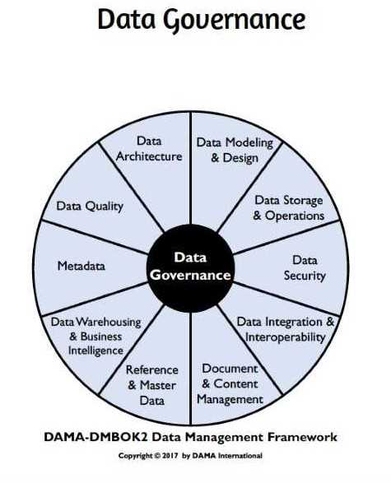
Data Management Workgroup
“Data Governance is a quality control discipline for managing, using, improving and protecting organizational information. Effective data governance enhances the quality, availability, integrity, and protection of a company's data by fostering cross-organizational collaboration and structured policy-making.”
- IBM

Slide 5
First Steps
Data Management Workgroup
Determine key data which is used by management to determine Key Performance Indicators (KPI) and Key Risk Indicators (KRI)
Catalog data quality rules (metadata) around key data
Catalog key entities and business context around entities in key datasets (metadata)
Determine entity data attributes (Master Data Management) which can be leveraged for data deduplication and record linkage

Slide 6
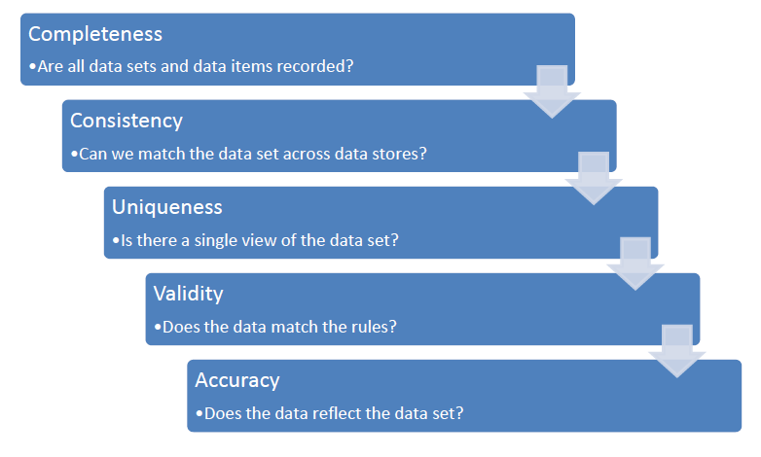

Data Quality
Dimensions & Measurements for Data Quality Assessment
Data Quality Dimensions
Describe a feature (characteristic, attribute or facet) of data that can be measured or assessed against defined standards in order to determine the quality of data.
Source: Askham, N., Cook, D., Doyle, M., Fereday, H., Gibson, M., Landbeck, U., ... & Schwarzenbach, J. (2013). The six primary dimensions for data quality assessment. DAMA UK Working Group, 432-435.

Slide 7
First Steps (continued)
Data Management Workgroup
Data deduplication/record linkage
Just enough theory (cluster analysis/measure in this case)
Tools (python/R/commercial)
Standards (HIPPA, FERPA, CJIS…)
Privacy preserving record linkage (Bloom filters/measure)
Data Lineage (metadata)

Slide 8

Data Quality Assessment Dimensions & Measurements
(data deduplication with Python)
Soundex functions
Business Rules Emphasis
Temporal Data
rowID | firstName | lastName | age | street | apt | city | state | zip | ssn
R01 | John | Willams | 38 | 643 Gulf Ln |  | Half Moon Bay | CA | 94013 | A2B-4C-678D
R02 | Richard | Alpert | 151 | 15 Black Rock St |  | Cannon Beach | OR | 97110 | A3B-5C-78D1
R03 | Ana Lucia | Cortez | 39 | 48 Ocean Park Ave |  | Santa Monica | CA | 90405 | A4B-6C-891D
R04 | Joh | Williams | 42 | 642 Gulf Lane |  | Halfmoon Bay | CA | 94013 | A2B-4C678D
R05 | Daniel | Faraday | 48 | 23 Martin St |  | Essex | MA | 01929 | A5B-7C-9123
R06 | Jonathan | Williams | 42* | 643 Gulf Lane |  | Half Moon Bay | CA | 94013 | A2B4C-678D
R07 | Penny | Widmore | 43 | 1623 Hawthorne Road |  | Palos Verdes | CA | 90275 | A6B-8C-123D
R08 | Austen | Kate | 38 | 1516 Ontario Street |  | Ames | IA | 50014 | A78-9B-234D
R09 | John | William | 47 | 403 Stadium Dr | B-005 | Tallahassee | FL | 32304 | A2B4C78D
R10 | Benjamin | Linus | 63 | 815 Oceanic Ave |  | Portland | OR | 97205 | A8B-C2-345D
Putting it all together—with an understanding of the primary business rules—increases the confidence level for finding duplicate records in the database.

Slide 9
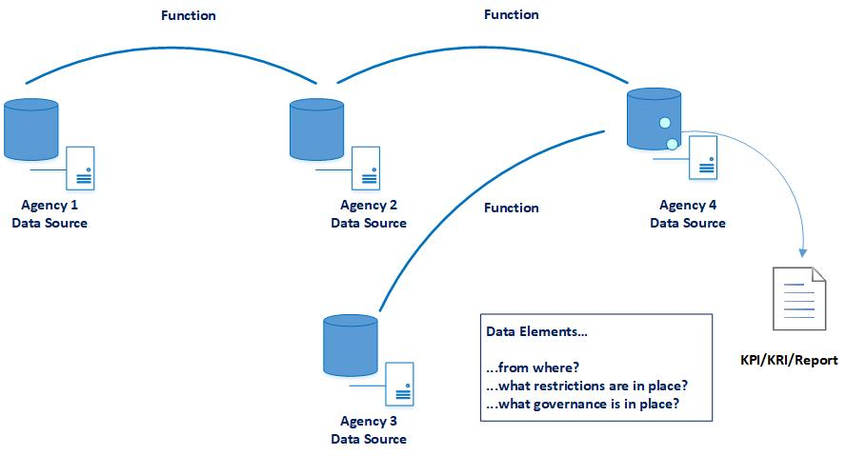
Impact Analysis/Business Lineage

Slide 10
CDO, GIO and Proviso
Data Management Workgroup
Chief Data Officer Established in 2017-2018 along with the Geographic Information Officer (Mrs. Ekaterina Fitos – moving to DEP)
For 2018-2019 responsibilities in Pages 381-382 of http://www.flsenate.gov/Session/Bill/2018/5001/BillText/er/PDF.

Slide 11
2018-2019 Proviso
Data Management Workgroup
Continuation of some work from 2017-2018
Enterprise Data Inventory
Methods for standardizing data to promote interoperability and reduce collection of duplicate data
Identify data classified as open data
Recommend open data technical standards
Recommend options and associated costs for a state open data catalog

Slide 12




Agencies Leveraging State Data
Data Catalog
Searchable Metadata
(agencies are metadata stewards)
Data Quality
Record Linkage
& Privacy-Protected
Record Linkage
MOUs
Data Use Agreements
(Data Use Licenses)
Techniques & Tools

Slide 13
Enterprise Data Inventory
Data Management Workgroup
Legislature has asked for the following (but not limited to):
The title and description of the dataset
Description of how the data is maintained including standards
Planned Application Programming Interfaces (API) to publish data and the data it exposes

Slide 14
Enterprise Data Inventory (continued)
Data Management Workgroup
Other information from 2017 Proviso
Is data sharing governed by an MOU
Ingress and Egress (interface) technologies and partners
Key entities in the dataset (Master Data Management/Metadata)
Business function (metadata) context around the data

Slide 15
Other Drivers
Data Management Workgroup
Education on technologies, techniques and processes
Developing Data User License Agreements which promote sharing while protecting both the sharing data steward and the citizen’s data
Metadata to help with understanding of data (requirement of the sharing party)
Serve the Citizen’s of Florida while protecting their data!

Slide 16

Unlocking Access to Data
Data Management Workgroup

Slide 17
Data Use License
Data Management Workgroup
What is required to have access to the data?
Credentials (training)
Purpose
Agreement to terms
Acceptance of responsibility of use
Indemnification for the provider

Slide 18
Data Use License
Data Management Workgroup
What can and should be expected from the provider?
Metadata
Data quality measures
Business context for the data
Timeliness of data
Standards including compliance
Lineage (source and process for creation)

Slide 19
Data Management Workgroup
“How do we get a holistic approach to data management and data sharing?”

Slide 20
Holistic Data Management
Data Management Workgroup
Coordination between application owners, security professionals, data professions, legal professionals and business professionals
AST supporting agencies in their service to the citizens of Florida
Help agencies with solutions and/or technologies

Slide 21
References
Elmagarmid, A. K., Ipeirotis, P. G., & Verykios, V. S. (2007). Duplicate record detection: A survey. IEEE Transactions on knowledge and data engineering, 19(1), 1-16. Retrieved April 27, 2018 from the Purdue University, Department of Computer Science website, https://www.cs.purdue.edu/homes/ake/pub/TKDE-0240-0605-1.pdf
Askham, N., Cook, D., Doyle, M., Fereday, H., Gibson, M., Landbeck, U., ... & Schwarzenbach, J. (2013). The six primary dimensions for data quality assessment. DAMA UK Working Group, 432-435. Retrieved April 23, 2018 from EM360Tech website, https://www.whitepapers.em360tech.com/wp-content/files_mf/1407250286DAMAUKDQDimensionsWhitePaperR37.pdf
De Jonge, E., & van der Loo, M. (2013). An introduction to data cleaning with R. Heerlen: Statistics Netherlands. Retrieved April 16, 2018 from The Comprehensive R Archive Network (CRAN) website, https://cran.r-project.org/doc/contrib/de_Jonge+van_der_Loo-Introduction_to_data_cleaning_with_R.pdf
Florida Department of State. (2012). Address Confidentiality Exemption Request Form Revised 08-2012 (2), Public Records Exemption Request to the Florida Department of State. Retrieved May 2, 2018 from the Florida Department of State website, http://dos.myflorida.com/media/696331/dos119-public-records-exemption-form.pdf

Slide 22

Questions?
Burt Walsh
burt.walsh@ast.myflorida.com
Michael Avello
michael.avello@ast.myflorida.com
Agency For State Technology
4050 Esplanade Way, Suite 115
Tallahassee, Florida 32399

