Slide 1
ISPITANIK #1
177.641s
150.708s
123.776s
25.513s
86.086s
t[s]
MMOD
START
SIMULATOR START
STARTLE
1
STARTLE
2
STARTLE
3
SIMULATOR
END
MMOD
END

Slide 2
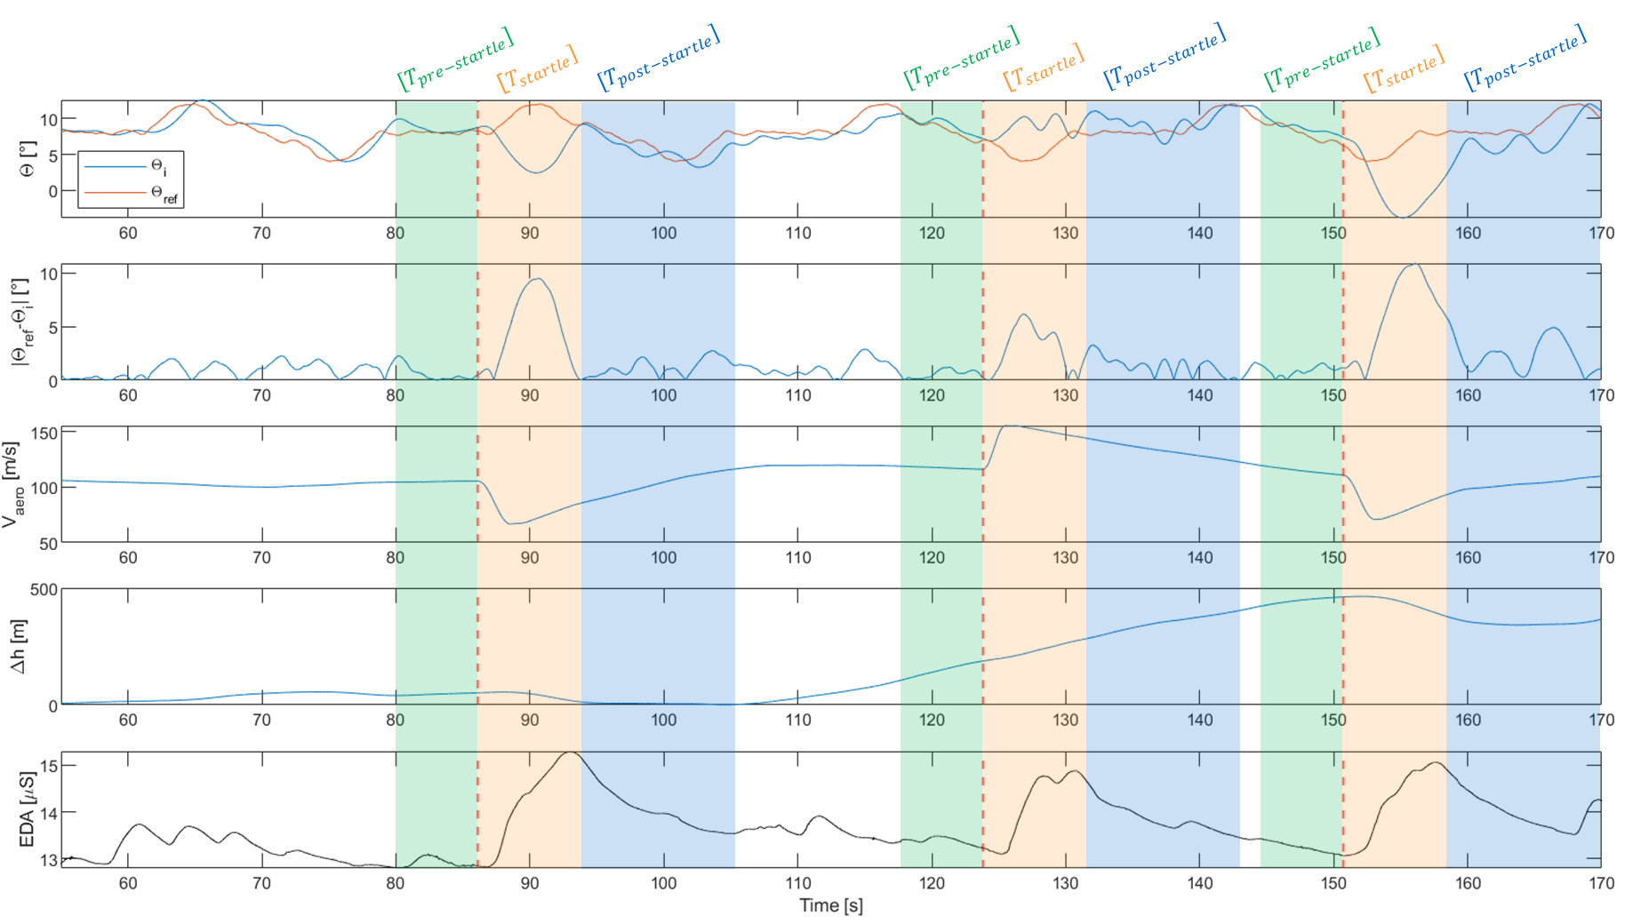
GREŠKA PRAĆENJA U SIMULATORU
ZNOJENJE

