Slide 1
.NET Core & Akka.NET
Tomasz Jaskula
@tjaskula

Slide 2
Why Actor Model ?
No manual threading managment
High abstraction level
Scale up / Scale out
Fault tolerance and handling
Common single architectuere

Slide 3
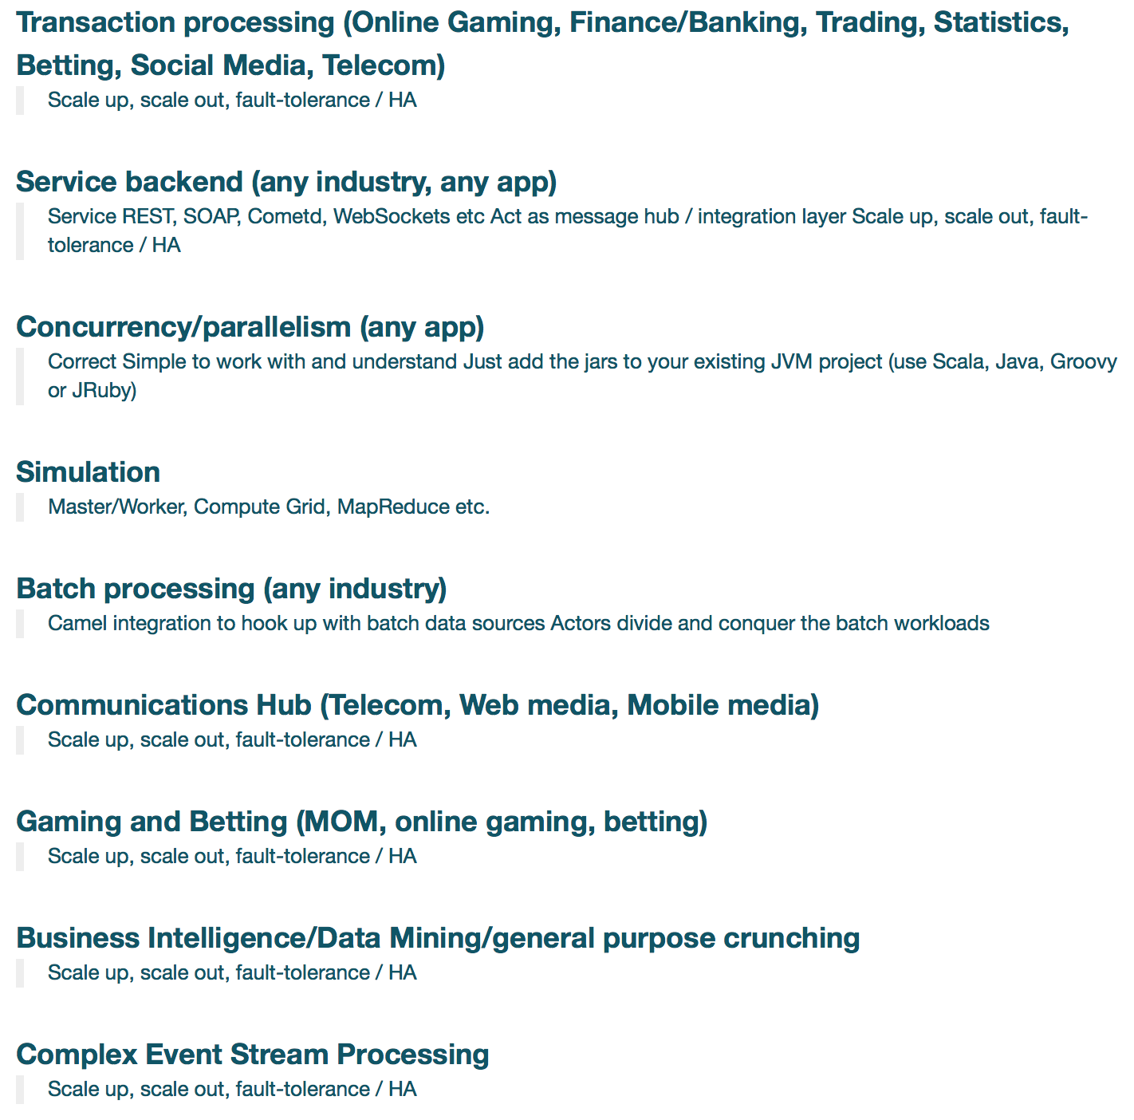

Slide 4
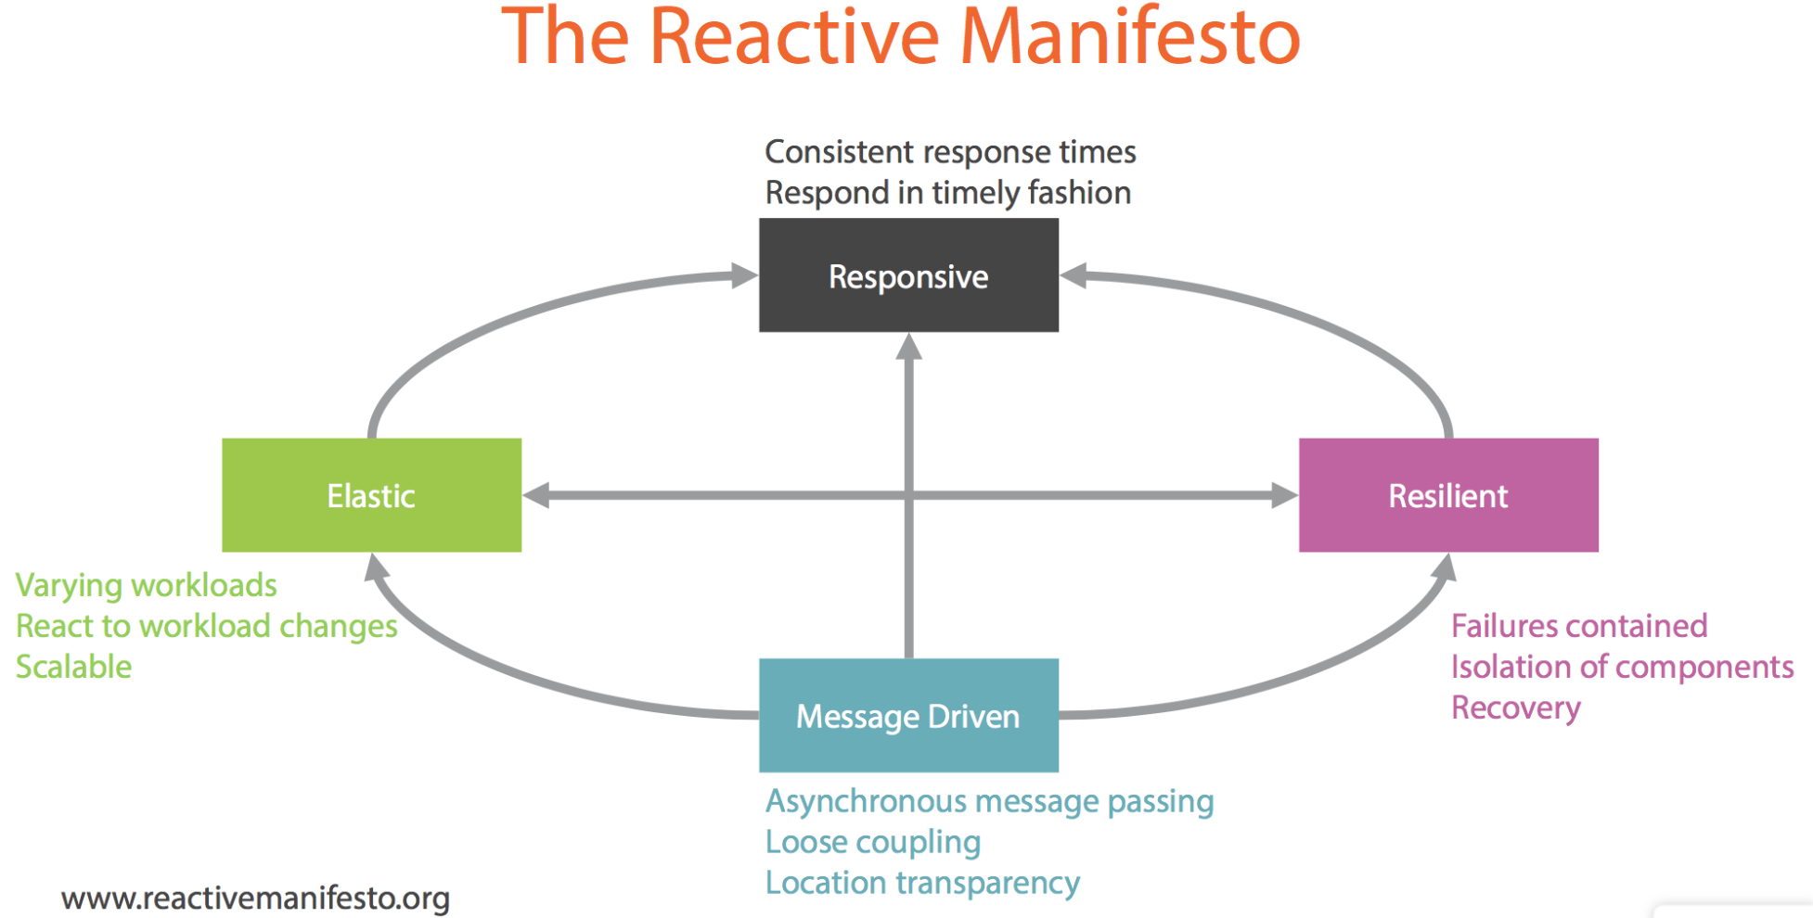

Slide 5
Key features of Akka.NET
Concurrency
Simple abstractions (actor, messages, FSM)
Asynchronous
Distribution
Location transparency
Remote deployment with configuration
Performance
50 million messages/s, 1GB heap memory = 2.5 million actors, load balancing
Resilient
Self healing
Supervision hierarchies and fault isolation

Slide 6
Actor can only do 4 things…
Receive/React to messages
Change behavior for next message
Create more actors
Send messages to other actors

Slide 7
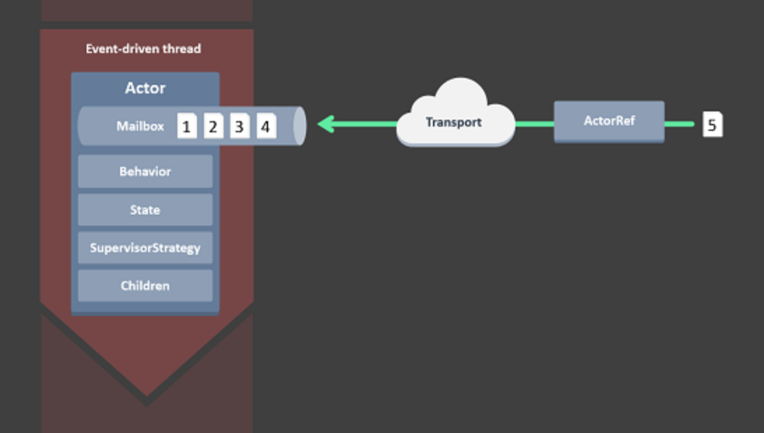
Akka.NET Actor

Slide 8
Supervision hierarchy
Root Guardian
User Guardian
System Guardian
StatCoordinator
Match 1
StatFetch
http
Match 2
Match 2

Slide 9
That’s all
Questions ?

