Slide 1


Projects Presentation Natural Language Processing
Master’s Degree in Engineering in Computer Science
Florin Cuconasu

Slide 2
Named Entity Recognition – NER
Homework 1

Slide 3
Named Entity Recognition – NER
NER is the task of locating and classifying named entities in a text.
Six Categories (Plus O tag for no named entity):
PERson CORPoration LOCation PRODuct GRouP CreativeWork
Ex:
Sundar Pichai is CEO of Google having headquarter in Mountain View.

Slide 4
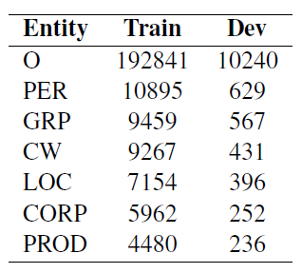
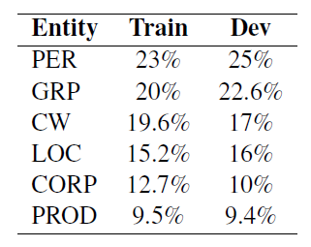
Dataset
English
14535 training examples
765 validation examples
Already tokenized
Lowercase tokens only
Contains non-Latin words
Entity Frequency without O

Slide 5
Word Embeddings
Fine-tuned
Frozen
+
GloVe (100d)
FastText (300d)

Slide 6
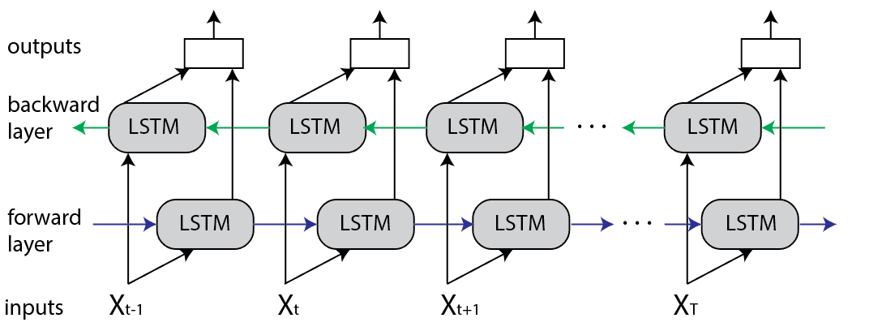
Bi-LSTM

Slide 7

POS Embeddings with
POS emb
POS
Bi-LSTM
Classifier
WORD
Bi-LSTM
GloVe
FastText
GloVe
FastText
POS emb
Bi-LSTM
Classifier

Slide 8
Depedency Parsing with
GloVe
FastText
Head emb
Dep emb
Bi-LSTM
Classifier
Head embedding: word embedding (GloVe + FastText) of the head word
Dependency embedding: dependency relation (nsubj, prep, det, etc.) embedding

Slide 9
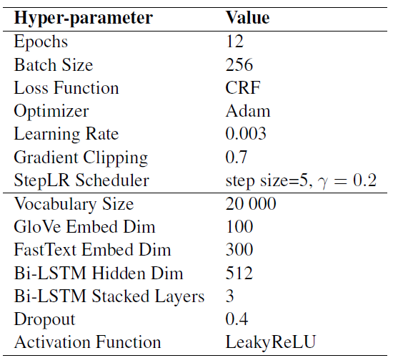
Best Model
GloVe
FastText
Bi-LSTM
Classifier
CRF

Slide 10
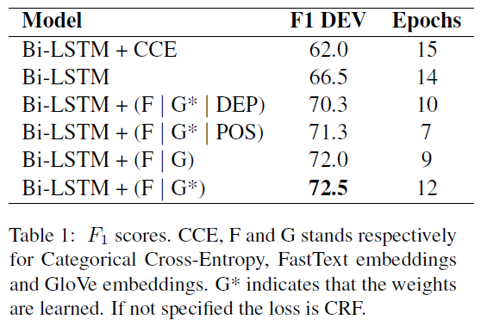
Results

Slide 11
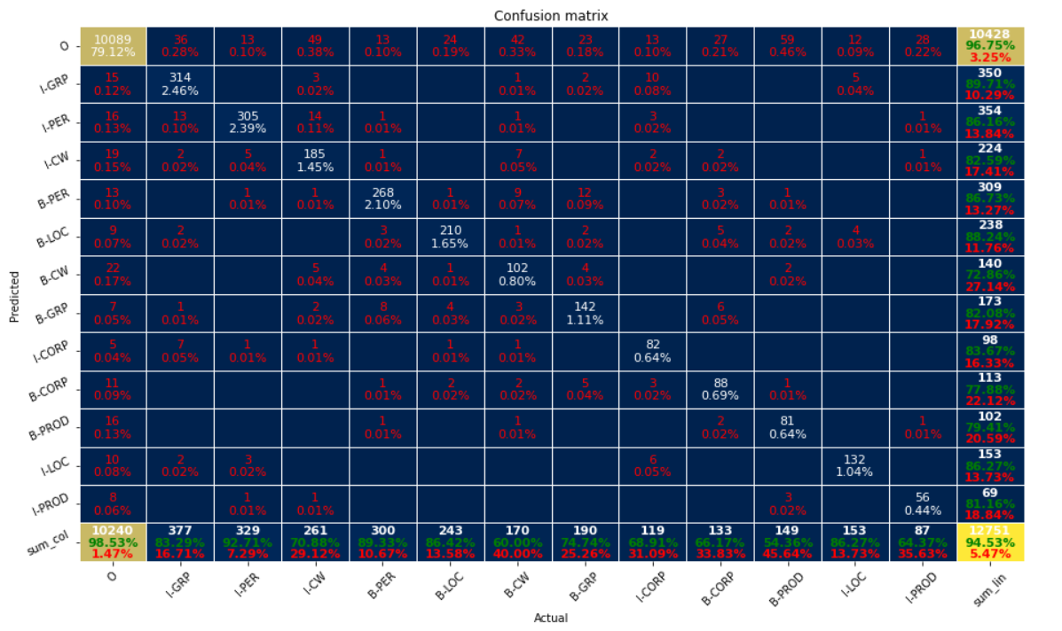

Slide 12
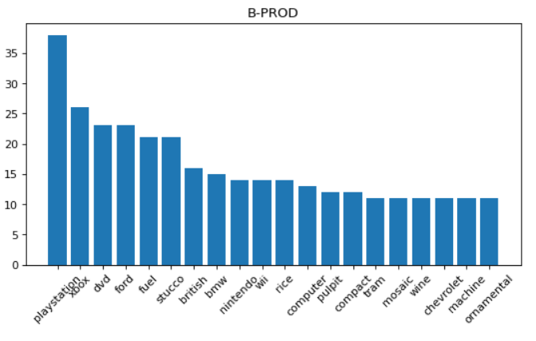
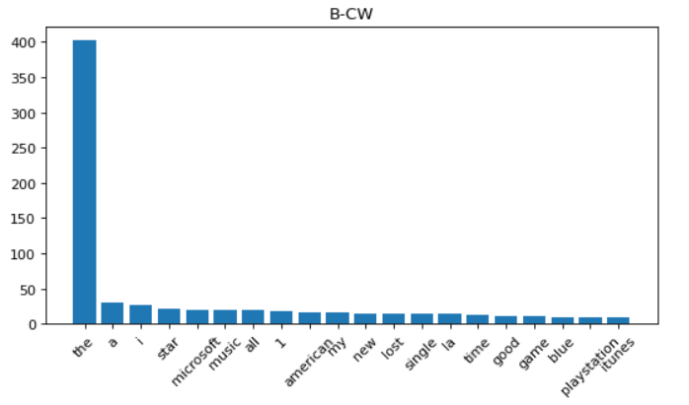

Slide 13
Coreference Resolution
Homework 3

Slide 14
Coreference Resolution
Coreference Resolution is the task of finding all expressions that refer to the same entity in a text.
John went home because he was tired.

Slide 15
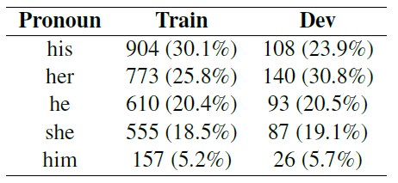
Dataset
Gender Ambiguous Pronounouns
English
2999 training examples
454 validation examples

Slide 16
Sample
Pam and Tara clean up Elijah 's body; Jessica , after learning about Russell 's attempt to kill Sookie , decides to call Jason , but Bill asks her why, and refuses.

Slide 17
Sample
Pam and Tara clean up Elijah 's body; Jessica , after learning about Russell 's attempt to kill Sookie , decides to call Jason , but Bill asks her why, and refuses.
her 69

Slide 18
Sample
Pam and Tara clean up Elijah 's body; Jessica , after learning about Russell 's attempt to kill Sookie , decides to call Jason , but Bill asks her why, and refuses.
her 69
Jessica 37
Sookie 93

Slide 19
Sample
Pam and Tara clean up Elijah 's body; Jessica , after learning about Russell 's attempt to kill Sookie , decides to call Jason , but Bill asks her why, and refuses.
her 69
Jessica 37 TRUE
Sookie 93 FALSE

Slide 20
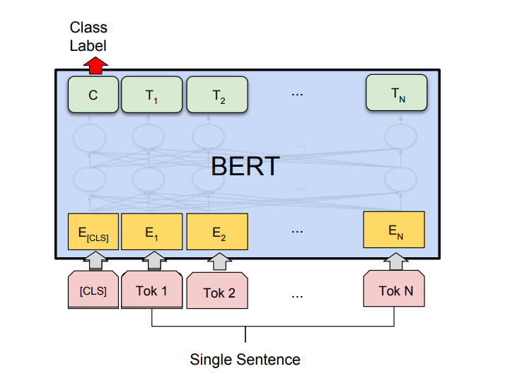
BERT

Slide 21
Baseline
A emb
Tokenize
BERT
B emb
FFNN
Classifier
P emb

Slide 22
A start
A end
A mean
FFNNent
B start
Tokenize
BERT
B end
FFNN
Classifier
B mean
P emb
FFNNP

Slide 23
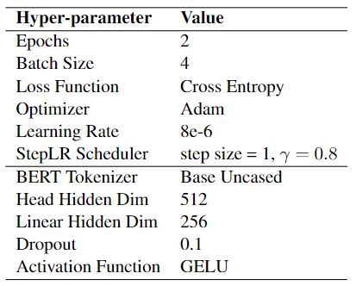
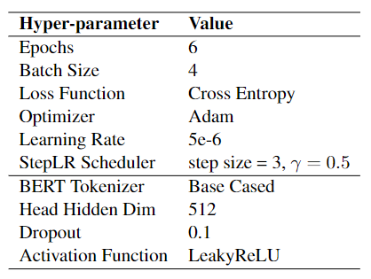
Models Hyper-parameters

Slide 24
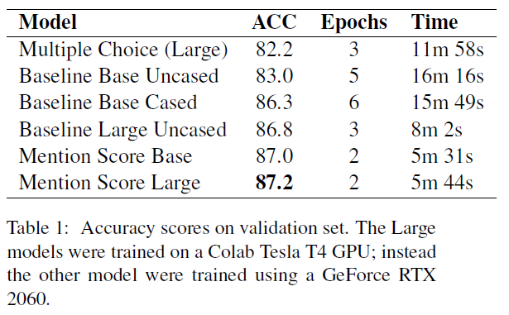
Results

Slide 25
Fine fin fund канец kraj край final kraj 終わり konec ende einde lõpp վերջ pää ein son final τέλος vég deireadh beigas 结 galas крајот aħħar slutt დასასრული koniec fim sfârşit 束 конец deireadh крај 종료 konec slutet آخر ахыр кінець oxiri diwedd kawg עק End

