Slide 1
Scala Workshop

Slide 2
Setup
Install JDK 1.8 - https://www.oracle.com/technetwork/java/javase/downloads/jdk8-downloads-2133151.html
Install SBT - https://www.scala-sbt.org/1.x/docs/Installing-sbt-on-Windows.html
Install IDE of your choice - https://www.jetbrains.com/idea/download/#section=windows
Note: add the scala plugin
Create New Project -> Scala sbt -> HelloWorld

Slide 3
Programming paradigms
Imperative
It features close relation to machine architecture
It works by changing the program state through assignment statements
Disadvantage: parallel programming is difficult to achieve
Subcategories:
Procedural
Object Oriented
Examples: C, C++, C#, Java, Python, Ruby, Visual Basic

Slide 4
Declarative
The programmer states only what the result should look like, NOT how to obtain it
Subcategories:
Functional
The control flow is expressed via function calls, rather than by assigning values to variables
Advantages:
the lack of dependence on assignment operations allows programs to be evaluated in many different orders.
the evaluation order independence makes it a good candidate for parallel programming
Examples: JavaScript, Haskell, Erlang, Clojure, Scala
Logic
programs are built by setting up relations that specify facts and inference rules, and asking whether or not something is true
Examples: Prolog, Mercury

Slide 5
Statements vs Expressions
Statement
Piece of code that performs some action
It changes program state
Is the syntactic unit of the imperative programming language
Expression
Piece of code that evaluates to a value
In functional programming everything is an expression
Advantage: concise code, achieve immutability

Slide 6
Evaluation
Call By Value
Expressions are evaluated as soon as they are encountered
val – is a form of call-by-value
Scala’s default evaluation strategy
Call By Name
The expression evaluation is deferred until the value is absolutely needed
def – is a form of call-by-name

Slide 7
Higher-order functions
functions that take other functions as parameters or return a function as a result
most common example if the map function:
val salaries = Seq(20000, 60000, 40000)
val doubleSalary = (x: Int) => x * 2
val newSalaries = salaries.map(doubleSalary)
->
Seq(40000, 120000, 80000)

Slide 8
Currying
The process of transforming a function that takes multiple arguments, into a function that takes just a single argument and returns another function which accepts further arguments, one by one.
def order(customerId, tableNumber, drink) = f: (Int, Int, String) => Int
->
def curriedOrder(customerId)(tableNumber)(drink) = f: (Int) => ((Int) => ((String) => Int))
Why?
You can defer when and where your arguments are specified in your codebase.
You can easily reuse abstract functions.
You can easily create more specialized functions by partially applying curried functions.

Slide 9
Classes
class User
val user = new User
class Point(var x: Int, var y: Int) {
def move(dx: Int, dy: Int): Unit
}
val point = new Point(2, 3)
class Point(var x: Int = 0, var y: Int = 0)
val origin = new Point
val point1 = new Point(1)
val point2 = new Point(y=2)
class Point(val x: Int, val y: Int)
val point = new Point(1, 2)
point.x = 3 → FAIL
Note: val entities are immutable.
class Point(x: Int, y: Int)
val point = new Point(1, 2)
val getX = point.x → FAIL
Note: Parameters without var or val are private members.

Slide 10
Traits
similar to the Java 8 interfaces
classes and objects can extend traits
traits cannot be instantiated
traits cannot have parameters
trait Iterator[A] {
def hasNext: Boolean
def next: A
}
class IntIterator(to: Int) extends Iterator[Int] {
override def hasNext: Boolean = ???
override def next: Int = ???
}
trait Pet {
val name: String
}
class Cat(val name: String) extends Pet
class Dog(val name: String) extends Pet
val cat = new Cat(“Sally”)
val dog = new Dog(“Harry”)
val animals = ArrayBuffer.empty[Pet]
animals.append(dog)
animals.append(cat)
animals.foreach(pet => println(pet.name))

Slide 11
Objects
a class that has exactly one instance
is created lazily when it is referenced
is treated as a value
object Logger {
def info(message: String): Unit =
println(s”INFO: $message”)
}
an object with the same name as a class is called a companion object
the companion object can access the private members of its class
companion objects can be used to model the static members from Java
class Circle(radius: Double) {
import Circle._
def area: Double = calculateArea(radius)
}
object Circle {
import scala.math._
private def calculateArea(radius: Double): Double =
Pi * pow(radius, 2.0)
}
val circle = new Circle(5.0)
println(circle.area)

Slide 12
Case classes
a special case of classes
good for modelling immutable data
can be pattern matched
case class Note(name: String, duration: String, octave: Int)
What does the Scala compiler define when we define a case class?

Slide 13
class Note(_name: String, _duration: String, _octave: Int) extends Serializable {
val name = _name
val duration = _duration
val octave = _octave
override def equals(other: Any): Boolean = ???
override def hashCode: Int = ???
override def toString = ???
def copy(name: String = name, duration: String = duration, octave: Int = octave): Note = ???
}
object Note {
def apply(name: String, duration: String, octave: Int): Note = ???
def unapply(note: Note): Option[(String, String, Int)]
}

Slide 14
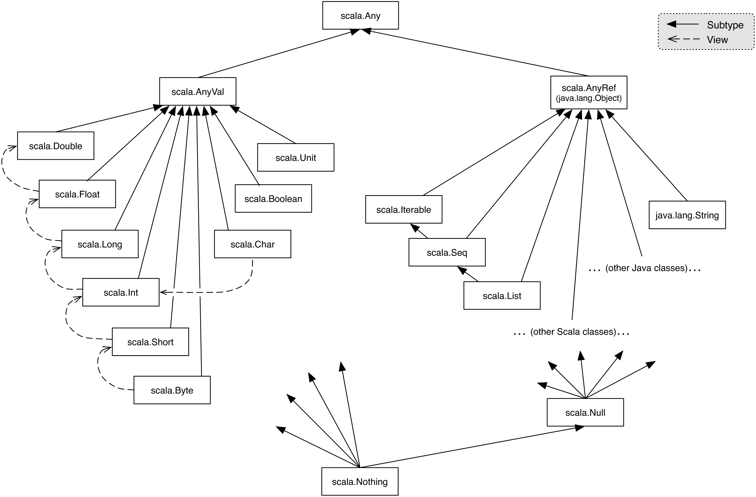
Type hierarchy

Slide 15
Everything is an Object
Java
Primitive types: boolean, char, int, double, float
Functions
Scala
Numbers are objects
1 + 2 * 3 / x -> 1.+(2.*(3)./(x))
Functions are objects – you can pass functions as arguments, store them in variables or return them from other functions
def oncePerSecond(callback: () => Unit): Unit = {
while (true) { callback(); Thread sleep 1000 }
}

Slide 16
Pattern matching
Syntax
expr match {
case pattern1 => expr1
case pattern2 => expr2
…
case patternN => exprN
}
Note: a MatchError exception is thrown if there is no matching!

Slide 17
Forms of patterns
constructors – i.e. Number, Sum
variables – i.e. n, e1, e2
wildcard patterns – i.e. _
constants – i.e. 1, true
Note: The name of a variable can only appear once in a pattern. So, Sum(x, x) is not a legal pattern!

Slide 18
eval(Sum(Number(1), Number(2)))
->
Sum(Number(1), Number(2)) match {
case Number(n) => n
case Sum(e1, e2) => eval(e1) + eval(e2)
}
->
eval(Number(1)) + eval(Number(2))
->
Number(1) match {
case Number(n) => n
case Sum(e1, e2) => eval(e1) + eval(e2)
} + eval(Number(2))
->
1 + eval(Number(2))
->…->
3

